Slide 1
Annual Review Executive Director's Report
UISA AGM 2023

Slide 2
What have I been up to?
Steering the organization and managing all operations;
Restructured board and staff roles
Updated all Rules and Policies
Created Referee Support Program
Created District Discipline Code
Updated all Guidelines
Created league schedules
Handled all financial operations
Reorganized communication systems
Created a cohesive and professional brand
Introduced streamlined processes
Provided resources to athletes, coaches and referees
Created data bases
Managed discipline issues
Overhaul and maintenance of websites and social media
Oversee daily operations and remain in collaboration in BCSA
Collect reports on behalf of BCSA
Attend all executive meetings
Generate Strategic Plans
Created District Referee Program
Created Female in Soccer Initiative
Secured grant for program
All district player and team official registrations
Manage online scheduling systems
Continually meeting with BCSA, club executives and referee coordinators
Trained staff
Continued Education

Slide 3
Growth

Slide 4
Growth by sector table

Slide 5
Registration by Gender
Males 568
Females 480

Slide 6
Competitive Players
2021 = 807 athletes
2022= 1050 athletes

Slide 7
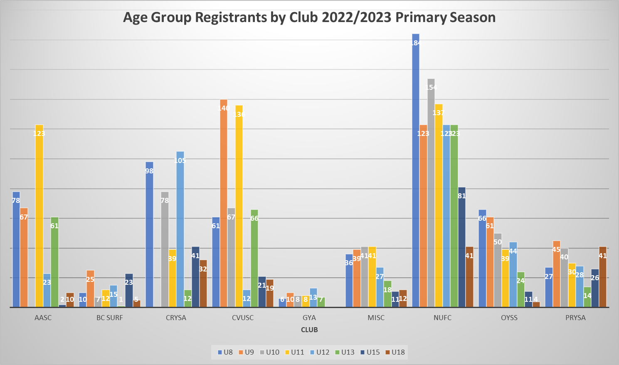

Slide 8
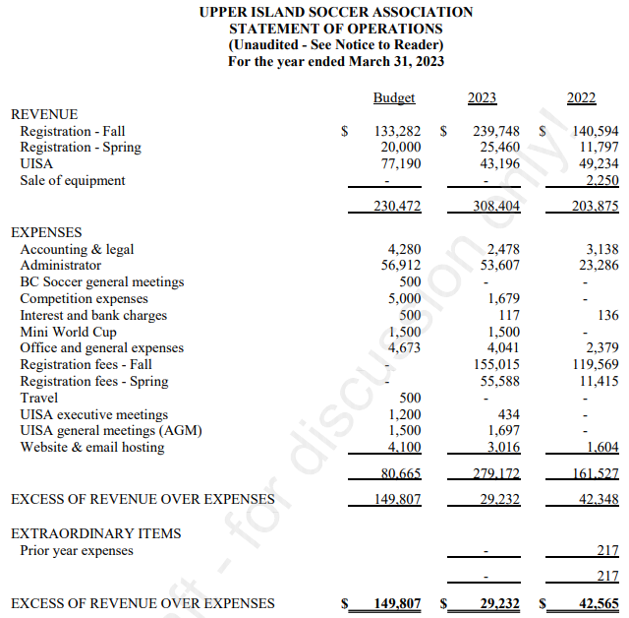

Slide 9
District per player fees
Mainland
Lower Island
Upper Island
$50.00
$20.00/$42.00
$15.00
2023 Fee Increase of $2.00 to per player

Slide 10
Upper Island Soccer Association Fee Schedule 2023/2024
U4 - U10 | BC Soccer Per Player Fee | $21.00
U11 – U18 | BC Soccer Per Player Fee | $34.00
U4-U18 | UISA Per Player Fee | $17.00

Slide 11
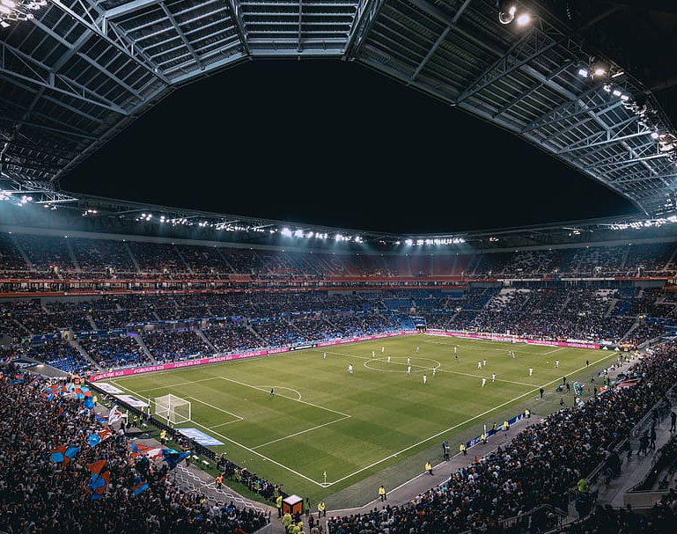
Pacific Development League
31 teams
746 matches
AVYSA U16 B – B Cup reps
West Coast League
28 teams
NUFC U17 B – A Cup reps

Slide 12
District Referee Program
An initiative to create a plan to provide development and management to referees through a collaborative process.
District to assign matches for district leagues
Along with the aid of BCSA (BC Soccer Association), the district will initiate continued education
Provide steady mentorship and development opportunities
Prevent referee abuse through Referee Showcase Project and Respect In Sport
Referee incentives
Benchmark – 30% increase

Slide 13
Females in Soccer
A district initiative to provide resources to include every female in soccer from player, coach, referee to executive roles.
Three-week deliverables by C licensed female coaches
$1000 grant provided by BCSA (BC Soccer Association)

Slide 14
Insights
Registration numbers are up 30% from last year but not at pre-covid numbers.
Financially we are lean with little funds for initiatives.
New programs to better support our members.
Club growth and accomplishments are outstanding.
District Scheduling – 100% success rate
Team participation – 98% success rate
Interlock – 99% success rate

Slide 15
Where do we want to be in five years?
My Recommendations & Ongoing Projects
Foster a safe and positive sports culture within our communities.
Improved governance and forward-thinking framework for growth.
Strong developmental programs aimed at all levels of athletic abilities to grow the sport.
Improved and efficient business operations to ensure smooth and simpler processes.
Strong support amongst executive and members with a more collaborative partnership.

Slide 16
PLAY INSPIRE UNITE
"Sport has the power to change the world. It has the power to inspire. It has the power to unite people in a way that little else does. It speaks to youth in a language they understand."- Nelson Mandela

Slide 17
In Appreciation
We strive to better support the clubs, their coaches, referees and all the athletes along with their families through added resources and strong competitive leagues.
Thanks to your commitment and strong work ethic, we know next year will be even better than the last.
We look forward to working together.

Slide 18
Annual Review Executive Director's Report End
UISA AGM 2023

