Slide 1


Department of Municipal Affairs and Housing
Housing Services Division

Slide 2
Are you looking for…
Housing, Housing, Housing, or Housing?

Slide 3
Who’s Who In Housing?
Housing Services – DMAH
Housing Development & Partnerships - DMAH
Rent Supplement – DMAH
Provincial Housing Agency – Formerly Housing Authorities

Slide 4
What we do
We offer programs that allow low-income Nova Scotia families and individuals to have continued, safe living in their home.
We offer grants and loans for urgent and necessary home repairs and accommodations needed due to disability and mobility issues.

Slide 5
How we do it
Grants
Loans:
Forgivable
Repayable
Interest Bearing
Zero Interest

Slide 6
Who we serve
Homeowners
Landlords
Tenants

Slide 7
Designated Groups
Seniors
Persons with Disabilities
Indigenous

Slide 8
Homeowner Programs
Homeowner RRAP Program (RRAP)
Provincial Housing Emergency Repair Program (PHERP)
Emergency Repair Program (ERP)
Small Loan Assistance Program (SLAP)

Slide 9
Seniors and Disability Programs
Disability Program (Dis-RRAP)
Senior Citizen Assistance Program (SCAP)
Access-A-Home-Program (AAH)

Slide 10
New and Rental Programs
Down Payment Assistance Program (DPAP)
Secondary and Backyard Suite Incentive Program (SABSIP)
Rental RRAP (Residential Rehabilitation Assistance Program)

Slide 11
Eligible Home Repairs
Furnace
Oil Tank
Electrical
Water
Sewer/Septic
Plumbing
Roof
Chimney
Windows (Excludes Drafty)
Doors (Excludes Drafty)
Step

Slide 12
Eligible Repairs – Seniors & Disability
Walk In Shower
Raised Toilet
Ramp
Low Rise Steps
Grab Bars
Widening Doorways
Guide Rails on Walls
Stair Lift
Relocate Washer/Dryer
Washroom Facilities on Main Floor
Bedroom on Main Floor

Slide 13
Ineligible Repairs
Mold Remediation
Asbestos Remediation
Cosmetic Repairs
Landscaping
Cost Incurred Prior to Approval in Writing
Efficiency Upgrades – Referrals can be made to Efficiency Nova Scotia.

Slide 14
Eligibility
Ownership and Tenancy Status
Previous Assistance
Type of Repairs
Total Household Income
Region | 1 Bdrm. | 2 Bdrm. | 3 Bdrm. | SLAP | AAH | DPAP
HRM | $55,000 | $67,500 | $77,500 | $60,000 | $60,000 | $145,000
Rest of Province | $62,500 | $73,000 | $84,500 | $60,000 | $60,000 | $145,000

Slide 15
Considerations
Applicants are required to engage the contractor(s) of their choosing.
The relationship for the completion of repair work is between the applicant and the contractor.
Housing Services performs inspections for program compliance only.
Applicants may be required to contribute if the cost exceed program funding.

Slide 16
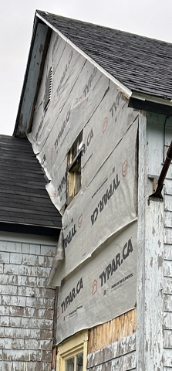
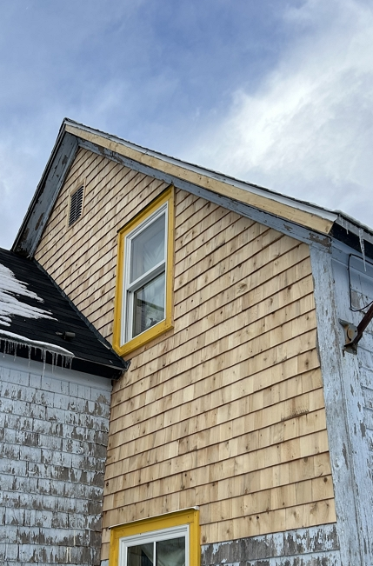
Home Repair and Disability Programs

Slide 17
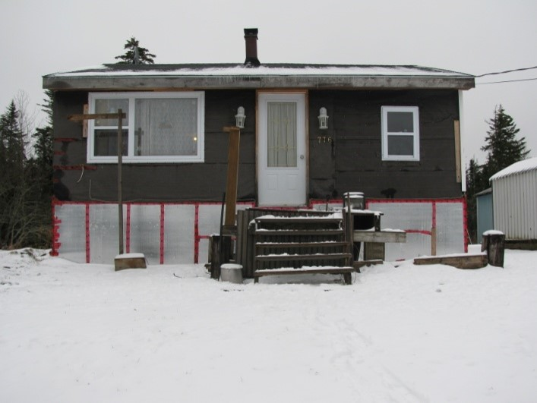
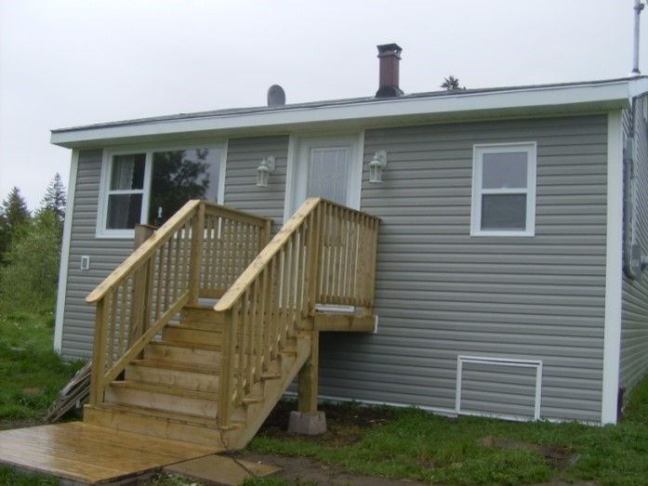
Home Repair and Disability Programs

Slide 18
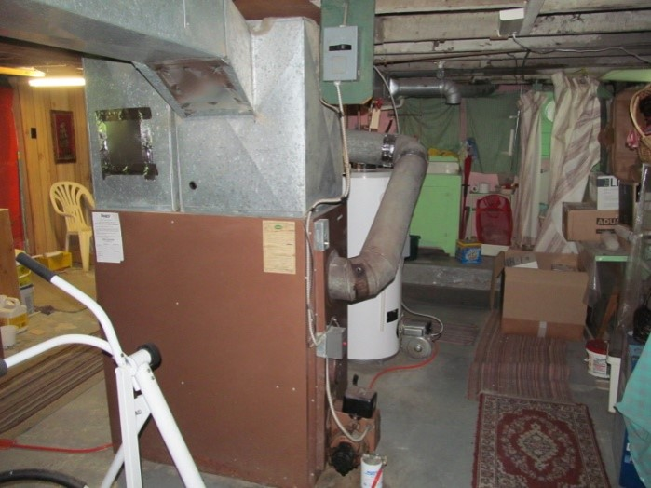
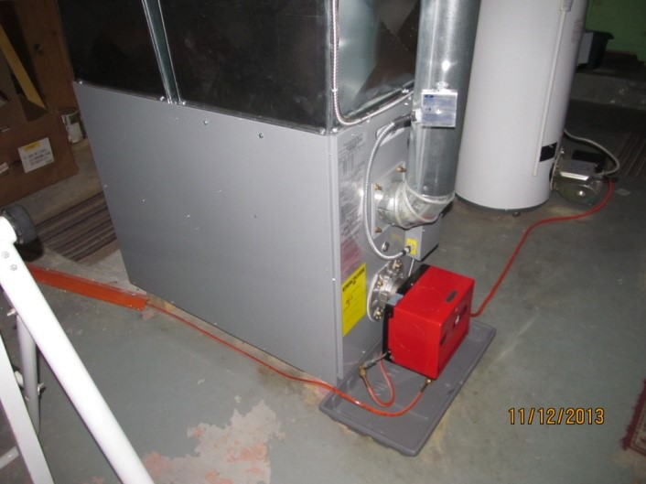
Home Repair and Disability Programs

Slide 19
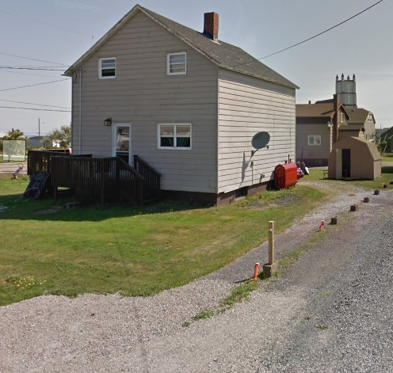
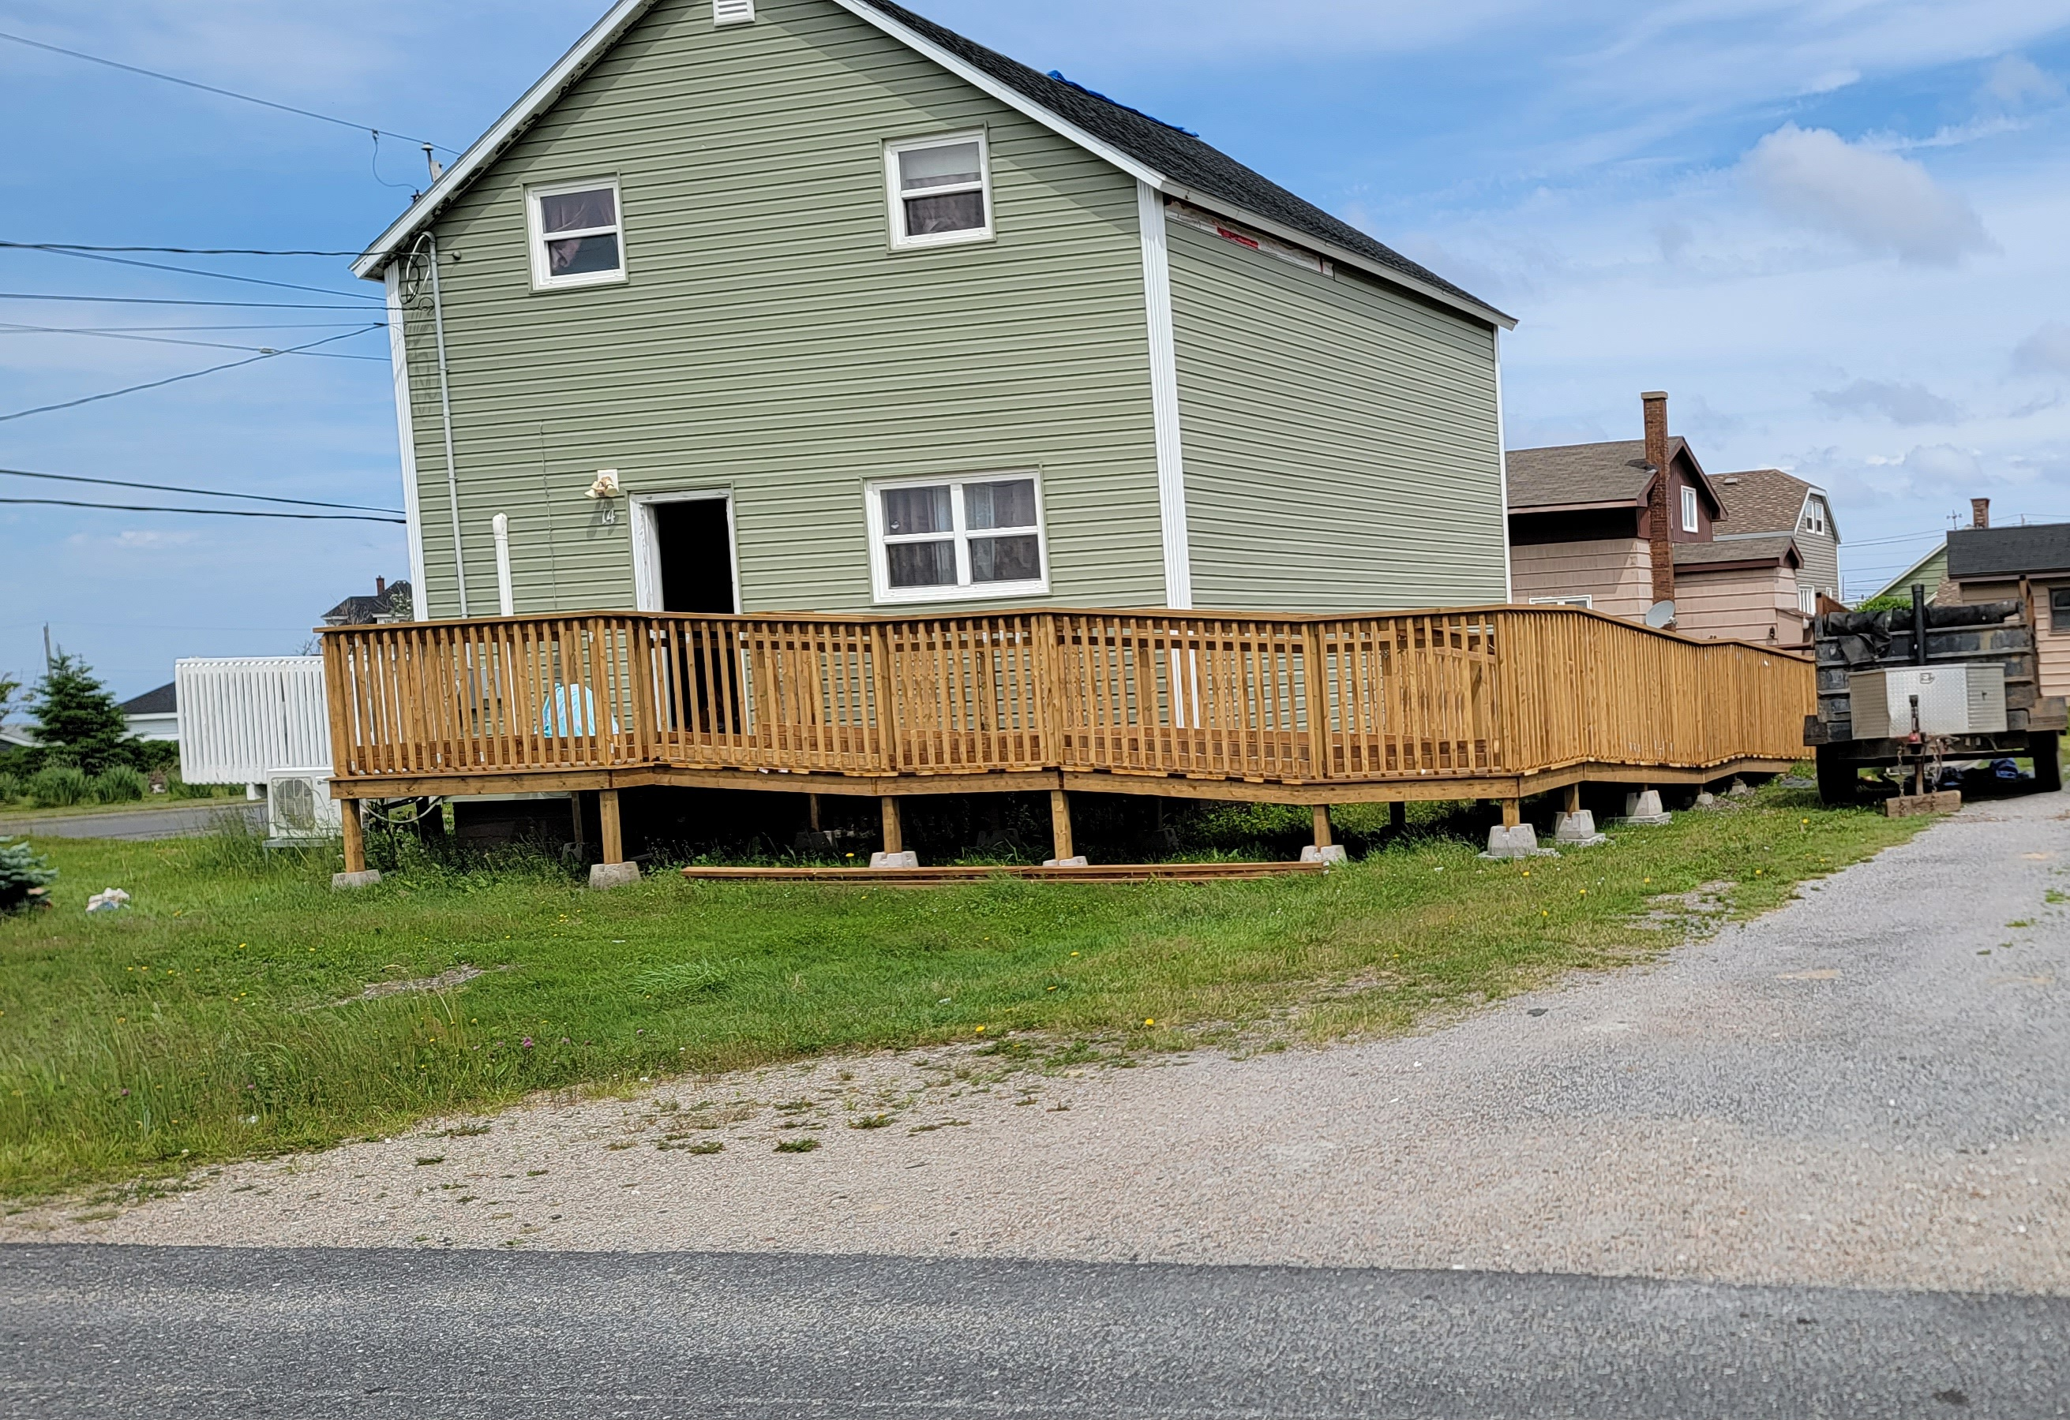
Home Repair and Disability Programs

Slide 20

Other Resources
211 Nova Scotia:
Dial 211 on your phone
Visit - ns.211.ca
Efficiency Nova Scotia
Dial 877-999-6035
Visit - www.efficiencyns.ca

Slide 21
What’s The Link?
List A
Loser
Worthless
Failed Grade 9
Clinical Depression
Generalized Anxiety
Social Anxiety
OCD
List B
Business Diploma
Business Degree
Master of Education
CPA (Accountant)
Dean's List
NS Subject Matter Expert

Slide 22
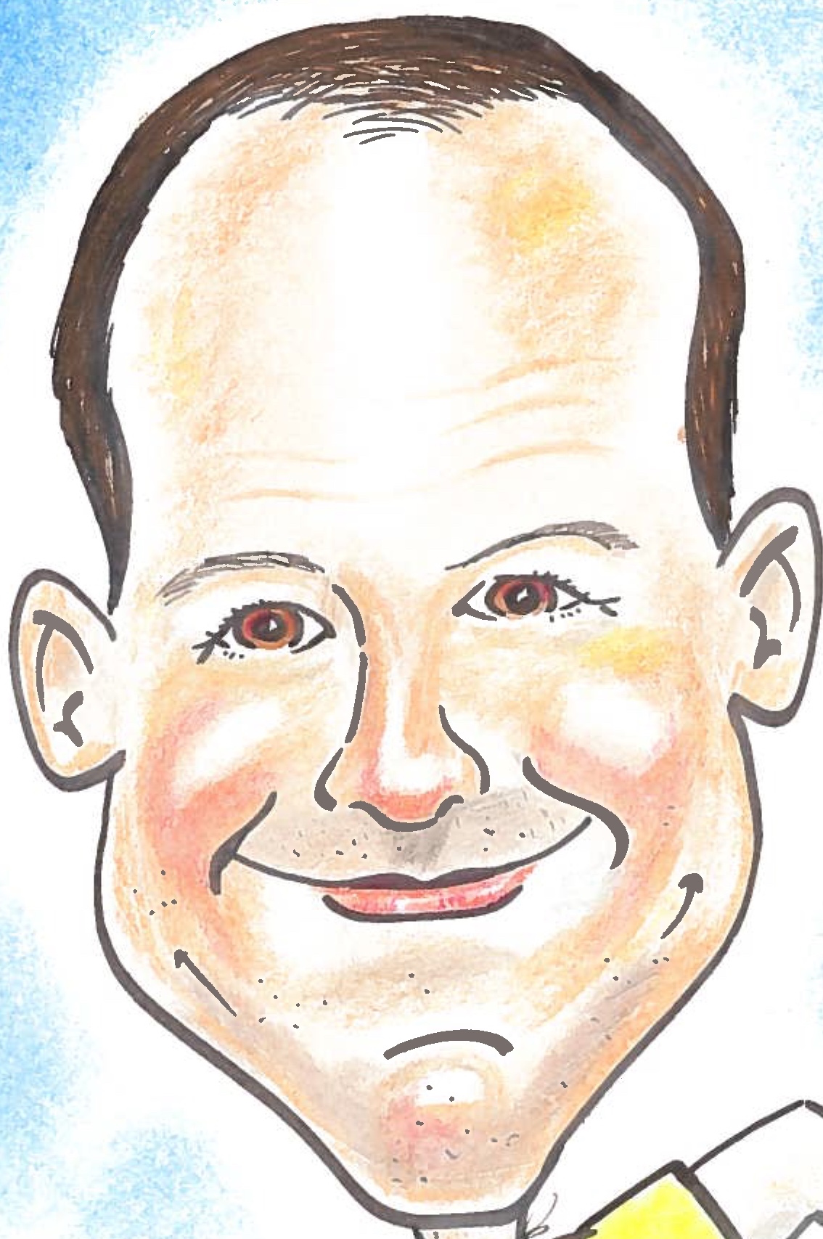
Me!!!

Slide 23

My Hero

Slide 24
Closing Thoughts
Importance of What We Do
Diverse Backgrounds (Florist)
Diversity
Information
Life Less Mapped Out
Unions
"Everybody's Free (To Wear Sunscreen)", also known as "The Sunscreen Song" by Baz Luhrmann

Slide 25


Thank you! Questions?

