Slide 1
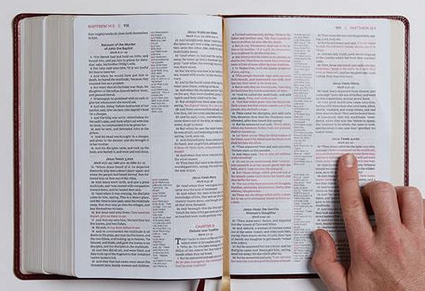
The Impact of Giving to the Lord’s Work
The 1611 and 1612 King James Bible
Matthew 6:19-21
May 12, 2024

Slide 2
Matthew 6:19-21
19 Lay not up for yourselves treasures upon earth, where moth and rust doth corrupt, and where thieves break through and steal: 20 But lay up for yourselves treasures in heaven, where neither moth nor rust doth corrupt, and where thieves do not break through nor steal: 21 For where your treasure is, there will your heart be also.

Slide 3
(Q) What is the PRINCIPAL reason followers of Messiah give to His work?

Slide 4
(Q) What is the PRINCIPAL reason followers of Messiah give to His work?
(A)To share with all of creation Who He is.

Slide 5
(Q) Why did Messiah come into the World?
?

Slide 6
(Q) Why did Messiah come into the World?
(A) He gives us the answer in John 17:2-3
2 As thou hast given him power over all flesh, that he should give eternal life to as many as thou hast given him.
3 And this is life eternal, that they might know thee the only true God, and Jesus Christ, whom thou hast sent. -KJB
2 just as you gave him authority over all mankind, so that he might give eternal life to all those whom you have given him.
3 And eternal life is this: to know you, the one true God, and him whom you sent, Yeshua the Messiah. -CJB

Slide 7
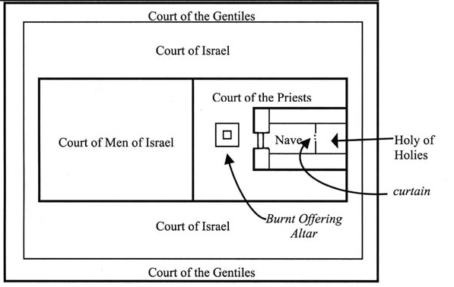
Matthew
Mark
Luke
John 17:1-3
John

Slide 8
Every follower of Messiah must examine themselves to this question.
“Where is my Treasure?”

Slide 9
The Possibility of Heaven
HEAVEN
10 But glory, honour, and peace, to every man that worketh good, to the Jew first, and also to the Gentile:
-Romans 2:10

Slide 10
The Experience of Heaven will be…
• different for each person.
• Vary depending on how much light we have been shown, and how long we have seen it.
• As we rejoice when are loved ones on Earth exceed us, we in Heaven will not b e envious but, rejoice in their blessing.

Slide 11
• Each vessel will be full but, each vessel will not be the same size.
• The Happiest will be the Most Holy. (The Most holy on earth are often called Martyrs)
• All will be perfectly Holy and perfectly happy.

Slide 12
• Each vessel will be full but, each
• Those with more love will have more love and happiness to share.
• These will also dwell in more humility.
• The entire society in Heaven will share all of the members happiness and joy.

Slide 13
The Works of Johnathan Edwards
-December 1740

Slide 14
3. There are different degrees of happiness and glory in heaven. As there are degrees among the angels, viz. thrones, dominions, principalities, and powers; so there are degrees among the saints. In heaven are many mansions, and of different degrees of dignity. The glory of the saints above will be in some proportion to their eminency in holiness and good works here.

Slide 15
Christ will reward all according to their works. He that gained ten pounds was made ruler over ten cities, and he that gained five pounds over five cities. Luke 19:17; 2 Cor. 9:6, “He that soweth sparingly, shall reap sparingly; and he that soweth bountifully shall reap also bountifully.” And the apostle Paul tells us that, as one star differs from another star in glory, so also it shall be in the resurrection of the dead. 1 Cor. 15:41. Christ tells us that he who gives a cup of cold water unto a disciple in the name of a disciple, shall in no wise lose his reward. But this could not be true, if a person should have no greater reward for doing many good works than if he did but few.

Slide 16
It will be no damp to the happiness of those who have lower degrees of happiness and glory, that there are others advanced in glory above them. For all shall be perfectly happy, every one shall be perfectly satisfied. Every vessel that is cast into this ocean of happiness is full, though there are some vessels far larger than others.

Slide 17
And there shall be no such thing as envy in heaven, but perfect love shall reign through the whole society. Those who are not so high in glory as other, will not envy those that are higher, but they will have so great, and strong, and pure love to them, that they will rejoice in their superior happiness. Their love to them will be such that they will rejoice that they are happier than themselves; so that instead of having a damp to their own happiness, it will add to it. They will see it to be fit that they that have been most eminent in works of righteousness should be most highly exalted in glory. And they will rejoice in having that done, that is fittest to be done.

Slide 18
There will be a perfect harmony in that society; those that are most happy will also be most holy, and all will be both perfectly holy and perfectly happy. But yet there will be different degrees of both holiness and happiness according to the measure of each one’s capacity, and therefore those that are lowest in glory will have the greatest love to those that are highest in happiness, because they will see most of the image of God in them. And having the greatest love to them, they will rejoice to see them the most happy and the highest in glory.

Slide 19
And so, on the other hand, those that are highest in glory, as they will be the most lovely, so they will be fullest of love. As they will excel in happiness, they will proportionally excel in divine benevolence and love to others, and will have more love to God and to the saints than those that are lower in holiness and happiness. And besides, those that will excel in glory will also excel in humility.

Slide 20
The saints in heaven are more humble than the saints on earth, and still the higher we go among them the greater humility there is.
The exaltation of some in heaven above the rest will be so far from diminishing the perfect happiness and joy of the rest who are inferior, that they will be the happier for it. Such will be the union in their society that they will be partakers of each other’s happiness. Then will be fulfilled in its perfection that which is declared in 1 Cor. 12:26, “If one of the members be honoured all the members rejoice with it.”

Slide 21
CONCLUSION
The Impact of giving to the Lord’s Church is not a self-seeking pursuit of temporary pleasure while on earth.

Slide 22
The Impact of giving to the Lord’s Church (which He owns because He paid for it by His Blood)
Is so…

Slide 23
ALL OF CREATION CAN EXPERIENCE HEAVEN!

Slide 24
What say you?
All of Eternity Awaits…

Slide 25
Each time someone comes to Messiah, the fullness of the Gentiles grows closer as does the Second Advent.
Please contact us with prayer requests or questions.
Www.pastorick.org
25 For I would not, brethren, that ye should be ignorant of this mystery, lest ye should be wise in your own conceits; that blindness in part is happened to Israel, until the fullness of the Gentiles be come in. - Romans 11:25 --KJV
The 1611 and 1612 King James Bible
The Textus Receptus
My Dear Friend Brother Floyd
www.loveisrael.org
The Jewish People for Preserving the Holy Writ
Sunday 11:00 A.M. Room AE203 OLSEN GROUP (Coed) -All Ages Mixed
Oakwood 2154 Loop 337 N (Adult Education Building) New Braunfels, TX 78130
youtube.com/watch?v=toFRfX0mWKU facebook.com/Pastorick.org

