Slide 1
New York State’s Digital Equity Plan
Summary Presentation for Public Comment
November 9th, 2023

Slide 2
01
ConnectALL’s Vision for Digital Equity
2

Slide 3
Agenda
ConnectALL’s Vision for Digital Equity
Developing the State Digital Equity Plan
Regional Snapshot
Deep Dives:
Broadband Availability & Affordability
Accessible Devices & Device Support
Digital Literacy
Privacy & Cybersecurity
Accessibility of Essential Resources & Services
Public Comment

Slide 4
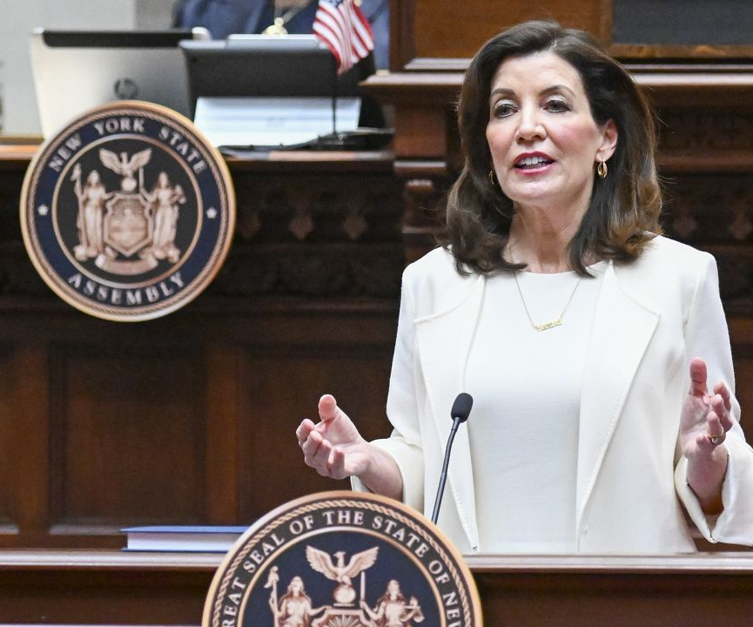
CONNECTALL OVERVIEW
New York State’s ConnectALL Office is tasked with implementing Governor Hochul’s $1B+ ConnectALL initiative and the 2022 WIRED Broadband Act, comprehensive plans to bring affordable, reliable, high-speed broadband service to all New Yorkers.
ConnectALL Programs
Rural Broadband Deployment
Affordable Housing Connectivity
State Digital Equity Plan & Program
Connectivity Innovation
Local Connectivity Planning & Municipal Infrastructure
Governor Hochul delivering the 2022 State of the State address.
Notes:
Last year Governor Hochul announced the historic ConnectALL initiative which is NY's largest investment in digital infrastructure ever. This is our way of meeting the moment that the Infrastructure Investment and Jobs Act created in allocating unprecedented once in a generation funding to close the digital divide, through the Digital Equity Act. The Digital Equity Act is a federal initiative established as part of 2021’s Infrastructure Investment and Jobs Act (IIJA) that provides $2.75 billion to establish grant programs that promote digital equity and inclusion nationwide.
The ConnectALL program includes grant programs, technical assistance and other support for municipalities, businesses, community anchor institutions and other community based organizations and we are also working on policy innovation and regulatory reform. We are taking a holistic approach designed to address every angle of the digital divide simultaneously while being responsive to community needs and experiences.
The Digital Equity program is one of our 5 signature programs and its guiding document, the State Digital Equity Plan, SDEP will inform all other investments across all of our other four programs. (1) Broadband Equity, Access and Deployment (2) Affordable Housing Connectivity (3) Connectivity Innovation (4) Local Connectivity Planning and Municipal Infrastructure

Slide 5
CONNECTALL FUNDING SOURCES
Legislation
Program
Expected Funding Amount
To Date
Infrastructure, Investment, and Jobs Act (IIJA)
Digital Equity Act
Broadband Equity, Access, and Deployment (BEAD) Program
Planning: $5M
Implementation: $664M
$5M
State Digital Equity Program
Planning: $2M
Implementation: Est. $50-80M
$2M
Spring 2024 (Estimated)
Federal Government issues NOFO for Capacity Grant
Fall 2024
CAO receives Capacity Grant Funds & opens grant program
Dec 1, 2022
ConnectALL received BEAD and Digital Equity Planning Grants
Summer-Fall 2023
CAO drafts SDEP
Winter 2023
State Digital Equity Plan due to NTIA
2023
2024
2025
Winter-Summer 2023
CAO conducts a comprehensive stakeholder engagement and research process to inform SDEP
PRESENT
Draft State Digital Equity Plan available for public comment
Notes:
The State Digital Equity Plan is currently open for public comment. Once the public comment window closes, CAO will submit the Plan to the National Telcommunications and Information Administration (NTIA) in late December. New York State is expected to receive between $50-80M in Digital Equity Capacity Grant funding to implement the activities stated in the Plan. The NOFO for that funding is expected to be released in the Spring of 2024 which will outline the guidelines and parameters around the funding in addition to a final amount. The State Digital Equity Grant Program is expected to open in the Fall of 2024.

Slide 6
UNIFIED VISION
ConnectALL’s vision is pursuant to the principles articulated in the 2022 WIRED Broadband Act:
The persistence of the digital divide is a key barrier to improving the general welfare
Access to high-speed, reliable, and affordable broadband is essential for education, economic growth, and full participation in civic life
The digital divide disproportionately affects communities of color, lower-income areas, rural areas, and other vulnerable populations, and the benefits of broadband access should be available to all
A robust and competitive internet marketplace in New York supports general economic development and benefits New Yorkers with improved internet service and affordability
Assist in ending the digital divide, supporting a more robust and competitive internet marketplace, and carrying out other actions to ensure universal access to high-speed, reliable, and affordable broadband
Notes:
Governor Kathy Hochul established the ConnectALL Office (CAO) in 2022 to transform New York State’s digital infrastructure so all residents and businesses have access to high-speed, reliable, and affordable broadband for education, economic growth, and full participation in civic life. This vision you see on your screen is pursuant to the principles articulated by the New York State Legislature in the 2022 Working to Implement Reliable and Equitable Deployment of Broadband Act (WIRED Broadband Act).
ConnectALL Responsibilities and Duties as authorized by the 2022 Wired Act are to :
Coordinate activities of all State agencies related to broadband access
Advise county and local government to expand broadband access
Manage public investments and grant programs to improve broadband access and digital equity

Slide 7
02
Developing the State Digital Equity Plan
7

Slide 8
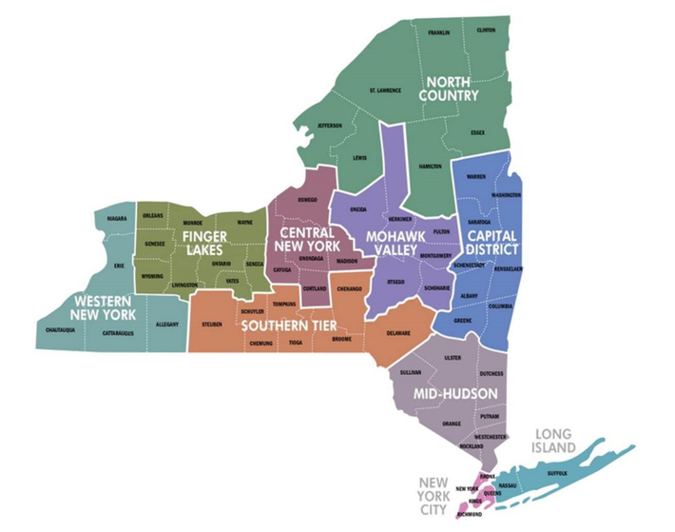
MAP OF THE REGIONS OF NEW YORK STATE
Notes:
To both honor and leverage New York’s incredible diversity, CAO has ensured unique geographic needs and differences are a cornerstone of the broadband and digital equity planning process through a regional approach to stakeholder engagement.
ConnectALL’s multifaceted stakeholder engagement strategy reflects the exceptional diversity of New York State residents and leverages the state’s mature ecosystem of broadband and digital equity stakeholders. The strategy includes comprehensive public engagement to ensure:
• Full geographic coverage
• Diverse stakeholders
• Awareness, outreach, and participation
• Transparency, and
• Targeted engagement for underrepresented communities.

Slide 9
STAKEHOLDERS AND DIGITAL EQUITY PLAN PRIORITIES
The State Digital Equity Plan seeks to address needs and barriers to access faced by eight ”Covered Populations” defined in the Digital Equity Act, as well as other key stakeholders.
Low-income households
People adversely affected by persistent poverty or inequality
Aging individuals
Members of ethnic and religious minorities
Incarcerated individuals
Women and LGBTQI+ individuals
COVERED POPULATIONS
Veterans
OTHER STAKEHOLDERS
Internet Service Providers
People with disabilities
Community anchor institutions, nonprofits, and community-based organizations
People with language barriers
Civil rights and labor organizations
Members of racial and ethnic minority groups
Education, healthcare, housing, workforce development, and economic development entities
Rural inhabitants
Local, county, regional, Tribal, and State government entities
Notes:
Per the Digital Equity Act, we were required to serve and consult with 8 covered populations you see listed here. To the right we see all the other stakeholders in the Digital Equity ecosystem who make CAO's goals realizable.

Slide 10
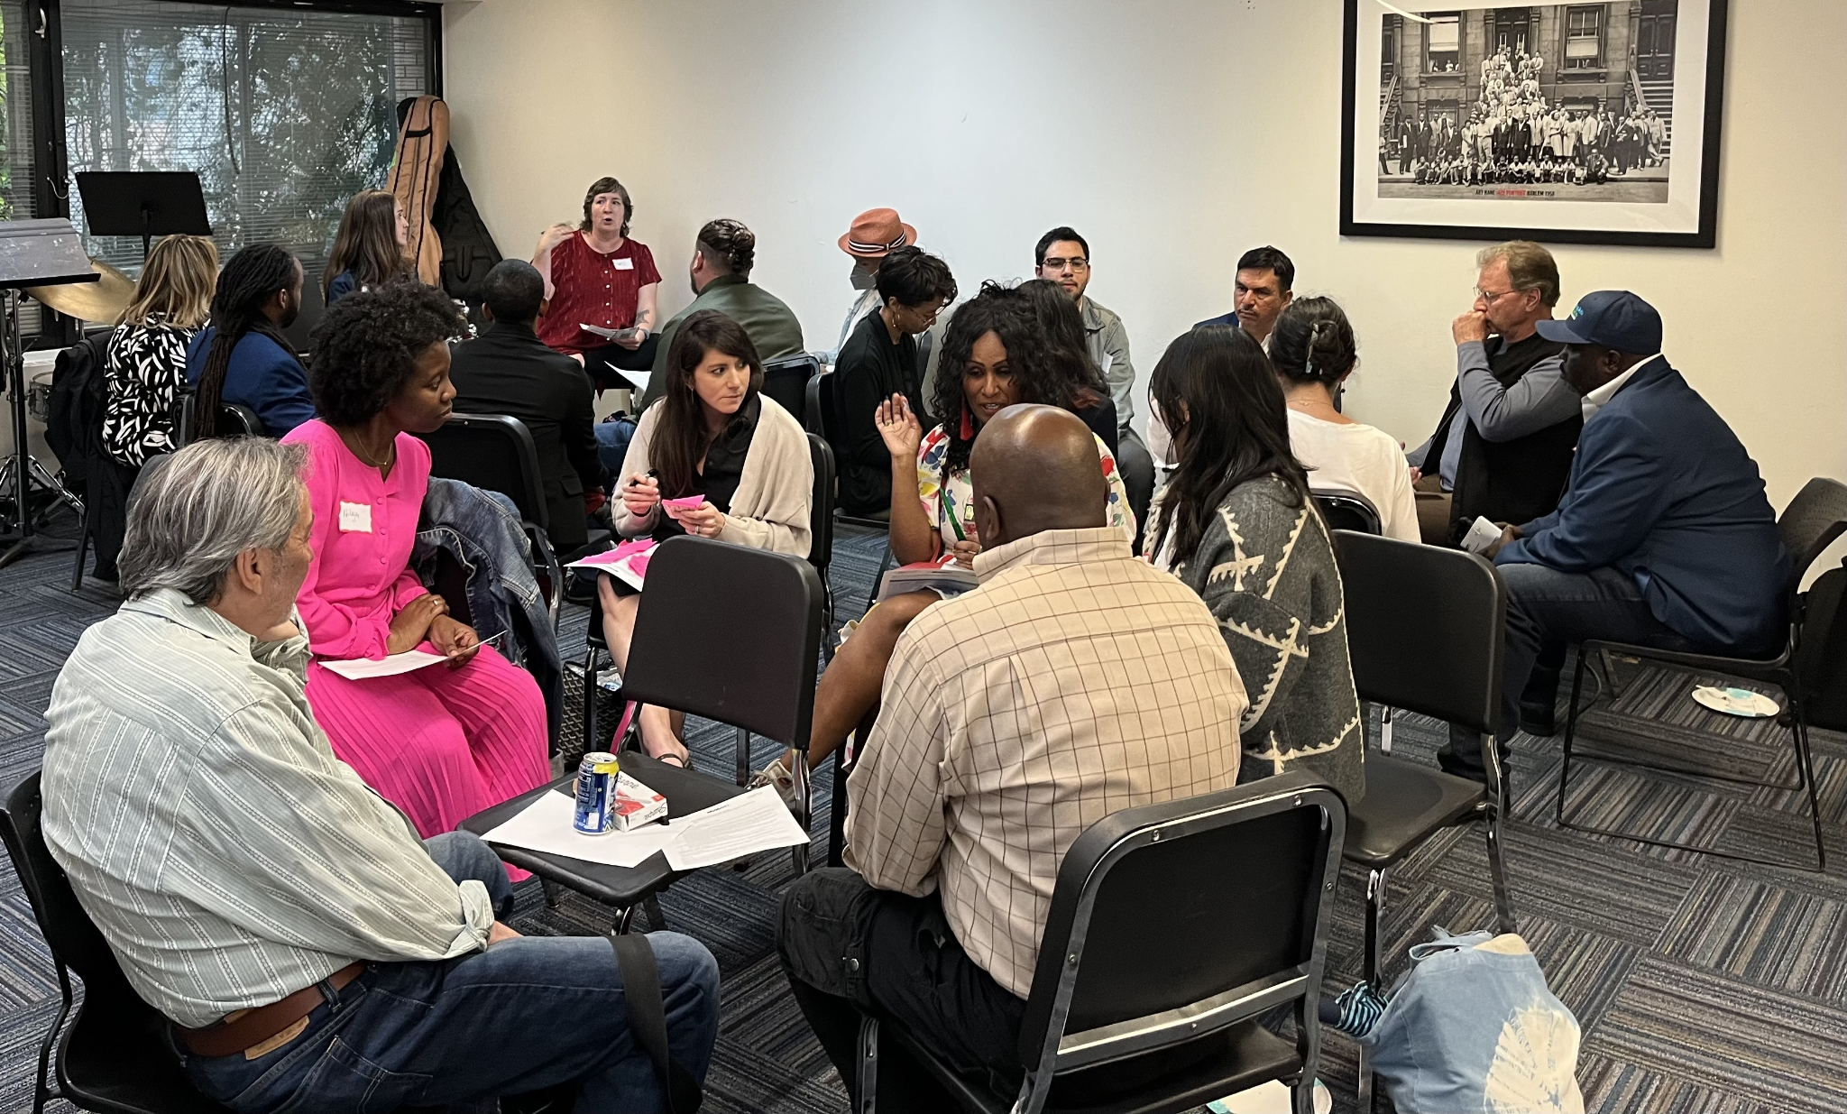
STAKEHOLDER ENGAGEMENT: DIGITAL EQUITY COALITIONS
ConnectALL worked with Digital Equity Coalitions in every region of the state to conduct stakeholder engagement events, gather data, and solicit feedback to inform the SDEP planning process.
Engagement activities included:
Over 40 stakeholder focus groups with members of historically marginalized groups
15 listening sessions, held in every region and borough of the state, attended by over 1,200 New Yorkers
CAO’s Digital Equity Survey of New York residents, which received >5,700 responses
THIS IS WHERE YOU MAY WANT TO ADD A FEW SLIDES OF YOUR OWN TO DISCUSS YOUR EXPERIENCE WORKING WITH CAO THROUGH PHASE 1 LISTENING SESSIONS AND PHASE 2 FOCUS GROUPS, NEEDS ASSESSMENT AND ASSET INVENTORY.
Notes:
CAO worked with DECs in every region of the state to conduct stakeholder engagement
events, gather data, and solicit feedback to inform the SDEP planning process. Engagement
activities included:
Over 40 stakeholder focus groups targeting members of historically marginalized
groups.
15 listening sessions, held in every region and borough of the state, attended by over
1,200 New Yorkers.
CAO’s Digital Equity Survey of New York residents, the first ever comprehensive
assessment of the digital divide in New York State, received more than 5,700
responses.
CAO also consulted various local governments and state agencies to ensure
recommendations were made in alignment with their existing efforts. CAO’s stakeholder
engagement plan centers the experience and expertise of covered populations through the
implementation of a participatory planning process created through partnerships with the
regional DECs. Continuing to develop the capacity and leadership of regional DECs will
remain a key priority and will ultimately strengthen the implementation of CAO’s digital equity
and broadband infrastructure plans.

Slide 11
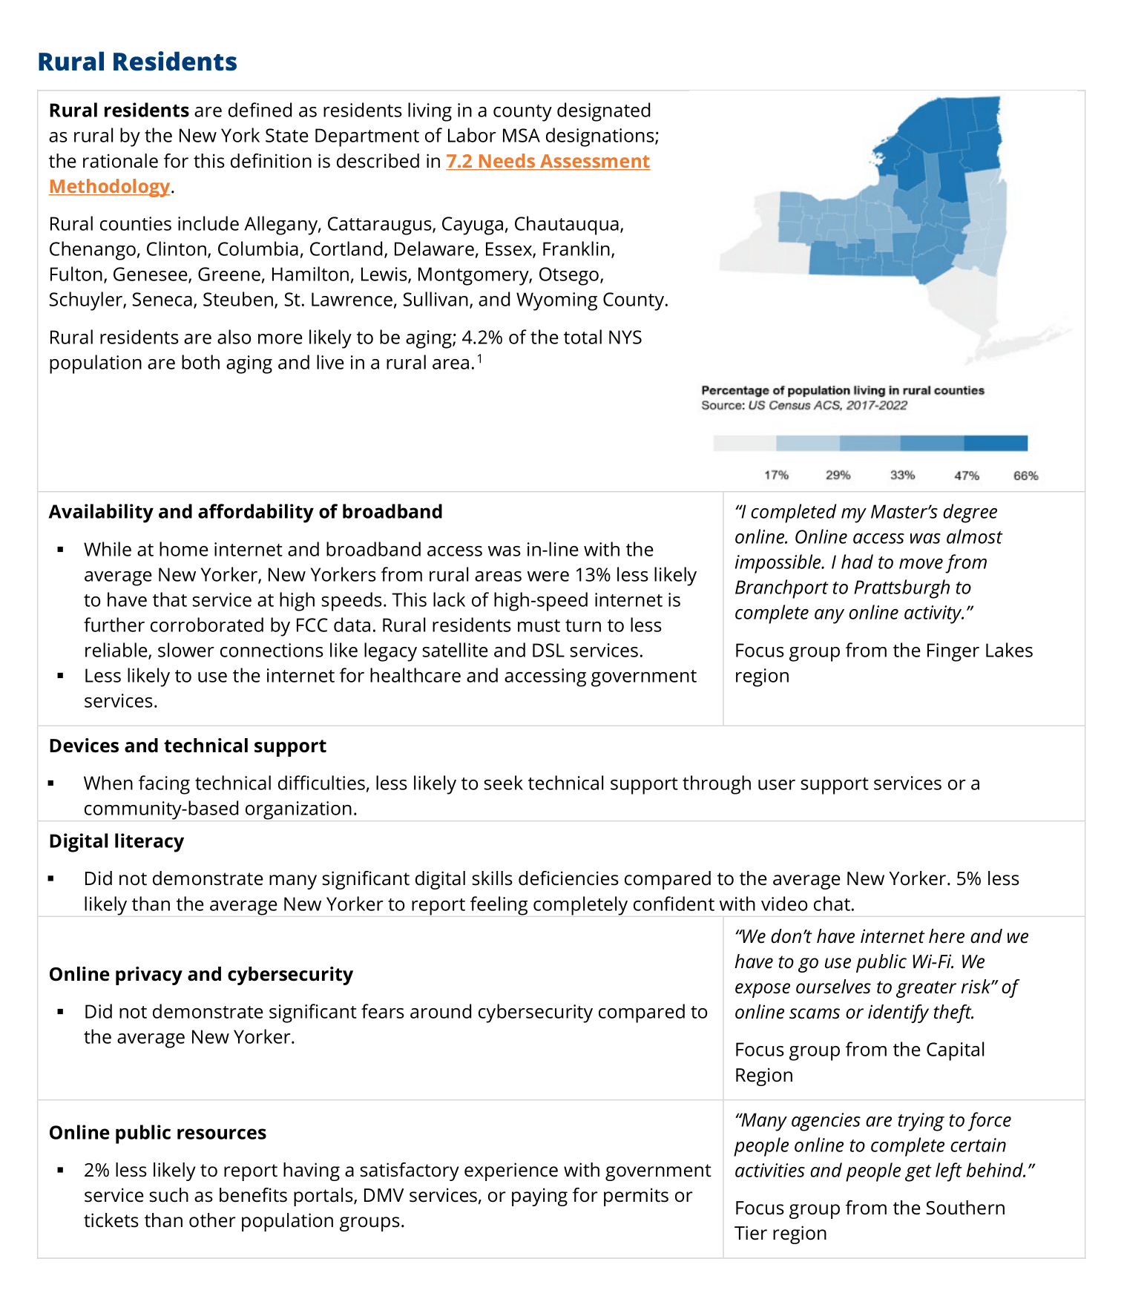
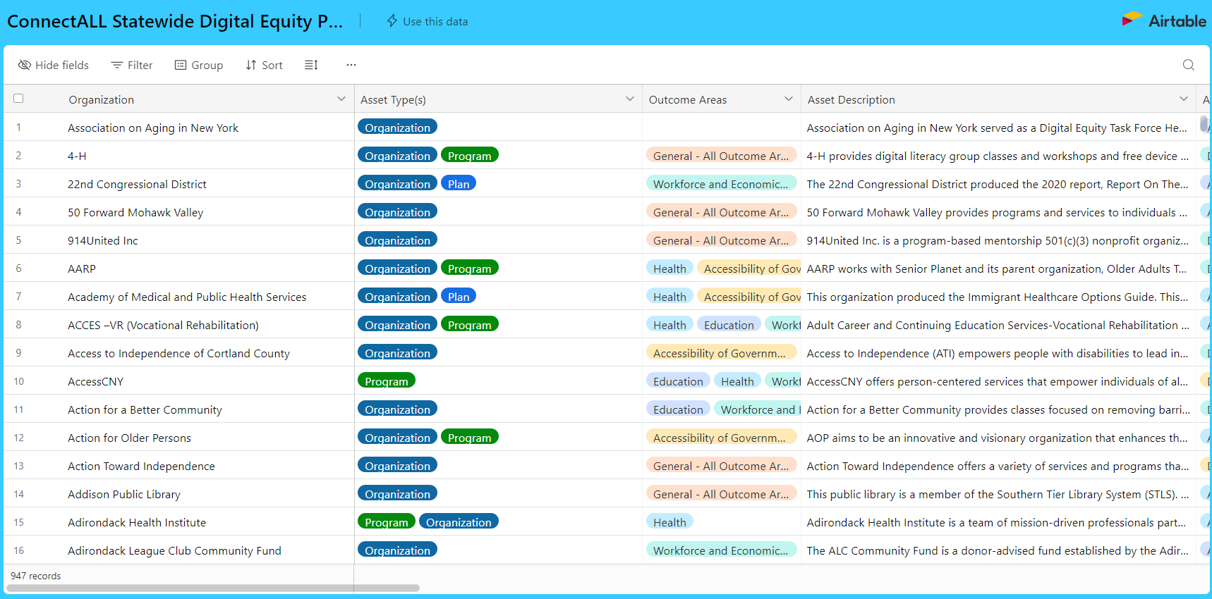
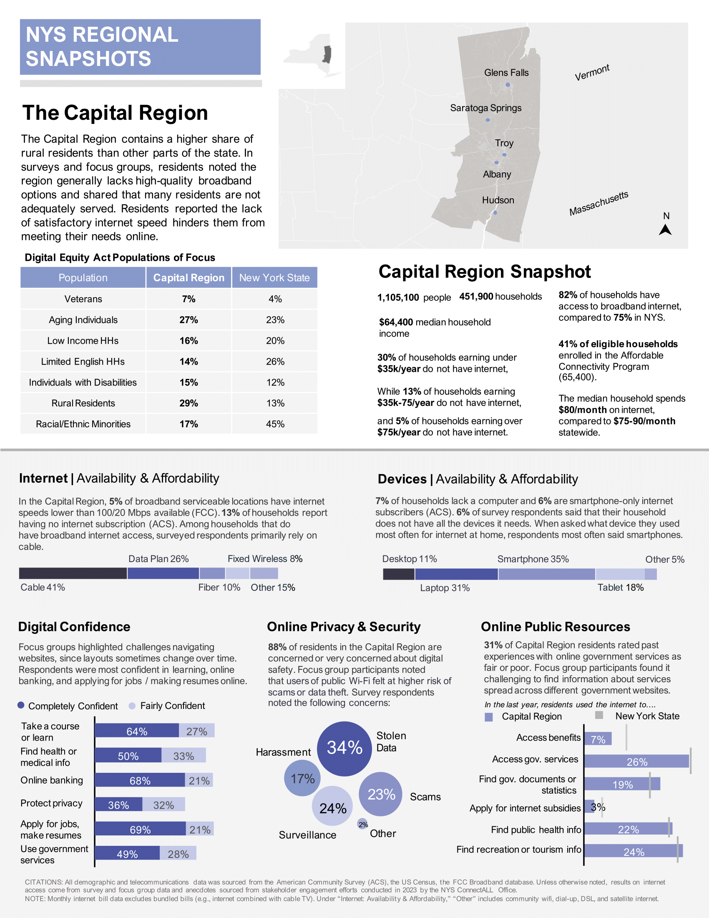
CURRENT STATE OF DIGITAL EQUITY
In preparation of the State Digital Equity Plan, ConnectALL developed a new and expanded baseline of digital equity data and activities in New York.
Needs Assessment
Asset Inventory
bit.ly/NYS-DE-Asset-Inventory
Notes:
In preparation of this Plan, CAO developed a new and expanded baseline of digital equity data and activities in New York, in the form of an asset inventory and needs assessment. CAO coordinated with regional entities, including Digital Equity Coalitions (DECs) and their partners who hold relationships with covered populations across the state.
1. Digital Equity Asset Inventory: A searchable database of more than 900 existing programs, organizations, plans, and other assets currently advancing digital equity within the state. These assets will be strengthened and built upon through CAO’s digital equity investments, and CAO will continue to refine the database.
2. Needs Assessment: A catalogue of the needs and barriers to meaningful internet adoption expressed by populations who have been historically left out of digital advancement. The needs assessment builds on administrative data by introducing new findings from CAO’s stakeholder engagement activities, including focus groups, listening sessions, and CAO’s New York State Internet Access Survey.

Slide 12
CONNECTALL’S DIGITAL EQUITY STRATEGY
ConnectALL will employ a range of strategies during implementation of the State Digital Equity Plan. When activated together, activities across strategic pillars will lead to meaningful, sustainable impacts.
Grounding Investments in an Asset Based Approach
Building alignment and awareness
Strengthening networks to share resources and take coordinated action
Sharpening and Socializing our Digital Equity Lens
Notes:
CAO’s strategy considers the limitations of its resources and is driven by the need to identify multipliers that can amplify and sustain past, present, and future investments. CAO must address needs across a population of approximately 20 million people in ten regions, including the largest, most diverse city in the country. The funding available to CAO is onetime, while the digital divide is perpetual, as technologies, threats, and New Yorkers themselves evolve. Aligning CAO initiatives with existing digital equity efforts in the state is key to CAO’s overarching strategy.
CAO is not attempting to reinvent the wheel. As you'll read in the plan, CAO identifies areas of alignment with existing State initiatives and plans. (Can be found in Chapter 2) Building on alignment with these existing efforts to improve outcomes, CAO identified the following strategic pillars, which together will allow CAO to prioritize and streamline activities in pursuit of its mission.

Slide 13
OUTCOME AREAS
ConnectALL will take actions to promote the general welfare as it relates to the benefits of broadband access across the following outcome areas.
1​ | Advancement of economic and workforce development goals, plans, and initiatives
2​ | Improvement in the quality and accessibility of educational resources
3​ | Improvements in access to health services and delivery
4​ | Increased civic and social engagement
5 | Delivery of accessible, navigable essential services
Notes:
ConnectALL will take actions to promote the general welfare as it relates to the benefits of broadband access across the following outcome areas.
1. Advancement of economic and workforce development goals, plans, and initiatives;
2. Improvement in the quality and accessibility of educational resources;
3. Improvements in access to and delivery of health services;
4. Increased civic and social engagement; and
5. Delivery of accessible, navigable public resources.
DETF**

Slide 14
SDEP STRUCTURE
The components of the plan follow a logic of inputs, outputs, and outcomes.
Chapter 1 - 4
Chapter 5
Chapter 5
Outcome Areas
Implementation
Needs Assessment
Measurable Objectives
Gap Analysis
Within the five measurable objective categories: 1. Broadband Availability & Affordability
2. Accessible Devices & Device Support
3. Digital Literacy
4. Privacy & Security
5. Accessibility of Essential Resources & Services
Strategies
Impact
Metrics
Asset Inventory
Stakeholder
Engagement
Notes:
After establishing a baseline for digital equity data and activities, and engaging stakeholder across the State, which we have previosuly tocuhed on, the State synthesized findings regarding the needs of covered populations within each measurable objective category. This process allowed the State to compare needs against Assets already working to advance digital equity and strategically close remaining gaps in service, as well as to identify where additional resources may be needed.
Chapter 5, Implementation, presents the measurable objectives CAO will use to measure impact, based on needs identified and the key activities representing approaches to meet needs and filling gap identified in the Gap Analysis (Chapter 3).

Slide 15
SDEP STRUCTURE
1.0 | Executive Summary
2.0 | Unified Vision
 | 2.1-2.3 ConnectALL Office, Planning Process, and Alignment with Outcome Areas
 | 2.4 Theory of Change, Strategy, and Measurable Objectives
3.0 | State of Digital Equity in New York
 | 3.1 Asset Inventory
 | 3.2 Needs Assessment
4.0 | Principles for Stakeholder Engagement 4.1-4.3 Statewide and Regional Engagement Methods
 | 4.4 Public Comment
5.0 | Implementation
 | 5.1 Implementation Strategy & Key Activities
 | 5.2 Implementation Timeline
6.0 | Conclusion
Notes:
Here is a breakdown of the structure of the plan and what topics are covered in each chapter. In the portal, you will have the opportunity to submit comments by chapter.

Slide 16
03
Regional
Snapshots
16

Slide 17
REGIONAL SNAPSHOTS
The Needs Assessment processed New York State Internet Access Survey responses by region to produce reports, or “snapshots,” capturing broadband and digital equity findings in the ten distinct regional geographies of New York State.
Each snapshot contains the following information:
Demographic information from the region to help compare regional covered populations to the broader composition of the state.
Selected Survey data across five broadband and digital equity areas: Broadband Affordability & Availability, Accessibility of Devices & Device Support, Digital Literacy, Privacy & Cybersecurity, and the Accessibility & Inclusivity of Public Resources.
Significant findings from focus groups, where applicable, to provide nuance and further depth on challenges affecting covered populations in specific regions.
Regional Snapshots HERE

Slide 18
04
Deep Dive: Broadband Affordability & Availability
18
Notes:
To connect CAO’s digital equity investments with the State’s outcome areas, the following sections present the measurable objectives CAO will use to measure impact, based on needs identified in Chapter 3. A set of associated activities CAO will pursue to achieve its objectives are then listed. The activities presented on the slides are paraphrased versions of the activities presented in Chapter 5. Participants should be encouraged to review the Plan to read the detailed strategies.

Slide 19
BROADBAND AFFORDABILITY & AVAILABILITY – NEEDS AND GAPS
Measurable Objectives
Needs
Measurable Objectives
11% of New Yorkers do not have broadband of any type at home
20% of low-income households and 14% of rural households lack broadband internet.
New Yorkers are concerned about a lack of choice among ISPs leading to lower quality of service at higher prices.
According to the Survey, the median household bundled internet monthly service cost was $90/month; the median household unbundled internet monthly service cost was only $75/month
48% of eligible households statewide (1.28 million) are enrolled in ACP as of September 2023
Number of households statewide with broadband internet connections at home
Share of locations in each region that have more than one ISP option.
Share of locations in each region that have options for unbundled, affordable broadband service.
Notes:
(1) What are your reactions to the identified needs listed? Do they resonate with your experience?
(2) What are your reactions/feedback to the measurable objectives? Do they algin with the needs? What’s missing?

Slide 20
BROADBAND AFFORDABILITY & AVAILABILITY – ACTIVITIES
To address the gaps and accomplish the measurable objectives, leading to the long-term outcomes, the following activities comprise the implementation plan.
Activities
Deliver last-mile connections
Invest in high quality internet infrastructure in low-income and areas over-reliant on DSL and Satellite service
Invest in outreach efforts
Fund existing efforts to greater reach aging individuals, veterans, and others with limited mobility
Invest in political base building
Raise public awareness of the risks associated with internet service bundles
Support awareness building campaigns
Change ACP implementation policy
Ensure costs from bundled services are not hidden from consumers
Align ACP eligibility and enrollment processes with other means-tested programs
Identify ways to complement ACP subsidies to make internet more affordable
Notes:
What are your reactions to the key activities you see here? Is there anything missing that you think should be incorporated in the plan?

Slide 21
05
Deep Dive: Accessible Devices & Device Support

Slide 22
ACCESSIBLE DEVICES AND DEVICE SUPPORT – NEEDS AND GAPS
Needs
Measurable Objectives
Number of New York households that have internet enabled devices at home.
Access to assistive technology
Number of New Yorkers reporting challenges maintaining or troubleshooting their own devices.
Options for proper device disposal, recycling, and refurbishment.
10% of New Yorkers reported lacking sufficient internet-enabled devices in their homes.
Low-income households are 20% less likely than other New Yorkers to access the internet through a laptop, and 7% less likely to do so through a desktop.
Individuals living with disabilities are 8% more likely to live in homes without a laptop.
24% of New Yorkers reported being self-sufficient at fixing issues with their devices.
76% of New Yorkers reported relying on friends, family, tech support, or other sources of assistance when their devices stopped working properly.
Notes:
(1) What are your reactions to the identified needs listed? Do they resonate with your experience?
(2) What are your reactions/feedback to the measurable objectives? Do they algin with the needs? What’s missing?

Slide 23
ACCESSIBLE DEVICES AND DEVICE SUPPORT – ACTIVITIES
To address the gaps and accomplish the measurable objectives, leading to the long-term outcomes, the following activities comprise the implementation plan.
Activities
Expand existing programs that are focused on distributing new and refurbished internet-enabled devices
Expand funding to assets and explore direct partnerships with device manufacturers
Identify cost-effective assistive technology, support the distribution of such devices across trusted asset partners, and require sub-grantees to report on distribution
Fund existing and new programs that provide technical support, in person and virtual
Link households with convenient programs to safely recycle or dispose of electronic waste
Deploy the NYS Digital Equity Asset Inventory as a "digital directory"
Collect and publish best practices in effective technical support
Evaluate the impact of and expand programming including inter-generational skill-sharing
Notes:
What are your reactions to the key activities you see here? Is there anything missing that you think should be incorporated in the plan?

Slide 24
06
Deep Dive: Digital Literacy
24

Slide 25
DIGITAL LITERACY – NEEDS AND GAPS
Needs
Measurable Objectives
13% of New Yorkers struggle to use the internet to meet their needs, and covered populations are universally more likely to struggle to do so
28% of individuals with limited English;
23% of veterans;
22% of individuals living with disabilities;
20% of aging individuals;
20% of individuals in low-income households.
Covered Populations—especially formerly incarcerated New Yorkers, racial and ethnic minorities, and people with limited-English ability—lack access to digital skills programming.
Providers of digital skills programs frequently raised a lack of consistent curricula and training standards that align with industry standards as barriers to effectively scaling their work.
New Yorker's awareness of available digital literacy programs
Covered populations' access to digital literacy programming aligned to their specific needs and interests
Coordination among training providers
Needs & Baseline Data
Notes:
(1) What are your reactions to the identified needs listed? Do they resonate with your experience?
(2) What are your reactions/feedback to the measurable objectives? Do they algin with the needs? What’s missing?

Slide 26
DIGITAL LITERACY – ACTIVITIES
To address the gaps and accomplish the measurable objectives, leading to the long-term outcomes, the following activities comprise the implementation plan.
Activities
Fund expansions and replication of the highest-performing digital skills-building job training programs
Pilot customizable training models
Provide financial incentives and support during training
Support education and training for educators
Coordinate the field to create a directory of vetted digital skill-building job training programs
Improve marketing efforts to raise awareness of programs
Deploy the NYS Digital Equity Asset Inventory as a "digital directory"
Share digital literacy and skill-development offerings with ACP subsidy subscribers
Compile and promote web accessibility standards to the public
Convene key stakeholders to align on standardized and potable credentials
Compile and consolidate best practices in digital literacy and digital job skills training
Explore needs or tech and digital skills education in K-12 schools
Evaluate the strategies and impact of existing assets that provide career-oriented digital skills support
Notes:
What are your reactions to the key activities you see here? Is there anything missing that you think should be incorporated in the plan?

Slide 27
07
Deep Dive: Privacy & Cybersecurity
27

Slide 28
PRIVACY AND CYBERSECURITY – NEEDS AND GAPS
Needs
Measurable Objectives
Number of assets providing privacy and cybersecurity training to New Yorkers, especially to members of covered populations.
Over 90% of New Yorkers are either somewhat concerned or very concerned about their online safety.
Notes:
(1) What are your reactions to the identified needs listed? Do they resonate with your experience?
(2) What are your reactions/feedback to the measurable objectives? Do they algin with the needs? What’s missing?

Slide 29
PRIVACY AND CYBERSECURITY – ACTIVITIES
To address the gaps and accomplish the measurable objectives, leading to the long-term outcomes, the following activities comprise the implementation plan.
Activities
Fund programming providing online safety trainings
Share digital cybersecurity and internet safety resources with ACP subsidy subscribers
Explore methods of shifting the burden of protection away from individuals
Publish guidance on key elements to digital safety
Ensure awareness of safety measures and data privacy are consistent across school districts
Notes:
What are your reactions to the key activities you see here? Is there anything missing that you think should be incorporated in the plan?

Slide 30
08
Deep Dive: Accessibility of Essential Resources & Services
30

Slide 31
ACCESSIBILITY OF ESSENTIAL RESOURCES AND SERVCICES– NEEDS AND GAPS
Needs
Measurable Objectives
New Yorkers living with disabilities were 5% more likely than others to report online public services as either not very or not at all accessible.
Limited-English New Yorkers were 3% less likely to do so.
Rural New Yorkers were 2% less likely to do so. And rural New Yorkers with internet at home are 7% less likely to use government services online than other New Yorkers, being the only covered population less likely to do so.
Improve the quality and consistency of online public resources.
Outreach campaigns to increase covered populations' trust in online government services.
Notes:
(1) What are your reactions to the identified needs listed? Do they resonate with your experience?
(2) What are your reactions/feedback to the measurable objectives? Do they algin with the needs? What’s missing?

Slide 32
ACCESSIBILITY OF ESSENTIAL RESOURCES AND SERVCICES – ACTIVITIES
To address the gaps and accomplish the measurable objectives, leading to the long-term outcomes, the following activities comprise the implementation plan.
Activities
Fund programs that support improved digital skills
Fund multilingual and accessible programs
Provide access to digital skills training classes and classes on navigating public resources
Fund re-entry programming
Share digital cybersecurity and internet safety resources with ACP subsidy subscribers
Explore methods of shifting the burden of protection away from individuals
Define updated design standards for State and local government websites and provide funding to support website updates
Update standards for state and local government websites so that content is ADA-compliant and includes robust and reliable translation services
Enforce or guide standard-setting for State and local government websites
Notes:
What are your reactions to the key activities you see here? Is there anything missing that you think should be incorporated in the plan?

Slide 33
09
Report Back
33
Notes:
Use this slide if you plan to hold breakout discussions and give each facilitator 2 minutes to report back key takeaways from their discussions.

Slide 34
09
Public Comment
34

Slide 35
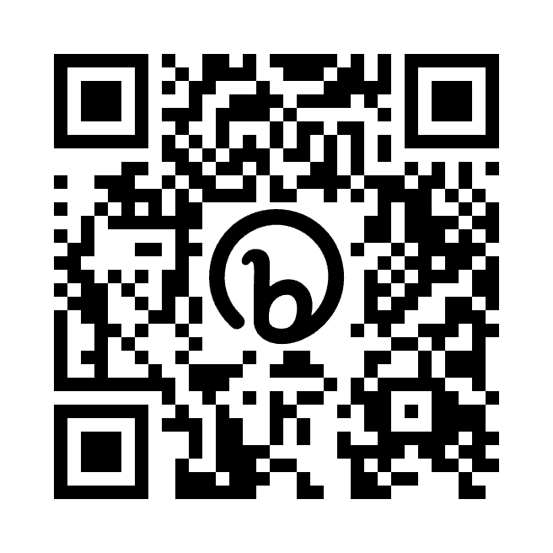
PUBLIC COMMENT
New York’s SDEP is open for public comment from November 6, 2023, to December 6, 2023.
Access the full Version 1 Draft of the New York State Digital Equity Plan at:
bit.ly/nys-sdep
Notes:
Direct participants toward the Plan and portal, both of which can be found at the above link and QR code.

Slide 36
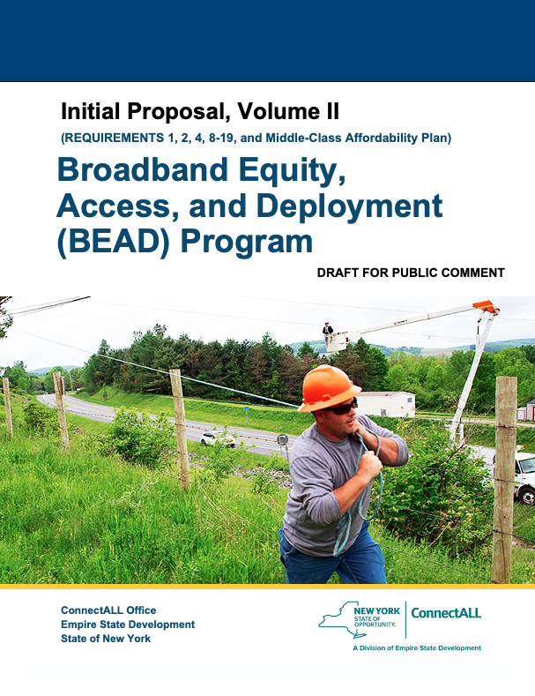
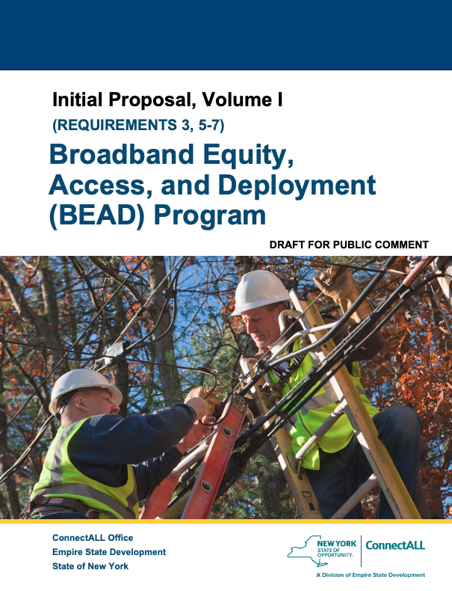
PUBLIC COMMENT – BEAD INITIAL PROPOSAL
New York’s Initial Proposal for BEAD is also currently open for public comment. Broken up into Volumes I & II, the proposal identifies existing broadband availability efforts in NYS, each unserved and underserved location, and eligible CAIs, in addition to proposing a challenge process and CAO’s overall broadband goals and priorities.
Access the full Version 1 Draft of the New York State BEAD Initial Proposal at:
bit.ly/nys-bead
Notes:
New York’s Initial Proposal for BEAD is also currently open for public comment. Broken up into Volumes I & II, the proposal identifies existing broadband availability efforts in NYS, each unserved and underserved location, and eligible CAIs, in addition to proposing a challenge process and CAO’s overall broadband goals and priorities.

Slide 37
Thank you!
Contact the ConnectALL Office at
ConnectALL@esd.ny.gov
Visit broadband.ny.gov for future updates and opportunities to engage
Notes:
DO NOT hold a Q&A. Direct participants to direct their questions to the ConnectALL email address above.
Emphasize that any "comments" sent to the email address will not be officially recorded and that ALL PUBLIC COMMENT must be submitted through the portal on the CAO website.

