Slide 1
Is There Racism in the Quite Corner? An Intersectional analysis
Dr. Phoebe Godfrey
May 21st 2021

Slide 2
Thanks for inviting me ..
Who Am I? About Me …
A white middle-class, middle-aged, lesbian, married to a woman, leftist European-American Sociology Associate Professor in Residence
Have been teaching on race / class / gender / sexualities for over 20 years
Currently my focus is on how these all intersect (more on that in a minute) and are in our culture in their oppressive forms- racism / sexism / classism (why is that not really a word?) / homophobia …etc the roots of climate change and environmental destruction ….
I don’t lecture – I engage and ask my students, as I will ask you to participate with me in dialogue, discussion, exploration
Who are you?
Why are you here?
What do you hope to learn –about others (usually when white talk about racism we want to focus on ‘the others’) ?
About yourself?
What do you hope to do with this knowledge about ‘racism in the Quite Corner’?
We’ll take a moment for you to think of answers ..we will aim to share them later

Slide 3
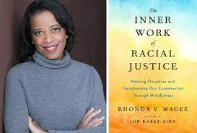
Yes…there is racism everywhere…
We’re going to pause and see what that feels like..
Rhonda McGee in her book The Inner Work of Racial Justice : Healing Ourselves and Transforming Our Communities Through Mindfulness ..introduces the idea of ‘The Pause’ to allow idea and insights to take root in our minds and bodies and to question how they make us feel and use those feeling as insights into how and where we need to work and grow …
Again we will share later …

Slide 4
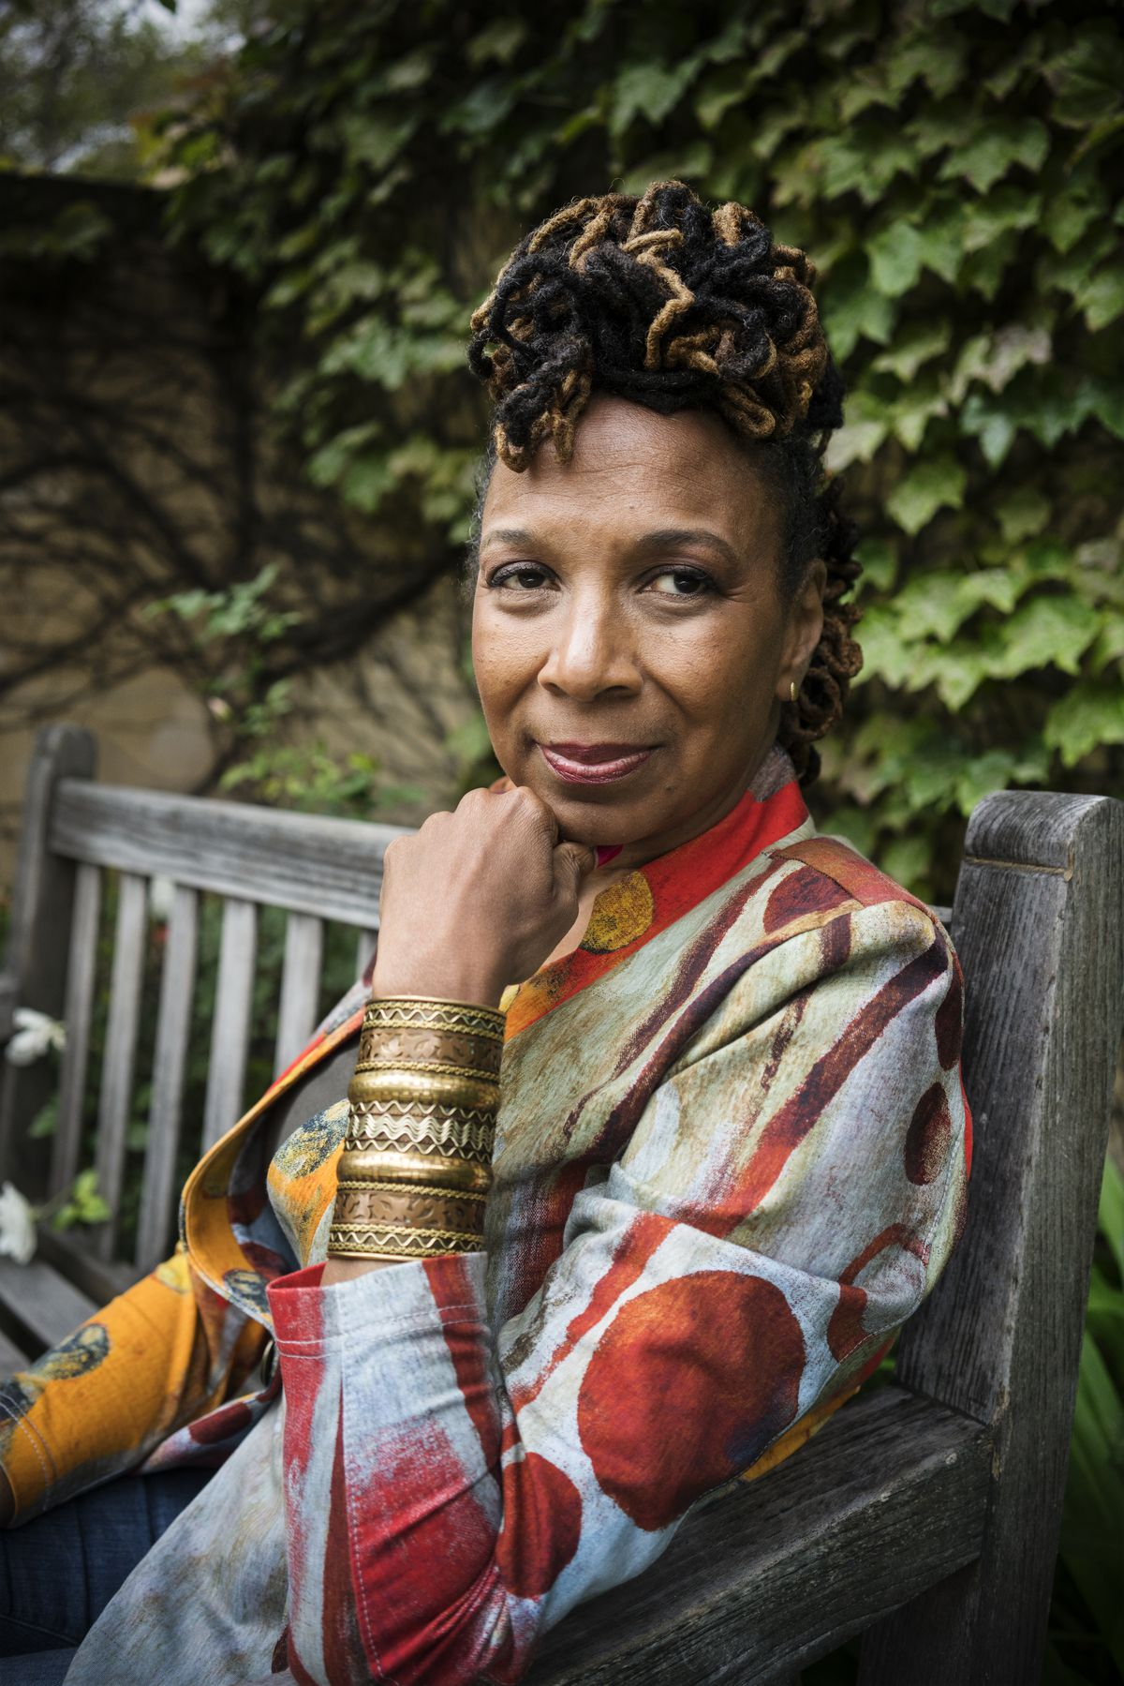
Intersectionality - Kimberle Crenshaw
The concept originated with Legal theorist Kimberle Crenshaw and her work with racial and gener discrimination cases. There was no way at the time to recognize how these two forms of discrimination intersect…As she states
“Intersectionality was a prism to bring to light dynamics within discrimination law that weren’t being appreciated by the courts,” Crenshaw said. “In particular, courts seem to think that race discrimination was what happened to all black people across gender and sex discrimination was what happened to all women, and if that is your framework, of course, what happens to black women and other women of color is going to be difficult to see.”
I will read …
Let’s pause …

Slide 5
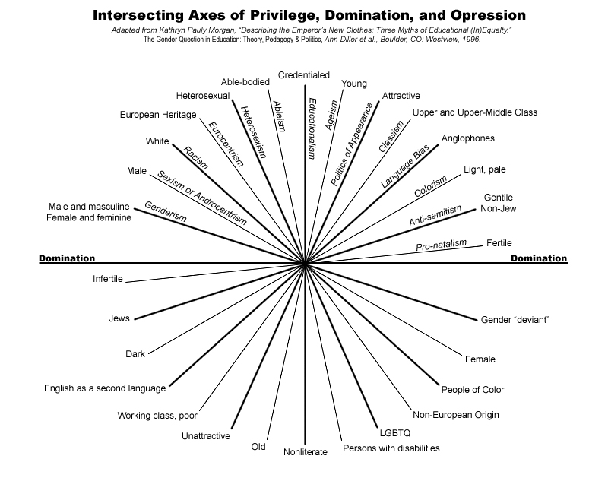
Who are you –intersectionally speaking?
Intersectionality has always been about challenging inequality .,.
It is theory and praxis….Talking about inequality is one thing ..theory to change inequality to be more equal is something else…
Talking about how we must change is something else again …and again
Let’s look at the chart and take 5 minutes to identify your identities….how many give you privledge? How many give you forms of oppression?
How do the intersect? Link back to how you answered ‘Who Am I’? What do you notice?

Slide 6
Discussion – 10 minutes?
Lets start going around and speaking about Who are you as you answered the first time – name, pronoun, ..etc (did you mention race / class/gender / sexuality..etc? If not why not? When do we mention these identities more? Go back to your chart…privilege tends not to be identifies but oppression is ..why..)
Go around share one reason you are here?
Go around share how the question about racism made you feel?
Go around how does realizing that we cannot address racism unless we also address sexism / homophobia and all the other oppressions change your view of the question of this talk?
Then we will come back – pick one person to share and report back- but don’t share anything personal –speak in general or for yourself..
Anything else ? Final questions?

Slide 7
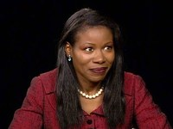
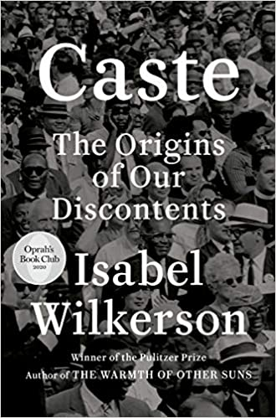
Radical Empathy -Isabel Wilkerson
“Radical empathy, on the other hand, means putting in the work to educate oneself and to listen with a humble heart to understand another's experience from their perspective, not as we imagine we would feel. Radical empathy is not about you and what you think you would do in a situation you have never been in and perhaps never will. It is the kindred connection from a place of deep knowing that opens your spirit to the pain of another as they perceive it. Empathy is no substitute for the experience itself. We don't get to tell a person with a broken leg or a bullet wound that they are not in pain. And people who have hit the caste lottery are not in a position to tell a person who has suffered under the tyranny of caste what is offensive or hurtful or demeaning to those at the bottom. The price of privilege is the moral duty to act when one sees another person treated unfairly. And the least that a person in the dominant caste can do is not make the pain any worse.” (p. 386)
Let’s pause …

Slide 8
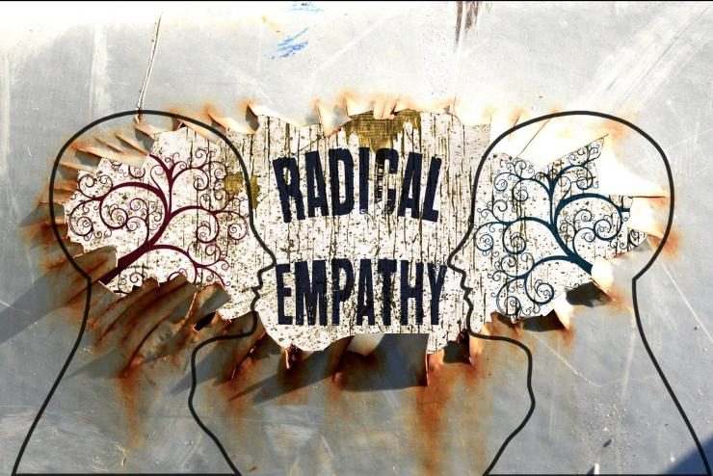
Wrap up?
What is your take away?
What else needs to be discussed?
What work do you need to do?
What work do we need to do?
How can you / we act on what Wilkerson says that it is ‘our moral duty to act’?
Other ?

