Slide 1
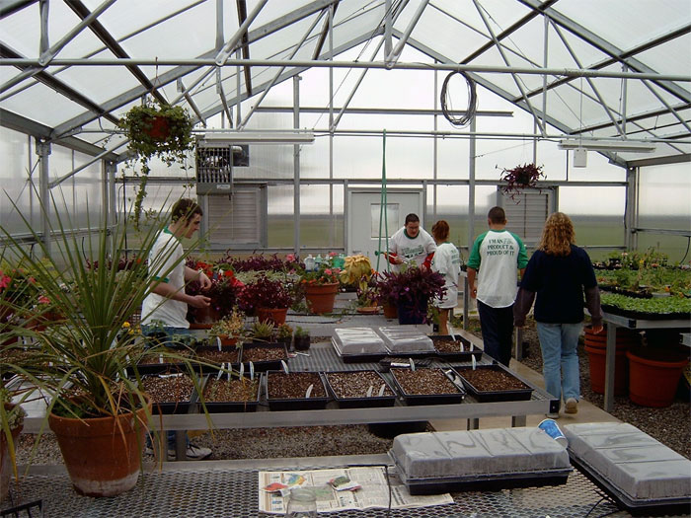
Expanding Our Roots Greenhouse Project
Holyoke Agricultural Education

Slide 2
The Purpose
Hands-on experiences
Meaningful Supervised Agricultural Experiences
Partners in Active Learning (PALS) Program
Growing lettuce for school cafeteria

Slide 3
The Structure
Junior Teaching Greenhouse
Greenhousemegastore.com

Slide 4
Who Benefits
Holyoke Ag. Ed.
HJS/HHS
Elementary School- PALS
The School Cafeteria through fresh food
The community

Slide 5
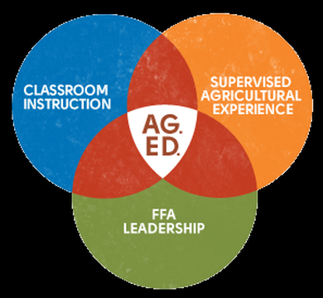
The Need
20% of students live on a family farm
50% Free & Reduced Lunch
2021 Graduation Requirements- Capstone
Meaningful SAE’s

Slide 6
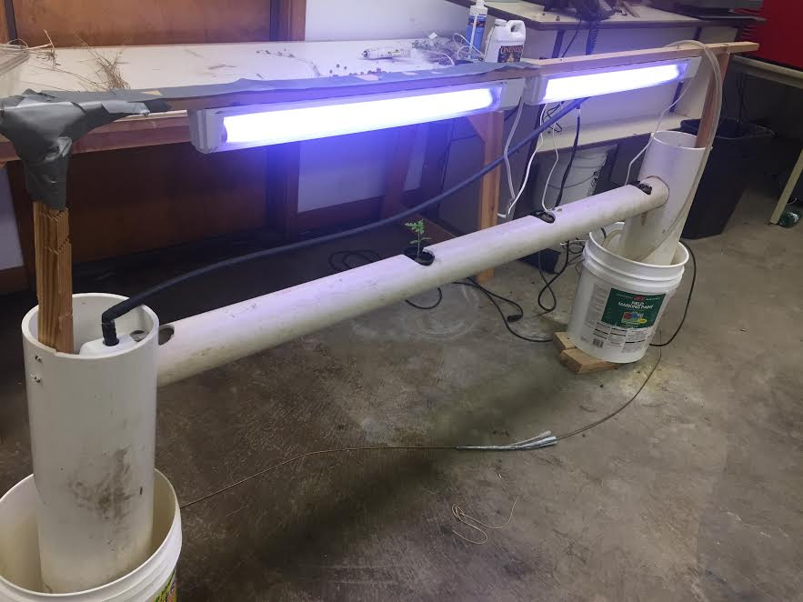
Student Driven
Business Plans
Research
Hydroponics

Slide 7
Sustainability
Annual Plant Sale
Potential of grants
DuPont Pioneer
Colorado FFA Foundation
Colorado Garden Foundation
Colorado Corn Grant
USDA Rural Developments Grant
Farm to School

Slide 8
1- Year Goal
Hold Annual Plant Sale
Establish PALS Program
Hydroponic Lettuce Production

Slide 9
3-Year Goal
2021 Graduation Guidelines- Capstone Class
Expanding from one plant sale, to multiple

Slide 10
Long Term Goals
Providing opportunities to ALL students
Post-Secondary & Career Interests
Growing the Ag Industry

Slide 11
Supporting Arguments
Many successful similar projects
Nutrition - USDA Healthier School Programs, Farm to School Programs, USA National School Garden Program
Careers in agriculture are crucial
According to Forbes- 57,900 jobs per year, only 35,400 graduates per year
27% of these agricultural jobs are in the STEM fields

Slide 12
Supporting Arguments
“By bringing elementary students to see the greenhouse, we will spark an interest for agriculture at a young age” -Wyatt McCallum, 12th
“A greenhouse could benefit anyone, especially those who live in town and don’t have the opportunity to work on a real agricultural establishment.”-Cole LeBlanc, 10th
“We will be able to learn more about agriculture because we will have a hands-on education.” -Ashley Aranda, 8th

Slide 13
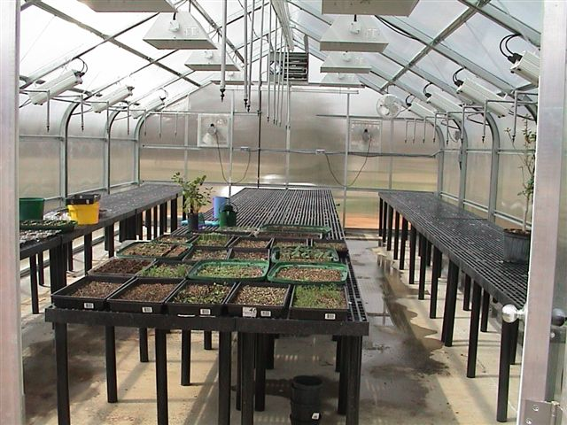
$25,000 Plan
Junior Teaching Greenhouse
Width = 18'
Length = 36'
Height = 10' 6"

Slide 14
$25,000 Plan
One hydroponic system
Benches/ Bench Tops
Basic growing supplies
Misting system

Slide 15
$50,000 Plan
Senior Teaching Greenhouse
Width=24'
Length= 48'

Slide 16
$50,000 Plan
Larger hydroponics system
Fodder systems
Rolling Benches
Germination Chamber
Control Panel

Slide 17
Thank you for your consideration!
Questions?

