Slide 1
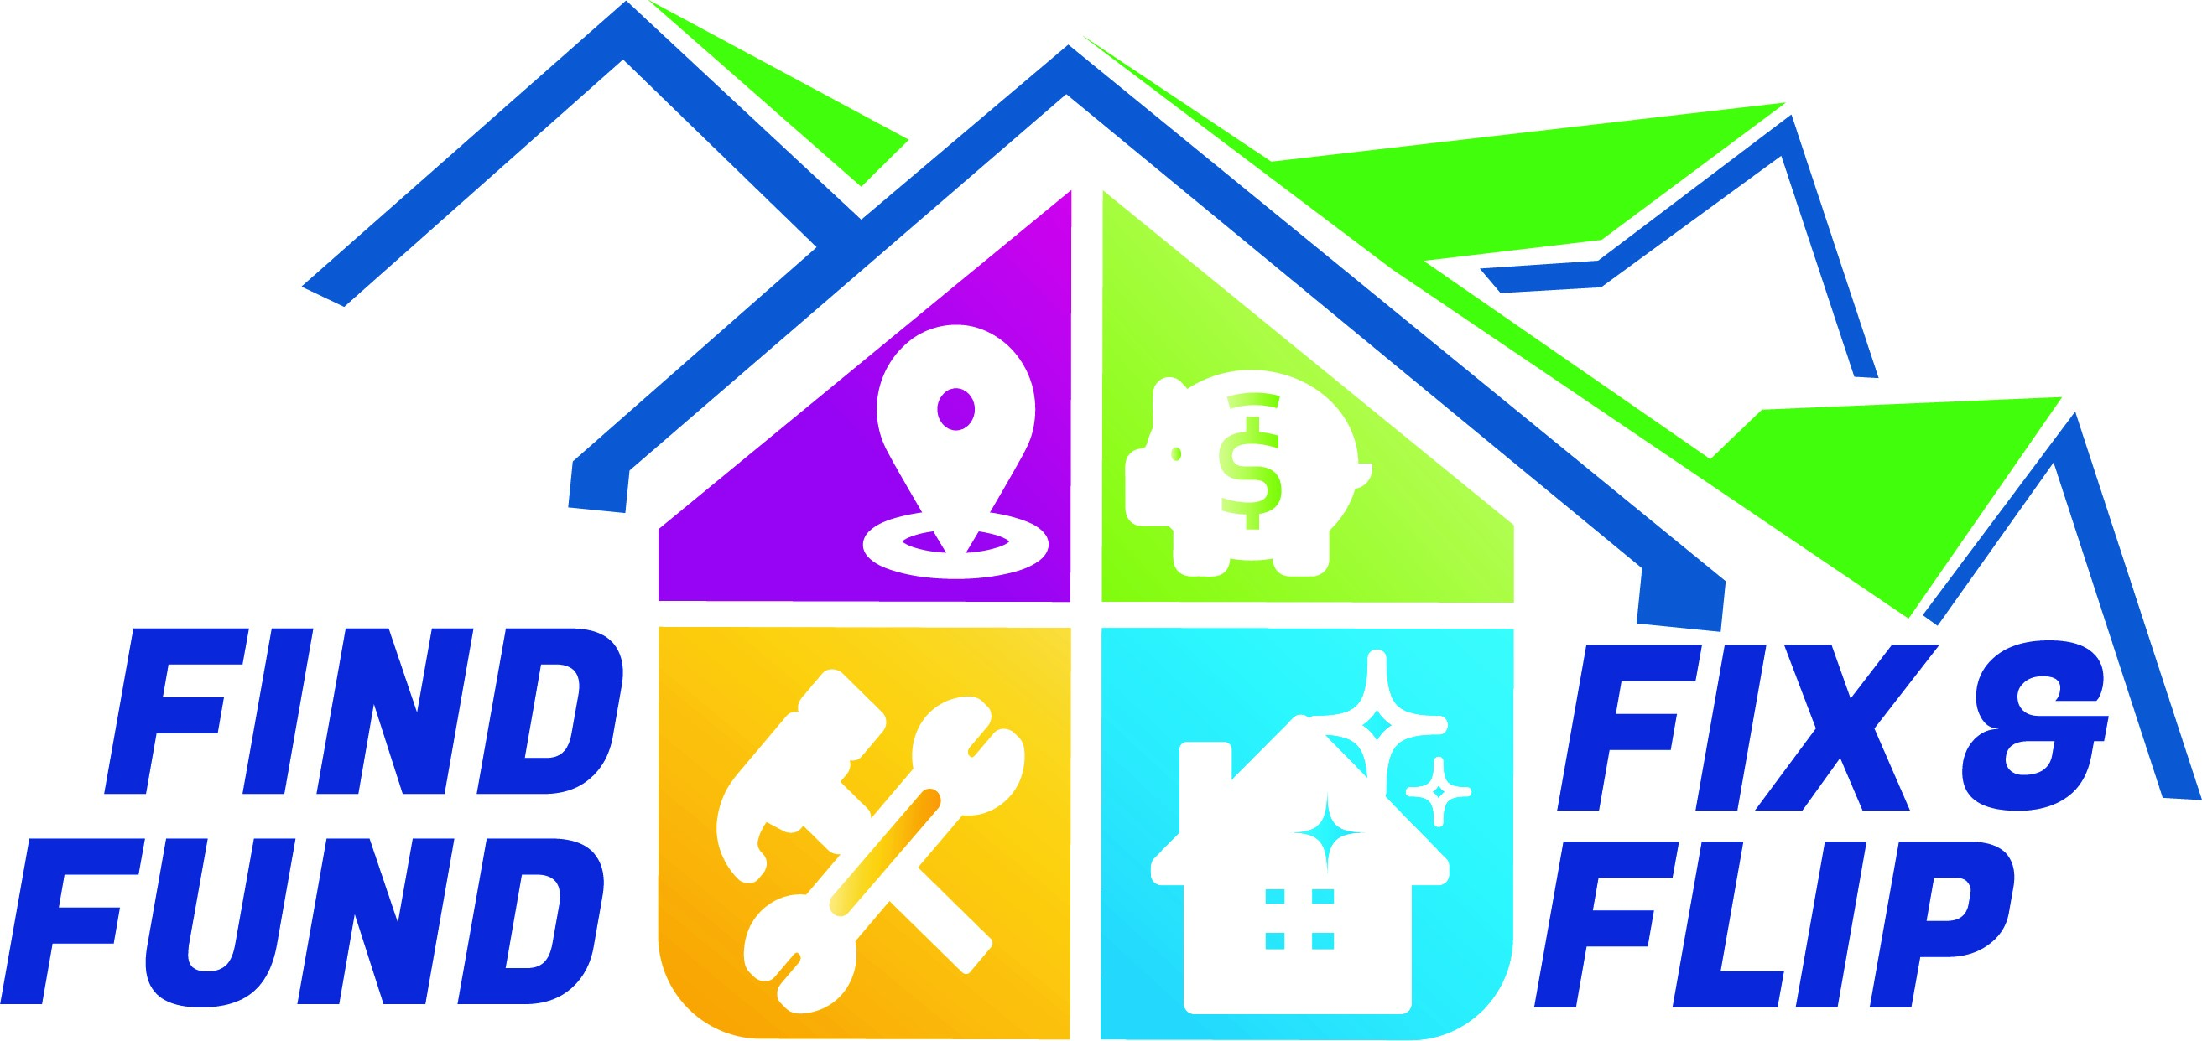
Brought to you by

Slide 2
Residential Real Estate Investment Properties 1-4 Family Rentals
Create Passive Income, Buying And Holding Multi Unit Properties
1-4 Family Rentals
Long and short term holding options.

Slide 3
Finding and evaluating profitable rental properties
Search local Global MLS
Craigslist, Facebook Marketplace, Zillow FSBO’s
Public notices - Notice of Sale description in the newspapers and city, county, state court houses, libraries, sheriffs offices, and city, state and county office’s.
Below are some of the due diligence buyers should be prepared to do.
Check county for ALL Current, past due or delinquent taxes, (2 years old or more).
Current & past due Water and Sewer Bills. (Call the County for Re-levy’s)
Past Codes Violations; and current zoning usage.
Current Year Tax Bill (will be prorated at closing) Zoning and Planning Allowed uses after closing—prior use does not always guarantee future zoning.

Slide 4
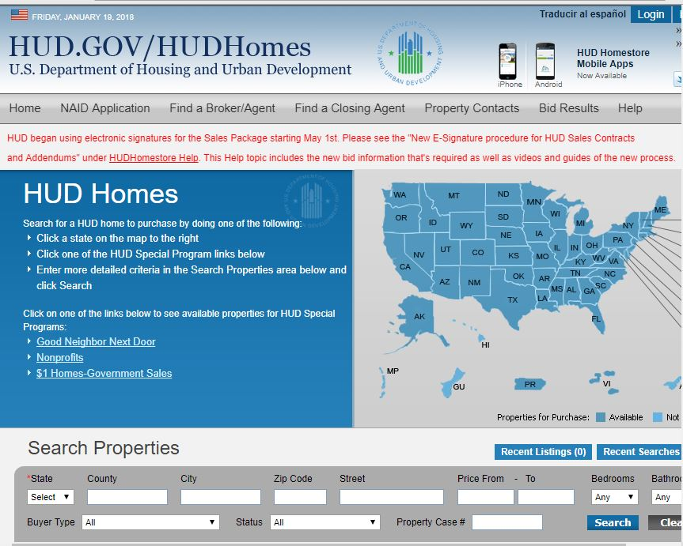
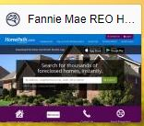
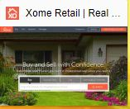
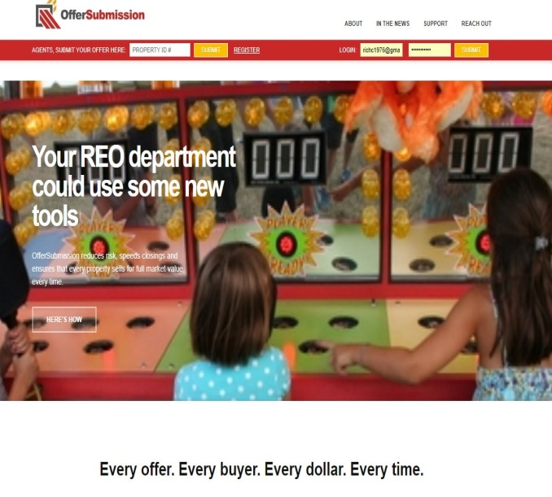
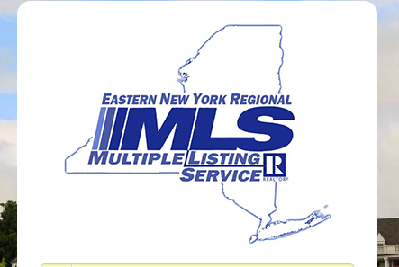
ACQUIRING PROPERTIES (Find Below Market Houses)

Slide 5
County, Bank & Privately Owned Investment Properties 1-4 Family -PROPERTY WEBSITES-
Local Global MLS
Hudhomestore.com
Homepath.com
Auction.com
Xhome.com
Hubzu.com
Reo.wellsfargo.com
offersubmission.com
Propoffers.com
This is just a few that exists. There are many to choose from.

Slide 6
WHAT IS A BANK OWNED PROPERTY?
A bank-owned or real estate owned (REO) property:
Bank regains title possession, only after foreclosure process has been completed.
Reverted to the mortgage lender after the home fails to sell in a foreclosure auction.

Slide 7
WHAT IS A BANK OWNED PROPERTY?
Either sells or fails to sell in a foreclosure auction.
Property reverted to the mortgage lender in first lien position after the property fails to sell at auction.
Bank owns the property, handles eviction, pay ‘s off tax liens, may be some repairs. Bank or servicing company handles process.
Bank will contract with local agent to list the property on the market.

Slide 8
County Tax lien Auctions
Albany County Auctions & Capital Region
Town of Colonie, City of Cohoes, City of Watervliet, City of Albany. (Albany County)
If the properties on the list remain unpaid after 2-4 years of collection efforts Albany County is now proceeding with foreclosure and will take title to any that remain unpaid. Once taken, county-owned parcels are transferred per the conditions set forth in the County Disposition Plan. Most likely an auction will occur.
Albany, Rensselaer, Schenectady, and Saratoga Counties are very similar when it comes to handling tax lien collection.

Slide 9
Creating Your Real Estate Team.
You need to find a real estate agent to help find investment properties.
Find a mortgage lender that will lend you money based on your individual financing needs.
You will also need a real estate attorney.
Locate a property manager or a contractor to help with managing and repairing the property.
Hiring a CPA to help navigate through tax benefits of owning rental properties.
Forming a LLC, LLP, or (C) or (S) corporation to protect your investment, and utilizing the tax benefits of owning rental properties.

Slide 10
Knowing your finances
Understanding your income to debt (49% DTI) Max
Down payment requirements, at 20% no PMI
Prepare to have 2 years taxes, 3 months bank statements, 2 years W-2, and 2 months pay stubs.
Credit score of at least a 620, 720 is preferred
Possible letter from CPA to explain income if questioned. (for self employed borrowers)
Leverage other people's money. (meaning borrow as much as you can afford.)
How many years will you finance the property?
Understanding the difference between banks and 3 party lenders (Brokers).

Slide 11
Funding Your investment property
Types of lending available.
What type of borrower are you?
Creative finaincing
Conventional financing 5%-25% down payment.
Will you owner occupy the property or is it investment?
FHA financing if your first time home buyer, 3.5% down.
FHA 203k Rehab Loan, finance the property and cost of repairs.
Conventional mortgage, can sometimes be utilized if the property needs TLC, Conv. Mortgage will not qualify if the property is a rehab.
Line of credit, on residential primary, or income property, commercial, and some SBA loans
Utilizing lines of credit to purchase homes is one of the best ways to purchase, you are consider a cash buyer.
There are other creative finance options as well, Hard money lenders.

Slide 12
$$ Funding Your Investment Property $$
Private Hard Money Lenders
Albany Hard Money Lenders
Justin 518-810-0101
https://www.albanyhardmoney.com/full-loan-application.html
Ajite LLC (J’ Money) Jeff Feinman
Jeff -518-253-6380
Fairway Independent Mortgage Co.
https://www.fairwayindependentmc.com/Drew-Aiello
Drew 518-573-2435
BRRRRR Method- buy with hard money repair, rehab, refinance, repeat.

Slide 13
Search Properties MLS
Find, Evaluate, Determine gross rental income & operating expenses, market analysis report.
Complete a pro-forma on a rental property of interest.
Research property taxes, and deeds. Sales history.
Rental market history.
https://Searchiqs.com (35 Counties supported)
https://egov.basgov.com
http://tax.neric.org/Search.aspx?district=412402
http://www.infotaxonline.com/
https://www.taxlookup.net/ https://publicrecords.netronline.com/state/NY/county/albany/
http://tax.neric.org/Search.aspx?district=415401

Slide 14
Pro Forma Evaluation
Understanding profit and loss statement on investment property.
Gross, and Net operating income
Operating expenses
Management fees
Taxes and hazard insurance, flood insurance, utilities, water & sewer, HOA fees, trash services.
Repairs and maintenance fees
Capital improvements ( Roofs, Kitchen, Bathrooms, ETC.)
Attorney fees ( Eviction Cost)
Rules for eviction changed 6/2019
Marketing & advertising
Loss of rental income ( vacancies) Marketing

Slide 15
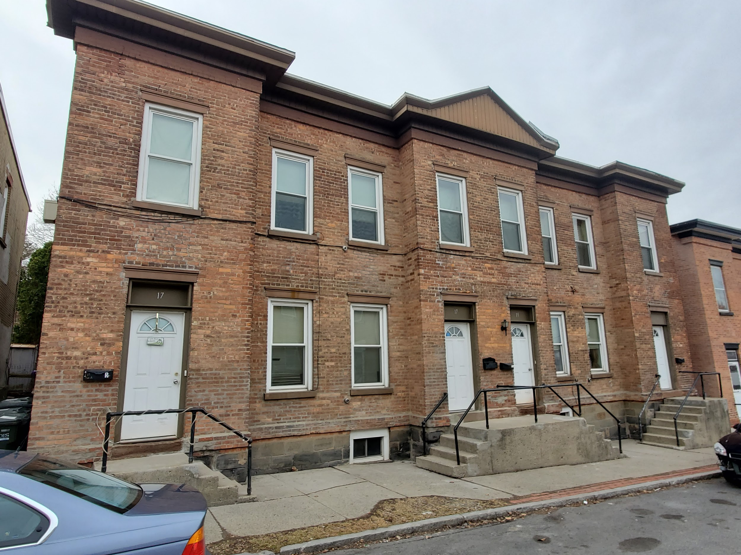
17-19 Strong Place, Cohoes- 4 Unit
Pro forma
Expenses Rent Roll
Mortgage payment Escrowed $1,256.00 $3,000.00
School & Property Taxes $4,783.00
Hazard Insurance (Yearly) $1,375.00
Garbage Removal (Annually) $275.00
Water & Sewer (Quarterly) $575.00
Monthly Repairs $250.00 (Monthly Budget)
Vacancy Rate 2%-5% $1,800.00 (Yearly Budget) Average rate 2%
Maintenance 3% $1,080.00 (Yearly Budget)
Attorney Expenses 1.5% $540.00 (Yearly Budget)
Total monthly realized expense $1,602.00 Net operating monthly income $1,598.00
Yearly Gross Rents $36,000.00
$1,800.00
$1,080.00
Annual Net Profits $ 16,296.00

Slide 16
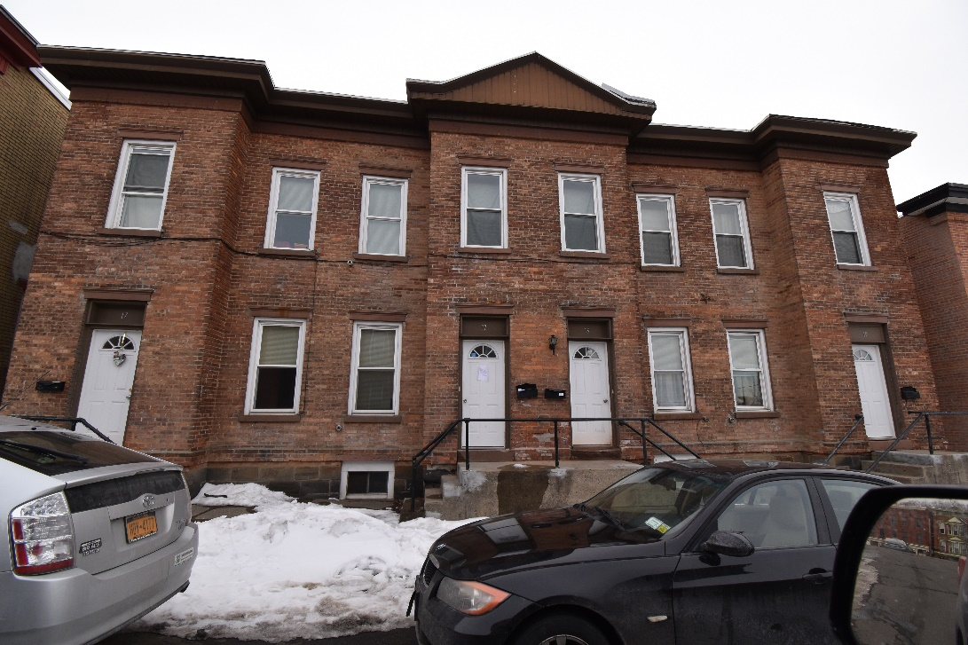
17-19 Strong Place, Cohoes (4 unit)
Pro Forma
Acquired the property $65,000
Rehab cost $45,000
Gross monthly rent roll $3,000
Payment on escrow $540.00
Principle, interest, taxes, $1,264.48
and insurance.
Water & Sewer Per-quarter $1,475.00 ( yearly)
mortgage based on $120,000 (After Refinancing)
Rate 4.25% Term 20 years.
Market value Estimated $235,000
As of 5/01/2020

Slide 17
17-19 Strong Place- Mortgage Statement

Slide 18
Rental properties as long term investment 17-19 Strong Pl.
(Example)
Monthly principal gain $422.00 ( After 8 years )
Yearly principal gain $4,565.00
Appreciation (17 years) 261.60 % at a rate of 7.60% per year.
Monthly Rent Roll $3,000.00
Monthly income $1,736.00
Net Monthly income $1,636.00 ( After all Expenses)
Water & Sewer per-year $1,475.00
Water & Sewer monthly $123.00

Slide 19
Calculating Appreciation
To calculate appreciation, take the purchase price, let’s say it is $120,000 and the expected appreciation using the average over a 25-year span. Let’s use the average appreciation for the NY Capital Region of 3.9%. Convert 3.9% to a decimal by dividing it by 100, you should get 0.039 now add a 1. To this figure equals 1.039, then to the 25 fifth power, to replicate 25 years of appreciation, that figure will come to $312,298.53. This is an astounding figure, but not all real estate market’s see this type of appreciation trends. The appreciation rate as you can see from the example is an important factor to remember when it comes time to buy either your personal home, or any investment property. The wealth that you can accumulate over the years from owning your home or many homes can be an astounding figure, for this example the accumulation of wealth not including what one might spend on repairs over the course of 25 years was $192,298.

Slide 20
Forced Appreciation
There are TWO forms of appreciation, one is appreciation over time with current and future market trends of housing, and years of properly maintaining the home. The second form of appreciation is FORCED, for this, is another reason why real estate is such an attractive investment vehicle. “Forced Appreciation”, Forced appreciation is when an owner does many repairs, OR major improvements (Capital Improvement) whether it is cosmetic or a major repair, just simply painting your home can be considered forced appreciation. Addressing the curb appeal of your home is one of the best home improvements you can make. These repairs can be done over a short period of time or long period of time. Doing multiple repairs to a home to increase the home's value over short or long period of time is what makes real estate so exciting. Most people buy a home either under market value or at market value. The excitement of buying a home generally leads to making some improvements right away to make the home feel like your own, and because of these improvements the home’s value increases. How much? Depends greatly on the type of improvements that were made , like kitchens, bathrooms, adding a room Etc.. and the quality of workmanship.

Slide 21
Capitalization Rate (Cap Rate)
The cap rate is the ratio between the net income of (NOI) the property and its original price or capital cost. Cap rate is expressed as a percentage.
Cap rate of 17-19 Strong Place, original purchase price $65,000
Rehab & remodeling cost $45,000 -
$1,636 (NOI) divided by $110,000 (Purchase Price & Rehab Cost)
Total cost $110,000 (Equals) 14.8 % Cap Rate (This property performs above average.)

Slide 22
Capitalization Rates Should NOT be Used as a sole factor to determine a investment properties value.
While the cap rate can be useful for quickly comparing the relative value of similar real estate investments in the market, it should not be used as the sole indicator of an investment’s strength because it does not take into account leverage, the time value of money, and future cash flows from property improvements, among other factors.
For instance- Improving (remodeling) one single apartment can greatly affect the monthly rent the apartment can receive from a prospective tenant.
There are many variable options to Cap Rate formulas, all depends if your buying or selling.

Slide 23
Investment properties –VS- 401 K retirement plans 17-19 Strong Pl. (Example)
Yearly appreciation gain 3.9% $4,290.00
Yearly principal gain $4,565.00
Monthly Rent Roll $3,000.00
Monthly income $1,736.00 (After Mortgage)
Net Monthly income $1,636.00 (After All Expenses)
Water & Sewer per-year $1,475.00
Water & Sewer monthly $123.00
Typically Minus out 2%-8% rental loss per year. (Depending on Location)
Yearly gross rents $36,000 - Yearly rent loss $1,800.00
Calculated yearly rent roll $17,832.00 (After all expenses)

Slide 24
17 Idlewild Park Watervliet - 3 Unit
House Hack
Live for FREE while your tenants pay the mortgage!

Slide 25
17 Idlewild Park 3 Family
I bought this property on HUBZU in 6/2016 For $29,559.00
Seller was Wells Fargo mortgage company, Ocwen Loan Servicing.
This property was bid on 3 times before the bank accepted my offer. First offer started at $70,000, then final offer $28,000
All repair cost were $55,000
Holding cost for 3 years were $12,800 ( Taxes, Utilities, Water & Sewer)
Sold property 12/2019 for $218,900

Slide 26
17 Idlewild Park- 3 Family Investment
1st Floor apt. 2 bedroom 1 bath estimated monthly rent $1,250
2nd Floor apt. 2 bedroom 1 bath estimated monthly rent $1,400
1st Floor rear studio apt. 450 sq ft estimated monthly rent $950
Total rent roll $3,600 per month
Estimated market value $214,900
Estimated mortgage $180,000 FHA or Conventional.
Estimated mortgage payment $1,556.00 Escrowed (30 Year Mortgage)
Hazard Insurance $1,200 per year
Estimate water & sewer bill $980.00 per year
School & Property Taxes $5,600
Total estimate net income per-month $1,963
Not including loss of rents due to vacancies or management fees

Slide 27
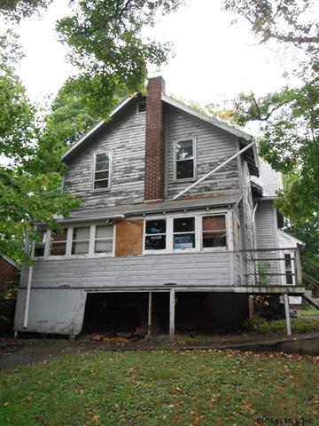
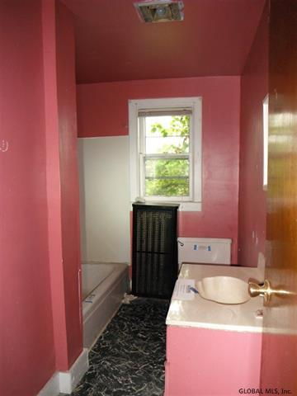
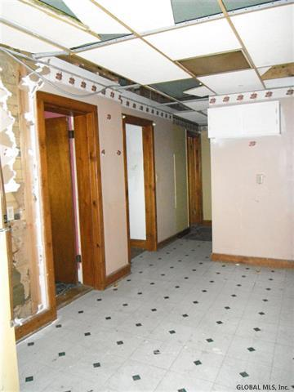
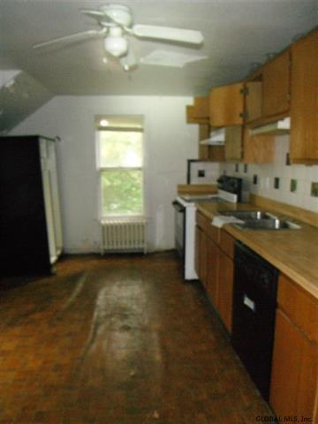
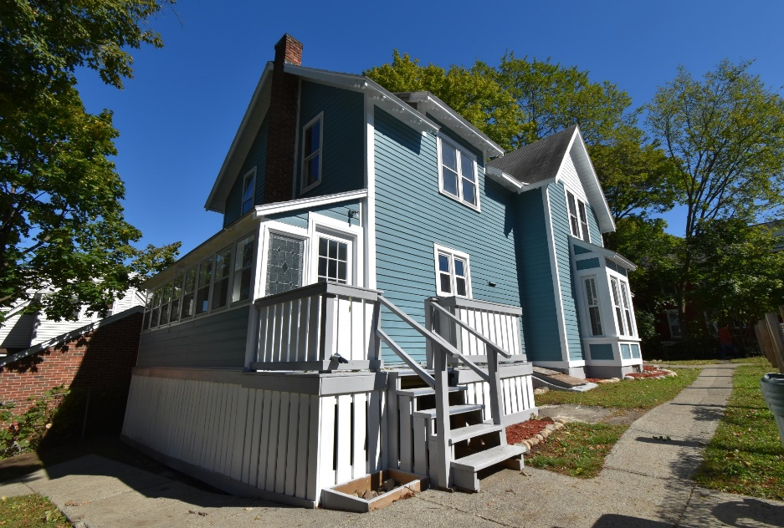
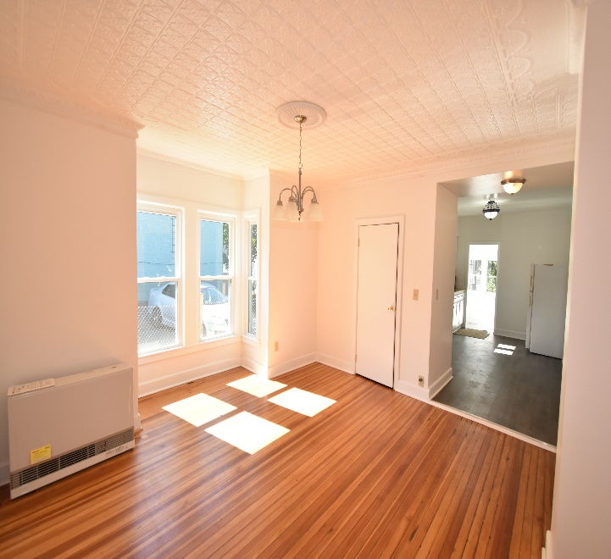
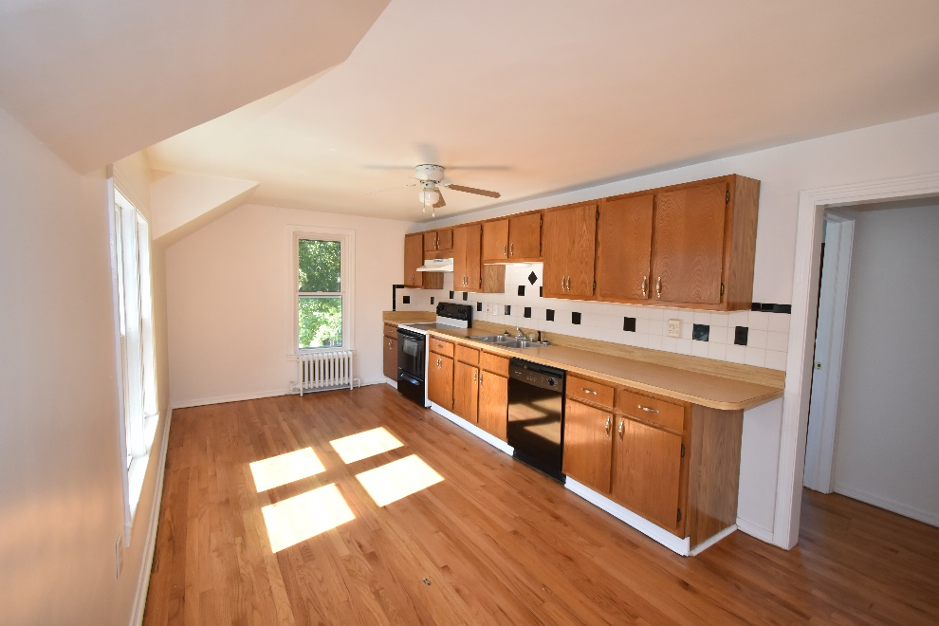
Before and After photos

Slide 28
17 Idlewild park SOS

Slide 29
Link below to review landlord and tenant law adopted affective 6/14/2019
NYS website
https://documentcloud.adobe.com/link/track?uri=urn%3Aaaid%3Ascds%3AUS%3Aad3cb21d-b049-4e63-9bf2-5368ad49c348
DOS Website
https://www.dos.ny.gov/licensing/pdfs/DOS-Guidance-Tenant-Protection-Act.pdf

Slide 30
NYS Court Help (Evictions & Small Claims) https://nycourts.gov/courthelp//
Evictions Outside of NYC
Foreclosure Process
Small Claim Filings
Collecting and Processing a Judgment
County Sherriff to Process Evictions

Slide 31
Cheat Sheet on Landlord, Tenant Protection Act.

Slide 32
14 Day Eviction Notice Also called the rent demand. This must be served by someone other than the owner.
1St Step

Slide 33
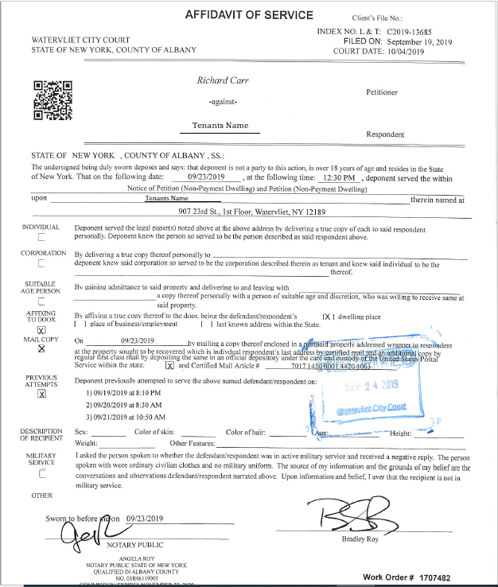
You must prepare your documents to evict a tenant, you can visit this website for help and written instructions for the entire procedure. This site works for all counties outside of NYC. Last Updated 6/14/2019
This site is 100% FREE
https://www.nycourts.gov/courthelp/Homes/evictions.shtml
A.B Roy Process
Rent Demand delivered by a process server

Slide 34
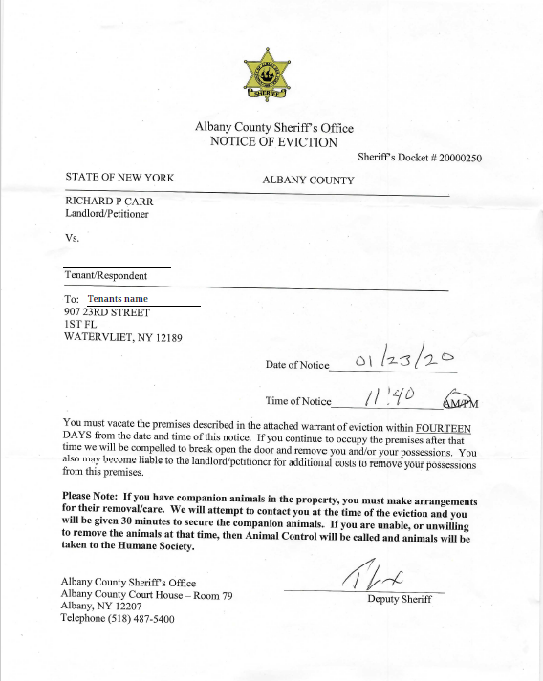
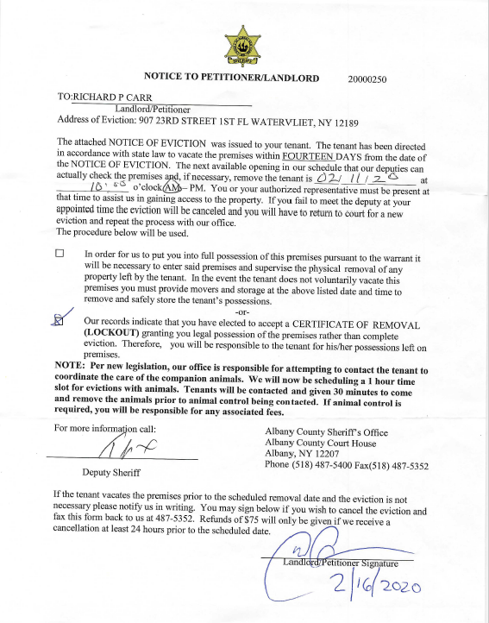
Notice of eviction after you get the judgement from the city or town judge.

Slide 35
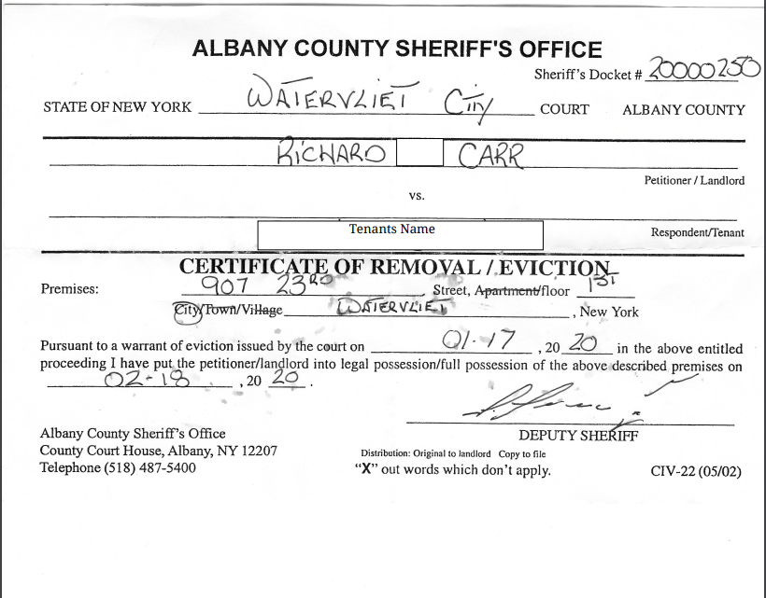
Once the sheriff serves the tenant and allows 14 days for the tenant to move, you can then proceed with the sheriff lock out if the tenant did NOT move out within the 14 day waiting period.
When the sheriff does arrive he will give you a Certificate of Removal / Eviction. This is your opportunity to change all locks and the tenant will no longer have legal rights to the property.

Slide 36
Class exercise Investment properties Versus 401K plans or the stock market
Stocks, mutual fund, or 401K investment plans have the ability to compound the interest of an investment, were on the investment properties do NOT compound the net income or the interest, but has the ability to compound the appreciation over the years of ownership. Both forms of investments have there share of pro’s and con’s.
Compound interest is the addition of interest to the principal sum of a loan or deposit, or in other words, interest on interest. It is the result of reinvesting interest, rather than paying it out, so that interest in the next period is then earned on the principal sum plus previously accumulated interest.

Slide 37
Stock Market –Versus- Real Estate Investment properties
Like I mentioned in the previous slide stocks or 401K plans have the ability to compound the interest in any individual stock or 401K plan can generate.
Example-
In the previous slide I mentioned, 17 Idlewild Park, 3 family in Watervliet, NET $1,950 per month in positive cash flow, with that income you could invest in 401K plan or solo 401K plan. You will still have positive cash flow, but, now you can create another source for investing.
This property can generate enough income per month to live and pay bills on, and also offer to invest some of the proceeds in the stock market or other investment options.

Slide 38
This calculator shows that investing $5,000 per year, which is around $450.00 per month out of the net income from any investment property that you purchase, this is what we call diversified assets. https://www.calculator.net/401k-calculator.html?age=25&income=50000&balance=5000&contribution=10&ematch=50&ematchend=3&retirementage=65&lifeexpectancy=85&incomeincrease=3&rate=6&inflation=3&hideirslimit=0&type=1&x=63&y=20#top

Slide 39
DOING YOUR HOMEWORK ON A PROPERTY
Once You Find A Property You Would Like To Invest In Compare the neighborhood location. Understand the rental market.
Real estate is about location, location, LOCATION!
Declining neighborhoods are most likely more difficult to rent or sell.
Study the rental market in the area you wish to invest in.
If there is more than one property that needs repair, that falls in the category of possibly a BAD LOCATION.
Pick your location wisely or you might find it difficult to rent out when you have vacancies.
Location, benefits for the tenant include, proximity to shopping areas, highways, convenience stores, health care,
Bus line, fitness centers, playgrounds, dog parks. The more amenities there are for the tenant, the more attractive the location will be.

Slide 40
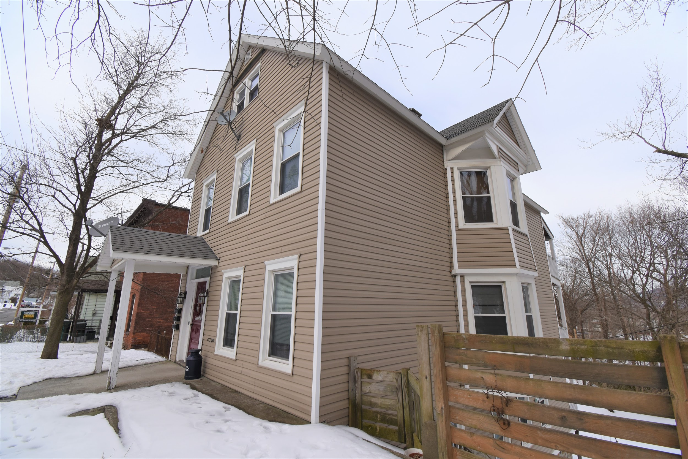
161 Central Ave, Cohoes - Triplex

Slide 41
161 Central Ave- Rent Roll
Purchased property in 2003 for $72,000
1st Fl. rent $800.00
2nd Fl. rent $775.00
3rd Fl. rent $750.00
Total gross rents $2,325.00
Monthly mortgage statement breakdown.
Principle - $279.71
Interest - $185.49
Escrow - $546.94 ( All taxes & insurance)
Current payment - $1,012.14
Monthly Net $1,312.86
This net figure doesn’t account for loss of rents to vacancies or repairs, utilities, marketing and advertising or attorney and court fees if any.
A quick evaluation: If a property can support itself with one unit vacant, that property would be considered a smart investment. It’s the owner or management company who ultimately determine a properties long term or even short term success.

Slide 42
161 Central Ave, Cohoes - Triplex
This property is one of my examples we will discuss for building wealth through real estate. I purchased this triplex home in 2003 for $72,000. I used FHA 3.0% down financing which the down payment came to $2,160. Closing cost consisted of an additional $6,900. Closing cost is calculated by the cost the financial institution charges you for acquiring the mortgage, this is called Origination fee. Which in this case was $1,475.00 I also escrowed the taxes and hazard insurance, the hazard insurance premium for the year was $875, and the school and property taxes were $3,900.00 combined.
Other closing cost consisted of appraisal fee, flood certification and PMI insurance. Private Mortgage Insurance is needed on all purchases when the buyer puts less than 20% down payment. Since this property is residential, I was able to use the tenant’s security deposits towards my closing cost, in theory this would go in a separate account to keep it from commingling with my personal money, but that is not required by law since it is considered residential. When financing through FHA (Federal Housing Authority) you are able to borrow additional money, up to 6 percent of the purchase price to use towards your closing cost, this is called a “Sellers Concession''. Remember the purchase price was 72,000, so 6% equaled $4,320.00, this was a credit to me, the (buyer). I was also able to use the security deposits and prorated amount of the rents all as a credit at closing. All credits equal to $6,640.00. My total out of pocket cost to purchase this triplex was $2,240.00. The first full month of collecting all rents equaled $2,200, my first mortgage payment of, principle, interest, hazard insurance and all taxes equaled $924.00 per month, my net after all bills were paid for the month was $1,090.00, this figure did NOT include repairs and maintenance expenses. Within 3 months my initial investment of $2,240 was paid back!

Slide 43
AFTER REPAIR VALUE (ARV)
ARV on 6 McelWain Ave Cohoes was $150,000.
That was my opinion of the property value once all the work was completed.
You figure this out by the comparable sales of the houses in the area / neighborhood, location, condition, amenities.
Once you know the ARV, you can begin to calculate cost of repair, as well as holding cost.
Take purchase price, repair cost, holding cost, Minus ARV and that net figure must be attractive enough to take all the risk. Every flip is unique.

Slide 44
Bank Foreclosure Single Family Rental 6 MCELWAIN AVE COHOES, Single family townhome
Potential monthly rent for a 3 bedroom single family $1,350-$1,650

Slide 45
KITCHEN (IN PROGRESS)

Slide 46
KITCHEN ( AFTER)

Slide 47
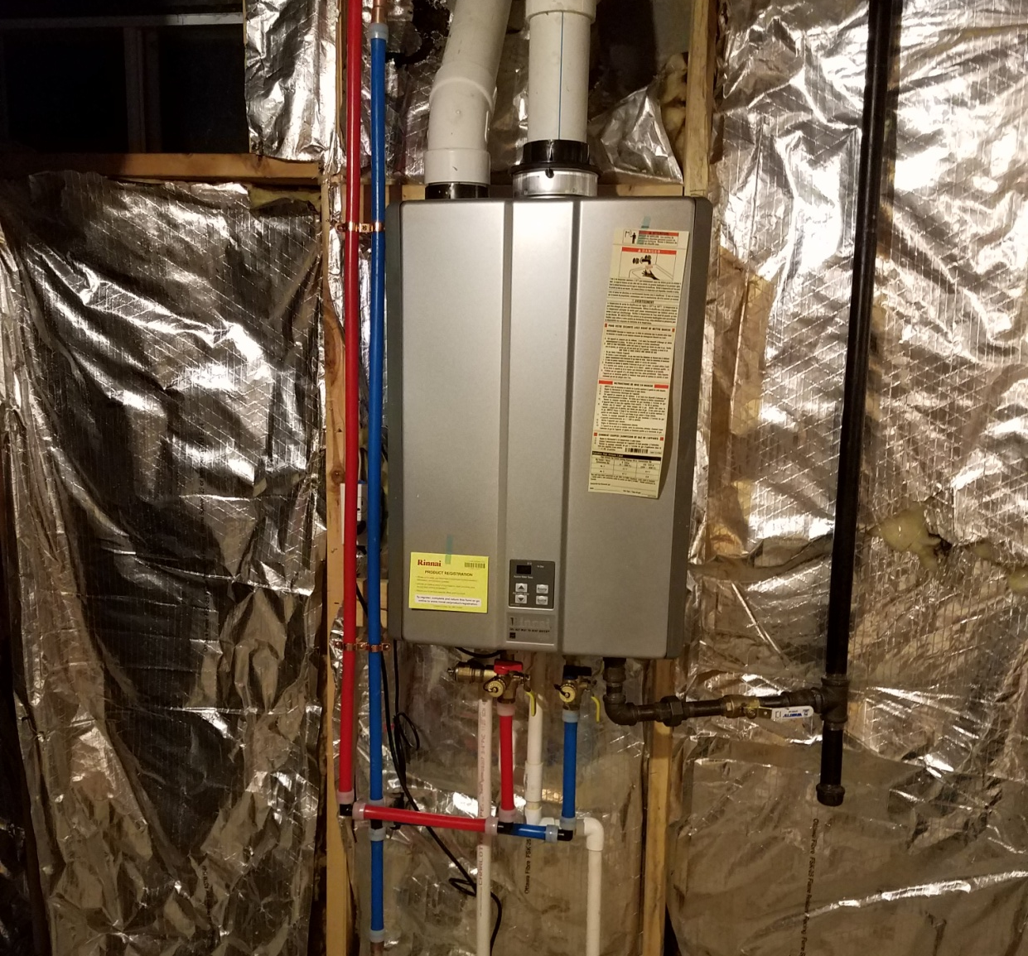
Tankless Water heater install

Slide 48
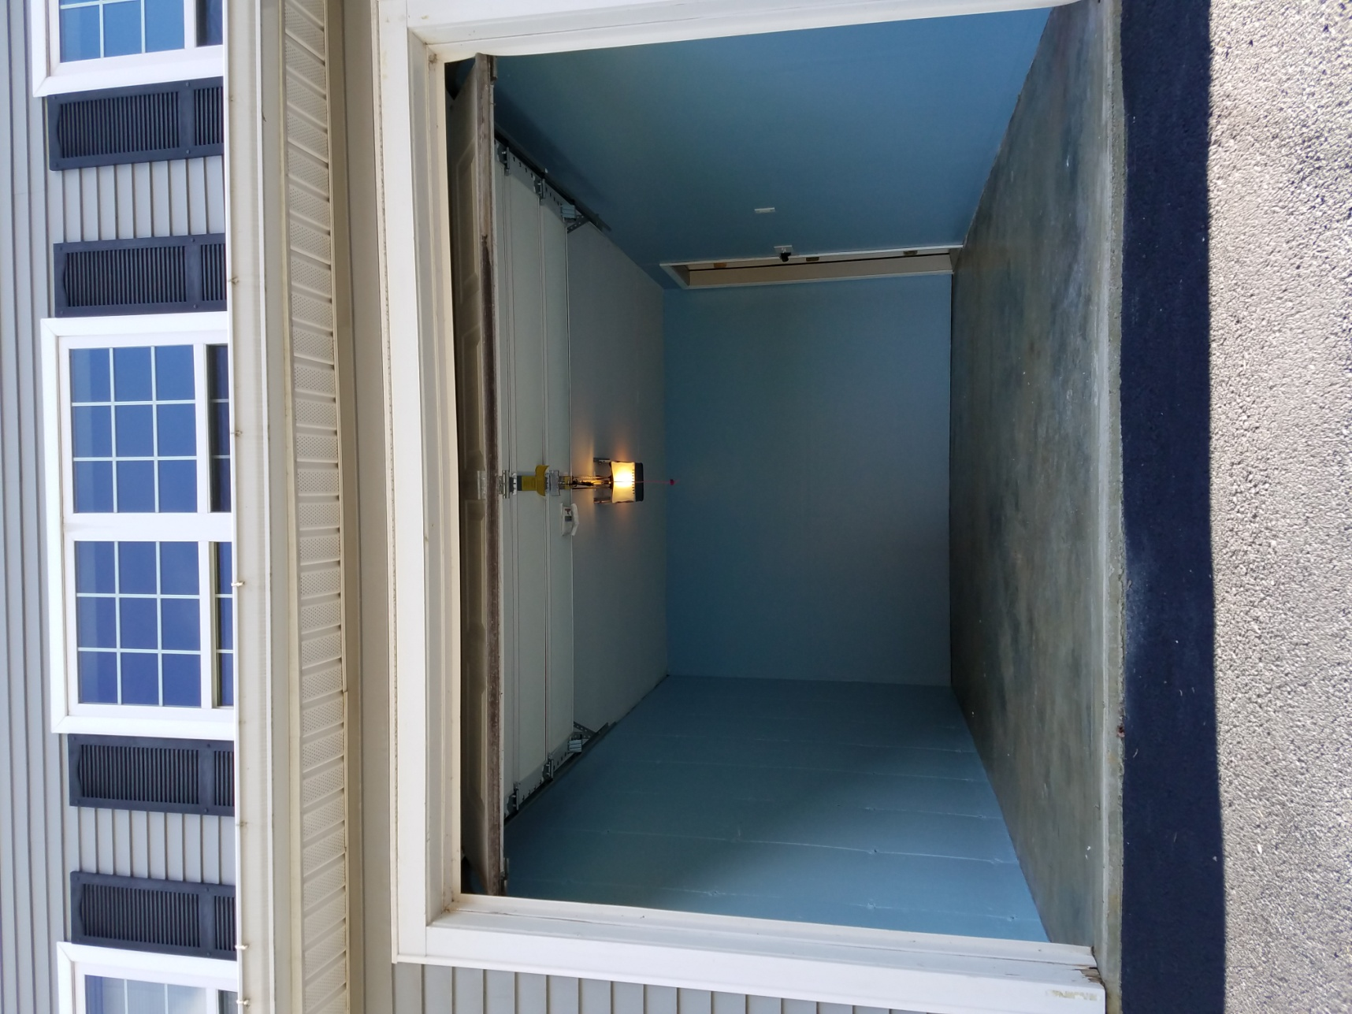
Garage & Basement Finished

Slide 49
6 MCELWAIN AVE COHOES
Purchased Property for $80,000 ( Homepath.com)
Repair cost $8,500
School and Property taxes prorated 3 months were $1,400 , Additional holding cost $300.00
Remodeled Kitchen, bathrooms, basement, electrical, garage, landscaping, and plumbing.
Property would rent for $1,500.00 monthly
Mortgage based on $95,000 -$995.00 Monthly escrowed
Estimated rental profit $525.00 (after water & sewer)

Slide 50
REPAIRS
Before you purchase a multi-family property
Walk through property multiple times.
Figure out what you can save from the materials and features that already exist in the house.
Try to save kitchens, bathrooms, doors, and moldings on most projects.
Very costly to replace, and require a lot of time to fix.
These items can be fixed or enhanced in some way to make them look better than they once appeared.
Saving these items can mean staying within budget.

Slide 51
Roof (before)

Slide 52
Roof (after)

Slide 53
Stair way (before)

Slide 54
Stairway (after)

Slide 55
POOL FILLED IN (AFTER)

Slide 56
Single Family Investment 908 24TH STREET
Purchased property for $52,000
Totally gutted property down to studs
Total rehab cost $32,000
Total cost to hold property for 14 months $5,400, Including taxes, insurance, utilities.
Entire inside of building brand new
Lease to buy option $1,350 (Leased for 1 year)
Sold property For $130,000
Net proceeds
$40,600

Slide 57
908 23rd Street Watervliet
After this property was rehabbed, I offered the home to a family as a rent to own, giving cash back assistance to the buyer after 13 month rental period. I choose this option because the property was situated alongside railroad tracks, which would have made it a difficult to sell. Rent to own options are very attractive to many buyers. The reason this option is so popular is because these individuals can afford to buy a house, but credit is usually the reason they are set back a year or two or longer until they can repair their credit, or fix the situation the prevented them from getting financing.

Slide 58
Rent to Own Option
908 24th Street, Watervliet
Purchase price, holding cost and total rehab cost was $90,000
Total taxes $3,800, property insurance $985.00
Total mortgage amount escrowed $945.50 -30 Yr. Fixed rate Mortgage
Rent to own option, monthly rent to potential buyer $1,350
Net income $405.00 per month after all expenses.
$2,500 was given to the buyer for down payment assistance to purchase this property after the 13 months of rent to own.
During the 13 months of the rent to own option the tenant paid $17,550
Of the $17,550, I rebated the tenant back $2,500 to use for closing cost.
The property still produce $4,000 net income.
Buyer purchased the property for $130,000 net proceeds were $35,000 After all expenses.

Slide 59
908 24TH STREET DEED

Slide 60
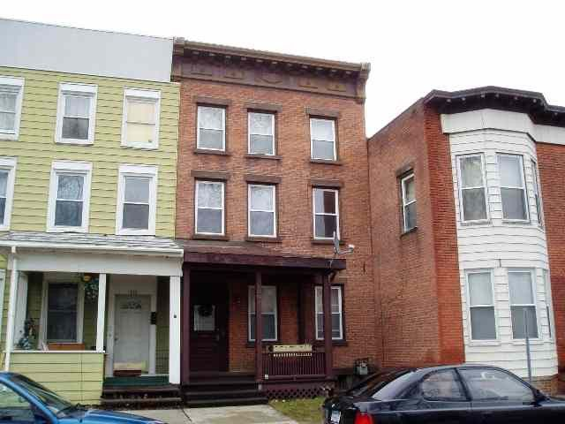
Purchased property for $79,000 (in 2005) 1608 3rd Ave 6 bed’s 3 bath’s Weekly room rental, each room rented for $100 per week, average $3,000 per month, $2,100 Cash Flow! Plus Coin op-laundry for additional $200 per month.
Property taxes $1,130
School taxes $1,150
Insurance $825
Water & Sewer $650

Slide 61
Weekly Room Rentals
Weekly bedroom rentals are very popular in all the major cities throughout the Capital Region, but check local code enforcement rules to make sure your property qualifies to allow more then 4 unrelated people to live into one single family home or, one apartment depending on number bedroom's and square footage the home has.
Visit https://www.nysenate.gov/legislation/laws/RPP
For more information on the number of tenants allowed in one apartment or single family dwelling.

Slide 62
1410 1ST AVE WATERVLIET (BEFORE)

Slide 63
1410 1ST AVE WATERVLIET
Purchased property for $37,000
Total all repairs cost $ 45,000
Rehabbed 80% of entire 4 store building
Additional holding cost for 13 months $4,500
Taxes & utilities
Possible Monthly Rent $1,450
Sold property for $159,000
Net proceeds
$64,500

Slide 64
SCOPE OF WORK
1410 1st Ave
Needed extensive brick foundation work, Over 2 months full time with a mason.
I found a mason on craigslist, He (Tony) was laid off from his union job, and he worked for me for $12.00 per hour, as a misc. 1099 employee.
When you are buying and selling properties you must try and find quality cheap labor (It does exist)! Tony ended up working for me for an additional 8 months until he went back to his previous job.

Slide 65
OLD KITCHEN

Slide 66
NEW KITCHEN

Slide 67
3rd FLOOR OFFICE (BEFORE)

Slide 68
3rd floor office (After)

Slide 69
1410 1ST AVE DEED

Slide 70
Holding multi-family properties for investment, and knowing when to sell.
Let's say you purchased a rental property 1-4 unit residential investment. One question I’m asked often is how long do I keep the rental property for? What’s the exit strategy? I often tell my clients, first look at the gross rental income, 2nd all the expenses of ownership. Then we need to figure out the net income of the property to see how marketable this property is, and has been. We all want to pay attention to all the major repairs on the home and the life expectancy of those items. The items I’m referring to are, the roof, heating & cooling systems, kitchens & baths, foundation, appliances, flooring, windows, electrical & plumbing. Keeping the property in good mechanical repair will allow you to capitalize on its full earning potential during the rental day’s of ownership, and when it comes time to sell it. I personally sell my properties once the major’s reach their halfway point of their useful life. I generally do this because I can capitalize on the properties full potential, meaning, once I purchase a multi-family I do many general and major repairs, so my rents can be at or above market, also when it’s time to sell its very marketable do to the property being in great condition.

Slide 71
Debt Service To avoid Capital Gains Tax
Flip / Refinance, (Cash out) the property to a LLC owned by the property owner to create weekly rental income through these channels AirbNb, VRBO Hometogo, Flipkey, ADKbyowner, Adirondack.net.
Holding the property as an investment property to rent weekly versus monthly makes this home an ideal investment property.
Holding as investment property avoids all Capital Gains tax while you own the property.

Slide 72
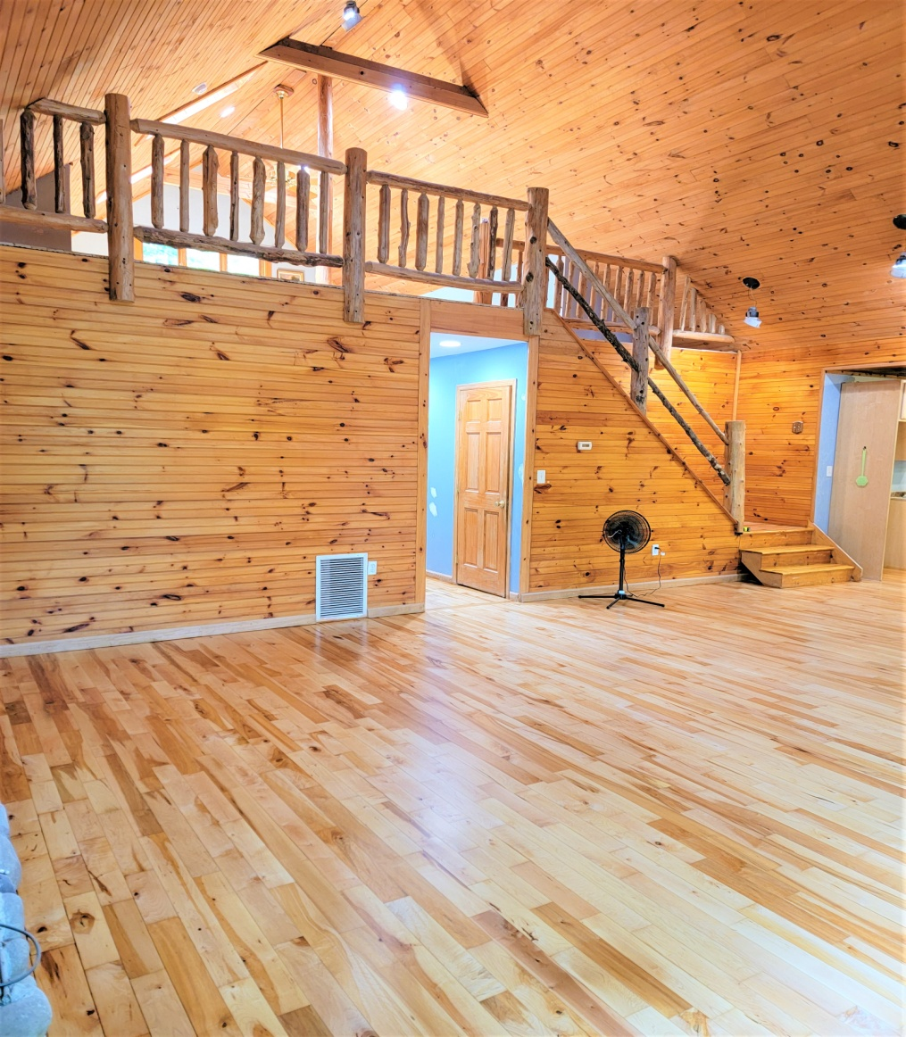
Flip to LLC Company for Debt Service. To Rent Weekly or Monthly?
9 Hemlock Drive, Schroon Lake, NY 12870

Slide 73
9 Hemlock Dr. Schroon Lake Weekly Rental Or Flip?
Purchased this property off the MLS -$145,000 03/04/2022
Closing cost $2,700
New appliances $7,500
New Roof 50 Year $18,800
Land Clearing (100 trees +/-) $14,200
New Crusher run driveway $2,500
Hardwood floors refinished $6,800
Trex decking materials (1000 sq ft) $14,500
New- York 2 stage 96% Furnace & A/C $5,700
New master bath shower enclosure $8,700
New Granite counter tops $7,500
New Wood Fireplace $6,500
All repairs and materials to date $95,400 10/01/2022

Slide 74
9 Hemlock Drive, Schroon Lake
Purchased off the MLS 03/04/2022 $145,000
4 Offers place- Got outbid 3 times
Property losses value each time it comes BOM
Took 5 months to evict the tenant occupying.
Total Repairs $95,400 –Expecting to spend $130,000
Holding Cost $10,800 (during repairs)
ARV estimated $475,000 - $600,000
Total Potential Net Proceeds $295,000

Slide 75
IRS Form 4562- Depreciation & Amortization
The list of benefits of owning investment properties
Lowering your taxable income (Reducing your tax obligation)
Appreciation
Forced Appreciation
Leverage (Cash out, line of credit, Mortgage)
Depreciation (Residential 27.5 Years)
Income producing (Cash Flow)
Wealth building (Passive Income)
Security (Create a Side Hustle or fulltime)
Entrepreneur (Be your own Boss!) ETC…..

Slide 76
MUNICIPALITIES PERMITS Code Enforcement
Permits are needed on all major changes that are made to the property. Individual permits are needed for:
Major construction floor plan change
Insulation (new walls)
All electrical
Water heaters
HVACs
All roofing
All siding
All foundation work
These permits are necessary at all stages of completion. Without permits it would be very difficult to obtain a COC, (Certificate of Occupancy).

Slide 77
MUNICIPALITIES PERMITS
Certificate of Occupancy
CO is needed to RENT or to sell the home once it is completed.
CO, states to the consumer (home owner or tenant) the property is free and clear of defects and is safe and up to code to occupy, to the best of their knowledge.
Most buyers will get a home inspection as well, its up to the homeowner ( buyer) to complete their due diligence.
Check with you local municipality to determine what permits are necessary for you to obtain and at what stages to apply for those permits.

Slide 78
SUMMARY
Bank Owned (REO) Properties
Check all taxes and liens.
Determine Repair Cost
Figure out what will be replaced, fixed and rehabbed.
Remember to always estimate repair cost higher.
Determine the Scope Of Work
Determine your order of repairs.
Determine timeline and expected completion date.
Your ARV (After Repair Value) MUST be Determined Before You Purchase Any Property.

Slide 79
SUMMARY
Once You Find A Property You Would Like To Invest In check the area rental market (Compare the neighborhood location.)
Pick your location wisely.
Once you know the rental market, you can begin to calculate cost of ownership, as well as , and CAP Rates. Pro-Forma calculations should be made on the property of interest. Ask owner for the tax schedule (E) on the property of interest to verify annual rental income.
Before You Start Any Fix & Flip Project or Multi-family investment property.
Figure out what you can save from the materials and features that already exist in the house.
You must try and find quality cheap labor. Also determine if you or a handyman will take care of the rental property.

Slide 80
SUMMARY
Permits are needed on all major changes that are made to the property
Certificate Of Occupancy (CO) is needed RENT and to sell the home once it is completed.
Most homeowners will want an inspection as well.
It’s the buyer / home owners job to complete their due diligence.
Auctions
Normally all auctions are paid in cash within 30 days of Auction being completed. Or you forfeit your 10% deposit.

Slide 81
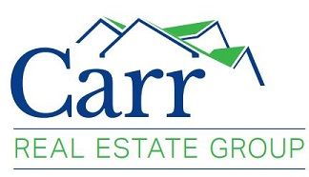
Multi-Family Investment Property
Find FREE downloads at
www.CarrRealEstateGroupllc.com

