Slide 1
Pretreatment importance to operational efficiency & savings
Focus on asset preservation & chemical increased efficiency

Slide 2
What does a water softener do?
Water softening is the removal of calcium, magnesium, and certain other metal cations in hard water. The resulting soft water requires less chemical for the same cleaning effort, as chemical is not wasted on calcium ions. Soft water also extends the lifetime of plumbing by reducing or eliminating scale build-up in pipes and fittings. Water softening is usually achieved using ion-exchange resins.

Slide 3
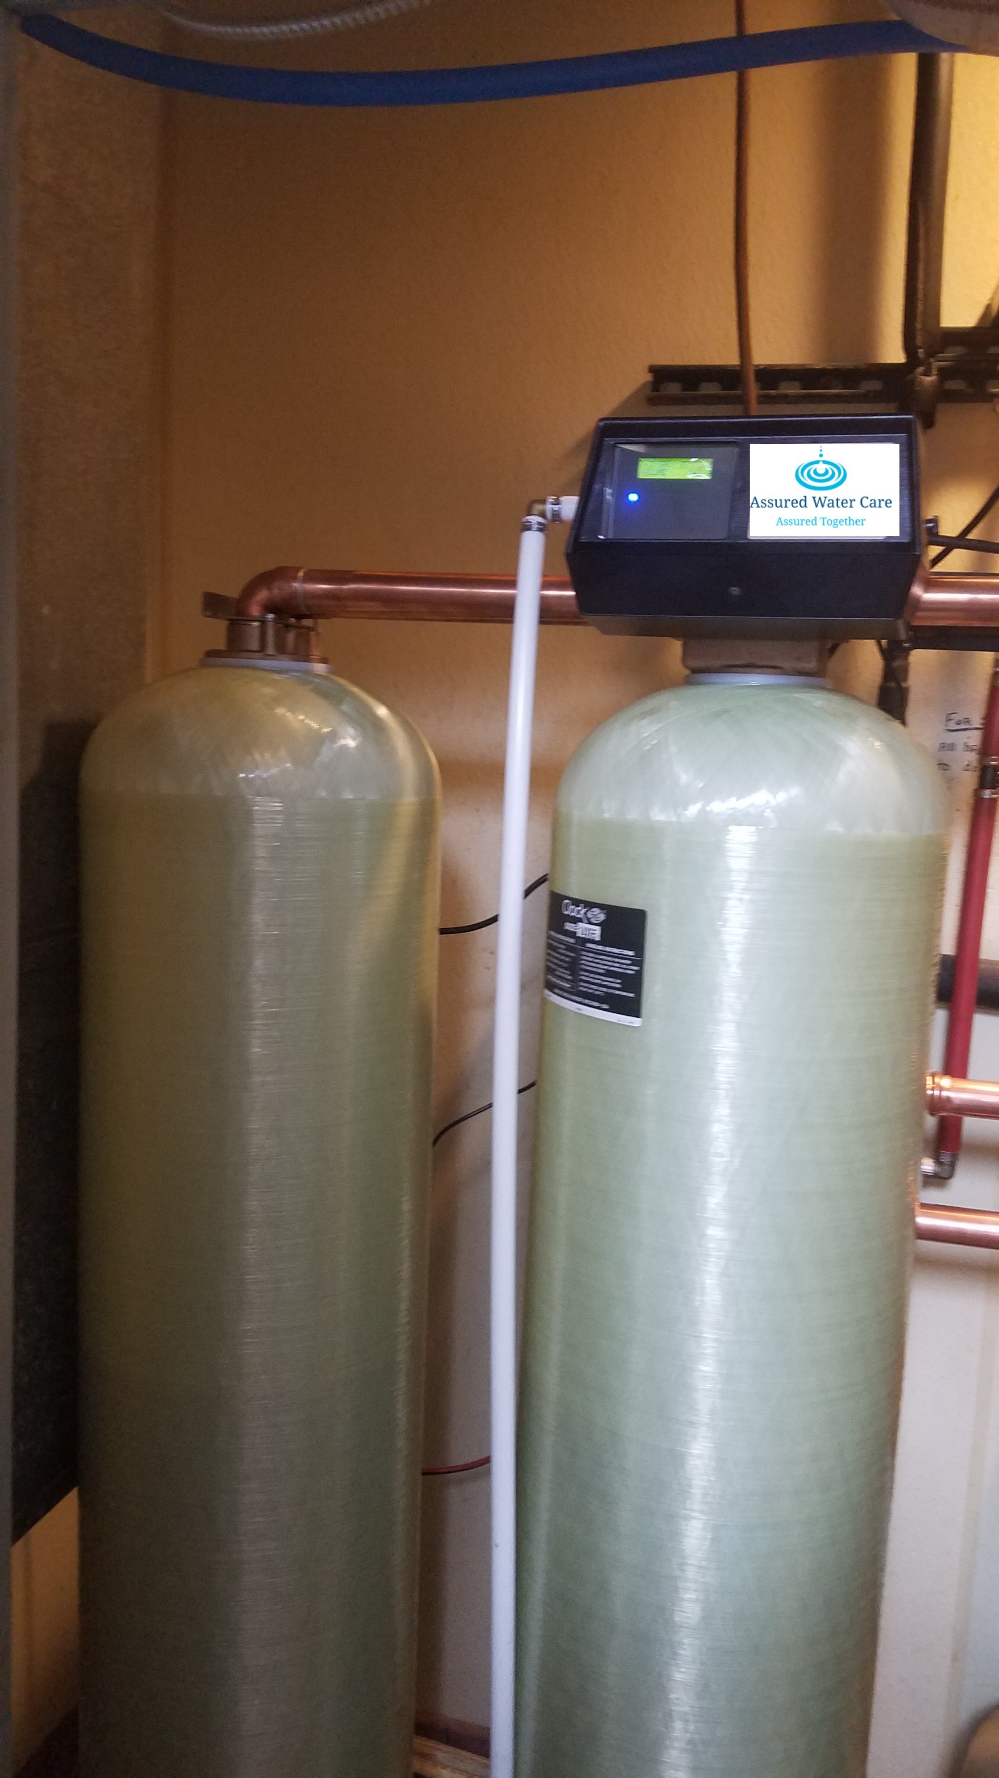
Water usage
The thermal efficiency and longevity of the cooling tower and equipment depend on the proper management of recirculated water. Water leaves a cooling tower system in one of four ways.
Evaporation
Drift
Blowdown
Leaks & overflows

Slide 4
Water replacement
From a water efficiency standpoint, you want to maximize cycles of concentration. This will minimize blowdown water quantity and reduce make-up water demand. However, this can only be done within the constraints of your make-up water and cooling tower water chemistry. Dissolved solids increase as cycles of concentration increase, which can cause scale and corrosion problems unless carefully controlled.

Slide 5
Rendering feed water non-scaling
Use of softened water immediately reduces the scale potential of the cooling water, rendering it non‑scale forming, if maintained, while typically eliminating further need for pH control via feed of corrosive, dangerous-to-handle acids.

Slide 6
Increased cycle of concentration issues
Unfortunately, increased COC also increases the concentration of hardness ions in the cooling water, making the cycled waters highly scale forming Formation of hardness scale in heat exchangers is unwanted, as even a small amount of scale will decrease the efficiency of heat transfer, resulting in increased power consumption for chiller operation and decreased productivity in industrial processes. In severe cases, scale can completely plug heat exchangers and piping.

Slide 7
Soft water conserves water & reduces operating cost
The purpose of a cooling tower is to conserve water. Cooling towers fulfill this purpose by rejecting waste heat to the atmosphere by evaporative cooling and then recycling the water back to the point of heat exchange where the cycle is repeated. As this process of evaporation and recycling continues, the cooling tower builds cycles of concentration.
Cooling tower bleed (BD) is used to control and limit the cycles of concentration. Water lost by evaporation (E) is the other component of water consumption. The makeup (MU) demand is, therefore, the sum of the evaporation (E) plus the bleed (BD).
Makeup (MU) = Evaporation (E) + Bleed (BD) (1)
Cycles of Concentration (COC) = Makeup (MU) / Bleed (BD) (2)

Slide 8
Costs of operation
Cooling tower blowdown is often the major water use in many facilities, as all blowdown from cooling tower operation must be replaced with fresh makeup water. Blowdown carries three costs
purchase price of the water
a sewerage charge for disposal
cost of water treatment chemicals.

Slide 9
Soft water conserves water & reduces operating cost
From these relationships we see that decreasing the bleed rate increases the cycles of concentration, which reduces the makeup demand. That is to say, increasing the cycles of concentration reduces water consumption.
As discussed previously, calcium hardness limits the cycles of concentration because of the limited solubility of calcium carbonate under high alkalinity and pH conditions. Softening the makeup removes this limitation and allows the tower to safely operate at maximum cycles.

Slide 10
Chemical & mechanical treatment working in tandem
Cycled soft water is more corrosive than hard water as the levels of all corrosion-promoting constituents are increased by factors of two to 15+ times. In particular, higher levels of chloride and sulfate increase the corrosivity of the cooling water. The water management program, therefore, must provide superior corrosion-control chemistry.

Slide 11
Soft water conserves water & reduces operating cost
For towers operating on soft water makeup, the total wastewater discharge is equal to the tower bleed plus the wastewater generated from the regeneration of the softeners. Ion exchange softeners typically recover 93.6% of the raw feedwater as product. That is to say that 6.4% of the softener feedwater is sent to drain during the regeneration cycle. Despite the softener wastewater flow, the total fresh water makeup requirement is reduced by 37% when using soft water versus hard water makeup.

Slide 12
Summary & conclusion
The use of soft water makeup for cooling tower operation offers several advantages over hard water makeup.
Soft water eliminates mineral scale deposits for “bare metal” clean heat transfer surfaces.
The natural carbonate/bicarbonate buffer produces a pH in the 9.2 to 9.6 range, which renders steel and other metals more passive and less prone to corrosion.
Soft water makeup reduces fresh water withdrawals resulting in a significant savings in water and wastewater.
Operating the tower on soft water helps control the growth of pathogenic organisms by maintaining the pH above the amplification range (pH > 9.2).
Overall, the use of soft water for cooling tower makeup helps protect the natural environment, saves energy, reduces operating costs and extends the useful life of plant equipment.

Slide 13
Water softener Regeneration steps
1. Backwash Cycle. The backwash cycle expands the resin bed from its settled and packed condition and cleans the resin by flushing out any suspended solids that may have been filtered during the service run. Resin particles can act as effective filter media because they have ionic charges, which can coagulate fine particles. During the backwash, the resin beads rub against each other, and this scrubbing action helps clean accumulated dirt or iron from the surface of the beads. The backwash flow also removes any broken resin particles or resin fines. In addition, the backwash cycle classifies the bed with the larger resin beads on the bottom and the finer resins on top. This provides the best conditions for a good uniform flow of brine, rinse and service.
It is desirable to expand the softener resin bed about 50% and to have the duration of the backwash cycle long enough to effectively remove all of the resin fines and other suspended solids. At ambient temperatures (about 60°F), using standard softening cation resin and a flow rate of 6 gpm per square foot of surface area for a duration of 10 to 15 minutes is sufficient. It is very important to consult manufacturers’ literature for the specific resin being regenerated to find the correct backwash flow rate. The backwash flow rate is dependent on temperature; cooler water expands the bed more than warmer water.

Slide 14
2. Brine Introduction. Sodium chloride is used as the regenerant chemical for converting exhausted softener resin back to the sodium form. The resin exchanges the collected hardness on the bead with the sodium ion present in the sodium chloride. It is applied to the bed at a concentration of 8 to 12%; usually, 10% is the norm. A contact time of 30 minutes is desirable. The total contact time is calculated from the time the brine is introduced to the bed until it is displaced from the bed during the slow rinse. Salt dosage range is 6 to 15 lb per cubic foot.
3. Slow Rinse. The slow rinse or displacement step removes from the bed the volume of brine regenerant that is still in the vessel. This is the most-pure brine that the resin will come into contact with, so it is important not to flush it out too quickly. During the slow rinse cycle, the valve from the concentrated brine is shut, and only the dilution water is introduced to the bed at the dilution water flow rate. It helps if the dilution water and the slow rinse water are from a softened water supply.
4. Fast Rinse. The final step is a fast rinse, and it is performed at the service flow rate. The fast rinse step removes any residual brine from the resin beads and helps flush out any brine that may be present in dead areas of the tank. The minimum recommended flow rate is 1 to 1.5 gpm per cubic foot.

Slide 15
Water softener capacities
Common dosages & capacities
06 lb/ft³: 20,000 grains/ft³ capacity
10 lb/ft³: 25,000 grains/ft³ capacity
15 lb/ft³: 30,000 grains/ft³ capacity
Capacities theoretical -- actual capacity may vary.
Salt dosages must be high enough to force multi-valent ions from exchange sites & allow sodium to takes its place
Higher salt dosage ⇨ More efficient regeneration ⇨ Lower effluent hardness
Law of diminishing returns
Increasing salt dosage > 15 lb/ft³ will result in only marginal capacity gains

Slide 16
Water softener types
Time-based regeneration
Simple & Inexpensive
Regenerates at a set day/time
Drawback: Regenerates independent of demand (too soon/late)
Ideal Applications: Single shift & constant volume
Volume-based Regeneration
Water meter (included) measures flow
Regenerates at set volume (gallons) of water treated
Switches tanks to provide uninterrupted water supply
Ideal Applications: 24/7 operations & variable flow rates
Potential drawback: Simplex unit may regenerate at ‘bad’ time

Slide 17
Water softener basic sizing
[437 ppm] ÷ [17.1 ppm/grain/gal] = 25.56 grains/gal
[25.56 gr/gal] × [32 gal/min] × [1,440 min/day] = 1,177,805 gr/day
From Data Sheet: 10 lb/ft³ = 25,000 grains/ft³
[1,177,805 grain/day] ÷ [25,000 grains/ft³] = 47.11 ft³/day
Vessel regenerations per day = 1
Determine vessel configuration
Simplex: [47.1 ft³/day] ÷ [1] = 47.1 ft³
What if we could live with 2 vessel regenerations per day?
[47.1 ft³/day] ÷ [2] = 23.55 ft³
Simplex; Twin; Duplex

Slide 18
