Slide 1
East Central Kansas CDDO
WELCOME!
Behavior Workshop
July 25, 2023

Slide 2
Better understanding of: What Behaviors are Why tracking them is important Understanding the behaviors How do we track them
Behavior Training

Slide 3
What are behaviors?
Definition: The way in which one acts or conducts oneself, especially toward others.
Behavior that is not acceptable by the norms of society, for the particular setting, are considered to be socially unacceptable.

Slide 4
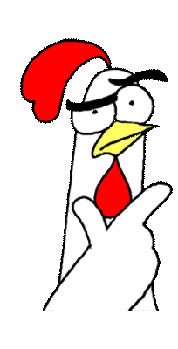
Recognizing Behaviors
Behaviors must be intentional and/or deliberate.
Is it a behavior?
Are they all bad?

Slide 5
What’s the point?
HCBS waiver eligibility requirement
Emotional/ physical wellbeing

Slide 6
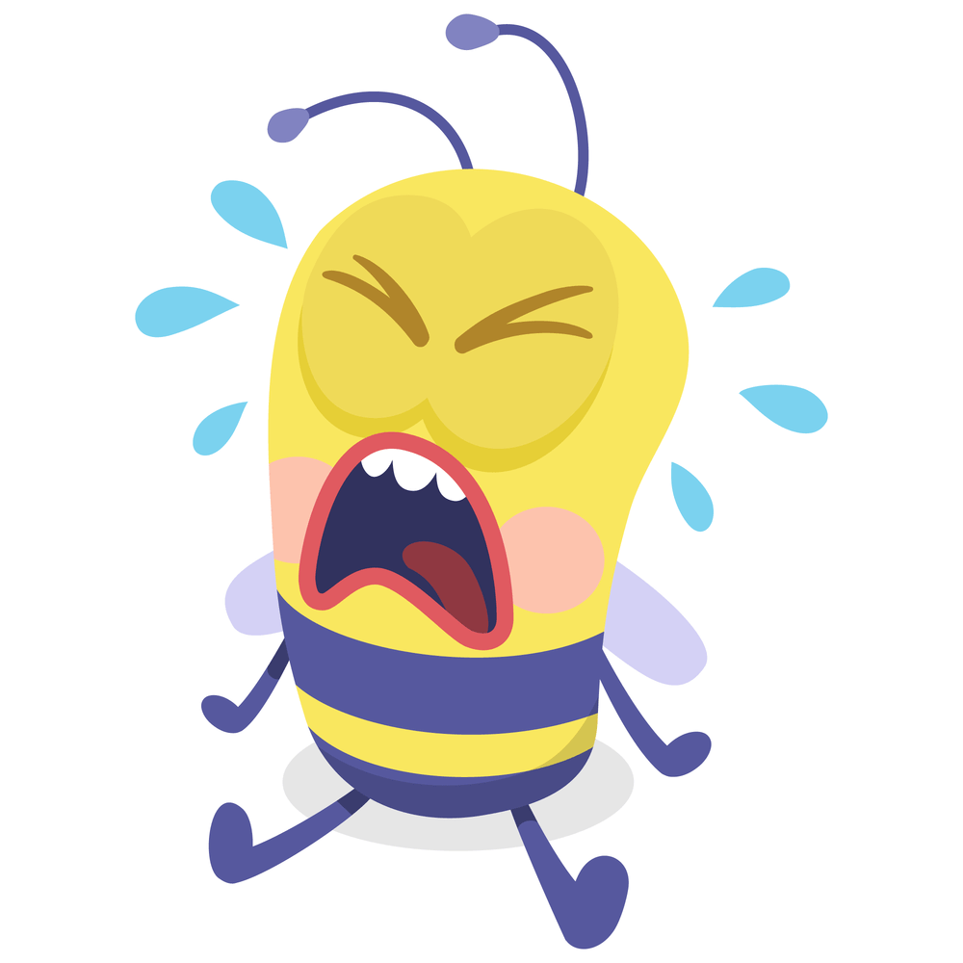
Definitions
Has Tantrums or Emotional Outbursts
Combination of 2 or more; screaming, crying, banging on the walls, doors, etc.

Slide 7
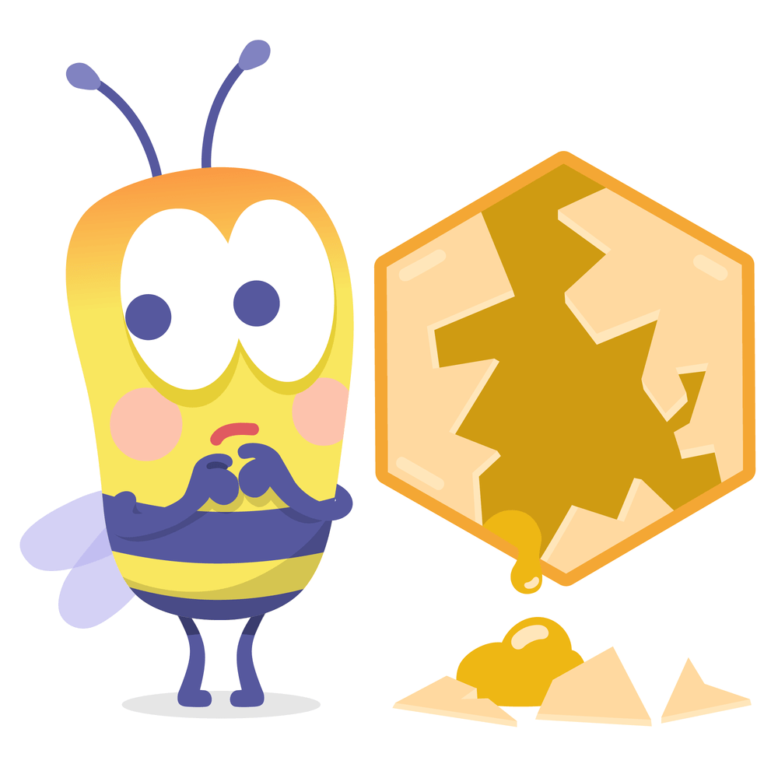
Definitions
Damages Own or Other’s Property
Deliberately breaking, defacing, or destroying things by, hitting, tearing, cutting, throwing, burning, marking, or scratching.

Slide 8
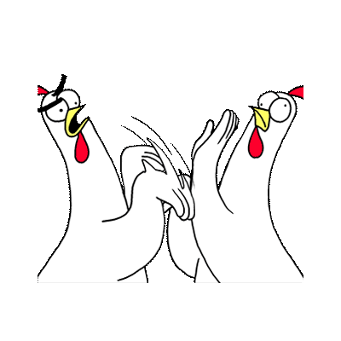
Definitions
Physically Assaults Others
Deliberately causing physical pain to other people or animals by hitting, kicking, biting, pinching, scratching, pulling hair, or striking with an abject.

Slide 9
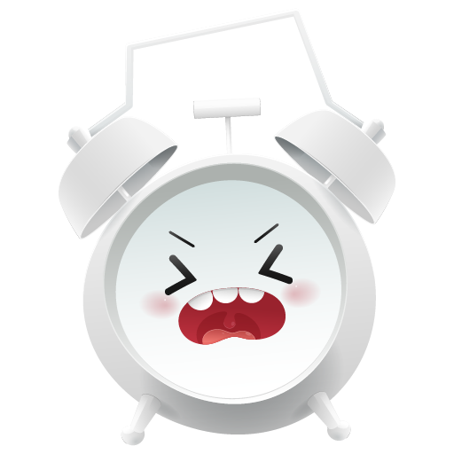
Definitions
Disrupts Other’s Activities
Interfering significantly with activities of others by clinging, pestering, or teasing, arguing, or complaining, picking fights, laughing or crying without reason, interrupting, yelling or screaming. Behavior considered to be beyond socially unacceptable.

Slide 10
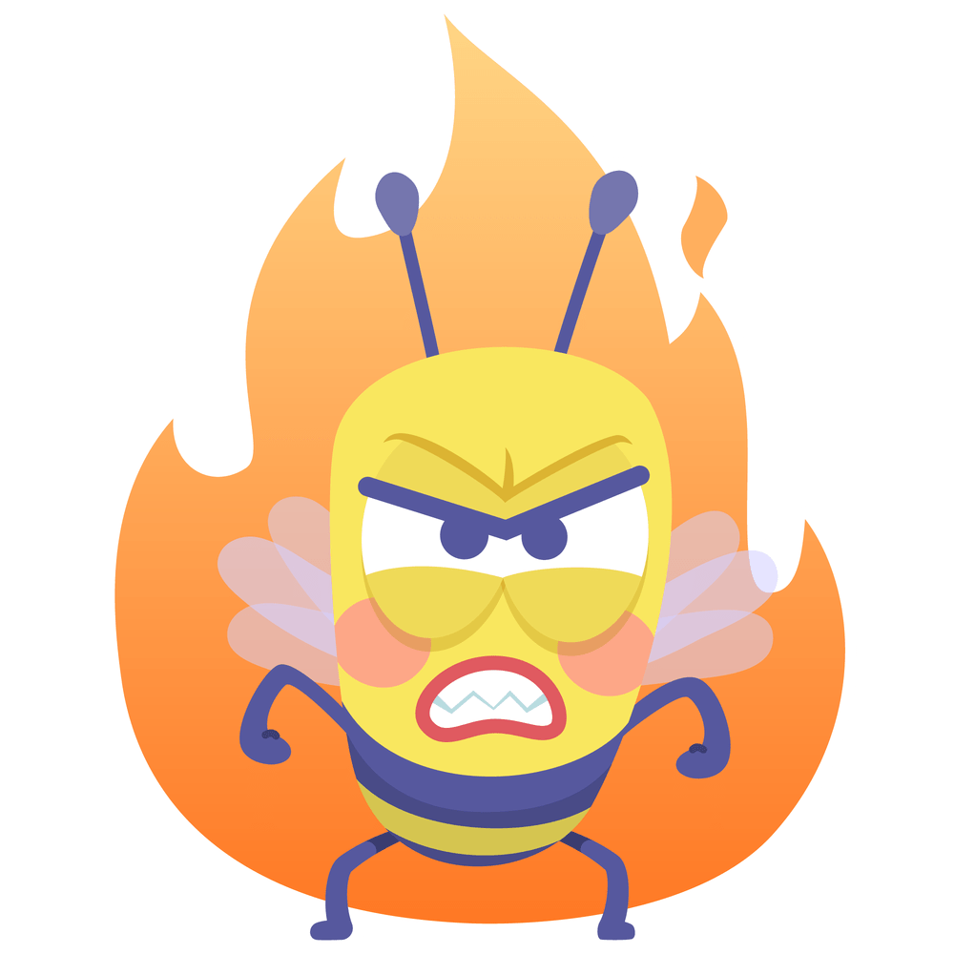
Definitions
Is Verbally or Gesturally Abusive
Swearing, verbal threats, name calling, obscene gestures, gestures indicate aggressive intent or threat. Behavior must be intentional/ deliberate, and the individual must intend to abuse others with their behavior.

Slide 11
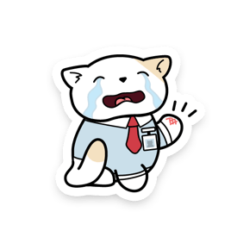
Definitions
Self-Injurious
Causing injury to your own body by, hitting, banging head, scratching, cutting or puncturing, biting, rubbing skin, pulling out hair, picking skin, removing scabs, chewing nails into the quick and causing them to bleed, damaging cuticles or nail bed, pinching self.

Slide 12
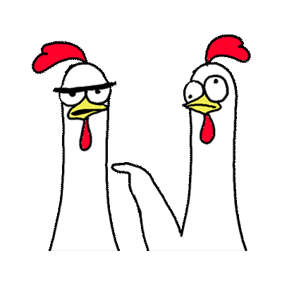
Definitions
Teases or Harasses Peers
Any behavior performed to deliberately annoy another person.

Slide 13
Definitions
Resists Supervision
Non-Compliant Behavior. Refusing to follow instruction. Decides not to do the task or needs to be asked multiple times.

Slide 14
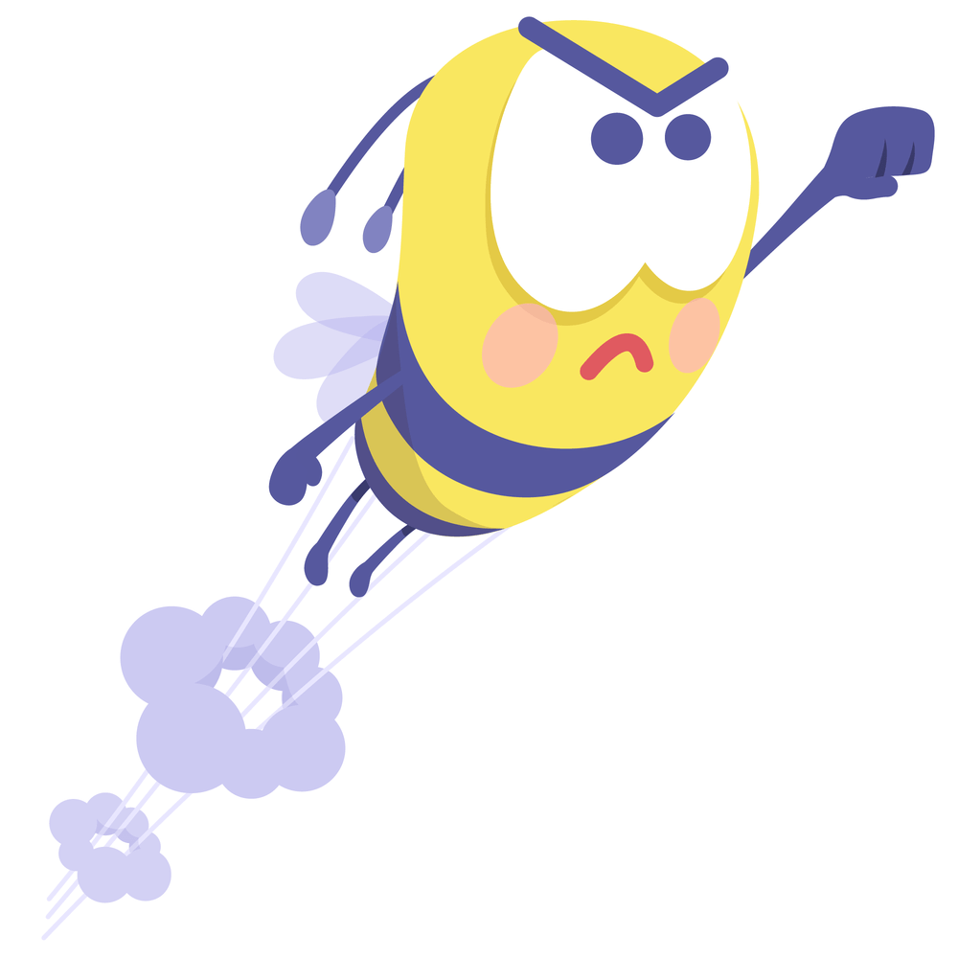
Definitions
Runs or Wanders Away
Repeatedly, deliberately or inadvertently leaves a program area, group activity and requires staff support to ensure the person's health and safety.

Slide 15
Definitions
Steals
Deliberately and intentionally taking the belongings; including food/ drink, from another.

Slide 16
Definitions
Eats Inedible Objects
Putting an object that is unfit to be eaten, into their mouth and swallowing/ ingesting the item.

Slide 17
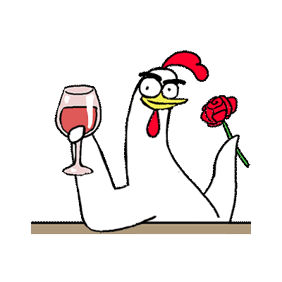
Definitions
Displays Sexually Inappropriate Behavior
Circle of support is not required to determine the intent of the person. Capture if the behavior is exhibited. Ex: hugging or kissing without permission, public undressing, inappropriate touching of self or others, etc.

Slide 18
Definitions
Smears Feces
Deliberately throwing or spreading bowel movement/ fecal matter.

Slide 19
How Do We Track Behaviors?
Tracking Sheet
Frequency and Severity Sheet

Slide 20
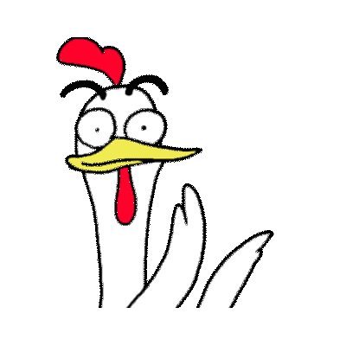
Thank You!
Questions? Comments?
Please feel free to reach out anytime
Jacqualynn Branch,
ECK CDDO Coordinator
JacqualynnB@eckaaa.org
785-242-7200

