Slide 1
A Story For All Ages The Cracked Pot A story about perfection As told by Friar News of St. Anthony’s High School YouTube channel: A Minute With A Monk

Slide 2
Notes:
Thank you Karen Costantino for sharing this story with us!

Slide 3
Let’s sing! This Little Light of Mine (p. 118)
Notes:
Eva and Eden are not feeling well today, so they are home resting. We hope they are feeling better soon, and their lights are shining bright again!
We are going to sing just the first and second verses of This little light of mine (page118 in the hymnal.)
Please stand as you are able. ☺

Slide 4
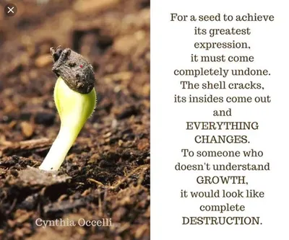
Notes:
This is the reading by Cynthia Occelli
Let’s pause to absorb and consider Ms. Occelli’s astute observation.
(1 minute, and then bell.)

Slide 5
Abundance flows from you,
And waters the path.
Thank you for the gift
Of your presence.
Breaking Bread
Written by
Randy L. George
Sung by Johnny Cash
Notes:
Song starts at 0:13
Taper out with volume (Fn/F3) if collection is done quickly.

Slide 6
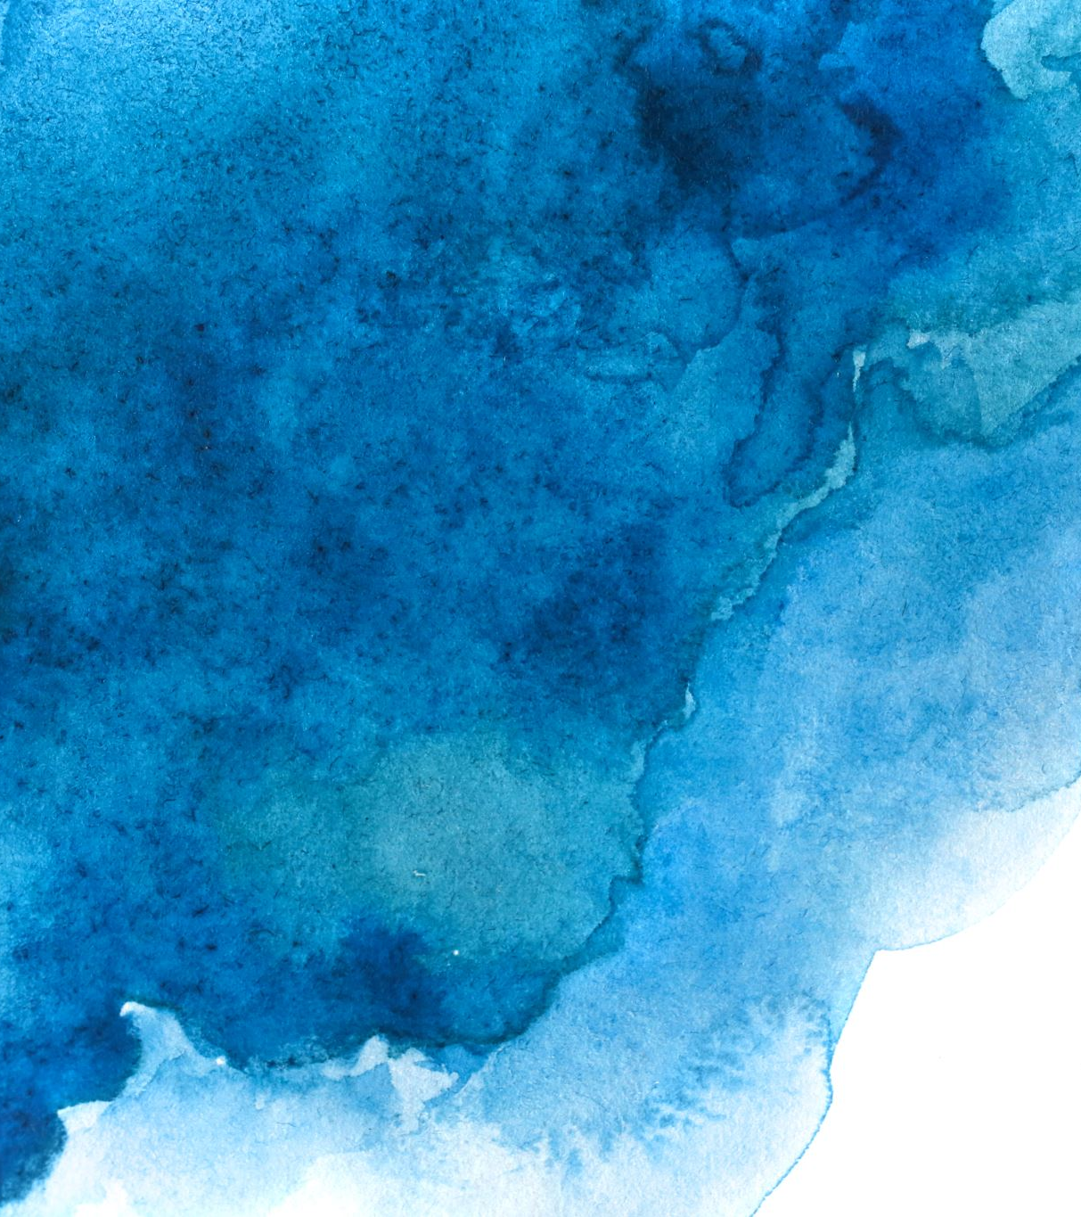
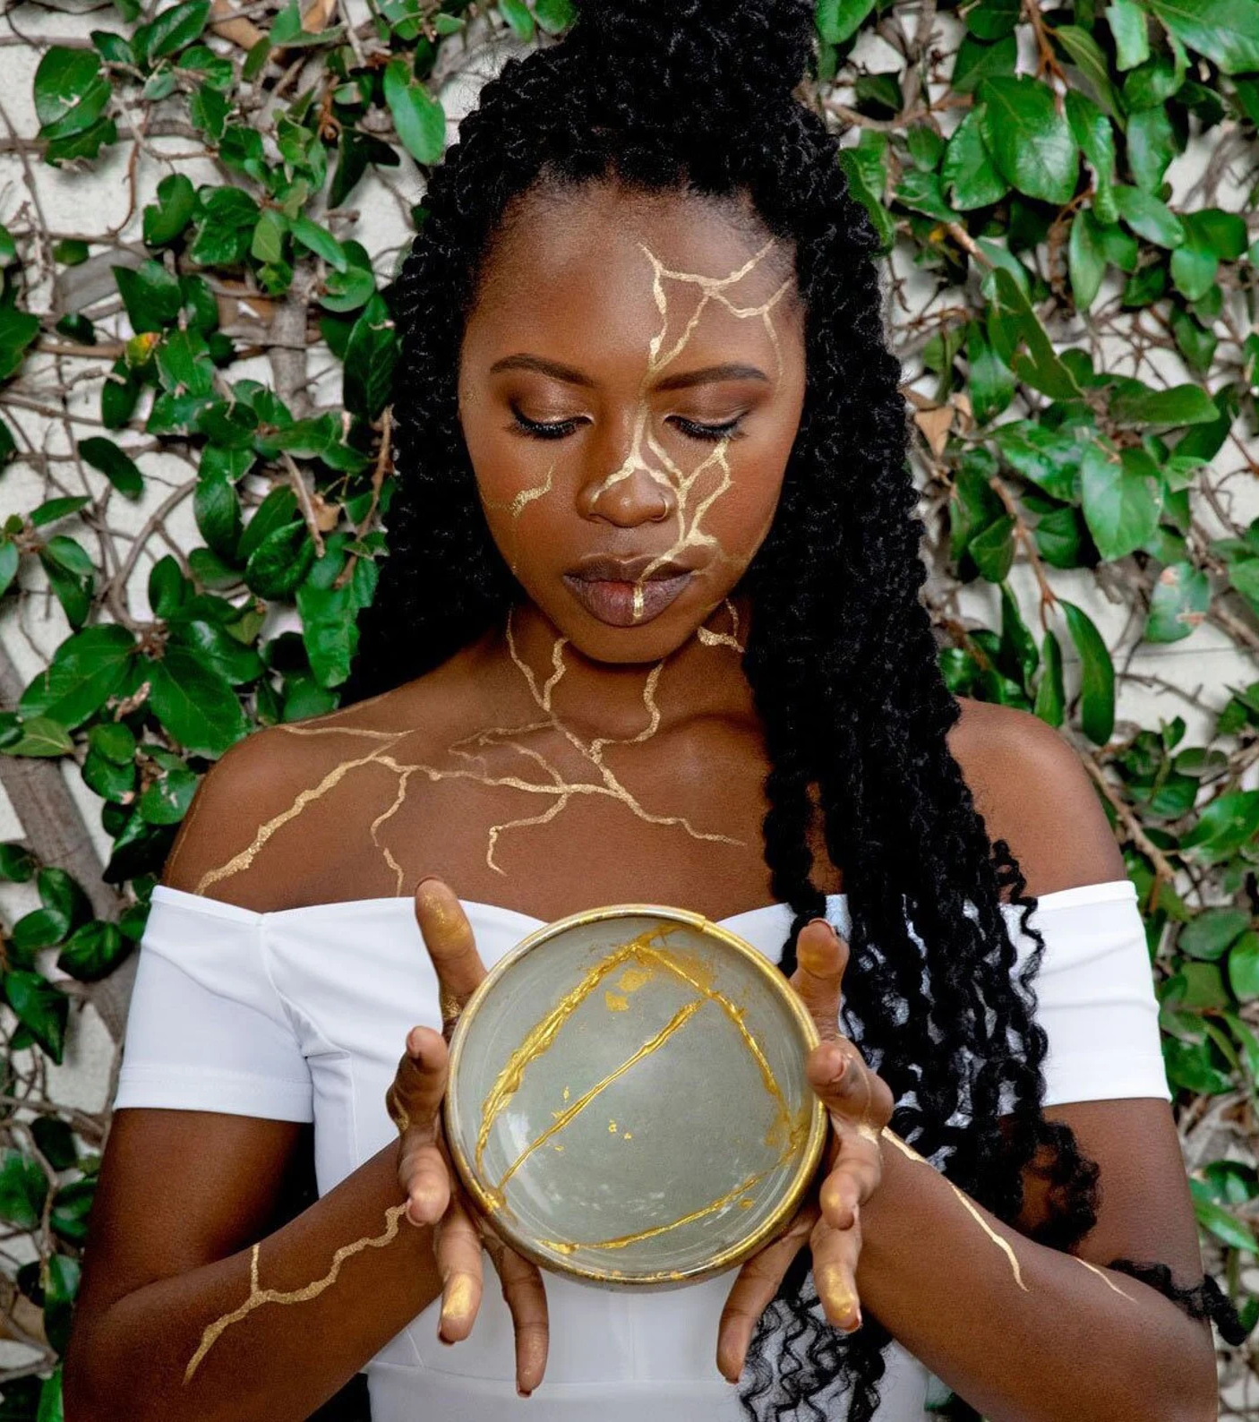
Our Beautiful Broken-ness
Donna Pirnat
DonnaPirnat.com
Notes:
February 11
Donna Pirnat
Our Beautiful Broken-ness
That strange bird, Donna Pirnat, is going off on one of her
tangents again. Something about bowls with cracks, inner
light, gold, Wabi Sabi, and rocks. The New Yorker says of Our
Beautiful Broken-ness, "An amazing feast for the eyes, ears,
and soul!" (No, it didn't.) But come anyway. You'll crack a
smile.
I’m going to do that disjointed thing I do. I have been captivated for the last couple of years with the imagery and symbolism of broken things: both objects and people, as well as their relationship with light and dark, and judgements about good and bad.
Since UU is a place, according to the bumper sticker I was given, where “All your answers will be questioned,” I am bringing this to you, for your unique perspective and input. Jeff and I are all about each of us having an important piece of the puzzle to share, and I will be leaving time at the end of this presentation for you to tell me what it all means. Feel into it. Your intuition knows.

Slide 7
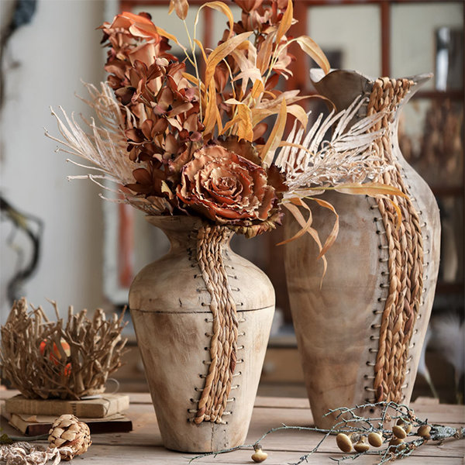
The Parable of Two Flower Vases
Notes:
(read aloud) I’d like to start with The Parable of Two Flower Vases
“[L]et us suppose that there are two flower vases made of fine China. Both are intricately carved and of comparable value, elegance, and beauty. Then a wind blows, and one of them falls from its stand and is broken into pieces.
An expert from a distant land is called. Painstakingly, step by step, the expert glues the pieces back together. Soon the broken vase is intact again, can hold water without leaking, is unblemished to almost all who see it.
Yet this vase is now different from the other one. The lines along which it had broken, a subtle reminder of yesterday, will always remain discernible to an experienced eye.
However, it will have a certain wisdom, since it knows something that the vase that has never been broken does not: it knows what it is to break, and what it is to come together again.” (pause)
I found this parable in an article on listeningtowar.com talking about combat veterans, and the ptsd many of them struggle with. A line that stood out to me said, “It is possible to know what it means to break apart….and to know what it is to come together again,” and though it may be “a knowledge that none of us wishes for… it is a knowledge that some of us, once endowed with it, can eventually find a way to use meaningfully and hopefully. “
And it occurs to me that each of us have those moments that we would not have asked for, and that we must learn to transform into resiliency and meaning.

Slide 8
Expansion by Paige Bradley PaigeBradly.com/blog
“The art world was telling me I had to break down my foundation, let my walls crumble, expose myself completely, and from there I will find the true essence of what I needed to say.”
-Paige Bradley
Notes:
Sculptor Paige Bradley says on her website that the curators of the art shows were tired of seeing the human form. They were demanding something more… a fresh perspective. Boy, did she give it to them.

Slide 9
Expansion by Paige Bradley PaigeBradly.com/blog
So, literally, I took a perfectly good (wax) sculpture—a piece I had sculpted with precision over several months—an image of a woman meditating in the lotus position, and just dropped it on the floor. I destroyed what I made. I was letting it all go. It was scary. It shattered into so many pieces. My first feeling was, “what have I done?!” Then I trusted it would all come together like I envisioned.
-Paige Bradley
Notes:
Now, try to imagine this sculpture before she broke it. How much more meaning does it have now, with the breaks and light in it? Truly transformed, right?

Slide 10
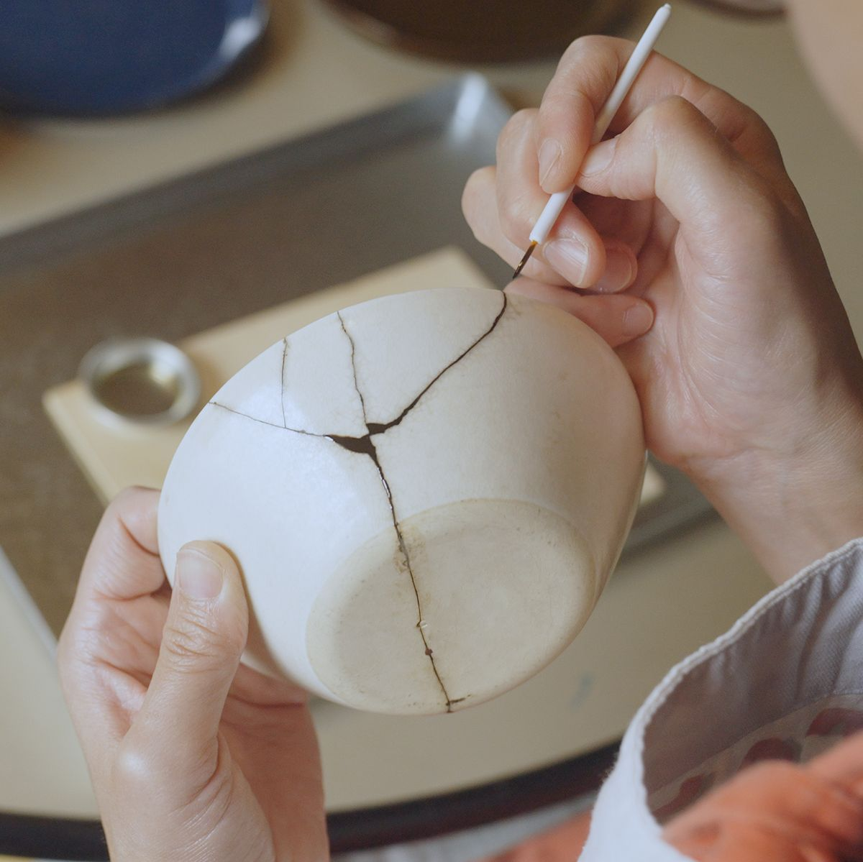
Notes:
The Japanese art of Kintsugi is built on the idea that in embracing flaws and imperfections, you can create an even stronger, more beautiful piece of art.
Every break is unique, and instead of repairing the item like new, you actually highlight the “scars” as part of the design.
Using this a s metaphor for healing ourselves, teaches us that sometimes in the process of repairing things that have broken, we actually create something more unique, beautiful, and resilient.

Slide 11
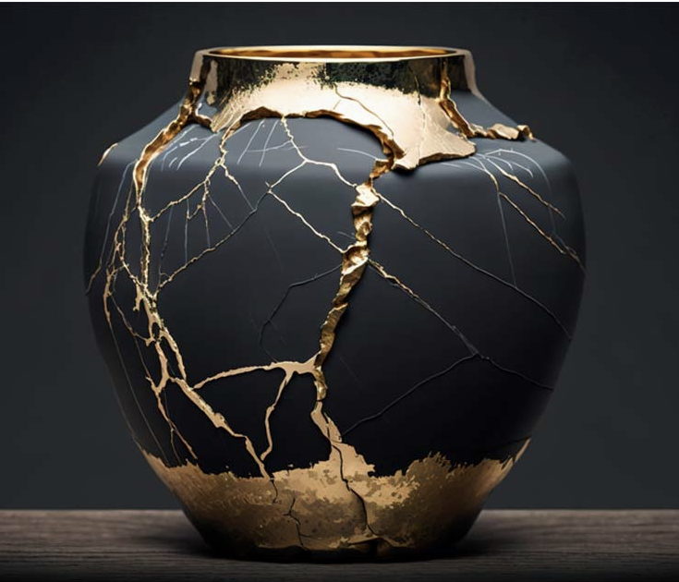
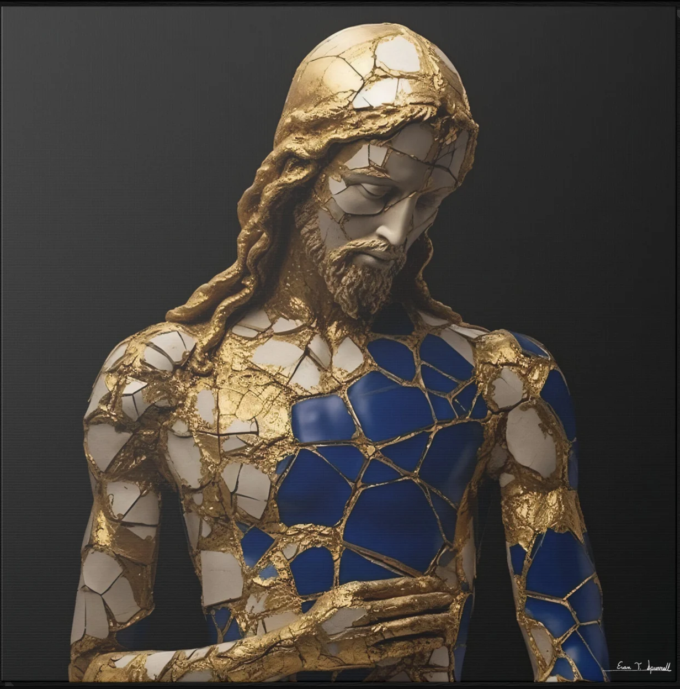
More unique, strong, and beautiful.
Notes:
Here are two examples of Kintsugi repair. What new meanings and depth does celebrated imperfection lend to these pieces for you?

Slide 12
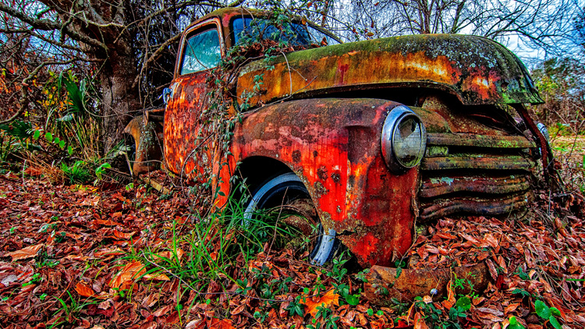
Wabi-Sabi
The beauty of rust and age.
This old 1950 Chevy truck is rusting away just off a street in Gonzales, La.
Notes:
Kintsugi is related to a Japanese world-view called Wabi-Sabi. Wabi Sabi is centered on the acceptance and appreciation of transience and imperfection.
While we in the West are always seeking perfection in our lives: apples without spots, socks that match, and faces with perfect symmetry, Wabi-Sabi nurtures all that is authentic by acknowledging the 3 simple realities: Nothing lasts. Nothing is finished. And nothing is perfect. (quoting Richard Powell on Wikipedia.)
Wabi-Sabi is derived from the Buddhist teaching of the 3 marks of existence: impermanence, suffering, and emptiness (or absence of self-nature.)

Slide 13
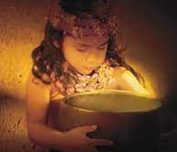
The Bowl of Light
“Don’t you carry stones
In your Bowl of Light.”
--Trevor Hall, Bowl of Light
Notes:
Now, let’s switch gears from broken bowls, to what we choose to fill those bowl with.
The Hawaiian Bowl of Light is an ancient story.
Its telling from one generation to the next instills the sacredness of the life force energy given to us at birth.
According to Hawaiian legend, at birth, we’re each given a bowl of light. This bowl of light is a gift from Au-ma-ku-a, or the spirit of all those who have come before us — especially family.
It Begins at Birth
As we take our first breath, our bowl is filled. This first breath is called Ha.
“This light resides within us, nourishes and sustains us as we pass through life until it returns to its source at life’s end.”
Our light diminishes as we judge others or enter the realm of negativity. “It can occur if we injure others with our deeds, words, or thoughts.”
“It is as though we put a stone in our bowl and some of our light goes out.” Stones of negativity and light cannot occupy the same space. The light is always still there, but if we cover it with stones, we cannot see it.
“Slowly our bowl fills with stones as our light dims until it’s nearly gone.” If we don’t pay attention to our bowl filling with stones, we can become cold and hard ourselves, like a stone. Stones do not grow or move.
But if we become conscious and aware of stones that we have allowed to replace our light, we can ,at any time we choose, dump our bowls upside down and empty them. Then our bowl immediately fills with our own light again.
It is at this point in time that we begin to live consciously with ourselves and others.
ALOHA means The Breath of Life
The ancient Bowl of Light story is like a vine spiraling up the Hawaiian tree of life. It nourishes the Hawaiian soul with Aloha as a means of living life consciously with one another. “Alo” is presence. “Ha” is the first breath of life. ALOHA, Combined, it’s commonly referred to as “the breath of life” or conscious awareness.
Bowl of light meditation: Hold your bowl at heart height. Feel into it. Look into it. Notice the stones blocking your light. Identify what some of them are for you. Take a deep breath, smile, and in your mind, say, “Thank you for your lessons, but I don’t need you anymore.”
Dump the rocks in your bowl on the ground.
Feel your lightness now, and see your light return to your bowl. Remember to dump your bowl whenever you are beginning to feel heavy or dark.

Slide 14
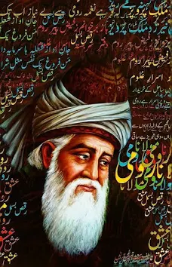
Stay With It.
“I said: what about my eyes? He said: Keep them on the road.
I said: What about my passion? He said: Keep it burning.
I said: What about my heart? He said: Tell me what you hold inside it?
I said: Pain and sorrow. He said: Stay with it.
The wound is the place where the Light enters you.”
-RUMI
Notes:
Rumi says the wound is where the light enters you.
The Hawaiian Bowl of Light legend says that we are born with the light inside us, and our job is to keep it emanating from us.
So, is it going in or coming out? Or both?
Or, since we are all made from energy, and light is energy, perhaps we simply ARE light?
But what about darkness? You can’t have a light without a darkness to put it in, right?

Slide 15
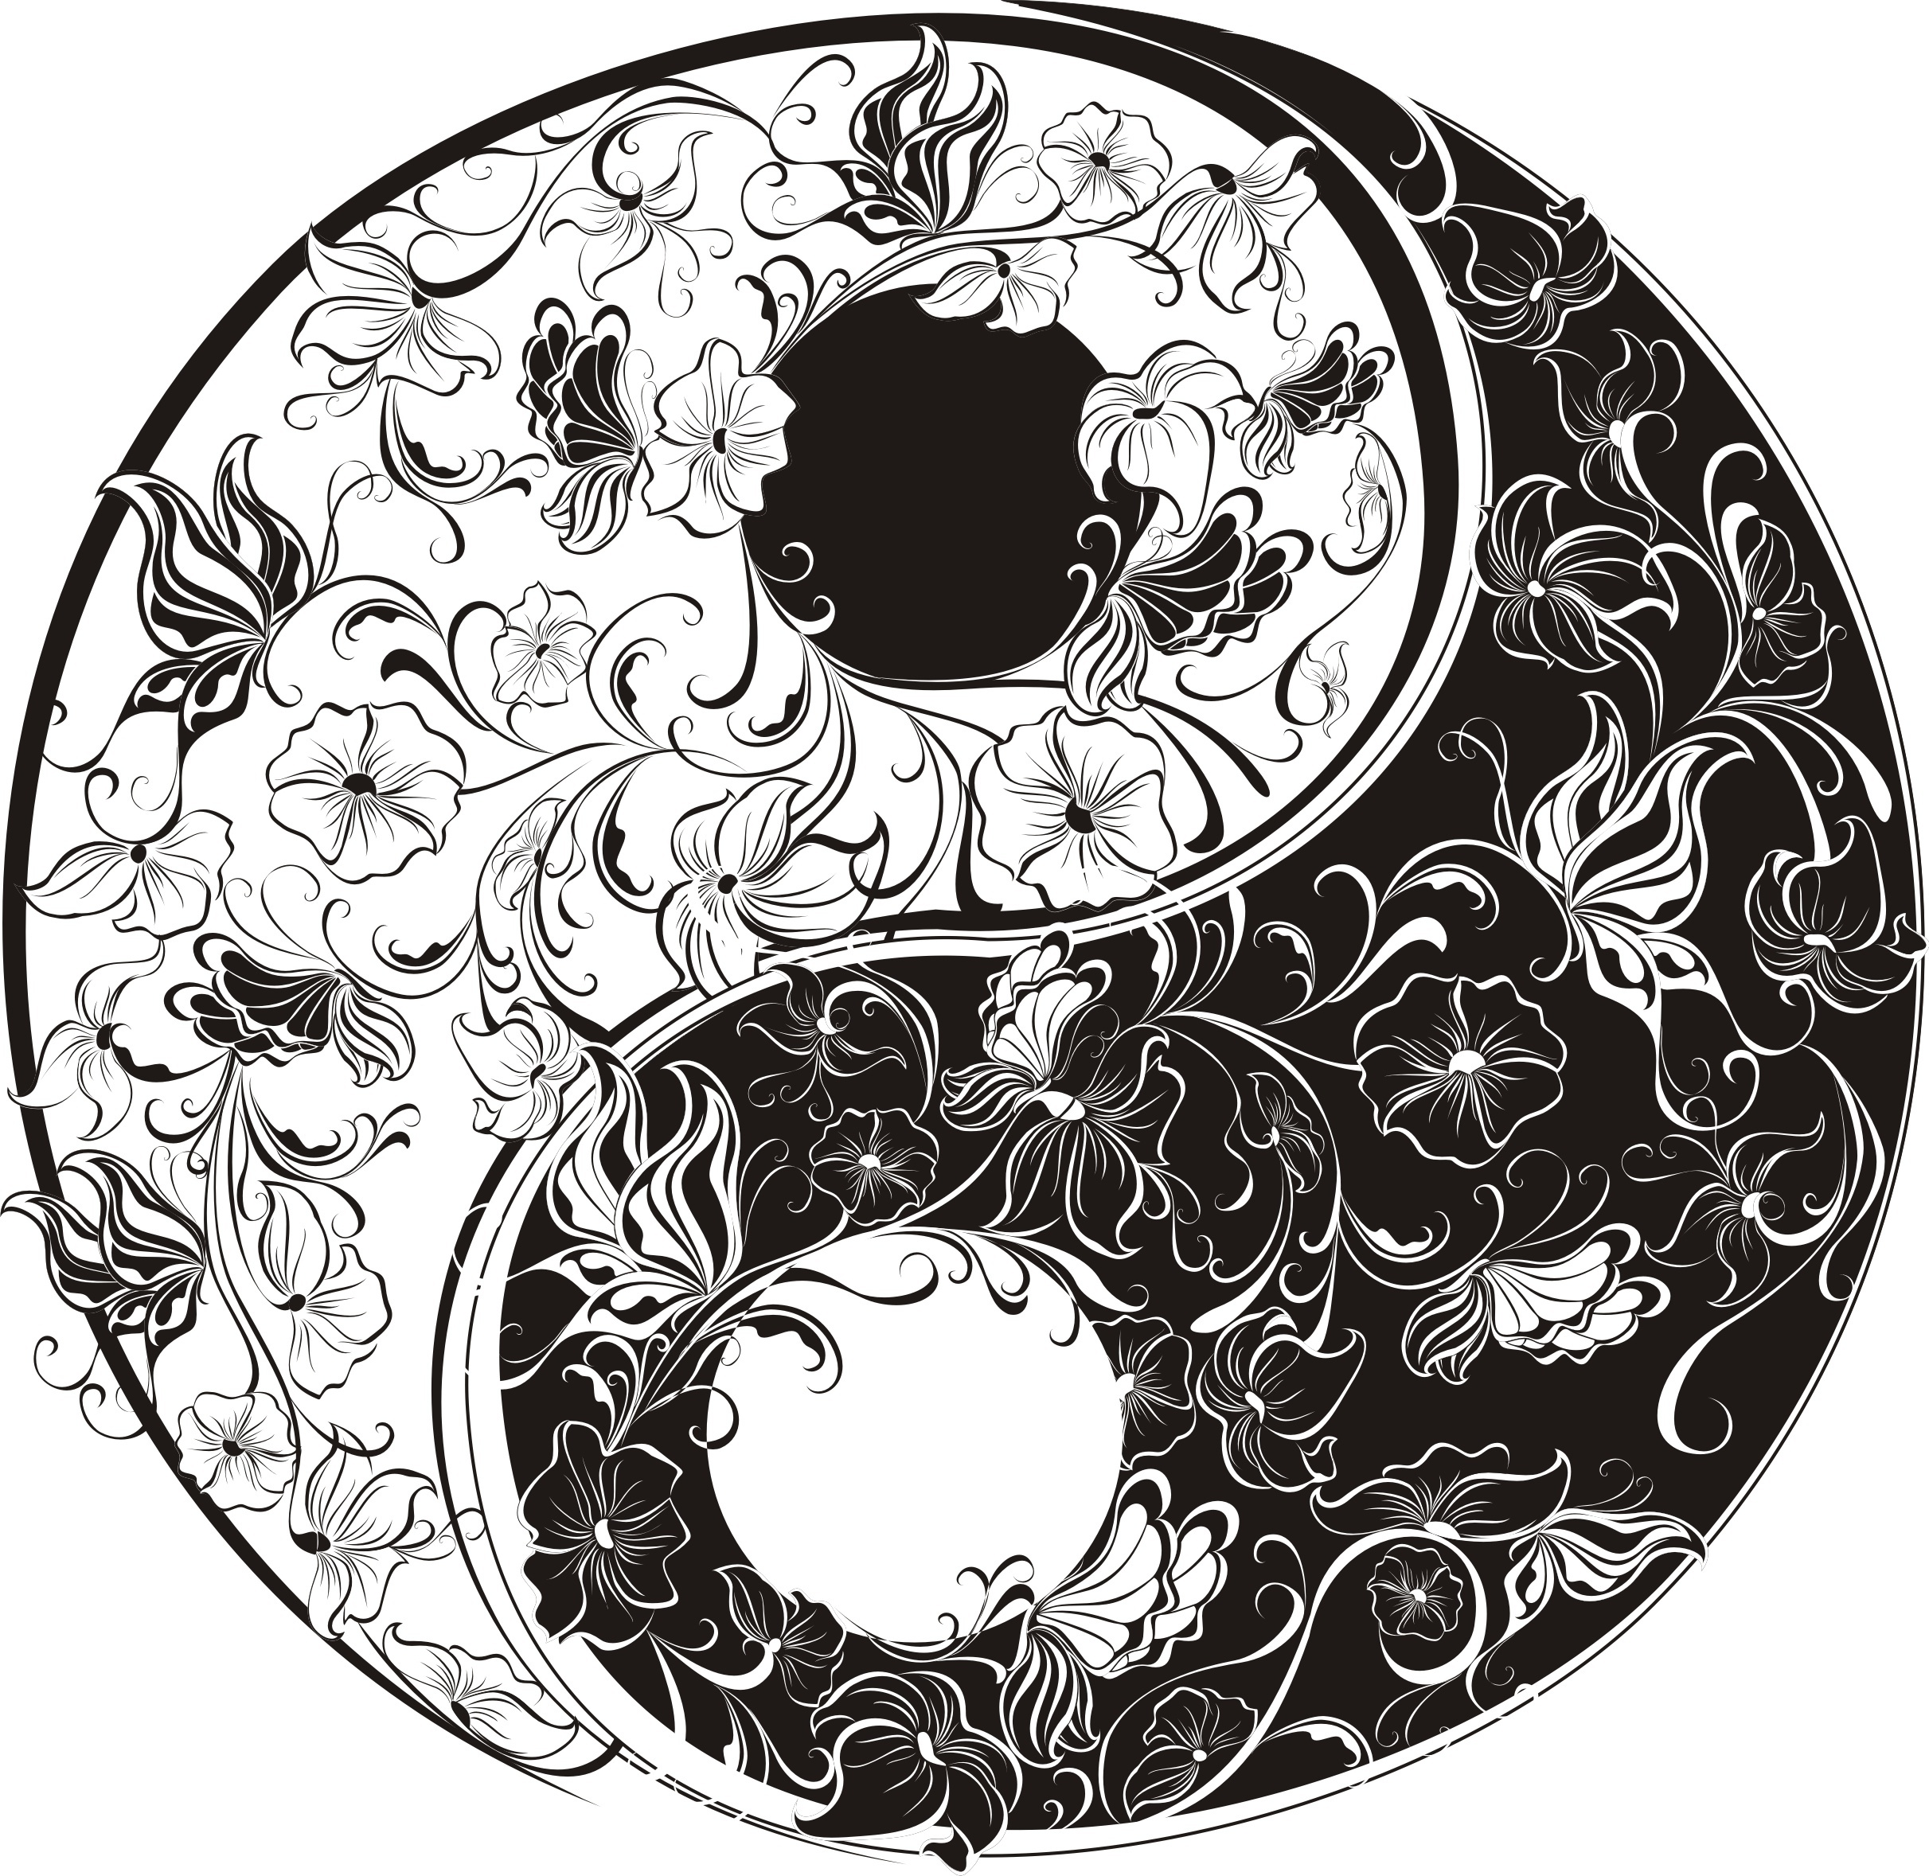
Valuing the Dark As Well As the Light
Notes:
The Taijitu ( tie-G-2, or yin-yang symbol) represents the light and the dark, and reminds us that it takes equal measures of both to make the whole. The two are always moving (hence the curve,) and in flux with one another.
When we have imperfections, or scars, or “triggers,” we tend to judge these as “bad,” and we are often taught to reject, suppress, or deny our dark sides.
It is only by embracing ALL of ourselves that we can become whole. Our wrinkles, our weight. Our infirmity. Our uncertainty. Whatever it is we want to reject about ourselves, THAT is the crack we must love and mend with gold.

Slide 16
Life is not a journey to the grave
with the intention of arriving safely
in a pretty and well-preserved body,
but rather to skid in broadside,
thoroughly used up,
totally worn out,
and loudly proclaiming –
WOW! -- What A Ride!
~ Erma Bombeck
Notes:
Perhaps it is the purpose of life
To break our hearts, over and over
Like a plow breaks the ground
And create within us
A fertile field
For unconditional love to grow.

Slide 17
More, As You Like.
There’s so much more I wanted to share, and so little time.
So, I put it here. That way, you can go deeper if you like.
I have included lyrics to songs in the notes section.
Unfortunately, if you try to scroll the lyrics while you listen,
It will stop the video. But I prefer to watch the artists, so, yeah.
I hope you find something interesting here.
And I hope you practice breaking open to love,
And not closing to it.

Slide 18
Broken and Beautiful written by Pink, performed by Kelly Clarkson
Notes:
Thanks, Kelly, for reminding us that it’s more than ok to not be perfect.
We need these gentle nudges.
Broken & Beautiful
Song by Kelly Clarkson
OverviewLyricsVideosListenArtistsComposers
Search Results
Main Results
Lyrics
I never held my hand out and asked for something free I got pride I could roll out for miles in front of me I don't need your help, and I don't need sympathy I don't need you to lower the bar for me
I know I'm Superwoman, I know I'm strong I know I've got this 'cause I've had it all along I'm phenomenal and I'm enough I don't need you to tell me who to be
Can someone just hold me? Don't fix me, don't try to change a thing Can someone just know me? 'Cause underneath, I'm broken and it's beautiful
I'm broken and it's beautiful I'm broken and it's beautiful I'm broken and it's beautiful I'm broken and it's beautiful
We're walking on the ocean, turning water into wine We bury our emotion and pretend that we're just fine The only way to live now is to know you're gonna fly Don't listen to the lying liars and their lies
I know I'm Superwoman, I know I'm strong I know I've got this 'cause I've had it all along I'm phenomenal, I'm enough I don't need you to tell me who to be
Can someone just hold me? Don't fix me, don't try to change a thing Can someone just know me? 'Cause underneath, I'm broken and it's beautiful
Hey, I'm broken and it's beautiful I'm broken and it's beautiful Hey, I'm broken and it's beautiful I'm broken and it's beautiful (oh)
I'm tired (oh) Can I just be tired? (Just be tired) Without piling on all sad and scared and out of time (oh) I'm wild (wild) Can I just be wild? (Just be wild) Without feeling like I'm failing and I'm losing my mind
Can someone just hold me? Don't fix me, don't try to change a thing Oh, someone just know me 'Cause underneath, I'm broken and it's beautiful
I'm broken and it's beautiful I'm broken and it's beautiful I'm broken and it's beautiful It's beautiful, it's beautiful (it's beautiful) It's beautiful, yeah, I'm broken and it's beautiful It's beautiful, yeah, it's beautiful (it's beautiful) It's beautiful, yeah, I'm broken and it's beautiful
Source: LyricFind
Songwriters: Alecia B. Moore / John Mcdaid / Steve Mac

Slide 19
Bowl of Light written and performed by Trevor Hall with his commentary on the inspiration and story behind the song.
Notes:
Trevor is so conscientious about getting the Chief’s blessing.
Such a lovely story.
Don’t you carry stones.
Aho!
"Bowl Of Light" The myth of Ulalena Of that ocean song Eyes of white pueo See the one in all The more I lose my words The more I'm coming home Let the mind grow humble Let that spirit roam Thread it through the thunder Let the sky mouth sing Through the black light rainbow Mother spoke to me Don't you carry stones Don't you carry stones Don't you carry stones Don't you carry stones Don't you carry stones Don't you carry stones in your bowl of light In your bowl of light In your bowl of light In your bowl of light Where we drove upcountry Our feet stained in the red Laid some good good prayers down She said, I see you child, I see you there We forget and remember And we forget again But this life is a circle And it's coming back around Coming back again Don't you carry stones Don't you carry stones Don't you carry stones Don't you carry stones Don't you carry stones Don't you carry stones in your bowl of light In your bowl of light In your bowl of light In your bowl of light Oh yeah Oh creator, I can hear you Thank you This is my offering, All I'm saying is Thank You Oh creator, I can hear you thinking This is my offering, All I'm saying is Thank You Thank you, thank you Thank you Yeah, thank you Don't you carry stones in your bowl of light Don't you carry stones Don't you carry stones in your bowl of light Don't you carry stones Don't you carry stones in your bowl of light Don't you carry stones Don't you carry stones in your bowl of light Don't you carry stones

Slide 20
You Can’t Rush Your Healing Song by Trevor Hall
Notes:
THIS.
This is a beautiful, meditative gift of a song.
You’re welcome.
You Can't Rush Your Healing
Song by Trevor Hall
Lyrics
It comes to me upon the strings When I hear it, well, I sing I can't say it's my creation Staying patient, what it brings Let me say, I'm coming humble I don't know what's right or wrong I just keep, keep on believin' Passing down an old, old song An old song
Well, everybody's got that chapter of dark and darker days, yeah Saturn seems to be returning, and his essence can't be tamed Some may like to fight it, try to plan a secret attack But the more you push it, the more it's pushin' you back
So, you can't rush your healing Darkness has its teachings Love is never leaving You can't rush your healing Your healing
Mama, well, she told me time is such a wonderful gift You're not running out You're really running in Confusion clouds the heart, but it also points the way Quiet down the mind, the more the song will play
So, you can't rush your healing Darkness has its teachings Love is never leaving You can't rush your healing
Your healing
Your healing
Your healing
Your healing
You can't rush your healing Darkness has its teachings Love is never leaving You can't rush your healing
Source: Musixmatch
Songwriters: Trevor Hall

Slide 21
Fix You by Coldplay
Notes:
Dude.
You can’t fix me.
All the king’s horses, and all the king’s men, couldn’t fix me.
Fix yoself.
Fix You
Song by Coldplay
Lyrics
When you try your best, but you don't succeed When you get what you want, but not what you need When you feel so tired, but you can't sleep Stuck in reverse
And the tears come streaming down your face When you lose something you can't replace When you love someone, but it goes to waste Could it be worse?
Lights will guide you home And ignite your bones And I will try to fix you
And high up above, or down below When you're too in love to let it go But if you never try, you'll never know Just what you're worth
Lights will guide you home And ignite your bones And I will try to fix you
Tears stream down your face When you lose something you cannot replace Tears stream down your face, and I
Tears stream down your face I promise you I will learn from my mistakes Tears stream down your face, and I
Lights will guide you home And ignite your bones And I will try to fix you
Source: Musixmatch
Songwriters: Christopher Anthony John Martin / Guy Rupert Berryman / William Champion / Jonathan Mark Buckland

Slide 22
Broken by Seether, featuring Amy Lee
Notes:
"Broken (feat. Amy Lee)"
I wanted you to know that I love the way you laugh
I wanna hold you high and steal your pain away
I keep your photograph and I know it serves me well
I wanna hold you high and steal your pain
'Cause I'm broken when I'm lonesome
And I don't feel right when you're gone away
You've gone away, you don't feel me here anymore
The worst is over now and we can breathe again
I wanna hold you high, you steal my pain away
There's so much left to learn, and no one left to fight
I wanna hold you high and steal your pain
'Cause I'm broken when I'm open
And I don't feel like I am strong enough
'Cause I'm broken when I'm lonesome
And I don't feel right when you're gone away
'Cause I'm broken when I'm open
And I don't feel like I am strong enough
'Cause I'm broken when I'm lonesome
And I don't feel right when you're gone away
'Cause I'm broken when I'm lonesome
And I don't feel right when you're gone away
You've gone away
You don't feel me here anymore

Slide 23
I Fall To Pieces Patsy Cline
Notes:
Hey, haven’t we all?
I Fall To Pieces
Song by Patsy Cline and The Jordanaires
I fall to pieces Each time I see you again I fall to pieces How can I be just your friend?
You want me to act like we've never kissed You want me to forget (to forget) Pretend we've never met (never met)
And I've tried and I've tried But I haven't yet You walk by and I fall to pieces
I fall to pieces Each time someone speaks your name (speaks your name) I fall to pieces Time only adds to the flame
You tell me to find someone else to love Someone who love me too (love me too) The way you used to do (used to do) But each time I go out with someone new You walk by and I fall to pieces You walk by and I fall to pieces
Source: LyricFind
Songwriters: Hank Cochran / Harlan Howard

Slide 24
Not Broken Anymore by Justin Furstenfeld and Blue October
Notes:
Ah, that one person whose cracks align with yours.
Priceless.
Not Broken Anymore
Song by Blue October
Lyrics
I know how to let you leave How am I supposed to let you go? Now you stand in front of me And all the rain is turning into snow
Can you tell me that you're real So I can really know That everything I feel I can finally show Standing next to me oh the person I can be Is finally here and he won't back down at all
But I can't stop thinking How you just keep making Sense of all that was broken before
And I won't keep faking 'Cause I'm done with taking 'Cause with you I'm not broken anymore
I've seen the empty deep I've damned up the water flow You're the touchstone my complete You're the ship that kept me afloat
Can you tell me that you're real So I can really know That everything I feel I can finally show Standing next to me oh the person I can be Is finally here and he won't back down at all
But I can't stop thinking How you just keep making Sense of all that was broken before
And I won't keep faking 'Cause I'm done with taking 'Cause with you I'm not broken anymore
But I can't stop thinking How you just keep making Sense of all that was broken before
And I won't keep faking 'Cause I'm done with all the taking 'Cause with you I'm not broken anymore
And I can't stop thinking How you just keep making Sense of all that was broken before
Yeah and I won't keep faking 'Cause I'm done with taking 'Cause with you I'm not broken anymore
I'm not broken anymore
Source: LyricFind
Songwriters: Christopher Marsh Lindsey / David Keith Castell / Justin S. Furstenfeld

Slide 25
She Used To Be Mine Sara Bareilles
Notes:
Lyrics
It's not simple to say Most days I don't recognize me These shoes and this apron That place and its patrons Have taken more than I gave 'em It's not easy to know I'm not anything like I used to be Although it's true I was never attention’s sweet center I still remember that girl
She's imperfect but she tries She is good but she lies She is hard on herself She is broken and won't ask for help She is messy but she's kind She is lonely most of the time She is all of this mixed up And baked in a beautiful pie
She is gone but she used to be mine
It's not what I asked for Sometimes life just slips in through a back door And carves out a person And makes you believe it's all true And now I've got you And you're not what I asked for If I'm honest I know I would give it all back For a chance to start over And rewrite an ending or two For the girl that I knew
Who be reckless just enough Who can hurt but Who learns how to toughen up when she's bruised And gets used by a man who can't love And then she'll get stuck and be scared Of the life that's inside her Growing stronger each day 'Til it finally reminds her To fight just a little To bring back the fire in her eyes That's been gone but it used to be mine
Used to be mine
She is messy but she's kind She is lonely most of the time She is all of this mixed up and baked in a beautiful pie She is gone but she used to be mine

Slide 26
Crazywise Full Documentary (2014, 79 mins)
If you want to watch full-screen, click on Youtube bottom right, and choose full screen bottom right.
Notes:
Sometimes mental illness is not pathological at all. (And sometimes it is.)
How many people are pathologized for their spiritual gifts and sensitivities?

Slide 27
Tantra Healer a film by Jeffrey M. Geis
Notes:
Tantra is a practice of presence.
Jeff is a Tantrika, Yogi, and Reiki Master who has been meditating, cultivating presence, and perceiving energy differently since he was six.
But the DSM V does not know what to do with spiritual sensitives.
What do you get when you cross a Wounded Healer with a Mystic? You get Jeff.
Disability? More like, “This ability.”

Slide 28
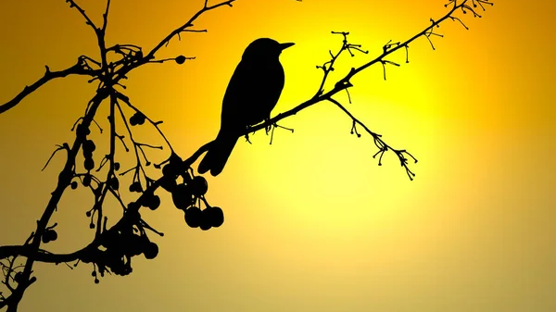
Hymn: Morning Has Broken (p.38)
Notes:
We’re going to do the faster Cat Stevens version. It has lyrics printed on the screen, or you can follow on p. 38 (but the pace is going to be a bit faster.) Please stand as you are able ☺

Slide 30
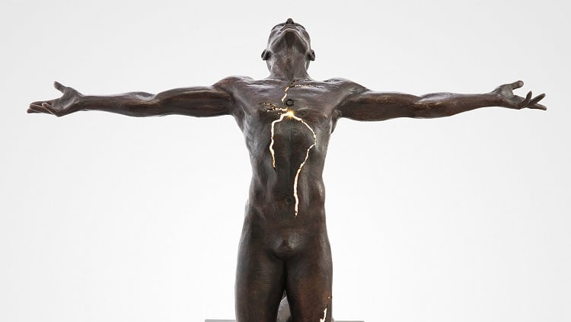
Please share your thoughts
Illumination half-life
By Paige Bradley

Slide 31
Other musings that didn’t make the cut!

Slide 32
Broken Mirrors and Bad Luck?
Notes:
The Greeks believed that one’s reflection on the surface of a pool of water revealed one’s soul. But it was Roman artisans who actually learned to manufacture mirrors from polished metal surfaces, and believed their gods observed souls through these devices. To damage a mirror was considered so disrespectful that people thought it compelled the gods to rain bad luck on anyone so careless.
Around the third century mirrors were being made from glass, and breakage became a lot more commonplace. But the Romans did not believe that the ensuing bad luck would last forever. They believed that the body renewed itself every seven years.
The belief that good luck would eventually return was surely comforting, and people have always tended to believe things that make them feel good, even when untrue.
Isn’t it amazing that the Romans believed (correctly) that the body renewed itself every 7 years? How did they know that?

Slide 33
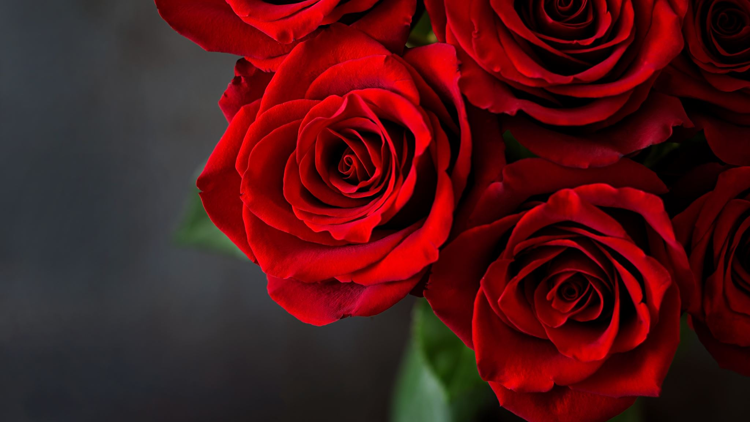
Valentine’s Day Meditation
Spend a few quiet moments alone.
Feel into the ways love has broken you open.
Where are you still feeling tightness and scarring?
Send unconditional love and compassion to those places.
Can you feel into the contracted areas, and invite them to expand?
Can you dump some rocks of anger and resentment, and
Replace them with the light of forgiveness?
Say to yourself the prayer of Ho’o Pono Pono:
“I’m sorry. Please forgive me. Thank you. I love you.”
That about covers it. Thank you for taking care of yourself.

Slide 34
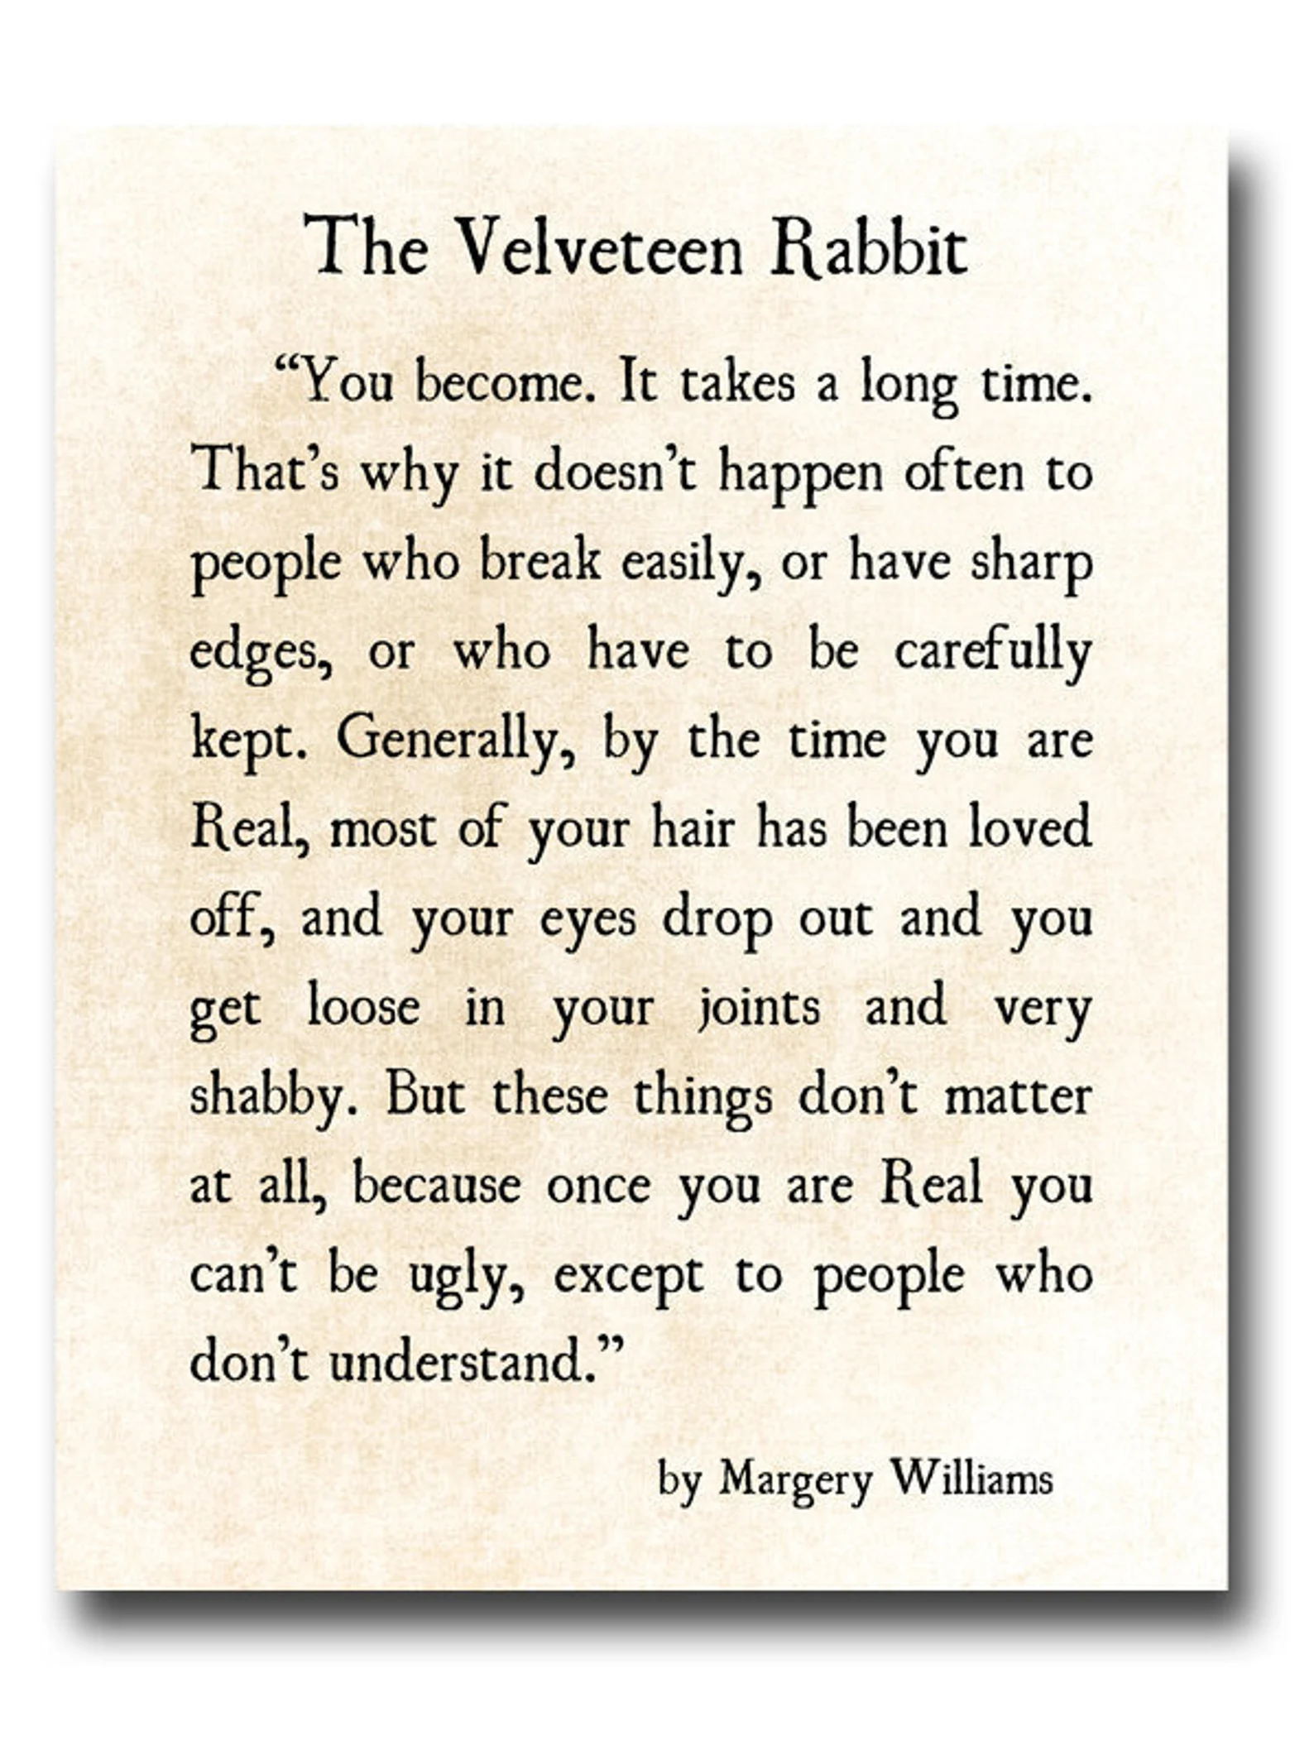
The Wabi-Sabi of The Velveteen Rabbit

Slide 35
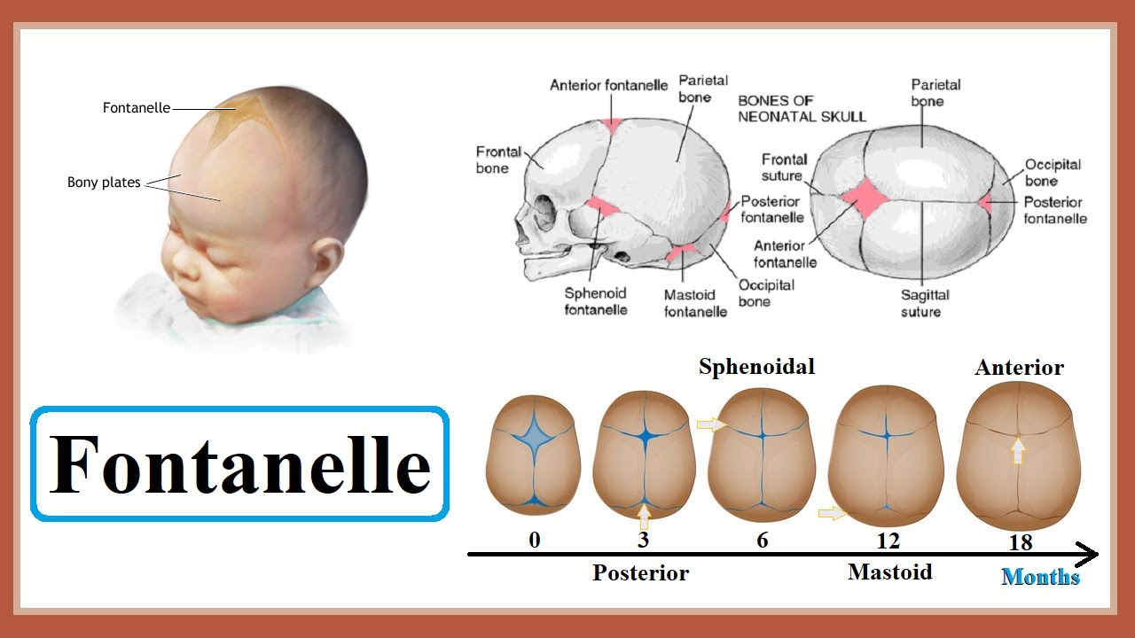
The Cracks We Are Born With
Notes:
In the Yogic tradition, the anterior fontanelle is the location of the Crown Chakra, which is the connection between a person and their divinity. Divine light passes down through the crown chakra, descends the spine, and exits through the root chakra (base of the spine) into the Earth. Earth energy comes in from the root chakra (base of the spine,) ascends the spine, and leaves through the crown chakra.
Infants sleep a lot in their first year, and it is said that as they come with their crown fully open, they are still connected to the spirit world. As their fontanelle closes, they spend more and more time awake to this place, in this 3-D material world. As people near a natural death, they begin to revert to the more infant-like sleep cycles until they return completely to spirit.

Slide 36
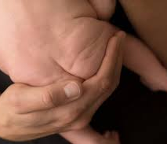
The Cracks We Are Born With
Notes:
I’m nothing if not cheeky.
I do find it ironic that the fontanelle cracks and the gluteal cleft are both located at the terminal chakras.
“Where the light enters us,” indeed. ☺
I hope you have enjoyed this compilation, and it has given you food for thought.
No need to be perfect. Just be perfectly YOU.
Namaste.

