Slide 1
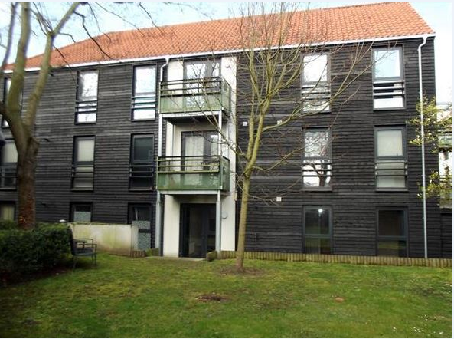
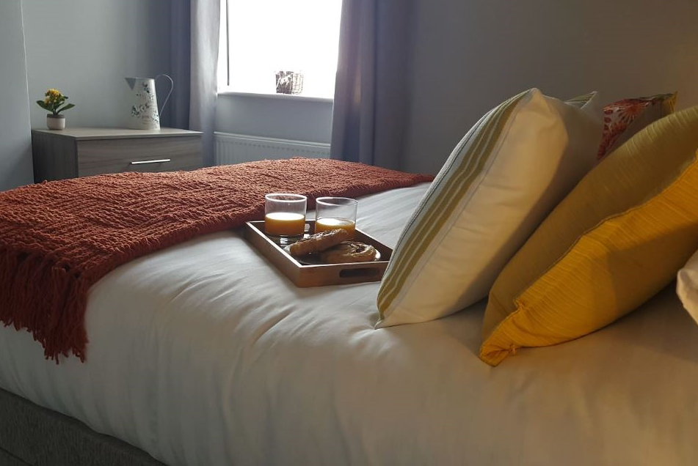
Vetrelax Chelmsford City Modern Apartment Upper Chase
Key Features
Sleeps 6 people (incl. sofa beds).
Free WIFI.
Free Parking.
Free Laundry facilities.
Spacious Apartment with garden.
Fully Equipped kitchen.
Close to BBC Essex, Museum etc

Slide 2
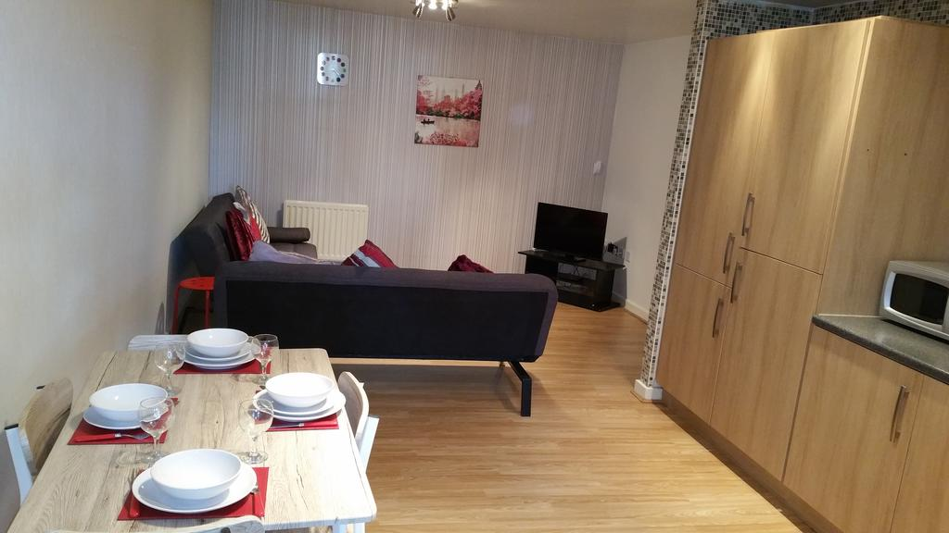
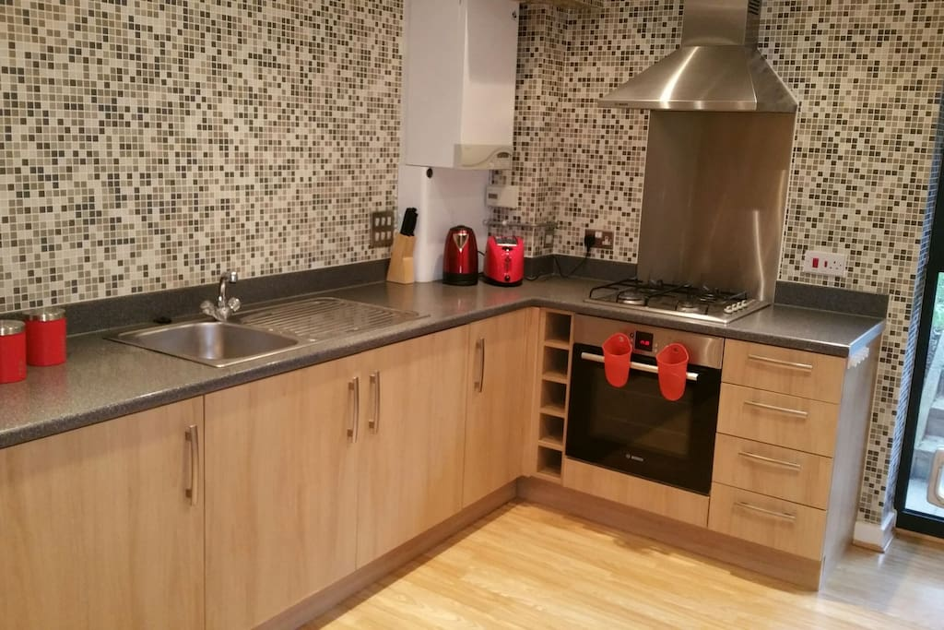
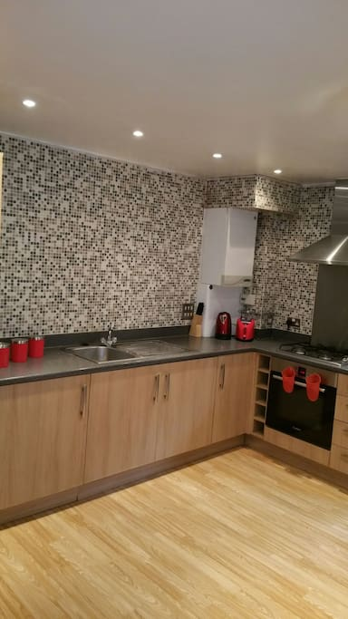
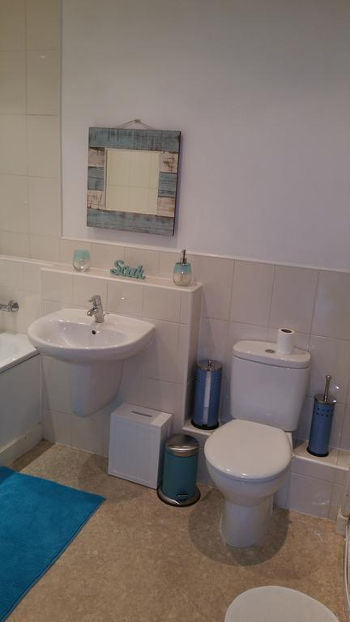
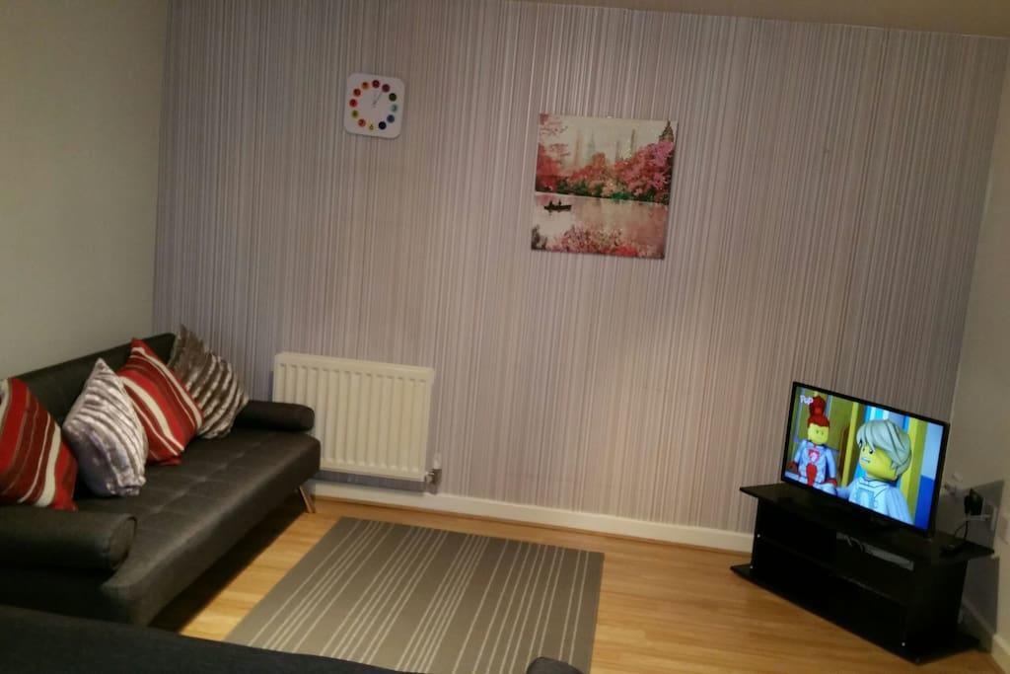

Slide 3
