Slide 1
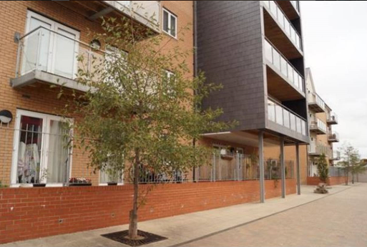
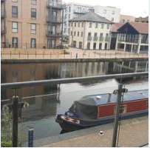
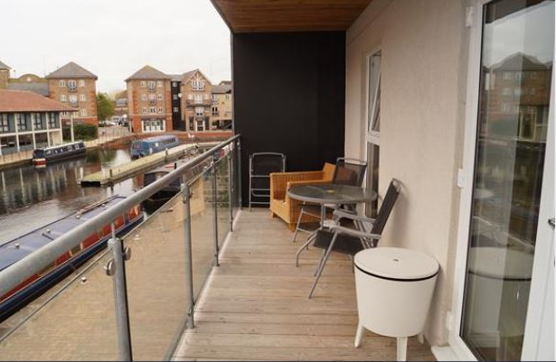
Vetrelax Chelmsford City Apartment Cressy Quays, Chelmsford.
Key Features
Sleeps 6 people (incl. sofa beds).
Free WIFI.
Close to city centre (5 mins walk).
Fully Equipped kitchen.
River Views
Spacious flat with Balcony.
2 Bathrooms.
Laundry Facilities
Free Parking.

Slide 2
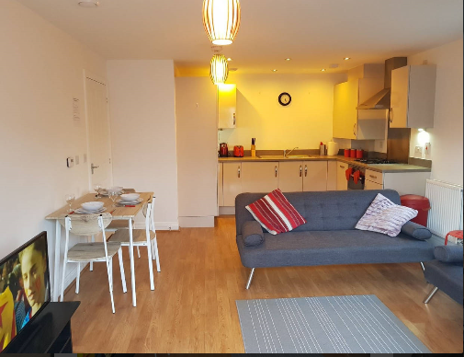
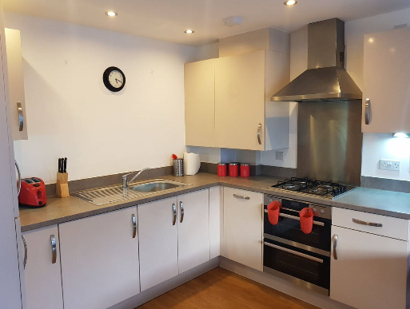
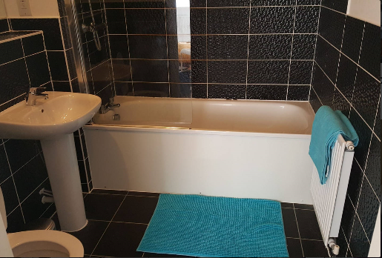
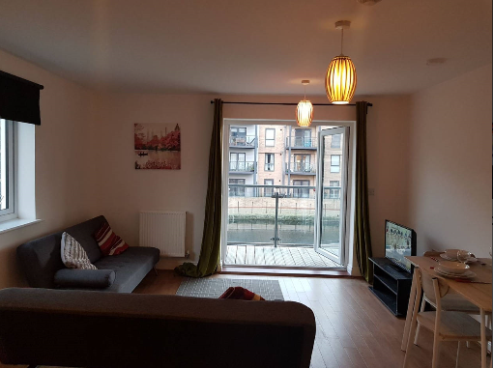

Slide 3
