Slide 1
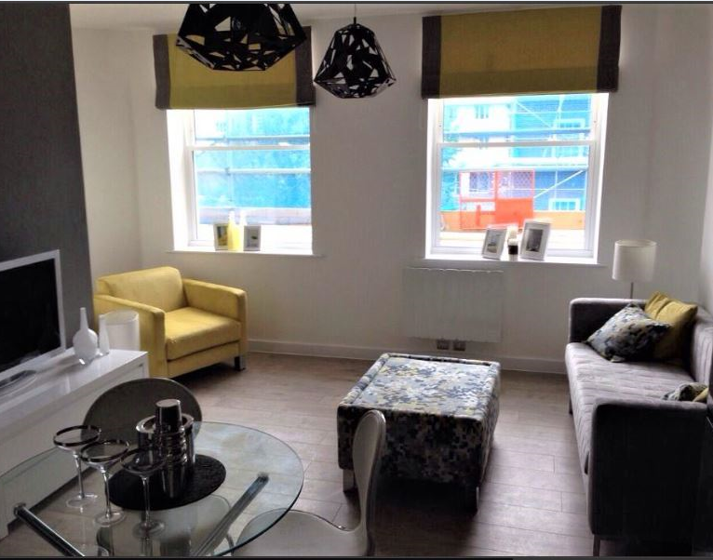
Vetrelax Chelmsford Gemini Apartment
New London Road.
Key Features
Sleeps 6 people (incl. sofa beds).
Free WIFI.
Free Parking.
1 min walk to town centre.
Spacious Apartment with high ceilings.
Laundry Facilities
Fully Equipped kitchen.
Close to station.

Slide 2
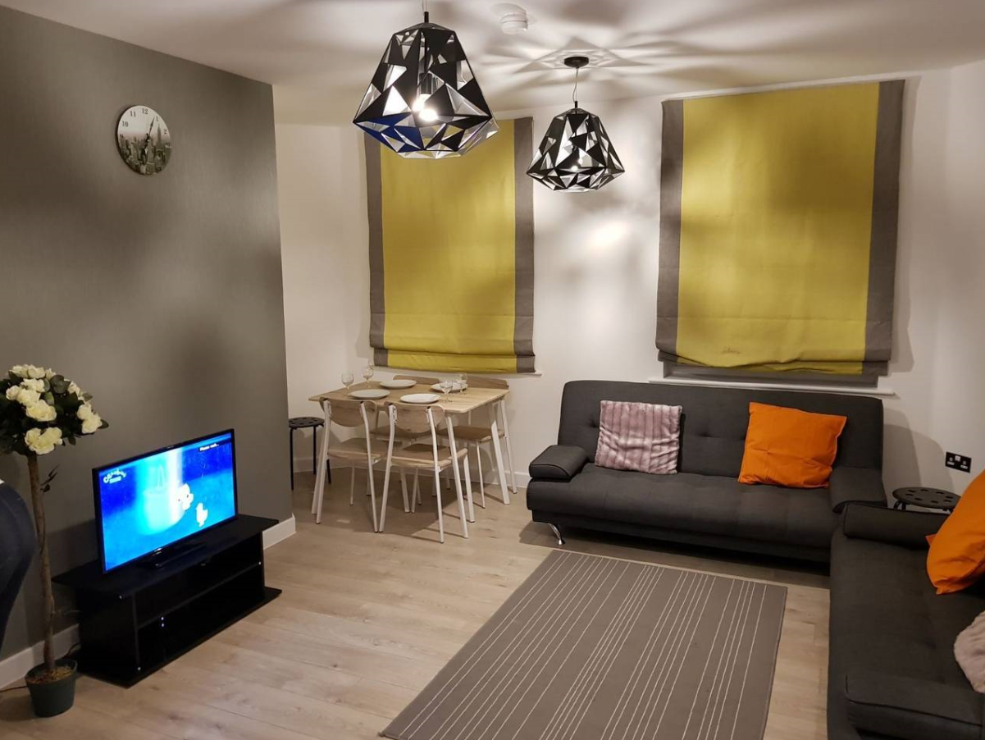
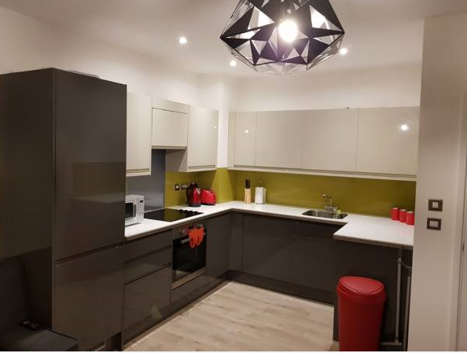
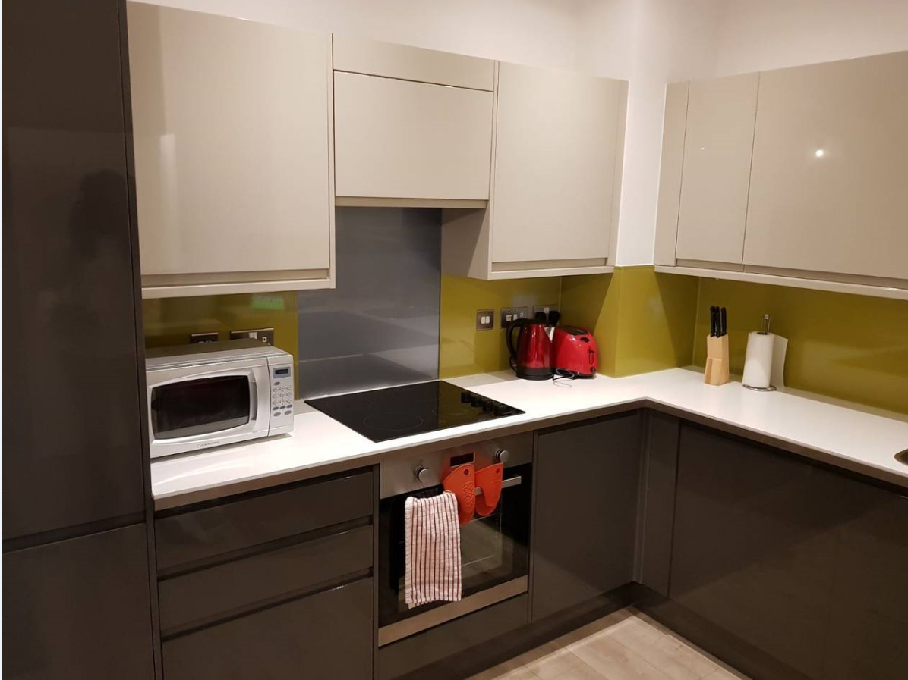
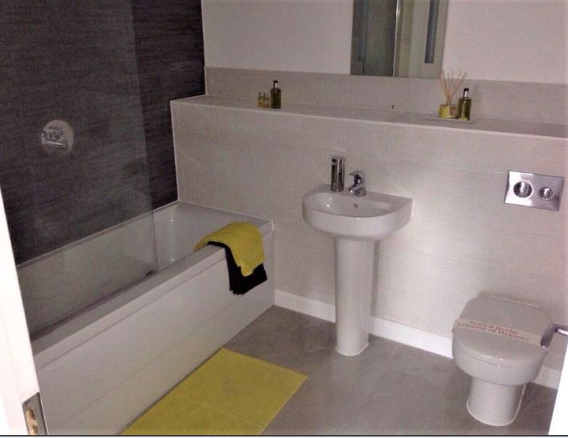

Slide 3
