Slide 1
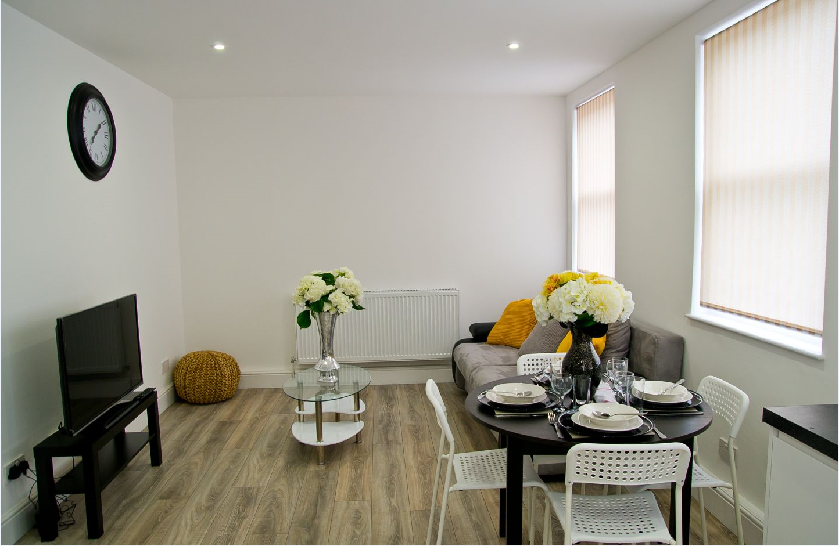
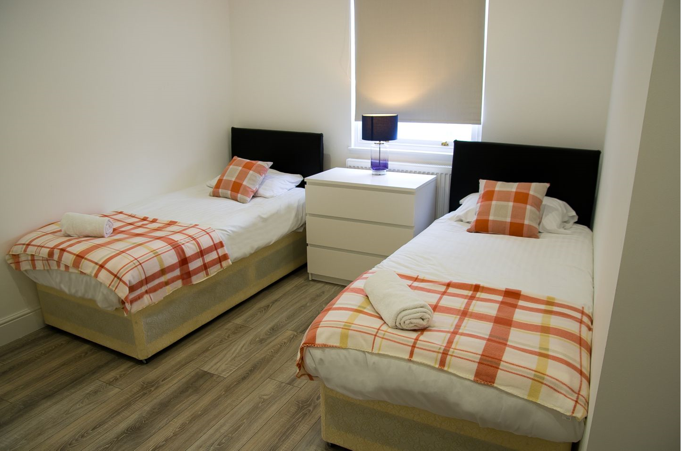
Vetrelax Brentwood Exec Apartment Broomfield Road, Chelmsford.
Key Features
Sleeps 6 people (incl. sofa beds).
Free WIFI.
Close to city centre and train station
Fully Equipped kitchen.
Spacious flat with Balcony.
2 Bathrooms.
Laundry Facilities
Free complimentary Parking.

Slide 2
