Slide 1
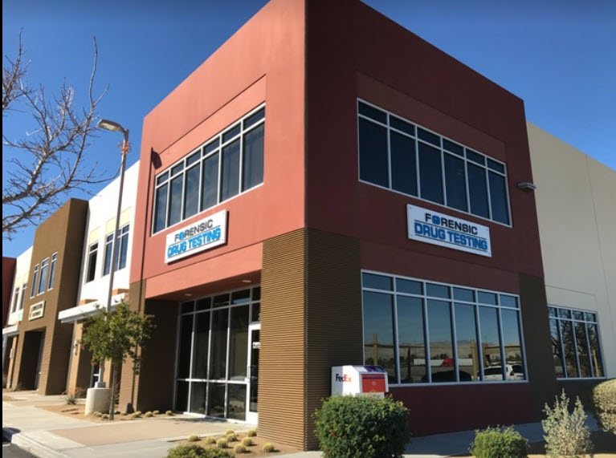
MARIJUANA Concerns
Is it “legal” or not?
Kevin Odenbaugh, President
Cell: 760-625-9992
Office: 760-770-6068
kevin@fdtsi.com

Slide 2
FEDERAL
Controlled Substance Act
Still has Marijuana listed as a Schedule One “Illegal” Substance
(Title 21 USC Section 801)

Slide 4
CALIFORNIA
Marijuana use is still prohibited within the workplace, in public places and within motor vehicles.
DUI 23152(a) - Use/Possession 11357 H & S,
This Photo by Unknown Author is licensed under CC BY-NC-ND

Slide 5
CALIFORNIA
POTHEAD PROTECTIONS
AB 2188 – T.H.C. ANTI-DISCRIMINATION LAW
California Government Code Section 12954 makes is “illegal” for employers to:
Take any negative job action based on a person’s off-duty use of THC
Take negative job action based on a positive “Metabolite” testing event (Hair/Urine)
This Photo by Unknown Author is licensed under CC BY

Slide 6
BIG WIN For the Pot Using Community
BUT WAIT……….there are some exceptions…….
This Photo by Unknown Author is licensed under CC BY-NC

Slide 7
Exceptions
Employers may still do the following:
Maintain a Drug Free Workplace
Test for Psychoactive THC (Saliva)
Prohibit use/possession while at work

Slide 8
Which employers get to ignore this new law?
This Photo by Unknown Author is licensed under CC BY-NC-ND
Federal or State Mandated Employers (DOT/CHP/CPUC)
Employers in the Building and Construction Trades (Contractor’s License?)
USDOD persons requiring a federal government background or security clearance.

Slide 9
What about the rest of us?

Slide 10
Testing Options
CARVE OUT T.H.C. from your current urine testing panel
ADD T.H.C. SALIVA to your current testing panel
Continue “As-Is” and do a “Fitness For Duty” evaluation for all positive THC Metabolite findings.

Slide 11
CONSIDERATIONS
CARVING OUT THC
Will open up some potential liability for those THC related accidents/incidents that occur within the workplace.
Trial Question: What did you do to prevent this T.H.C. related accident from occurring?
ADDING T.H.C. SALIVA
Will help shore-up any potential liability for those T.H.C. related accidents/incidents that occur within the workplace.
Trial Question: What did you do to prevent this T.H.C. related accident from occurring?
FITNESS FOR DUTY
Will open up some potential liability for those T.H.C. related accidents/incidents that occur within the workplace.
Trial Question: What did you do to prevent this T.H.C. related accident from occurring?

Slide 12
T.H.C. Detection Times
URINE: UP TO 30 DAYS
HAIR/FINGERNAIL: UP TO 6 MONTHS
SALIVA: UP TO 12 HOURS

Slide 13
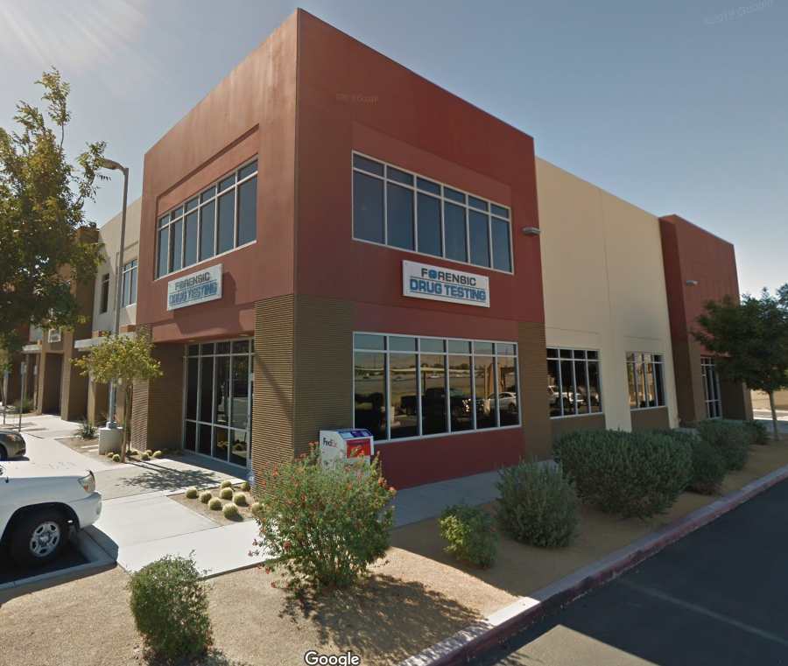
RECOMMENDATIONS
CARVE OUT T.H.C. from your current testing process, then
ADD T.H.C. SALIVA

