Slide 1
Accordant
Document Overview
July 2020

Slide 2
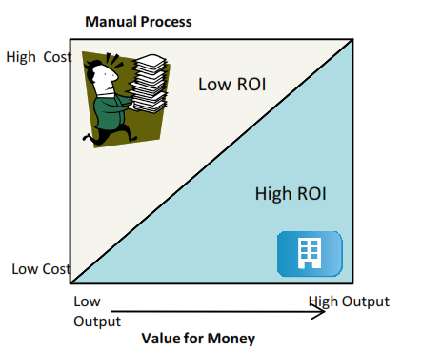
Accordant
Introduction
Adept Space and CADM have worked closed together to provides award winning space management consulting, technology solutions and outsourcing services to companies striving to optimise the efficiency of their office design, space utilisation and space administration functions while reducing costs. Adept Space is a Reseller of Accordant.
Accordant Offers:
Delivers a High Output and ROI for Low Effort and Cost
Overview
Accordant is web-based solution, designed to meet the needs of managing Real Estate and Moves in the current office environment. It provides comprehensive and easy-to-use web tools for Facilities Management that delivers
People & Asset Tracking
Moves & Change Management
Space Allocation & Recharge
Space Utilisation and Occupancy Reports
Strategic Planning and Trends
Lease
Utilisation Surveys
Assets
Resource Booking (Rooms and Hot Desks)

Slide 3
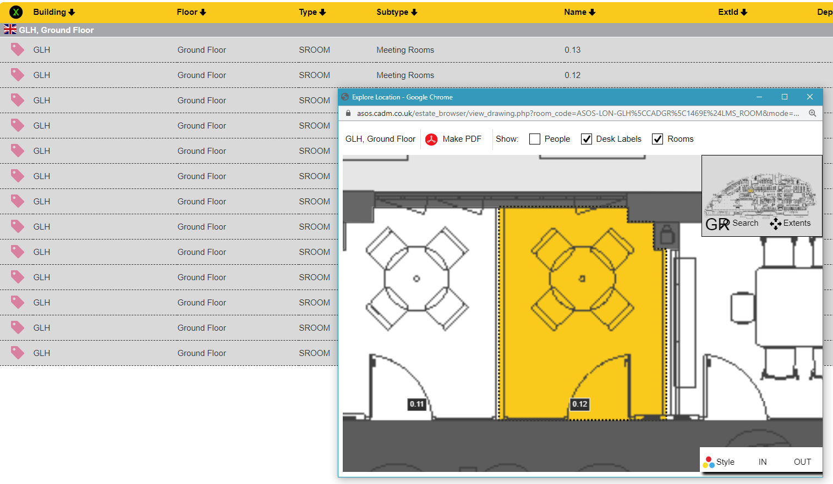
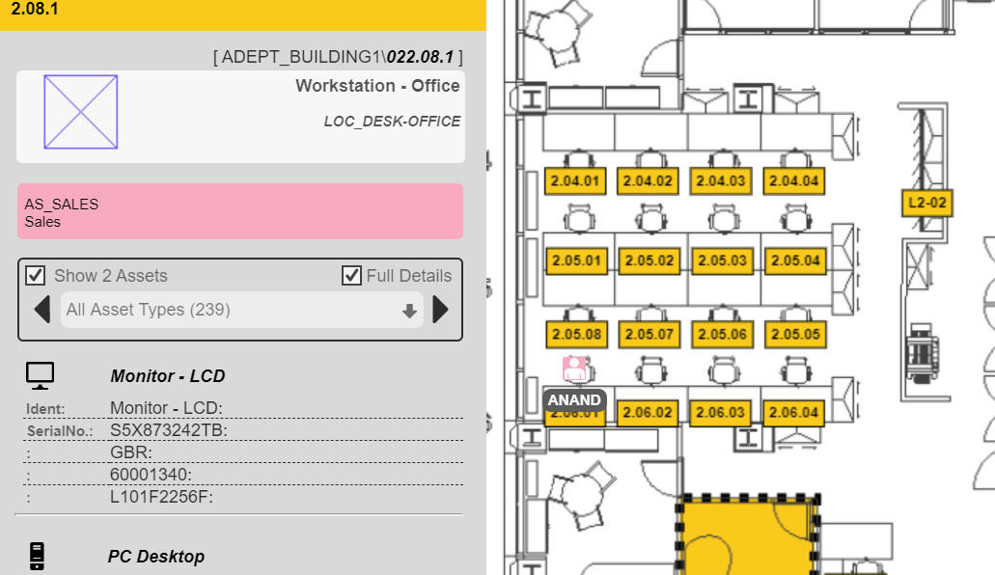
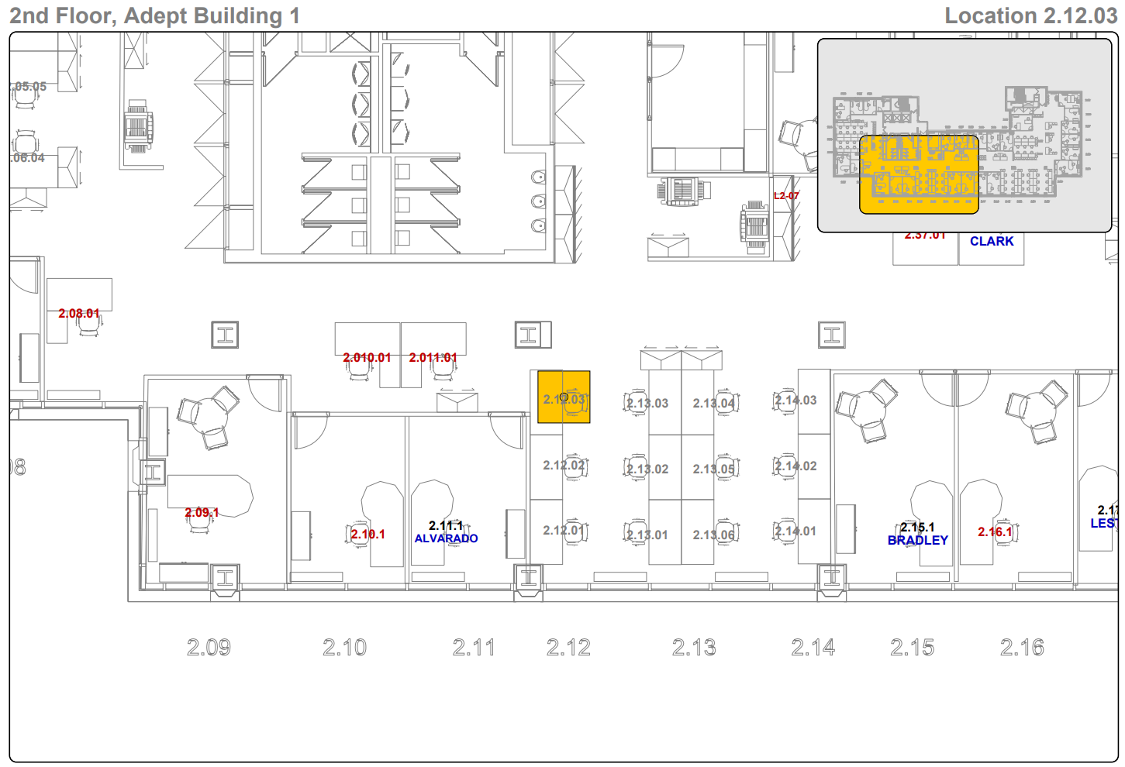
Accordant
Finder
Reports are both detailed and visual to accurate information to support informed decision making. The following is just a small sample of the reports available
Sharing Knowledge
Personnel Locater
Room Locater
The system allows a company to store and co-ordinate useful data in to one easily accessible location.
By allowing its personnel access to certain elements of the information embraces the sharing of knowledge across the firms which increase cooperation and efficiencies
Assets Tracking
Floor Plans

Slide 4
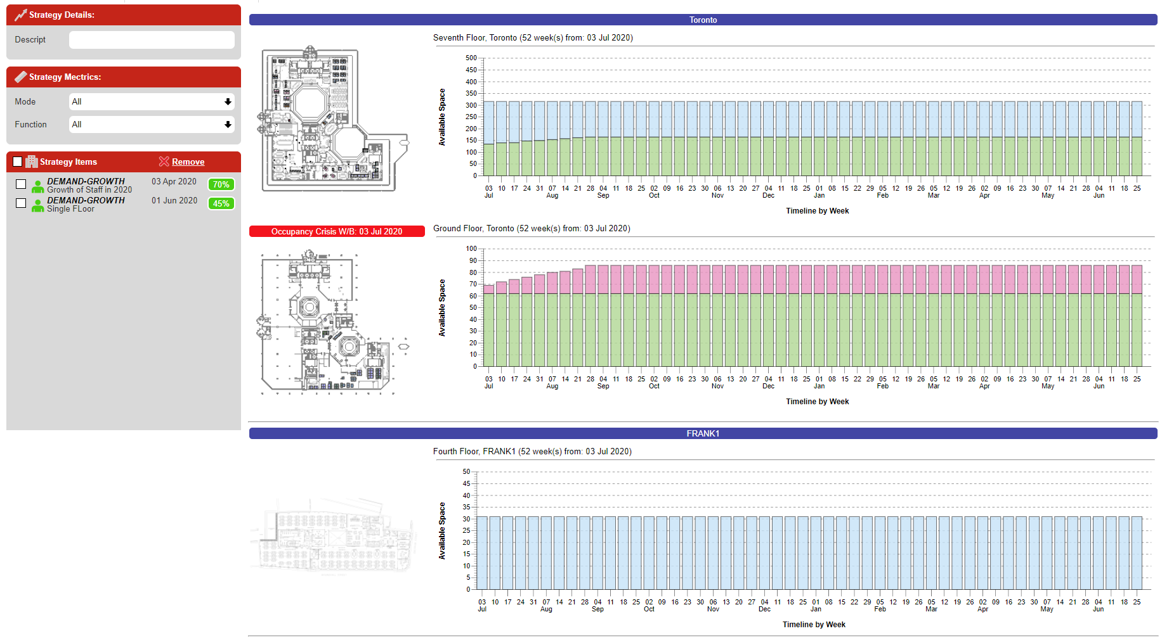
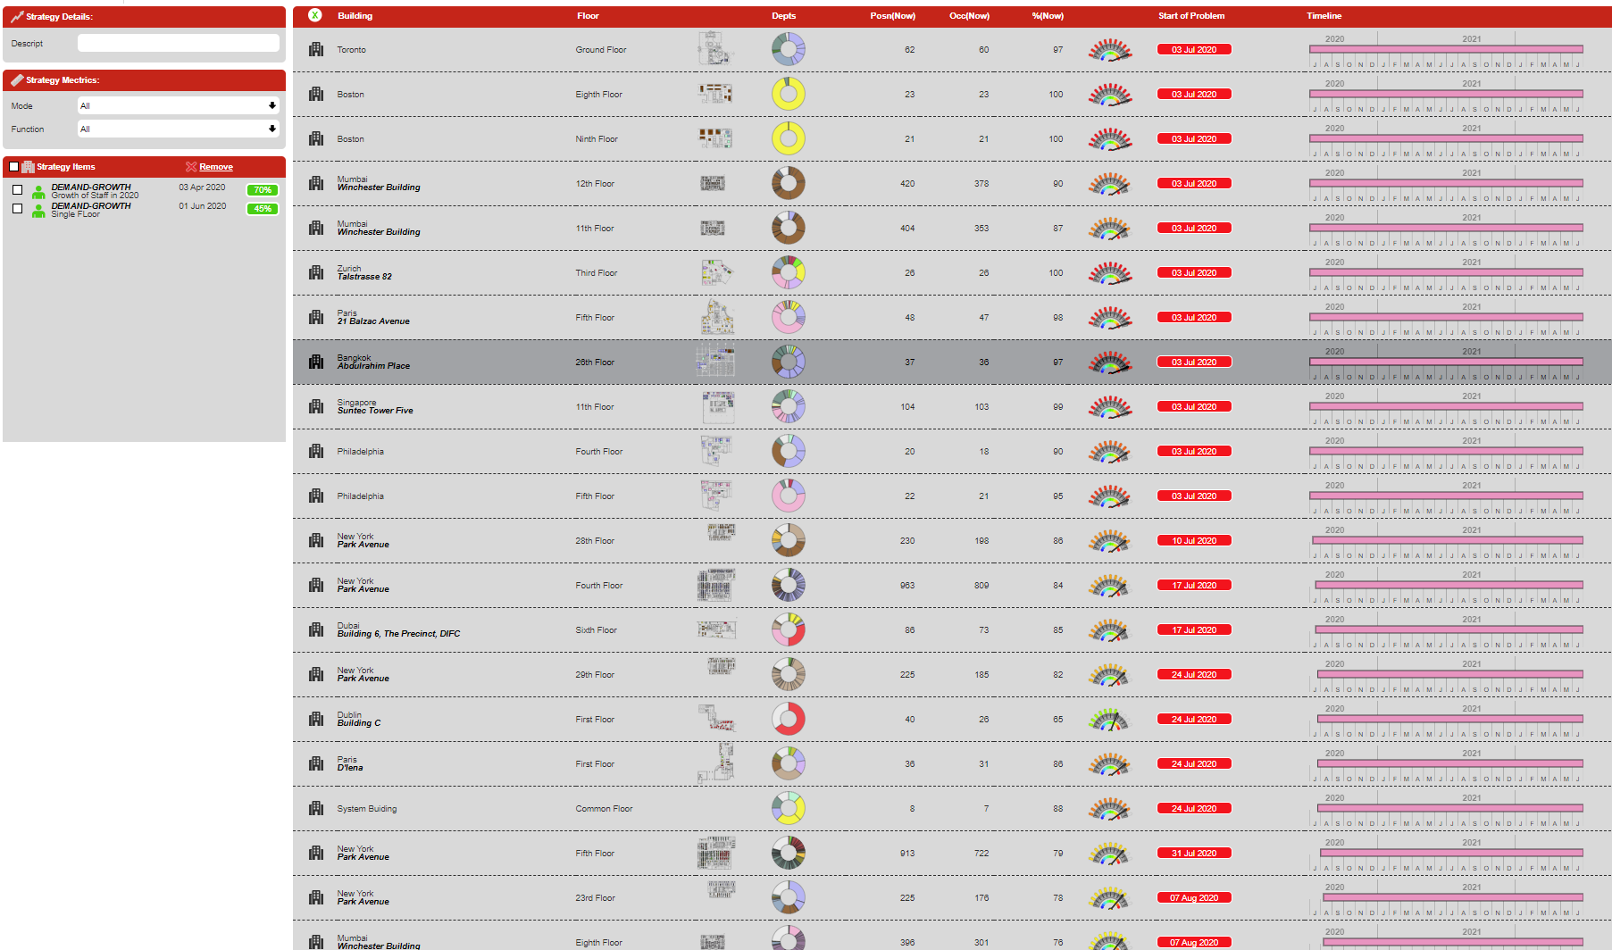
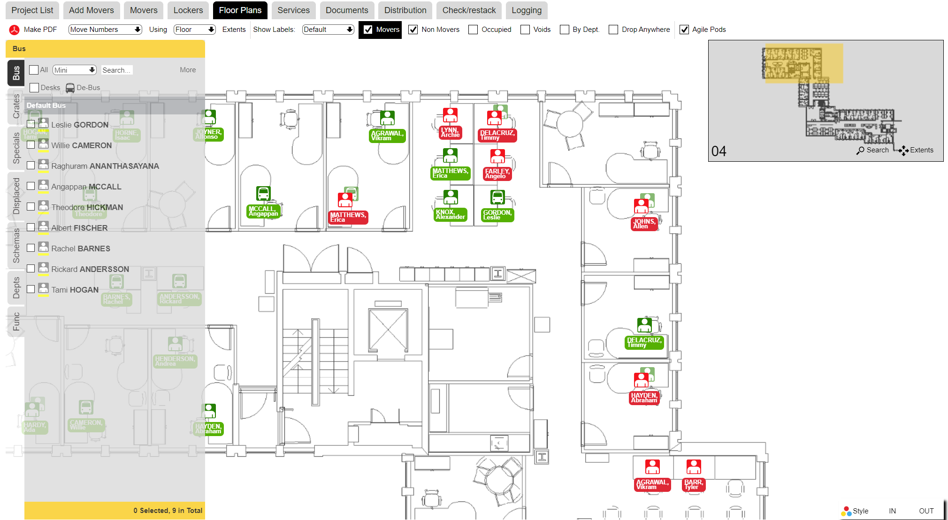
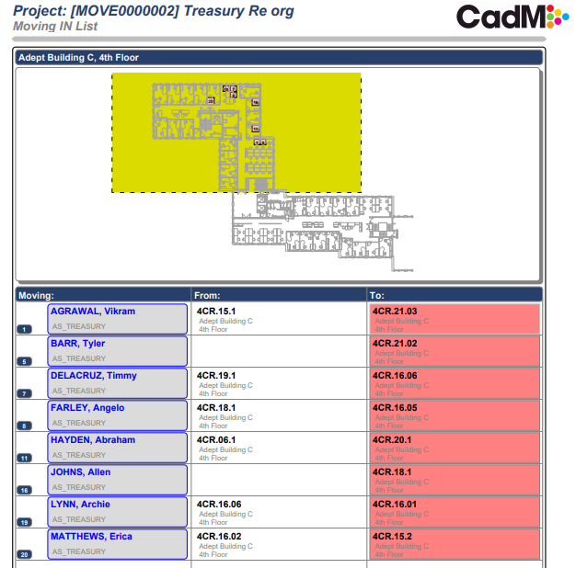
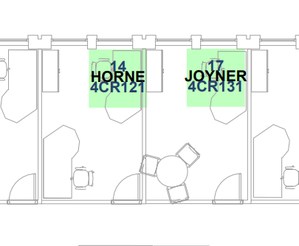
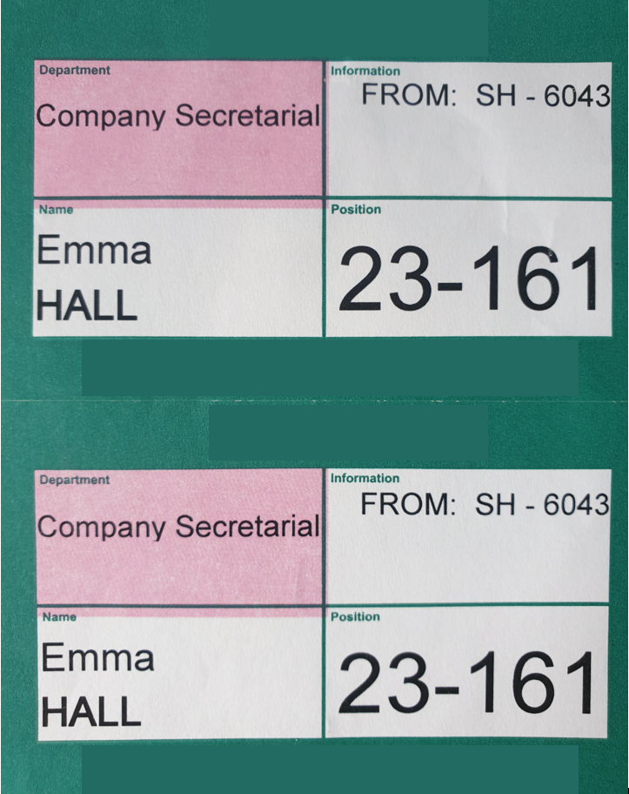
Accordant
Strategy & Moves
Accordant Provides Modules to support a client to do strategic planning all the way through to the physical move
Strategy
Strategy (Floor Points)
Strategy (Crisis Points)
Strategic Space Planning
Run projections to see when floors/buildings reach capacity
Set up best practice metrics
Compare performance on Key metrics by Building/Floor Dept etc
Plan future capacities
Interactive Stacking Planner to model reconfigurations
Moves
Strategy (Crisis Points)
Documentation
Plan, execute and communicate large scale moves
Create multiple scenarios for one move
Notify department heads when moves occur
Produce move documentation
Report on churn
Reduced admin cost

Slide 5
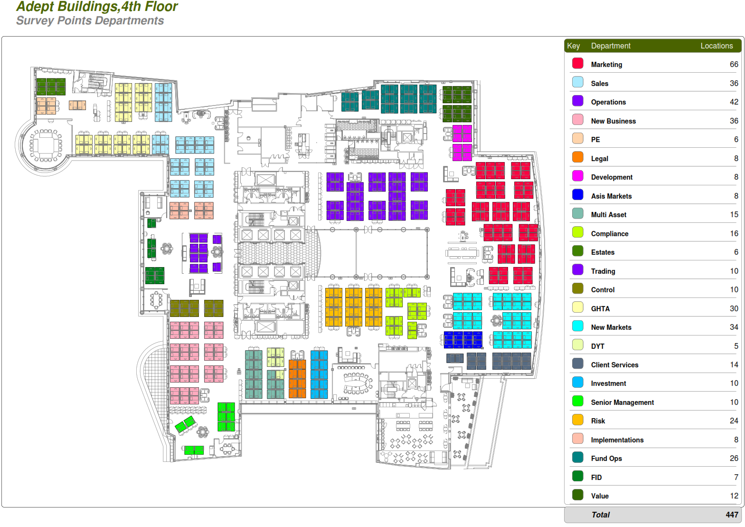
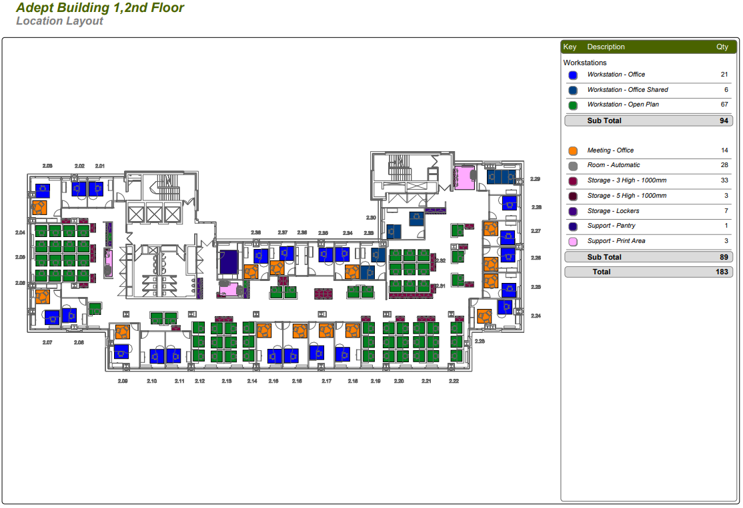
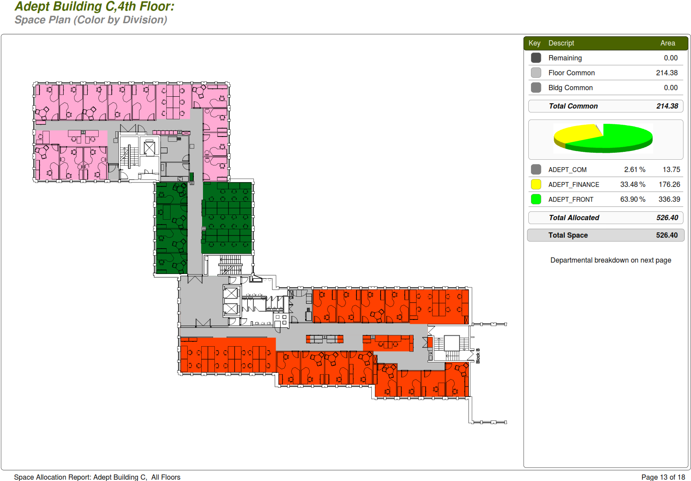
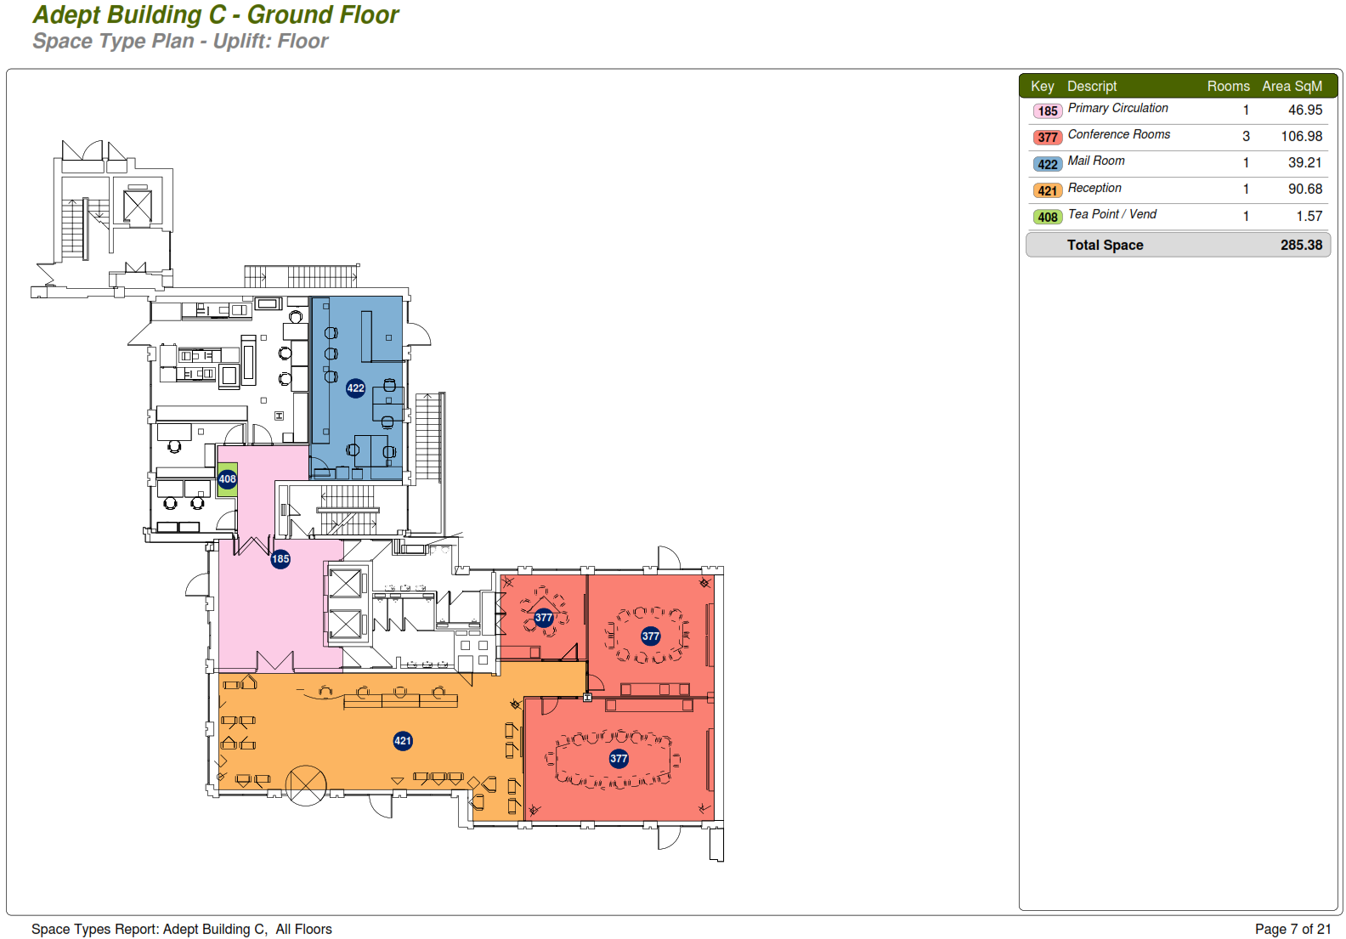
Accordant
Space & Reporting
Reports are both detailed and visual to accurate information to support informed decision making. The following is just a small sample of the reports available
Reporting
Desk Allocation
Location Types
The system allows the user to view the data from high level summaries down to the most minute detail, in both a data and visual format
The information can be made available to departments through-out the firm. This will enable these departments to increase productivity.
Room types can be tagged to the clients requirements, to give meaningful matrix
Departmental Allocation/Chargeback
Space Type Measurement

Slide 6
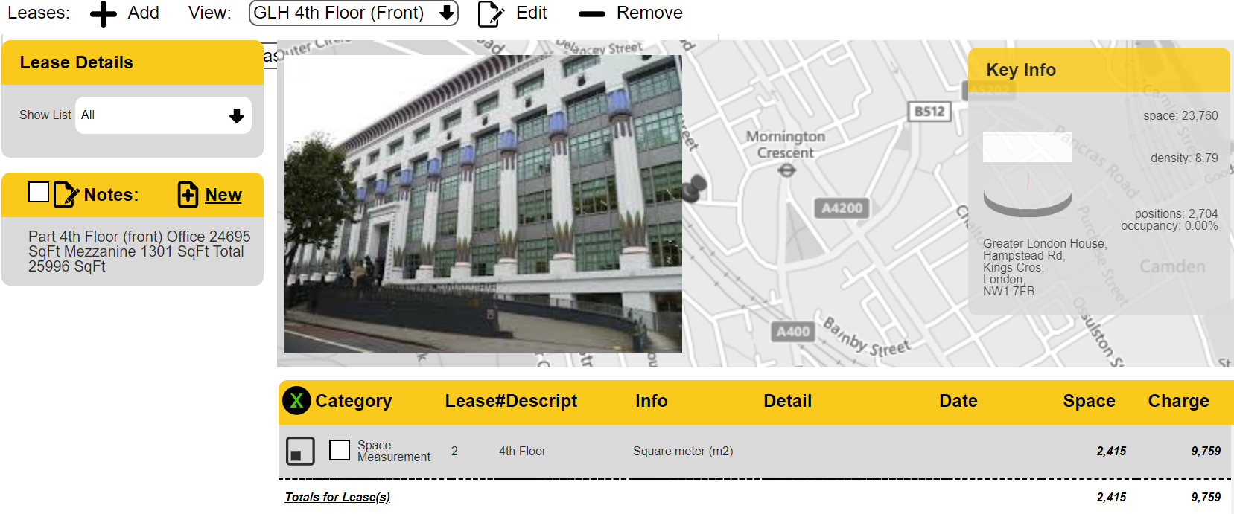
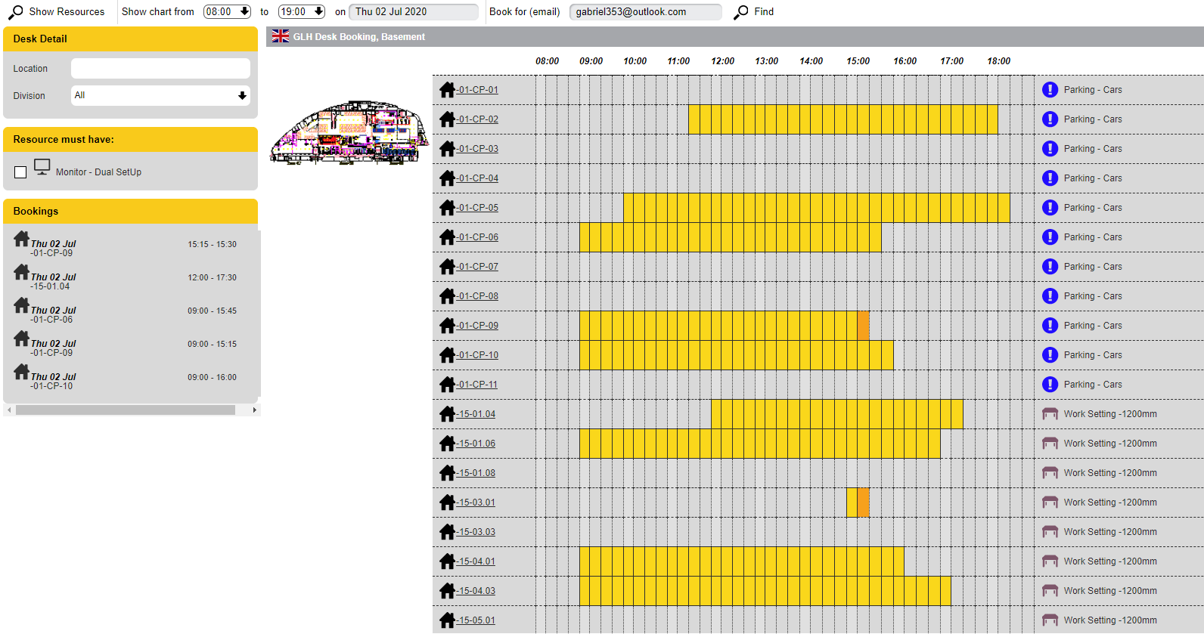
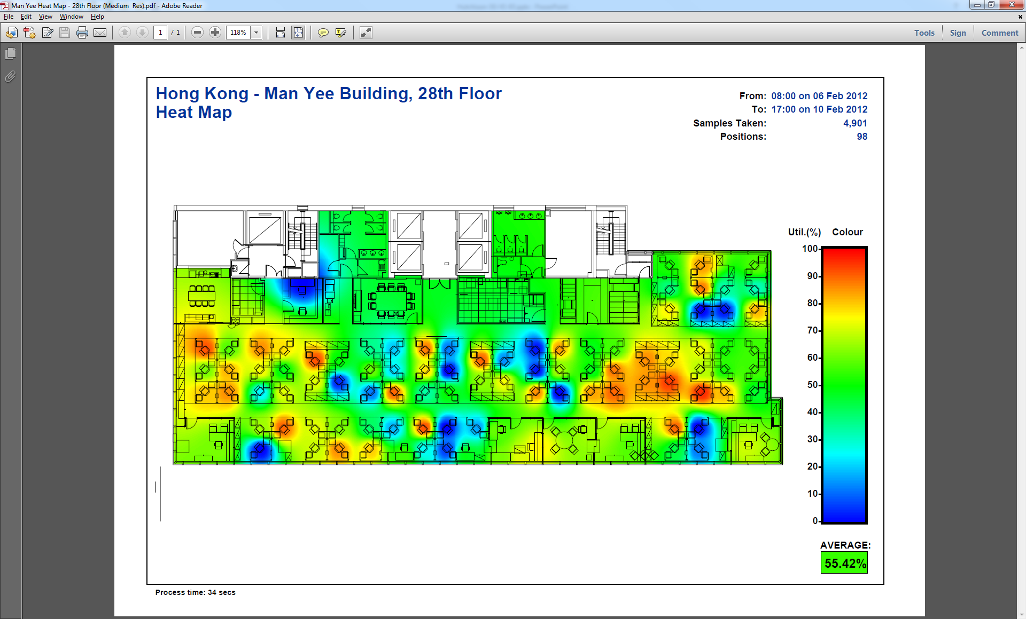
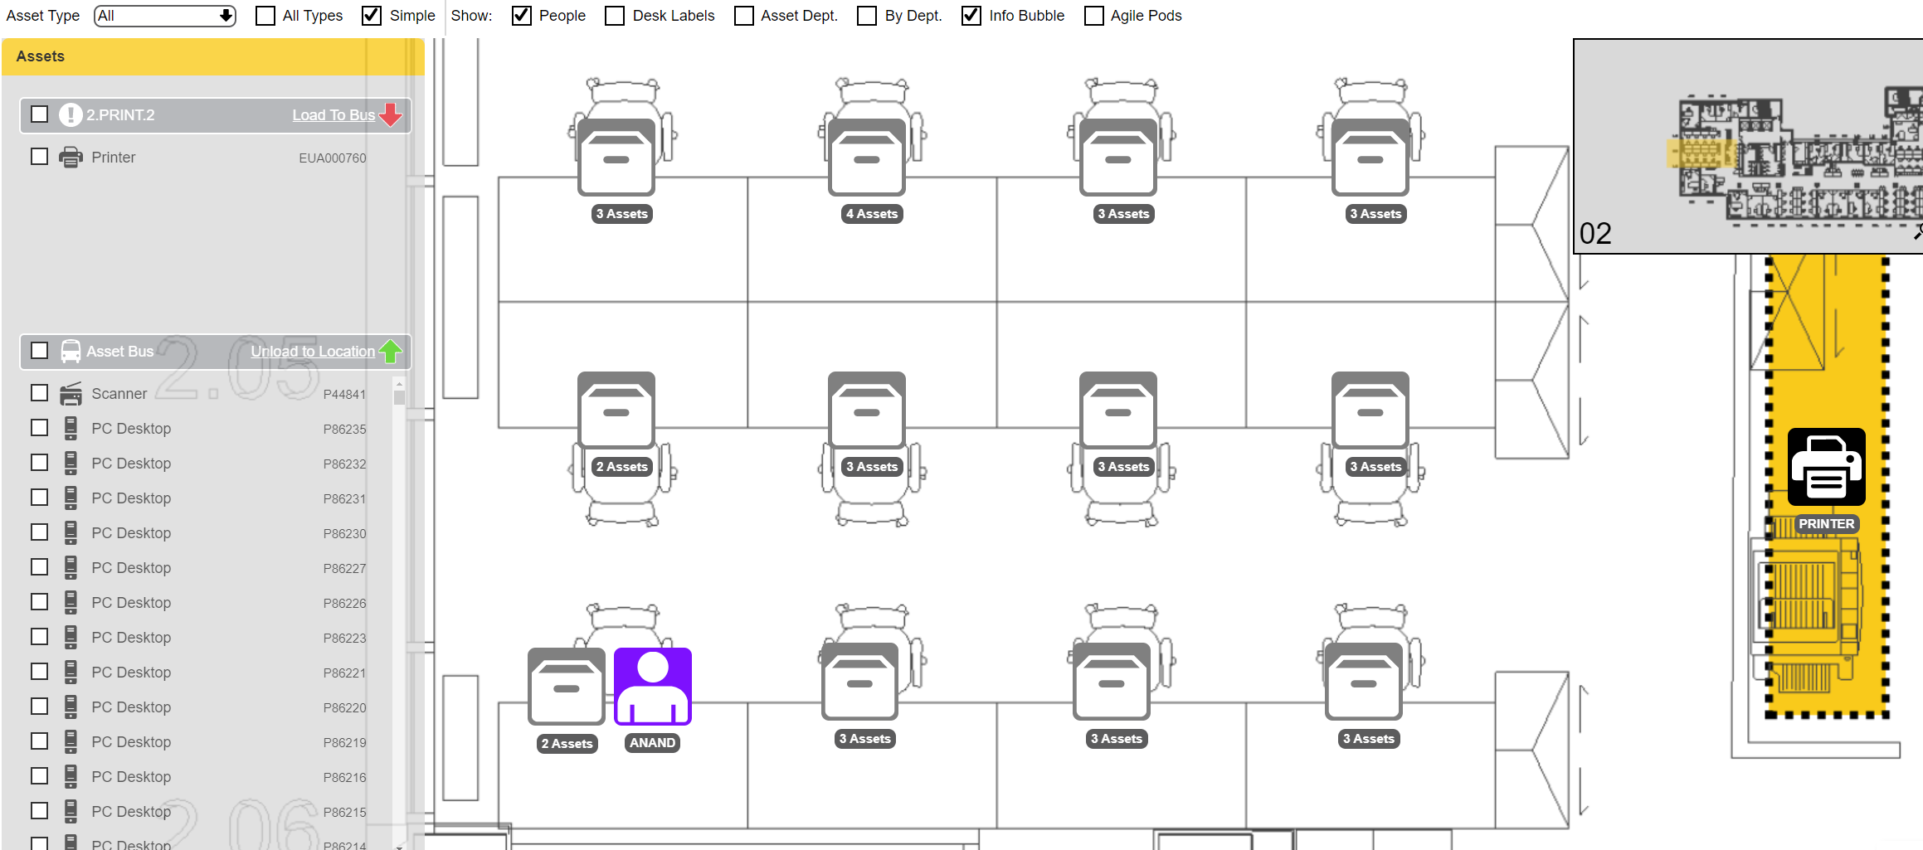
Accordant
Other Features
Accordant offers lots of others features, here is some of the Modules that are included in the software. All modules are included in the software with no additional licencing costs
Leases
Desk Booking
Utilisation
Utilisation Studies
Asset Tracking
Adept Space has used Accordant to deliver utilisation studies globally
Surveys: 360
Buildings 586
Floors: 1,833
Survey Points: 306,537
Observations : +15 million

Slide 7
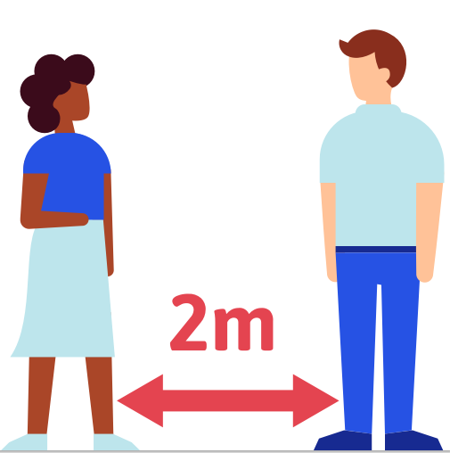
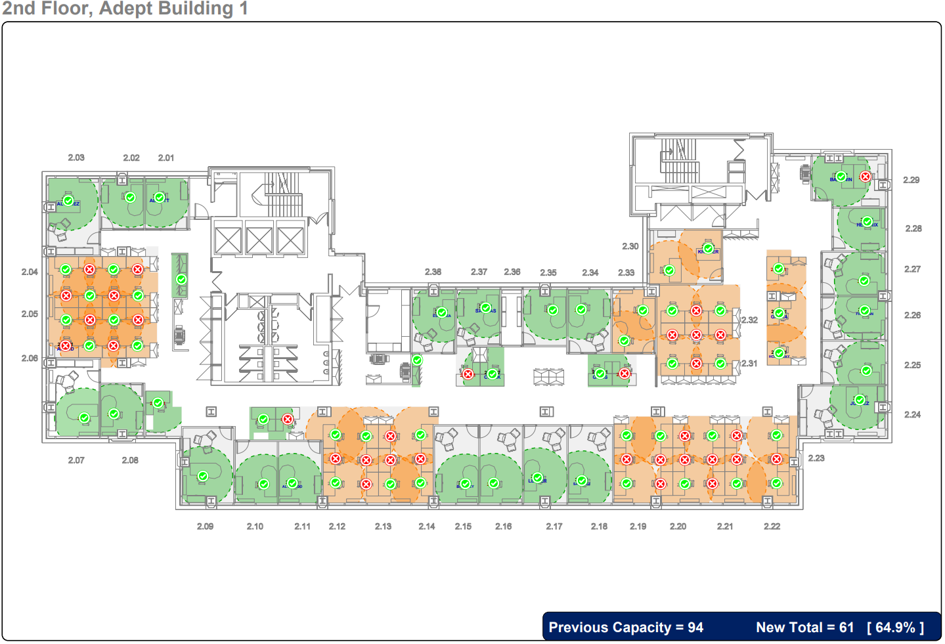
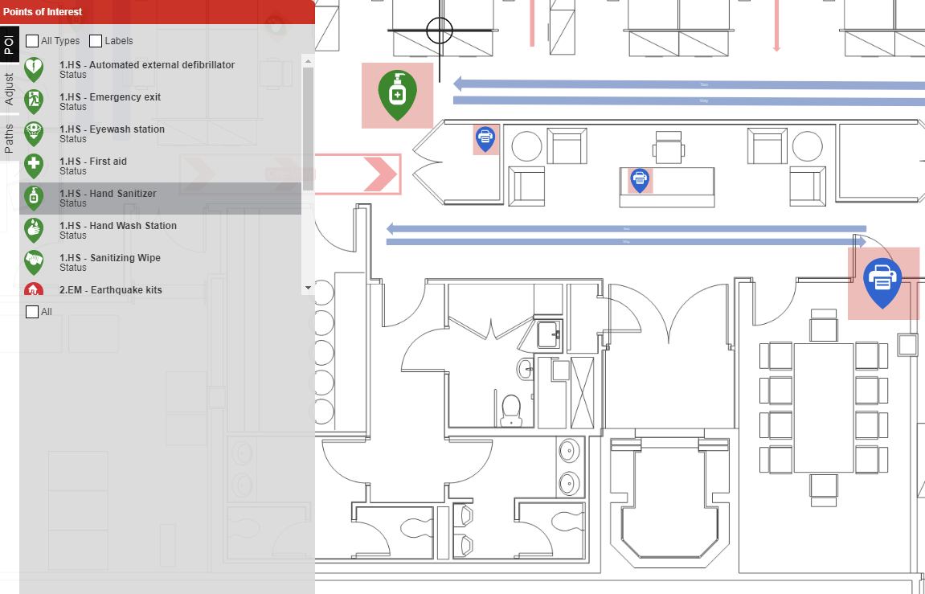
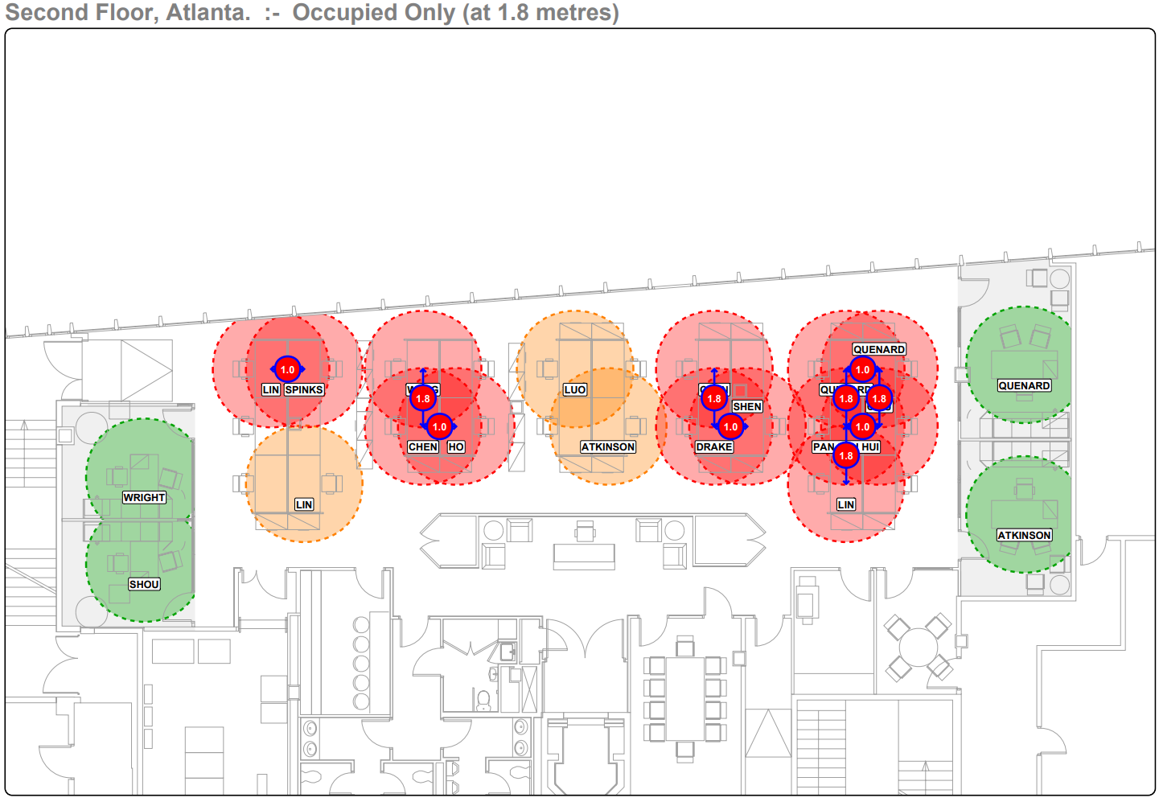
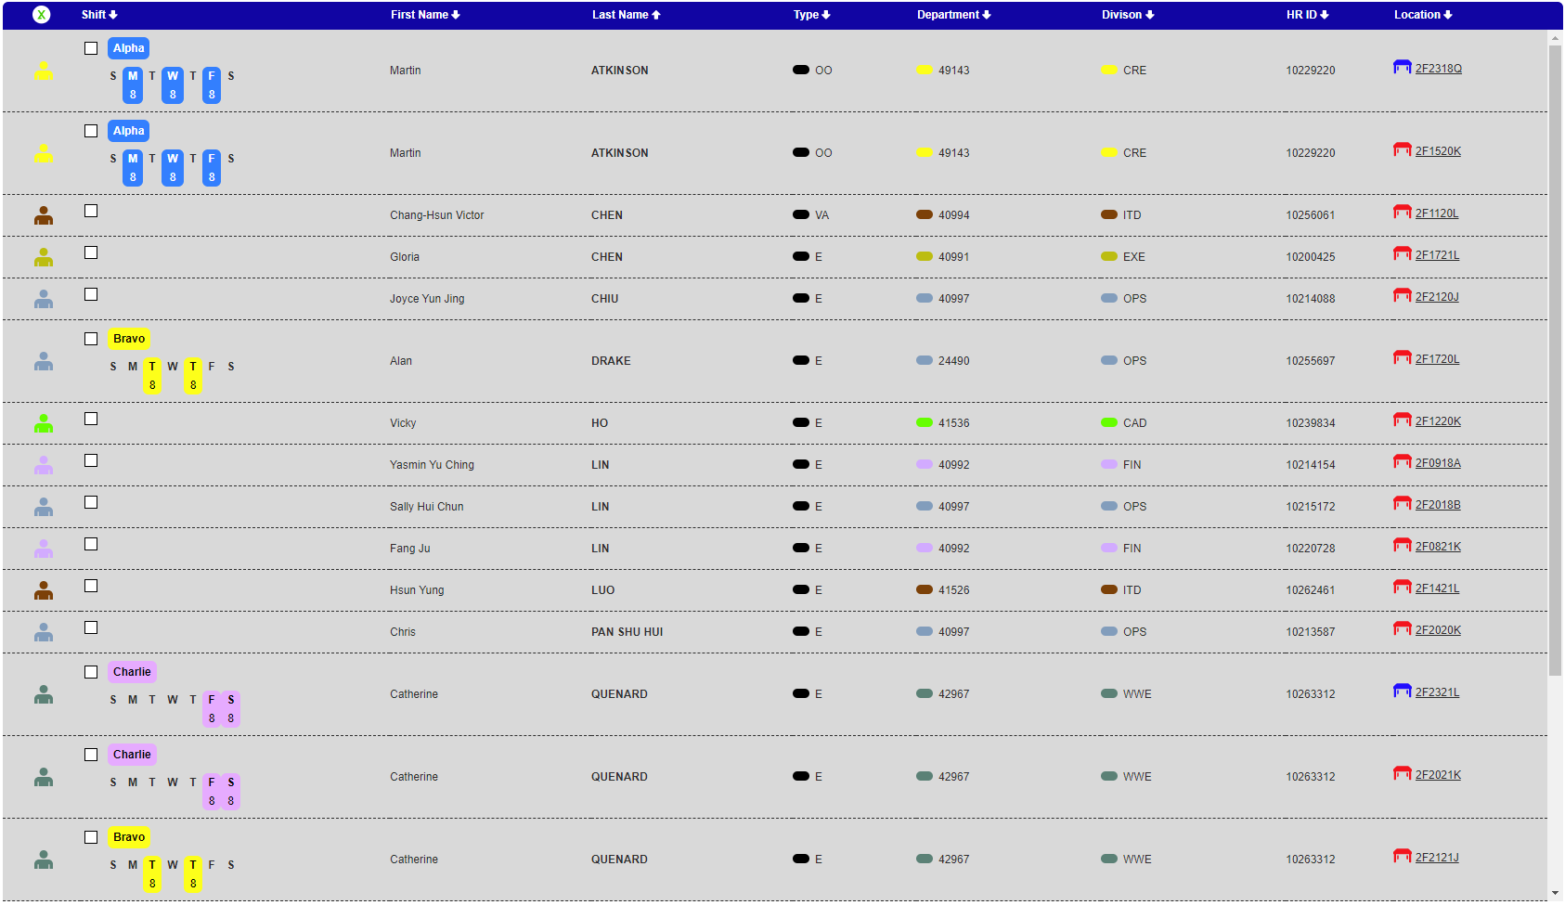
Accordant
Covid Planning
In the current climate CADM have responded to their clients needs and added a range of new features that have proved invaluable to clients using Accordant
Back to Work
Social Distance Plans
Key Features and Routes
Accordant’s Return to Work Toolkit has been developed to help you analyse your workspaces, allocating desks to employees based on the social distancing guidelines that are being provided by your regional and national government
Shift Mapping
Shift Allocation

