Slide 1
Cap Table
Allowing for Enough Rounds of Financing to Achieve Profitability

Slide 2
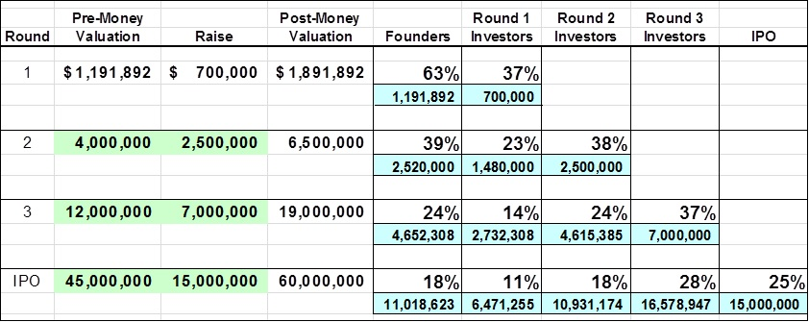
Cap Table Valuation vs. Dilution Analysis
Identify major uses of funds for each round prior to exit.
Set aside equity to recruit key executives.
Plan how to establish valuation for each round.
Identify comparables for exit (IPO or sale to larger firm).

Slide 3
Blank Slide

