Slide 1
Market Sizing

Slide 2
Document Number of people who have a need for your product or service
(Not total world population.)

Slide 3
Compute Market Size
TAM = Total Available Worldwide Market (Market size)
SAM = Serviceable Available Market
(your serviceable geography and niche)
SOM = Realistically Obtainable Market (by year)
SMART = Starting Market Target (Reasonable first year goal)
FIRST USER = Potential first customer

Slide 4
For example...
... if you make dimmable LED light bulbs, then.
TAM would be the whole worldwide lighting market.
SAM would be the worldwide dimmable LED bulbs market.
SOM would be the realistic and obtainable production and market penetration, by year

Slide 5
... Example Continued
SMART would be the conservative number of units you can make (with zero defects), sell, deliver and service in the first (pivotal) year.
FIRST USER name of first customer to whom you will sell and deliver an MVP within 6 months

Slide 6
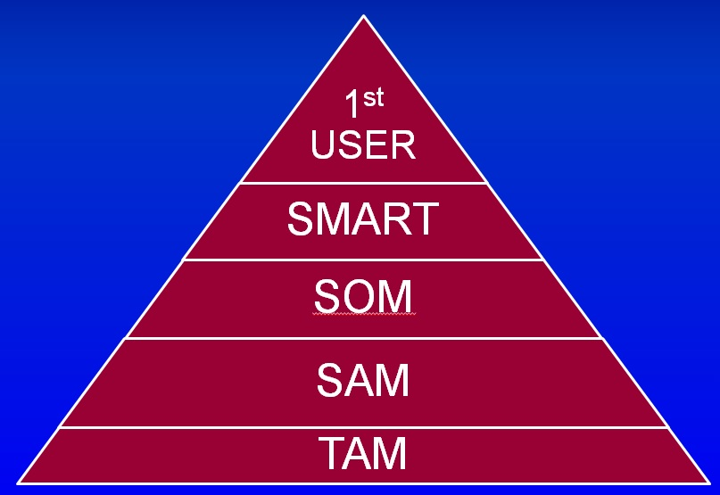
Market Size Hierarchy Chart

Slide 7
Blank Slide

