Slide 1
MEDIA AND ADVERTISING KIT
www.UnitedChestnuts.com

Slide 2
ABOUT BRANCHING OUT
Embark on a Captivating Journey
At its core, the Branching Out podcast seeks to illuminate the multifaceted nature of the chestnut industry. It serves as a platform to spotlight the industry's evolving trends and significant developments. Through engaging conversations, the podcast delves into the perspectives of different stakeholders and aims to:
Share captivating stories of individuals immersed in different facets of the chestnut journey.
Encourage listeners to join the ever-expanding chestnut movement.
Provide a collaborative space for networking and knowledge exchange.

Slide 3
OUR GUESTS
Diverse Perspectives on Chestnuts
The podcast brings forth unique voices from the industry, each contributing their own note to the chestnut narrative.
Roger
Blackwell
Jeremy
Kaufman
Food experts exploring chestnut as a
gluten-free superfood
Chestnut growers sharing experiences
and expertise
Landowners, corporate leaders, researchers, and academics offering unique perspectives
Hunters, agroforestry practitioners, suppliers, and entrepreneurs contributing insights and innovations
James “Mike”
Nave
Greg
Miller

Slide 4
OUR HOSTS
Meet Brad & Melanie
Hosted by Brad and Melanie Jones who transitioned from urban living to Central Kentucky to realize their dream of a rural lifestyle.
The Jones, deeply rooted in the chestnut industry, manage expansive orchards with thousands of chestnut trees and serve as suppliers to others entering the field.

Slide 5
EPISODE THEMES
Trends in chestnut cultivation
and consumption
What We Talk About
Discover modern approaches to chestnut
growth and utilization.
Explore a few of the themes we explore
in our episodes
Innovations in agroforestry and sustainability
Sustainable practices reshaping chestnut
farming and land management.
Expert advice and tips for aspiring chestnut enthusiasts
Valuable advice for those passionate about cultivating and enjoying chestnuts.

Slide 6
WHERE TO LISTEN
The Branching Out podcast is available on over 13 streaming platforms, including:

Slide 7
WHERE TO WATCH
Branching Out on Youtube
Discover exclusive interviews on the Branching Out Youtube channel. Dive deeper into the captivating chestnut industry with our month interview series featuring insights from industry experts, growers, researchers, and more.

Slide 8
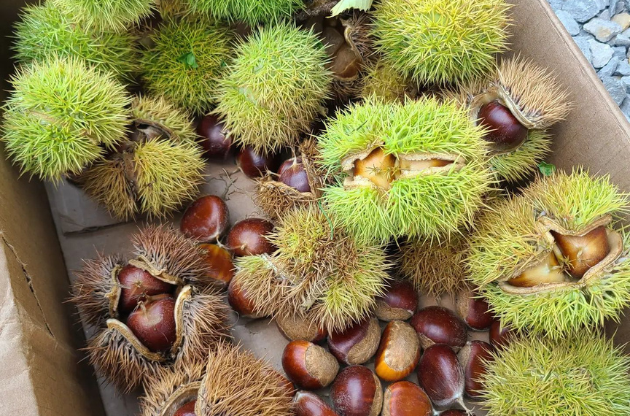
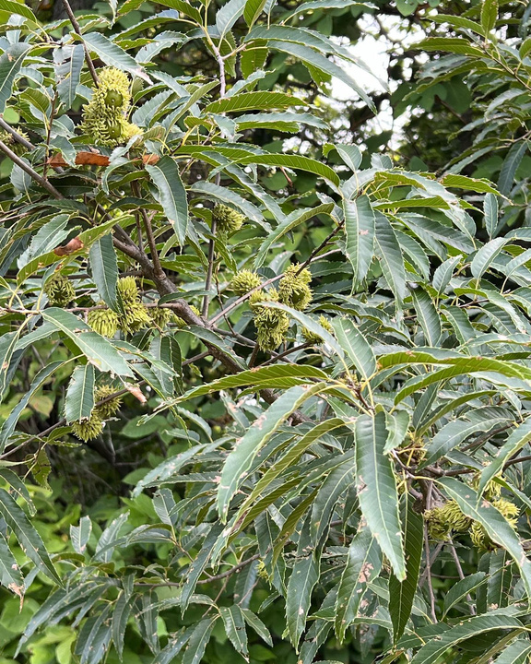
OUR NUMBERS
9 months
6,047
in operation
views
(Youtube)
125
469
subscribers
watch time
(Youtube)
(Youtube)
445
48,580
downloads
impressions
(Podcast Results)
(Youtube)
1.1K
5%
Followers
impressions click-through
(Facebook Group)
(Youtube)
*Note: All reporting is measured from August 2023 - April 2024.

Slide 9
AUDIENCE
Chestnut growers and enthusiasts
Connecting with Chestnut Enthusiasts
This includes established orchard owners, aspiring farmers considering chestnut cultivation, and hobbyists with a passion for these unique trees.
Culinary professionals and foodies
Appeal to a broad spectrum of individuals across various professions and interests.
Chefs, bakers, and adventurous home cooks seeking to incorporate versatile and delicious chestnuts into their recipes.
Sustainability advocates
Individuals interested in exploring sustainable and ecological agricultural practices embodied by the chestnut industry's revival.
Business-minded listeners
Those curious about the economic potential of chestnut production and the market for chestnuts.

Slide 10
OUR TOP 3 MARKETS
Michigan (12.69% of Downloads)
Michigan
Michigan leads in downloads, engaging chestnut enthusiasts with insightful industry narratives and trends.
Tennessee (12.19% of Downloads)
Tennessee
Tennessee embraces our podcast, exploring the rich chestnut movement and its diverse stakeholders.
New York (10.20% of Downloads)
New York listeners immerse themselves in our podcast, discovering the evolving chestnut industry and its compelling stories.
New York

Slide 11
OUR SERVICES
What Service We Offer
Partner with Branching Out for the following advertising opportunities:
Blog Sponsorship
Brand Partnerships
Advertising and Sponsorships
Feature your brand or product in our blog posts related to chestnut industry topics.
Collaborate on integrated campaigns to amplify your brand's presence within the chestnut community.
Elevate your brand with targeted pre-roll, mid-roll, or post-roll advertising slots within our podcast episodes. Connect with chestnut growers, food processors, culinary brands, and kitchenware manufacturers through tailored sponsorship opportunities.
Native Advertising
Consulting or Services
Seamlessly integrate sponsored content into our episodes, allowing your brand to authentically connect with our audience.
Leverage our expertise for consulting services, workshops, or personalized guidance within the chestnut industry.

Slide 12
PRICING PLANS
Affordable Pricing Plans
BASIC
ENHANCED
CUSTOM
$500
$1,000
Talk to Us
Custom banner on the blog post
Recorded audio advertisement during the podcast
Logo inclusion on two graphics for social media featuring podcast content
Audio and video pre-roll, mid-roll, and post-roll commercials
Custom banner on the blog post*
Logo inclusion on two graphics for social media featuring podcast content
Banner can be an image or text with a link to your website or product.
One dedicated Facebook post and mention promoting sponsored episode and content.
Want a package that is customized to your brand’s needs? Reach out and we can discuss a custom solution.

Slide 13
Thank You
Thank you for exploring our media and advertising kit. We look forward to collaborating with you to showcase your brand and connect with our dedicated audience. Together, let's branch out and grow within the flourishing chestnut industry!
Get in touch
270.449.1150
678.234.4894
melanie@unitedchestnuts.com

