Slide 1
DIRECT FAMILY ENGAGEMENT AND ADVOCACY ACTIVITIES
Session 1A: Introduction – Building Relationships
Presenter Name | Title
Flint Families

Slide 2
SESSION 1A AGENDA
Welcome ​
Overview of Ready Set Succeed
Introduction to Direct Family Engagement & Advocacy Activities
Purpose of Session​ 1A
Discussion: How Will We Work Together
Next Steps
2

Slide 3
Mindfulness Activity
Take a deep Breath
Close your eyes
Take a few deep breaths to ground yourself in work you about to do with Ready Set Succeed
Focus on the children, teachers and families in Flint. What do you value most about relationships with your child’s school?
Photo Source: https://www.apa.org/topics/mindfulness/meditation
3

Slide 4
Pair Share with the following Questions
What are you most excited about when it comes to your child entering Kindergarten?
What are you most concerned about when it comes to your child entering Kindergarten?
ICEBREAKER
What Are Your Thoughts?
4
Notes:
Facilitator:
Ask participants to pair up with someone to discuss the questions.
Bring the larger group together to share their responses

Slide 5
Overview of Ready Set Succeed

Slide 6
What is Ready Set Succeed?
Ready Set Succeed is a community-wide, relationship-based approach to improve preschool to kindergarten transitions for Black children and their families in Flint, Michigan. The initiative includes 5 components strategically created to engage all important adults in a child's life—community partners, families, educators, school leaders— as well as the children themselves, to all be ready for the kindergarten transition.
The overarching goal of Ready Set Succeed is to improve kindergarten transitions in Flint, with a focus on racial equity.
6
Notes:
Ready Set Succeed is a community-wide, relationship-based approach to improve preschool to kindergarten transitions for Black children and their families in Flint. The initiative includes six components strategically created to engage all important adults in a student’s life—community partners, families, educators, school leaders— as well as the students themselves, to all be ready for the kindergarten transition.
The overarching goal of Ready Set Succeed is to improve kindergarten transitions in Flint, with a focus on racial equity.
To achieve this goal, Ready Set Succeed includes six components to strengthen relationships between kindergarten and preschool educators, help families navigate the kindergarten transition, familiarize scholars with the kindergarten environment, and address issue of racial bias against Black children head-on. Each components provides tailored content to the major partners in a child’s life and education. The six core components will together transform kindergarten transitions for students in Flint.

Slide 7
Ready Set Succeed Core Components
7
Notes:
Facilitator Notes
Professional Development on Culturally Responsive Instruction: This core component sets the foundation for all other work in Ready Set Succeed. Preschool and kindergarten educators and school leaders will complete PD with an improved understanding of the link between racial systems of oppression, implicit biases, and culturally responsive Instruction
Building Bridges: Four meetings of educators and school leaders across Flint to break down silos and create common goals and shared understanding between PreK and Kindergarten educators.
Family Visits: Support strong home–school connections by partnering with families as experts in their children’s education. This includes sharing real-time information about the children’s development and co-creating educational goals.
Buddy Visits: Preschool children will be paired with classroom buddies in Kindergarten to help them become familiar with the elementary school experience.
Direct Family Engagement & Advocacy Activities: Meetings to strengthen the educational advocacy skills of families and caregivers to better support their children as they transition into kindergarten and throughout their educational career.

Slide 8
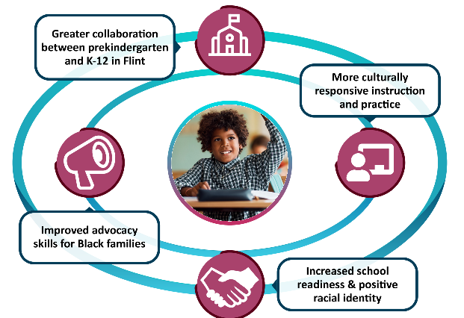
Intended Outcomes:
An Ecological Approach
8

Slide 9
INTRODUCTION TO DIRECT FAMILY ENGAGEMENT & ADVOCACY ACTIVITIES

Slide 10
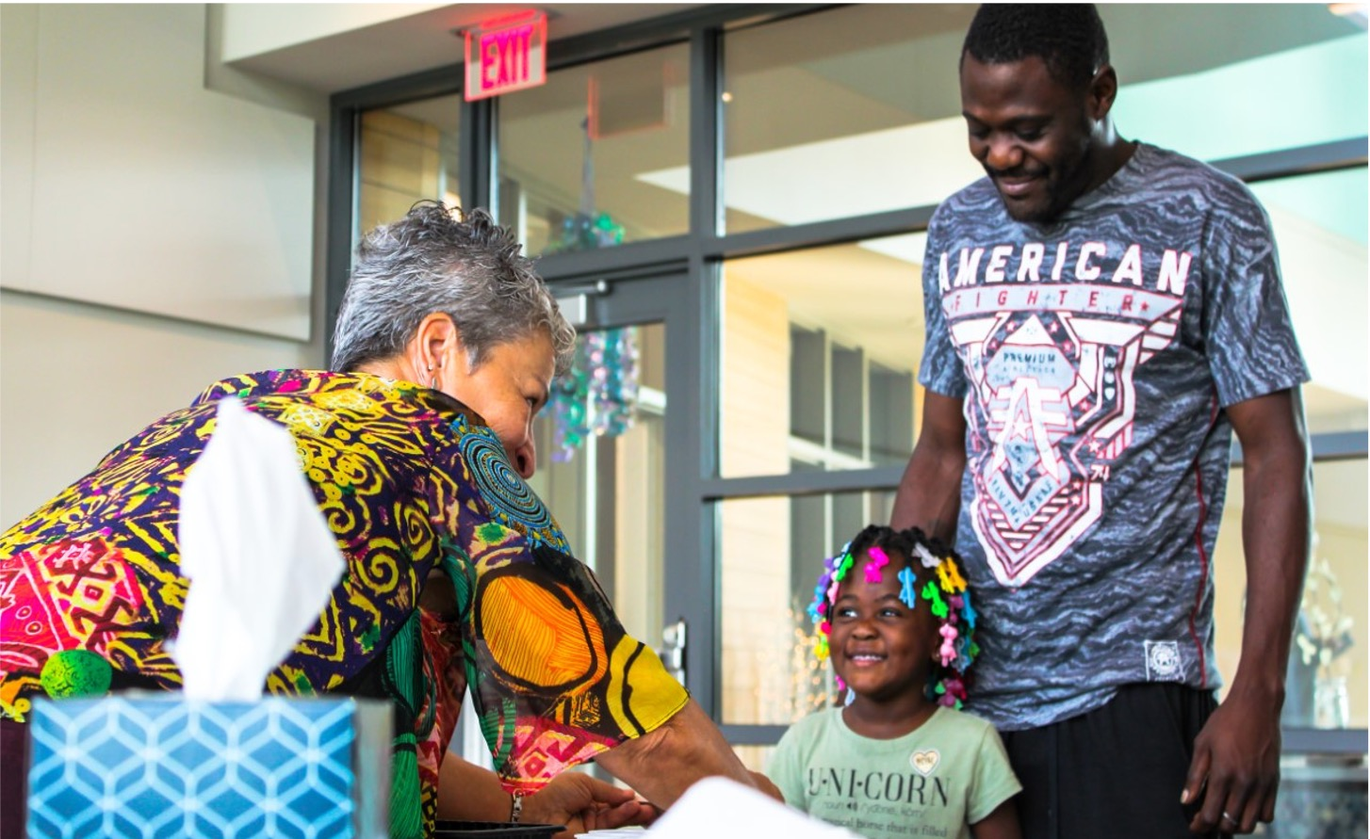
Goals and Objectives of Direct Family Engagement and Advocacy Activities
Ready Success Succeed (Ready Set Succeed) will bring families together to strengthen their educational advocacy skills to support their children as they transition into kindergarten and throughout their educational career.
Monthly family meetings held at a time that’s good for families (childcare & food provided, as needed)
A mix of structured & open content/topics
Led by Family Engagement Advocates at each school
Groups are held separately at each school
10

Slide 11
Family Engagement Sessions
Session 1: Introduction: Building Relationships—This session is for families to connect with each other and learn about Ready Set Succeed. In addition, families will use this time to think about the hopes and dreams they have for their rising kindergarten student.
Session 1A – Learning about Ready Set Succeed and family engagement activities
Session 1B – Reflection on hopes and dreams for your rising Kindergartener
Session 2: Learning from Each Other: Effective Communication—This session allows families time to discuss ways to have effective communication teachers, and school leaders.
Session 3: Understanding School-Based Advocacy in ECE—This session is for families to learn about problem-solving, managing conflict and dealing with discrimination in schools.
Part A – Addressing Discrimination Through Advocacy
Part B – Strategies and Tools to Manage Conflict
Session 4: Understanding Your Rights in Special Education—This session is for families to learn about special education services offered in their community and discuss family’s rights and the rights of children in preschool and kindergarten
Session 5: Understanding Schools as Organizations—This session is for families to learn more about their school districts and discuss their kindergarten school choices community
Session 6: Family-School Partnerships Fair—This session is for families to learn more about how strong family-school partnerships help their child grow and learn.
You are here
11

Slide 12
Purpose of Session 1A
Today PreK Families will…
Learn about the purpose and goals of Ready Set Succeed
Introduce themselves and discuss what brought them to the meeting
Discuss future meeting topics
12

Slide 13
Getting to Know Each Other

Slide 14
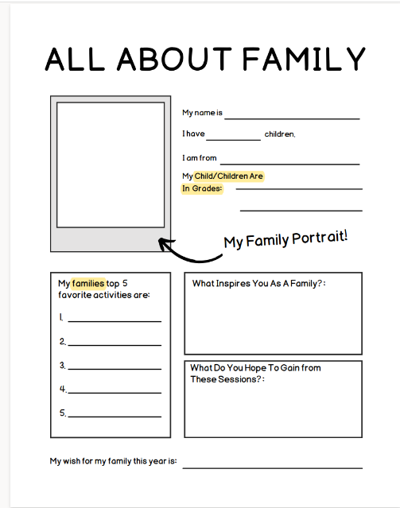
All About Family
The Facilitator will provide everyone a copy of the handout
Form groups of 3- 5 people
Introduce yourself to the group
Take 15 mins as a group to discuss the questions on the handout
Choose a group spokesperson(s) to share group responses
14
Notes:
Facilitator: This part of the meeting is important. A goal of the meeting is to build rapport and engagement amongst families, and foster Collegiality amongst the families. We want to encourage the families to feel a familiarity with each other and connect to their inspirations as families
Ask Parents to get into groups of 3 to 5 participants.
Please introduce yourself to your group and answer the questions below.
You will have 15 minutes to answer and discuss the questions.
Once you have completed answering the questions, vote for a spokesperson for your group to share out your responses to the questions when called upon.

Slide 15
PURPOSE OF FAMILY/SCHOOL ENGAGEMENT

Slide 16
Family Meetings Strengthen Parents Advocacy for Children
During Family Meetings you will:
Meet and learn from other families
Talk to each other and get answers to your questions
Receive important information about kindergarten and the choices you have as a parent
Gain tools to help you advocate for child while in kindergarten
Build stronger bonds between you and your child’s school.
16
Notes:
Our family meetings are a time for us to meet, talk together, and answer any questions you might have.
Families will learn from each other during our meetings.
We will also share important information about kindergarten and the choices you have as a parent.
We will also work together to help you to advocate for child while in kindergarten.
We also hope that our family meetings will build stronger bonds between you and your child’s school. Having a good relationship with your child’s preschool can help them grow and learn.

Slide 17
Family Small Group Questionnaire
The Facilitator will provide everyone a copy of handout
Please take 10 minutes in small group to share your responses to the questions
17
Notes:
Facilitator: Ask families to work together to discuss how they would like to proceed with future meetings and discussions.
Break the families into small groups
pass out the Family Small Work Group Questionnaire

Slide 18
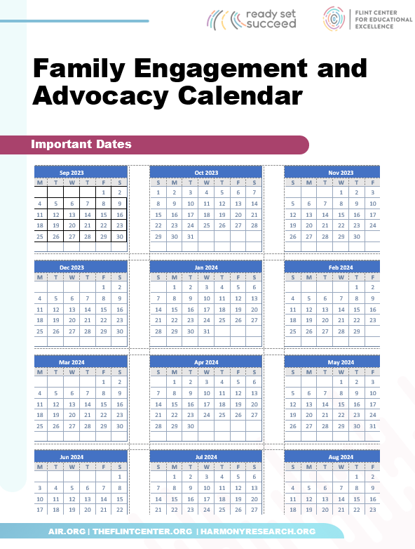
Purpose of Family Engagement Activities
The Facilitator will provide everyone a copy of handouts
18
Notes:
Facilitator: Please note that proposed calendar dates should be selected prior to the meeting
Review and discuss purpose of Family engagement activities
Share calendar and proposed time commitment for families

Slide 19
Family Meeting Schedule
During the school year
6 meetings together
Meetings will happen after school
Duration: 1 hour
Dinner and childcare will be provided
If you have ideas about what would work better for families, please let us know!
Jnunn@theflintcenter.org
19
Notes:
During the school Year
we will have 6 meetings together
Meetings will happen after school.
Meetings will last for 1 hour
We will provide dinner and childcare to make it easy for you to attend.
If you have ideas about what would work better for families, please let us know!

Slide 20
Proposed Family Meeting Dates
Meeting 1: (Include dates)
Meeting 2
Meeting 3
Meeting 4
Meeting 5
Meeting 6
20
Notes:
During the school Year
we will have 6 meetings together
Meetings will happen after school.
Meetings will last for 1 hour
We will provide dinner and childcare to make it easy for you to attend.
If you have ideas about what would work better for families, please let us know!

Slide 21
Next Steps

Slide 22
Next Steps
Session 1B
Vision Board: Reflection on Hope & Dreams for Your Rising Kindergartener
If you have questions, please feel free to reach out to the Ready Set Succeed team at Jnunn@theflintcenter.org
22

Slide 23
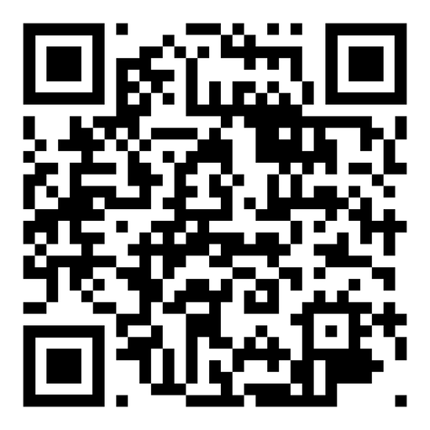
Ready Set Succeed Survey:
Please share any other comments or concerns you have by calling our Digital Comment Card Voicemail Number or contact us via email:
(202) 403-5493
Tryznar@air.org
23

Slide 24
THANK YOU!
Presenter Name Presenter Job Title Phone Number Email Address

