Slide 1
DIRECT FAMILY ENGAGEMENT AND ADVOCACY ACTIVITIES
Session 1B: Vision Board—Reflection on Hopes and Dreams For Your Kindergartener
Presenter Name | Title
Flint Families

Slide 2
SESSION 1B AGENDA
Welcome ​
Overview of Ready Set Succeed
Introduction to Direct Family Engagement & Advocacy Activities
Purpose of Session​ 1B
Activity: Create Your Vision Board
Discussion: A Vision for School Support
Next Steps
2

Slide 3
Mindfulness Activity
Take a deep Breath
Close your eyes
Take a few deep breaths to ground yourself in work you about to do with Ready Set Succeed
Focus on the children, teachers and families in Flint. Center yourselves on your hopes and dreams for your child.
Photo Source: https://www.apa.org/topics/mindfulness/meditation
3

Slide 4
LIST HERE
ANNOUNCEMENTS
4
Notes:
Facilitator:
List school activities and announcements you would like to share with the families

Slide 5
Overview of Ready Set Succeed

Slide 6
What is Ready Set Succeed?
Ready Set Succeed is a community-wide, relationship-based approach to improve preschool to kindergarten transitions for Black children and their families in Flint, Michigan. The initiative includes 5 components strategically created to engage all important adults in a child's life—community partners, families, educators, school leaders— as well as the children themselves, to all be ready for the kindergarten transition.
The overarching goal of Ready Set Succeed is to improve kindergarten transitions in Flint, with a focus on racial equity.
6
Notes:
Ready Set Succeed is a community-wide, relationship-based approach to improve preschool to kindergarten transitions for Black children and their families in Flint. The initiative includes six components strategically created to engage all important adults in a student’s life—community partners, families, educators, school leaders— as well as the students themselves, to all be ready for the kindergarten transition.
The overarching goal of Ready Set Succeed is to improve kindergarten transitions in Flint, with a focus on racial equity.
To achieve this goal, Ready Set Succeed includes six components to strengthen relationships between kindergarten and preschool educators, help families navigate the kindergarten transition, familiarize scholars with the kindergarten environment, and address issue of racial bias against Black children head-on. Each components provides tailored content to the major partners in a child’s life and education. The six core components will together transform kindergarten transitions for students in Flint.

Slide 7
Ready Set Succeed Core Components
7
Notes:
Facilitator Notes
Professional Development on Culturally Responsive Instruction: This core component sets the foundation for all other work in Ready Set Succeed. Preschool and kindergarten educators and school leaders will complete PD with an improved understanding of the link between racial systems of oppression, implicit biases, and culturally responsive Instruction
Building Bridges: Four meetings of educators and school leaders across Flint to break down silos and create common goals and shared understanding between PreK and Kindergarten educators.
Family Visits: Support strong home–school connections by partnering with families as experts in their children’s education. This includes sharing real-time information about the children’s development and co-creating educational goals.
Buddy Visits: Preschool children will be paired with classroom buddies in Kindergarten to help them become familiar with the elementary school experience.
Direct Family Engagement & Advocacy Activities: Meetings to strengthen the educational advocacy skills of families and caregivers to better support their children as they transition into kindergarten and throughout their educational career.

Slide 8
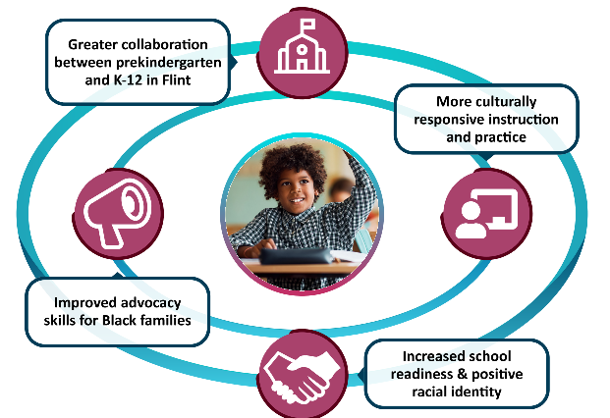
Intended Outcomes:
An Ecological Approach
8

Slide 9
INTRODUCTION TO DIRECT FAMILY ENGAGEMENT & ADVOCACY ACTIVITIES

Slide 10
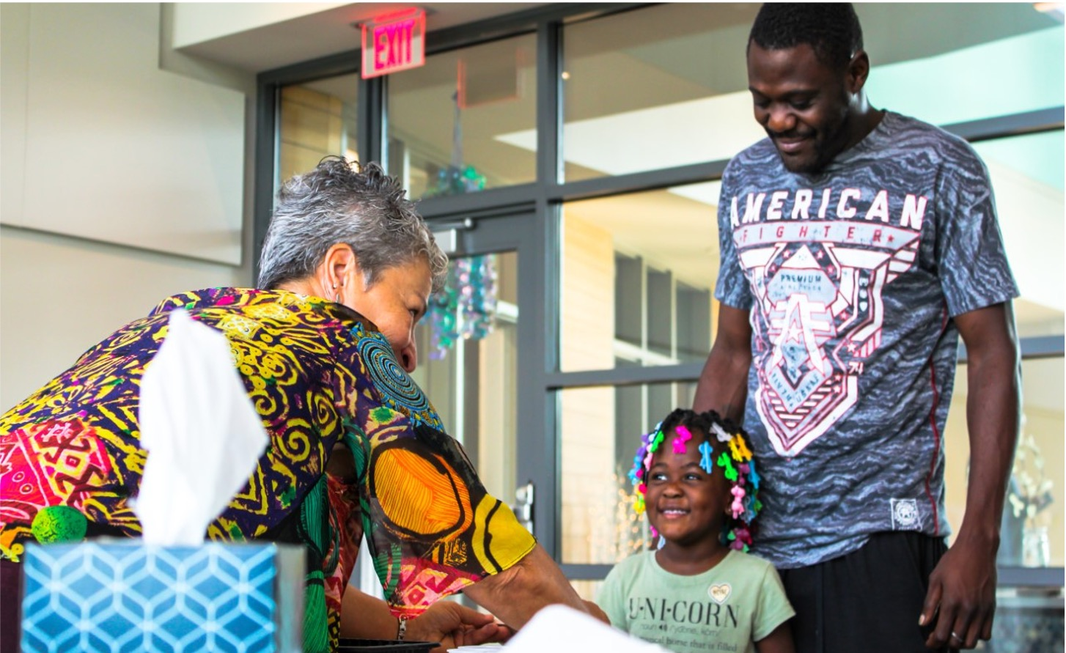
Goals and Objectives of Direct Family Engagement and Advocacy Activities
Ready Success Succeed (Ready Set Succeed) will bring families together to strengthen their educational advocacy skills to support their children as they transition into kindergarten and throughout their educational career.
Monthly family meetings held at a time that’s good for families (childcare & food provided, as needed)
A mix of structured & open content/topics
Led by Family Engagement Advocates at each school
Groups are held separately at each school
10

Slide 11
Family Engagement Sessions
Session 1: Introduction: Building Relationships—This session is for families to connect with each other and learn about Ready Set Succeed. In addition, families will use this time to think about the hopes and dreams they have for their rising kindergarten student.
Session 1A – Learning about Ready Set Succeed and family engagement activities
Session 1B – Vision Board: Reflection on hopes and dreams for your rising Kindergartener
Session 2: Learning from Each Other: Effective Communication—This session allows families time to discuss ways to have effective communication teachers, and school leaders.
Session 3: Understanding School-Based Advocacy in ECE—This session is for families to learn about problem-solving, managing conflict and dealing with discrimination in schools.
Part A – Addressing Discrimination Through Advocacy
Part B – Strategies and Tools to Manage Conflict
Session 4: Understanding Your Rights in Special Education—This session is for families to learn about special education services offered in their community and discuss family’s rights and the rights of children in preschool and kindergarten
Session 5: Understanding Schools as Organizations—This session is for families to learn more about their school districts and discuss their kindergarten school choices community
Session 6: Family-School Partnerships Fair—This session is for families to learn more about how strong family-school partnerships help their child grow and learn.
You are here
11

Slide 12
Purpose of Session 1B
Today PreK Families will…
Create a vision board that includes their hopes and dreams for their rising Kindergartener
Discuss ways the school can support your vision
12

Slide 13
CREATING YOUR VISION BOARD
Notes:
Facilitator:
Review what a vision board is and explain the boards can include photos, phrases, words, quotes, drawings, or anything that captures your vision

Slide 14
What is a Vision Board?
A vision board:
Is intended to inspire you to manifest your dreams and get where you want to go.
It’s comprised of a collage of cut out pictures and images, words and phrases that represent goals and dreams
14
Notes:
Photo Source: https://www.rachellewelling.com/blog/how-to-create-a-2020-digital-vision-board

Slide 15
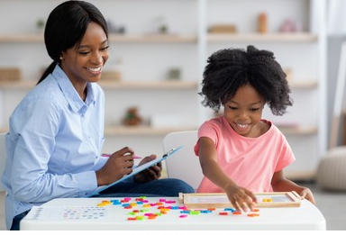
Tips for Making A Vision Board
Explore your values
What really matters to you for your child and family?
What are your goals for your child?
What will you do and what do you need from others?
Set Priorities
What can you reasonably accomplish?
15
Notes:
Start by exploring your values. If your goals are not aligned with your personal values, achieving these goals won't provide the sense of satisfaction and well-being that you're seeking. Ask yourself, what really matters to you? What gives you meaning? Who do you want to be? Who do you want to help? And how do you want to spend your time? When making a vision board and thinking through your goals, keep these values-focused questions in mind.
What will you do to manifest what you desire for your child and your family And what do you need from others (i.e., your child’s school)?
Set priorities. If we really want to achieve goals for your child and family, you need to be more realistic with them. What can we reasonably accomplish in a year or five years? You can visualize your priorities by focusing a vision board on your most important life goals or by placing them above, in the center, or over a greater majority of the board.
Photo source: https://www.shutterstock.com/search/black-woman-child-kindergarten

Slide 16
Let’s Get Started
Materials are available for use:
Magazines
Glues, Markers, Tape
Please take 20 minutes to create your first draft
16
Notes:
Direct families to all the materials available to them
Allow families 20 minutes to create a draft vision board (let them know they can always add to the board)
Play music and encourage families to engage in organic conversation or provide the conversations starters handout. (See materials for handout)
Photo Source: https://www.rachellewelling.com/blog/how-to-create-a-2020-digital-vision-board

Slide 17
PRESENT YOUR VISION BOARD

Slide 18
Present Your Vision Board
What are Your Hopes and Dreams for Your Child?
In the Interest of time, please limit your presentation to 5-minutes
18

Slide 19
WHAT SUPPORT DO YOU NEED FROM THE SCHOOL?

Slide 20
Desired Future and Support
Please break into small groups for 10 minutes to discuss:
What support do you need from your child’s school to achieve the hopes and dreams you have for them?
20
Notes:
Facilitator: Ask families to work together to discuss what they see for themselves in the future and what support do they need from their child’s school to achieve these hopes and dreams?
Break the families into small groups
In large group: Ask individuals to share their responses t

Slide 21
Next Steps

Slide 22
Next Steps
Next Meeting Session 2
Learning from Each Other: Effective Communication
If you have questions, please feel free to reach out to the Ready Set Succeed team at Jnunn@theflintcenter.org
22
Notes:
Session 2: Learning from Each Other: Effective Communication—This session allows families time to discuss ways to have effective communication teachers, and school leaders.

Slide 23
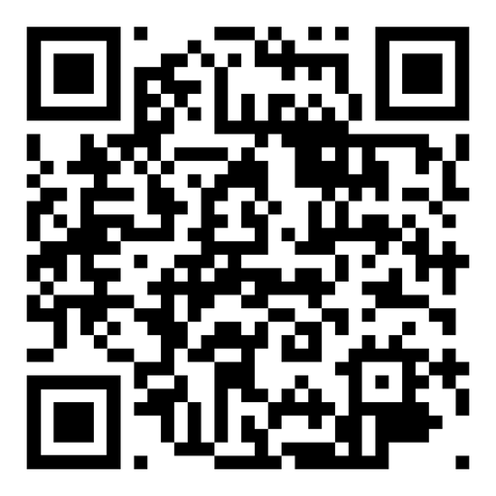
Ready Set Succeed Survey:
Please share any other comments or concerns you have by calling our Digital Comment Card Voicemail Number or contact us via email:
(202) 403-5493
Tryznar@air.org
23

Slide 24
THANK YOU!
Presenter Name Presenter Job Title Phone Number Email Address

