Slide 1
Direct Family Engagement and Advocacy
Family-School Partnerships: Community Fair
Presenter Name | Title
Flint Educators, School Leaders, and Families

Slide 2
Welcome to the Family, School & Community Fair!

Slide 3
SESSION 6:
AGENDA​
Welcome to the Family, School, & Community Fair
Introductions
Overview of Ready Set Succeed
Introduction to Family Engagement & Advocacy
Goal of Session 6
Presentations from Community Organizations and Education Programs
Fill out the Feedback Survey

Slide 4
Please share:
Your name
Share one word to describe how you’re feeling
Introductions
Who is here today?
4

Slide 5
Mindfulness Activity
Take a deep Breath
Close your eyes
Take a few deep breaths to ground yourself in work you about to do with Ready Set Succeed
Reflect upon this statement:
FLINT KIDS THRIVE!
Photo Source: https://www.apa.org/topics/mindfulness/meditation
5

Slide 6
Overview of Ready Set Succeed

Slide 7
Ready Set Succeed Core Components
7
Notes:
Facilitator Notes
Professional Development on Culturally Responsive Instruction: This core component sets the foundation for all other work in Ready Set Succeed. Preschool and kindergarten educators and school leaders will complete PD with an improved understanding of the link between racial systems of oppression, implicit biases, and culturally responsive Instruction
Building Bridges: Four meetings of educators and school leaders across Flint to break down silos and create common goals and shared understanding between PreK and Kindergarten educators.
Family Visits: Support strong home–school connections by partnering with families as experts in their children’s education. This includes sharing real-time information about the children’s development and co-creating educational goals.
Buddy Visits: Preschool children will be paired with classroom buddies in Kindergarten to help them become familiar with the elementary school experience.
Direct Family Engagement & Advocacy Activities: Meetings to strengthen the educational advocacy skills of families and caregivers to better support their children as they transition into kindergarten and throughout their educational career.

Slide 8
What is Ready Set Succeed?
Ready Set Succeed is a community-wide, relationship-based approach to improve preschool to kindergarten transitions for Black children and their families in Flint, Michigan. The initiative includes 5 components strategically created to engage all important adults in a student’s life—community partners, families, educators, school leaders— as well as the children themselves, to all be ready for the kindergarten transition.
The overarching goal of Ready Set Succeed is to improve kindergarten transitions in Flint, with a focus on racial equity.
8
Notes:
Ready Set Succeed is a community-wide, relationship-based approach to improve preschool to kindergarten transitions for Black children and their families in Flint. The initiative includes six components strategically created to engage all important adults in a student’s life—community partners, families, educators, school leaders— as well as the students themselves, to all be ready for the kindergarten transition.
The overarching goal of Ready Set Succeed is to improve kindergarten transitions in Flint, with a focus on racial equity.
To achieve this goal, Ready Set Succeed includes six components to strengthen relationships between kindergarten and preschool educators, help families navigate the kindergarten transition, familiarize scholars with the kindergarten environment, and address issue of racial bias against Black children head-on. Each components provides tailored content to the major partners in a child’s life and education. The six core components will together transform kindergarten transitions for students in Flint.

Slide 9
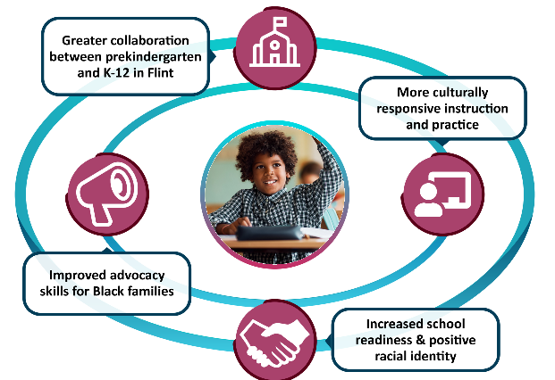
Intended Outcomes:
An Ecological Approach
9

Slide 10
INTRODUCTION TO FAMILY ENGAGEMENT & ADVOCACY

Slide 11
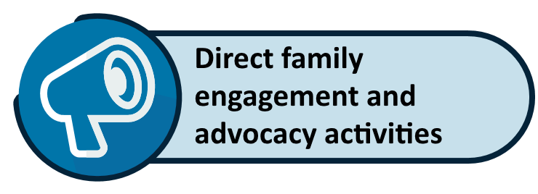
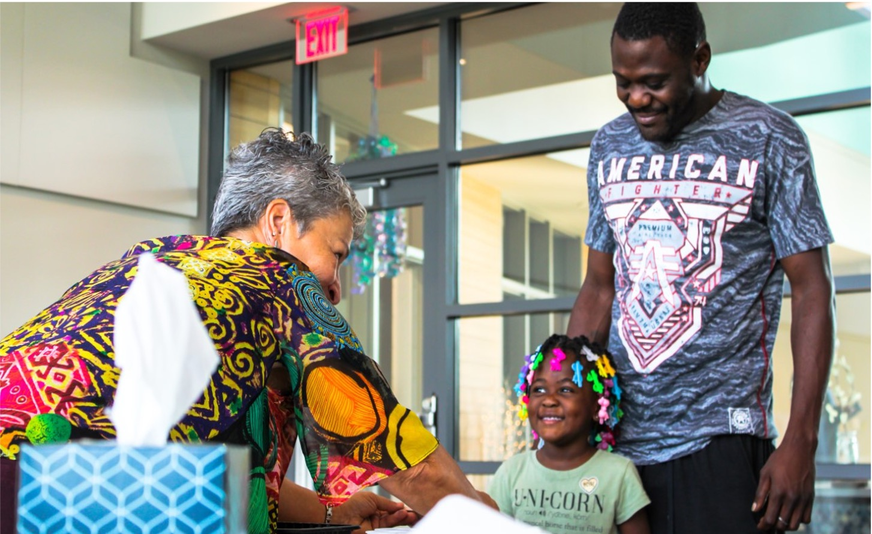
Goals and Objectives of Family Engagement and Advocacy
Family Engagement and Advocacy of Ready Success Succeed (Ready Set Succeed) will bring families together to strengthen their educational advocacy skills to support their children as they transition into kindergarten and throughout their educational career.
Activities in these sessions are focused on family involvement and collaboration with schools.
11

Slide 12
Goals and Objectives of Family Engagement and Advocacy
Monthly family meetings held at a time that’s good for families (childcare & food provided, as needed)
A mix of structured & open content/topics
Led by Family Engagement Advocates at each school
Groups are held separately at each school
12

Slide 13
Family Engagement Sessions
Session 1: Introduction: Building Relationships—This session is for families to connect with each other and learn about Ready Set Succeed. In addition, families will use this time to think about the hopes and dreams they have for their rising kindergarten student.
Session 2: Learning from Each Other: Effective Communication—This session allows families time to discuss ways to have effective communication teachers, and school leaders.
Session 3: Understanding School-Based Advocacy in ECE—This session is for families to learn about problem-solving, managing conflict and dealing with discrimination in schools.
Part A – Addressing Discrimination Through Advocacy
Part B – Strategies and Tools to Manage Conflict
Session 4: Understanding Your Rights in Special Education—This session is for families to learn about special education services offered in their community and discuss family’s rights and the rights of children in preschool and kindergarten
Session 5: Understanding Schools as Organizations—This session is for families to learn more about their school districts and discuss their kindergarten school choices community
Session 6: Family-School Partnerships Fair—This session is for families to learn more about how strong family-school partnerships help their child grow and learn.
You are here
13

Slide 14
Purpose of Session 6
Today PreK families will …
Learn about community education-based programs in the area
Network and collaborate with school and community organizations
14

Slide 15
DISCUSSION: WHAT DO YOU KNOW ABOUT RESOURCES AND SERVICES?

Slide 16
What Do You Know?
What resources and services are you aware of to benefit families in the Flint community?
How do you engage with your school and community?
16
Notes:
Photo Source: https://www.independent.com/2019/05/18/seeking-help-is-a-sign-of-strength/

Slide 17
PRESENTATIONS FROM FLINT COMMUNITY-BASED ORGANIZATIONS

Slide 18
Presentations
LIST PRESENTATION NAMES & AFFILIATIONS HERE
18
Notes:
Facilitator: List organizations and representatives here

Slide 19
Next Steps

Slide 20
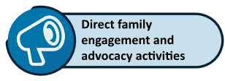
Congratulations!
You Have Completed
Direct Family Engagement and Advocacy Activities
Session 1: Introduction: Building Relationships
Session 2: Learning from Each Other: Effective Communication
Session 3: Understanding School-Based Advocacy in ECE
Session 4: Understanding Your Rights in Special Education
Session 5: Understanding Schools as Organizations
Session 6: Family-School Partnerships Fair
We want to hear from you! Please complete the feedback survey.
Additional information will follow in preparation of other Ready Set Succeed component trainings.
If you have questions, please feel free to reach out to the Ready Set Succeed team at Jnunn@theflintcenter.org
20
Notes:
Session 7: Cultural Competence in Early Childhood Education ( IS THIS GOING TO BE BUILT OUT?)

Slide 21
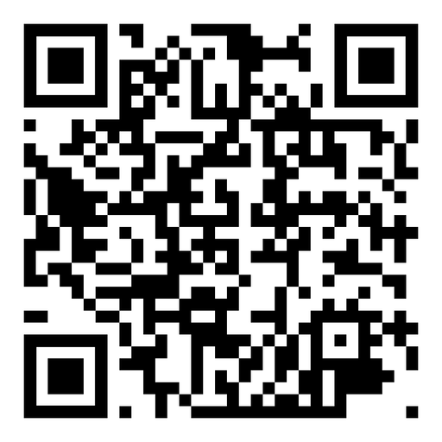
Ready Set Succeed Survey:
Please share any other comments or concerns you have by calling our Digital Comment Card Voicemail Number or contact us via email:
(202) 403-5493
Tryznar@air.org
21

Slide 22
THANK YOU FOR YOUR ATTENDANCE!

