Slide 1
How Our Bible Came To Us
Where
Did
Your
Bible
Come From?
Notes:
Today for Knowing Truth we are going to look at How our Bible came to us through manuscripts.
Have you ever wondered –
Where some Bibles in our time came from? Maybe even the one you use.
Today we will reveal several versions and where they derived the New Testament Scripture from.

Slide 2

Bible Stuff 901
Notes:
Let’s begin with cataloging. Some of you may recognize this – if you are old enough. These were in you local and school library to help you find a specific book. It was called the Dewey Decimal Classification System. You would look up the title of a book and get the corresponding Letter or Number to find the book that was sitting on a shelf. For Example: 901

Slide 3
Bible Stuff 901
Notes:
Would be in the 900’s shelving. Now the 200’s in this system is related to Religion but I chose 901 – because the 900’s relate to Geography, history and auxiliary disciplines. This cataloging system would shorten the time it took dramatically to find the book you were looking for – now we have digital cataloging - That makes the process even faster. This same general system is used with manuscripts for the Bible. We spoke before and will even show proof in the future of manuscripts of old used for writing the Bible.
Classification and Cataloging – Introduction to Library and Information Science (pressbooks.pub)

Slide 4
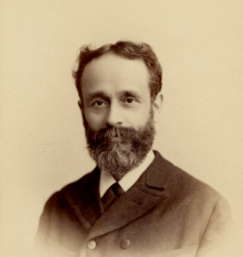
Caspar Rene’ Gregory
1846-1917
Notes:
This ole chap introduced the Gregory-Aland cataloging system that is widely used – it is a standardized way to refer to New Testament manuscripts – making it easier for scholars to use them for study, comparison and interpretation into English for the Bibles we use today.
Manuscripts 101: GA Numbers – The Center for the Study of New Testament Manuscripts (csntm.org)

Slide 5
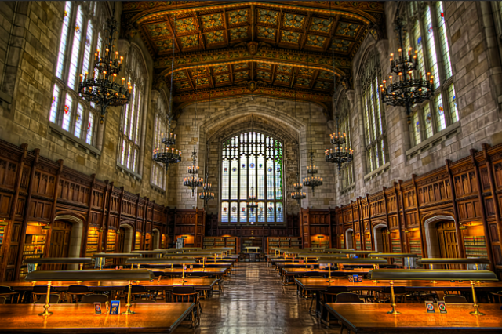
Notes:
A magnificent manuscript that is even close to home --- well not here --- this library is the University of Michigan Law Library… you would think manuscripts would be held here but they are locked up and shown on display…

Slide 6
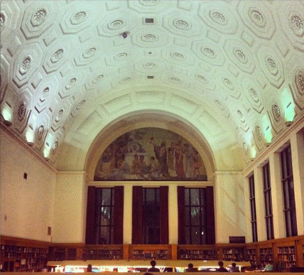
Notes:
Here at the Harlan Hatcher Graduate Library the Universities largest and most historic library. Manuscripts rotate on display in the Hatcher Gallery Exhibit Room.

Slide 7
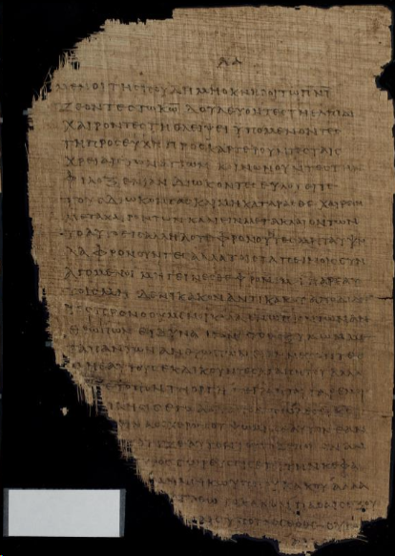
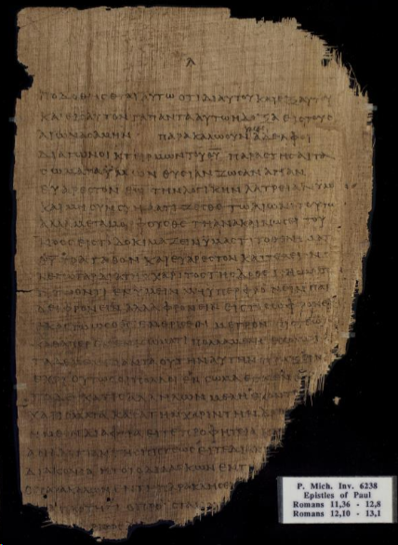
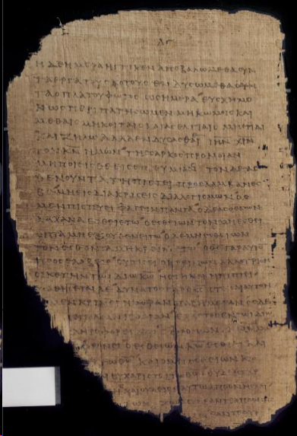
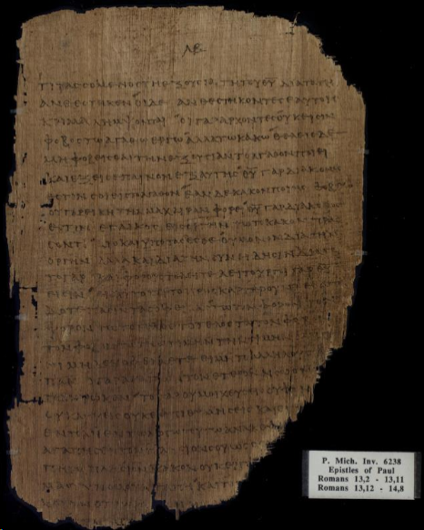
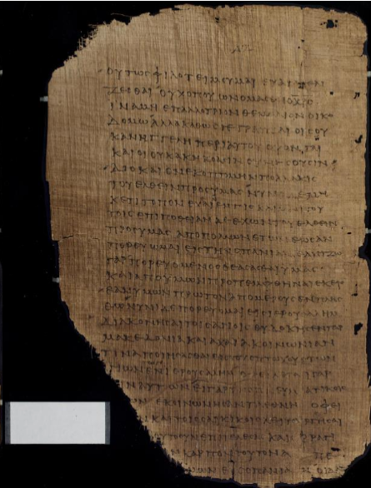
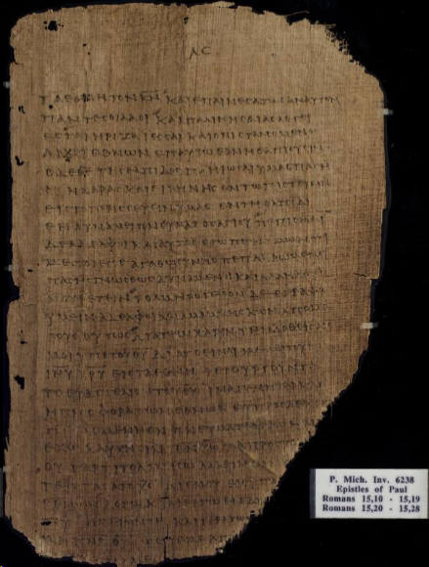
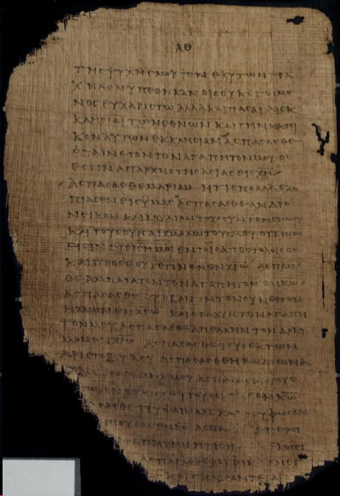
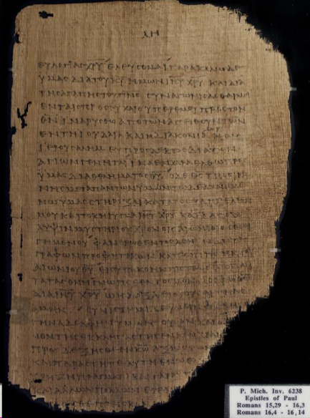
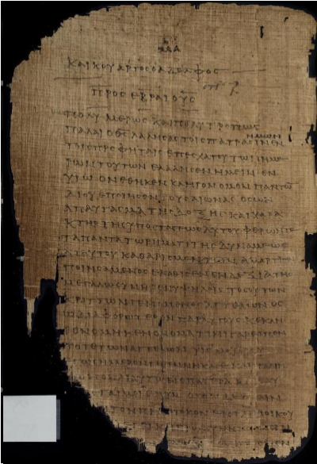
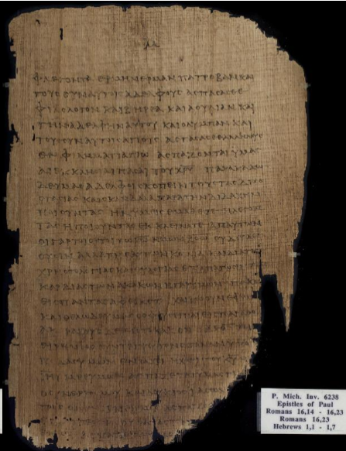
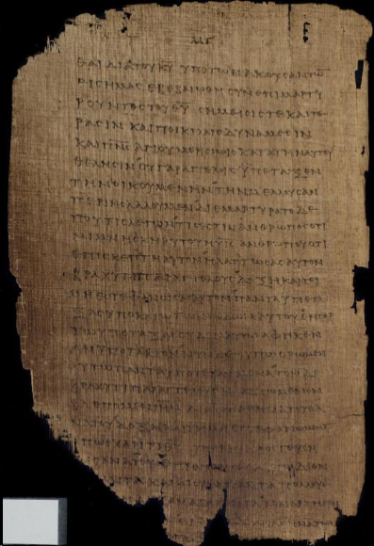
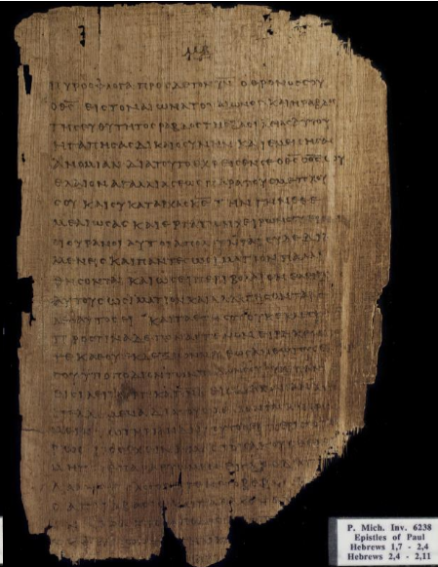
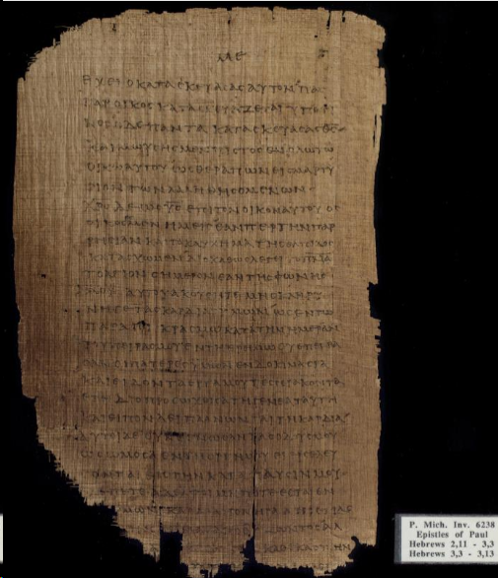
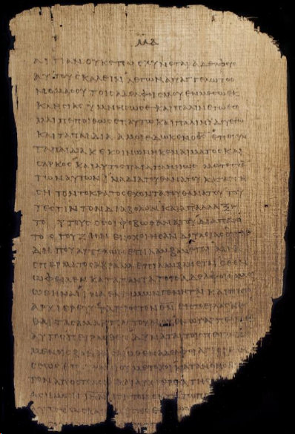
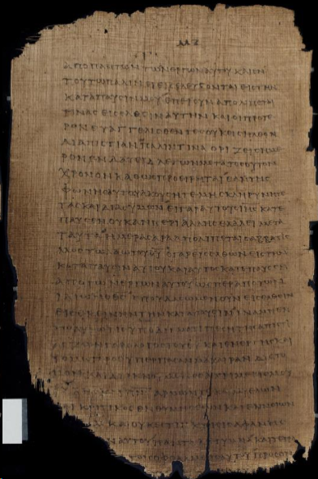
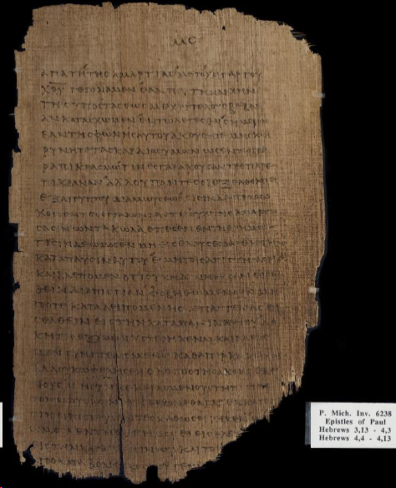
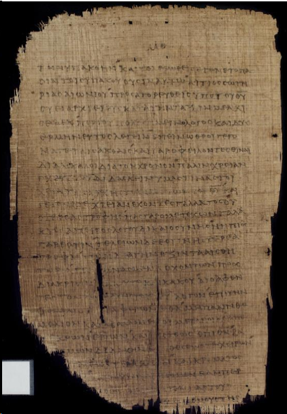
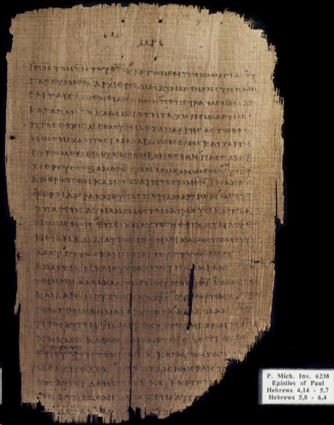
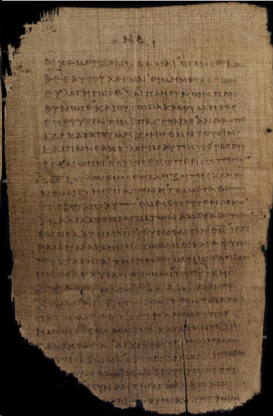
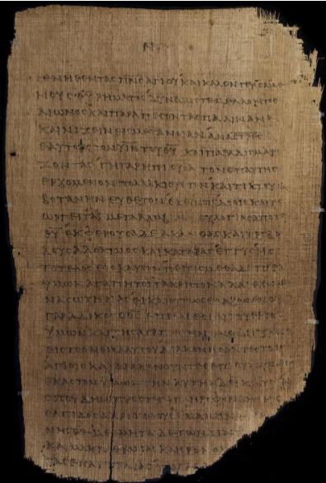
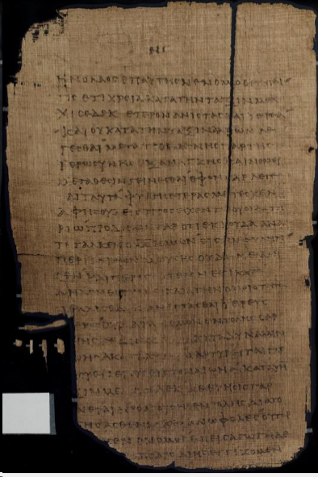
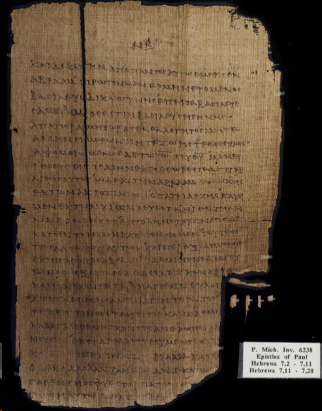
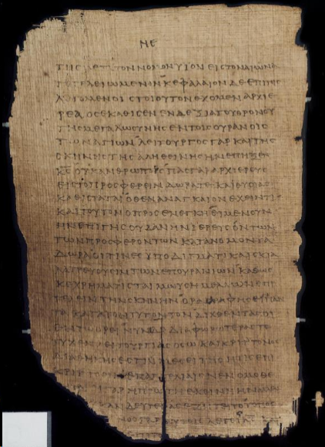
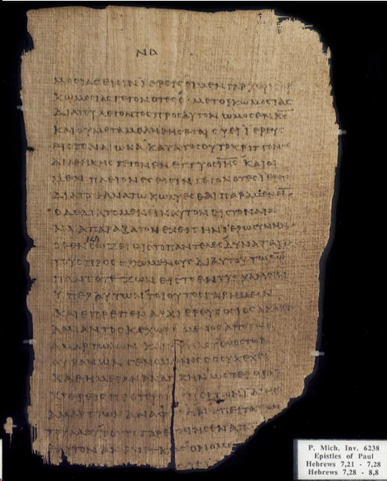
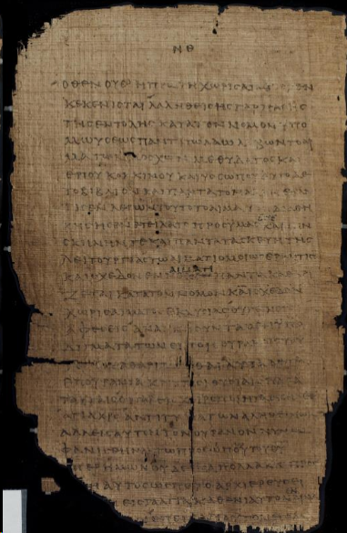
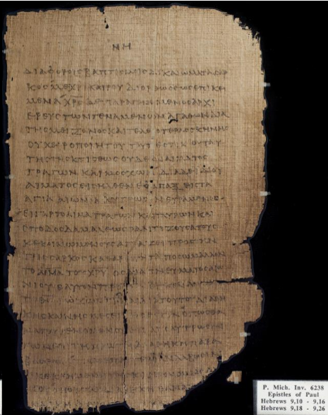
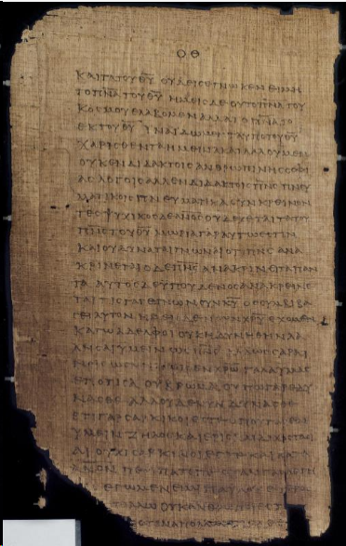
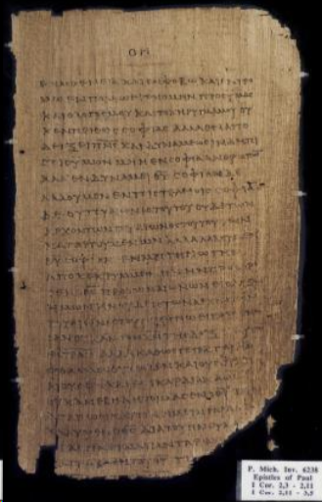
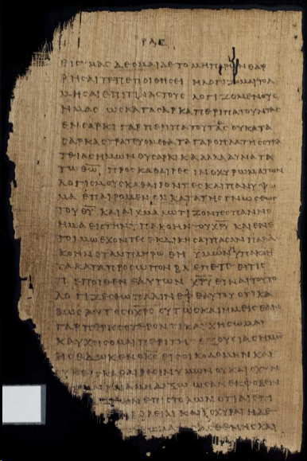
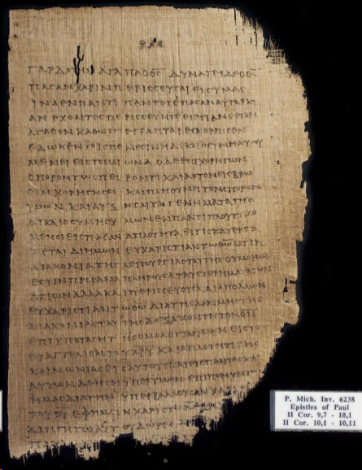
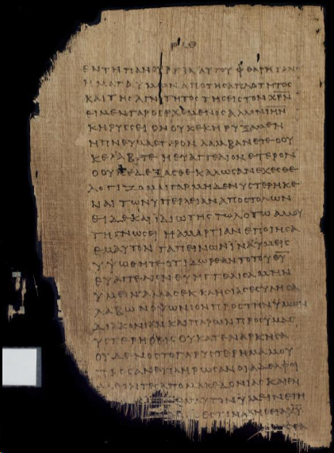
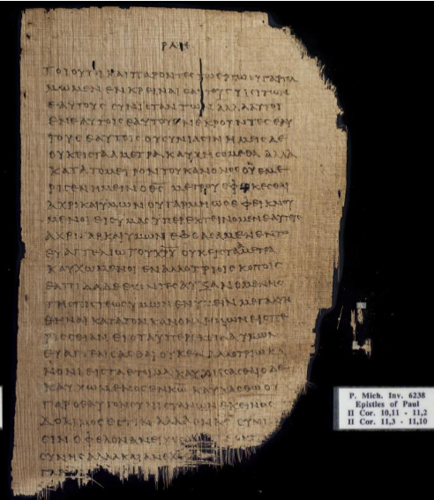
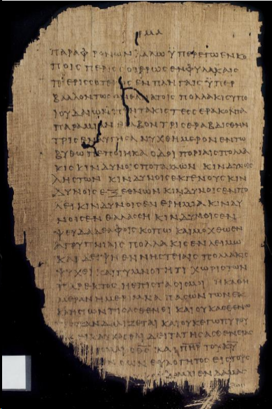
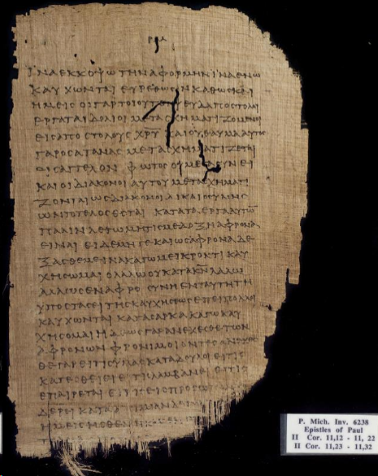
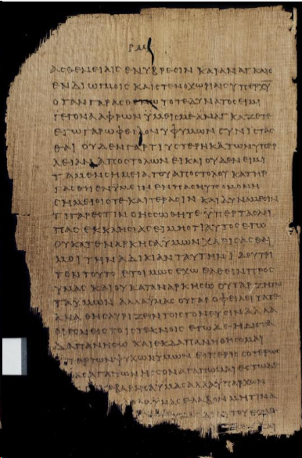
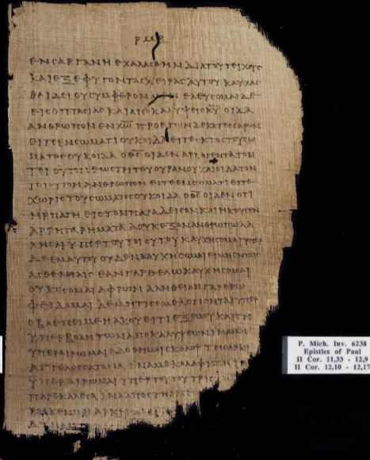
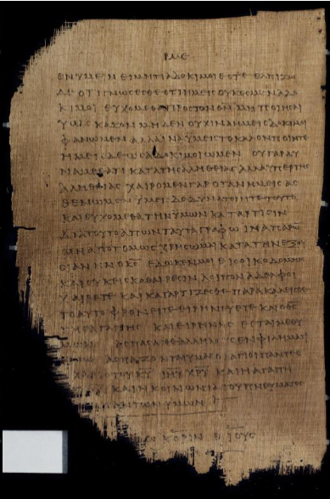
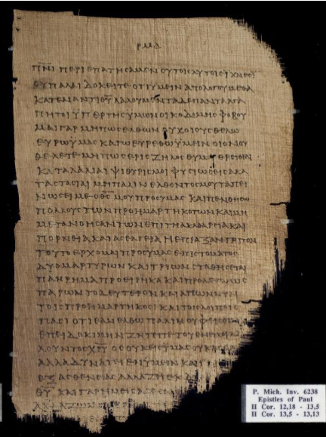
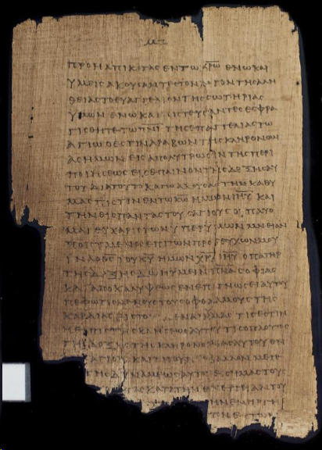
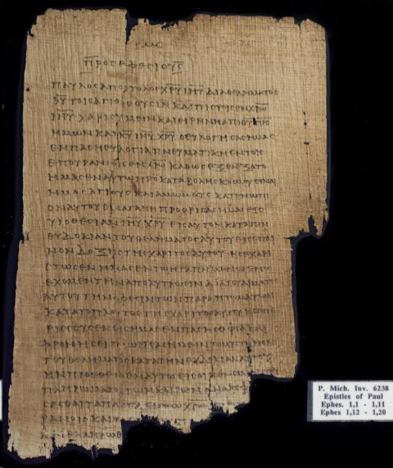
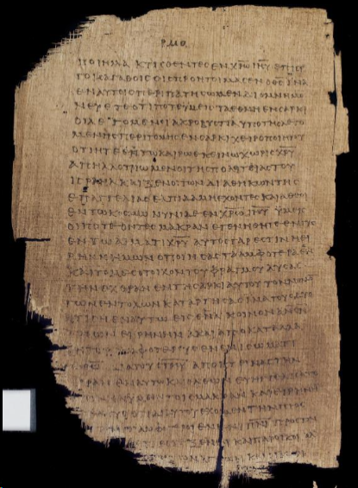
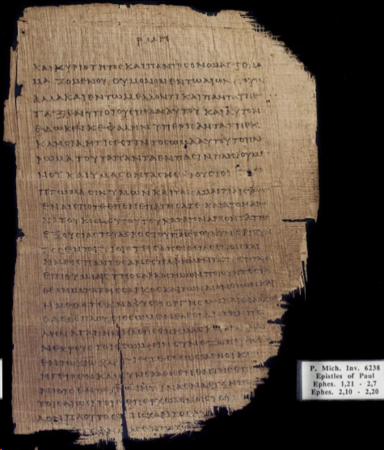
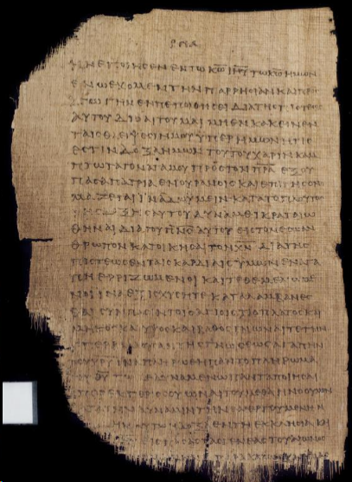
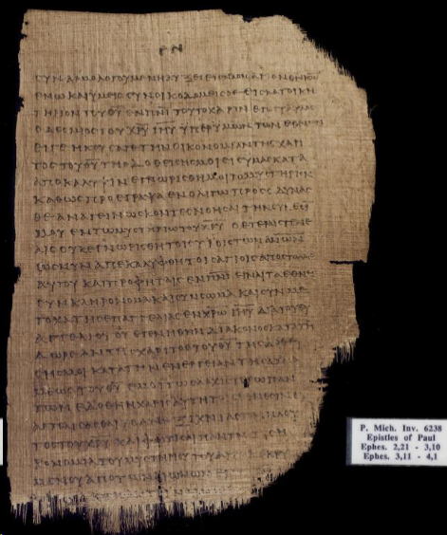
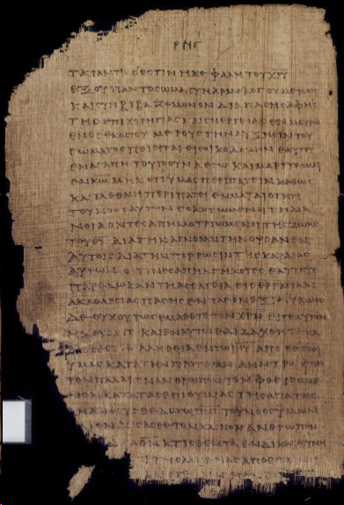
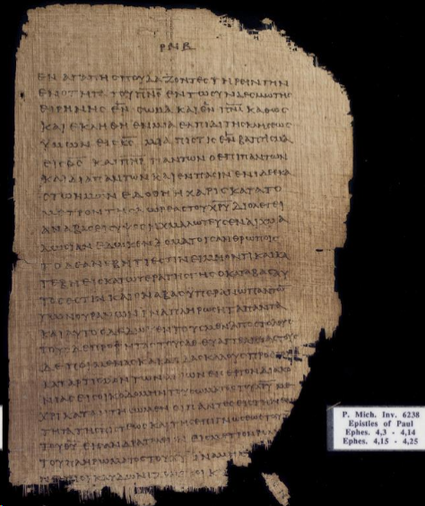
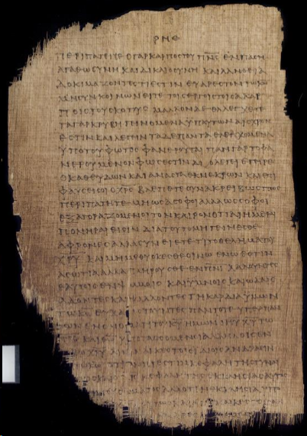













Romans 11.36, Rom 12.1-8, Rom 12.10-21, Rom 13.1-14,
Rom 14.1-8, Rom 15.11-33, Rom 16.1-23
Hebrews 1.2-14, Heb 2.1-18, Heb 3.1-19, Heb 4.1-16, Heb 5.1-14, Heb 6.1-20, Heb 7.1-28, Heb 8.1-8, Heb 9.10-16, Heb 9.18-26
1 Corinthians 2.3-16, 1 Cor 3.1-5
2 Corinthians 9.7-15, 2 Cor 10.1-33, 2 Cor 12.1-21, 2 Cor 13.1-13
Ephesians 1.1-11, Eph 1.14-18, Eph 1.12-13, Eph 1.19-23, Eph 2.1-7, Eph 2.10-22, Eph 3.1-21, Eph 4.1-10, Eph 4.15-29, Eph 4.31-32,
Eph 5.1-6, Eph 5.8-33, Eph 6.1-6, Eph 6.8-18,Eph 6.20-24
Galatians 1.1-8, Gal 1.10-24, Gal 2.1-9, Gal 2.12-21, Gal 3.2-29, Gal 4.2-17, Gal 4.20-31, Gal 5.1-17, Gal 5.20-25, Gal 5.26, Gal 6.1-8
GA Number P46
150AD – 250AD
Notes:
This is 30 Leaves or 60 pages – located in Hatcher Library in Ann Arbor Michigan. CLICK It is categorized as Gregory-Aland P46 – this only part of the collection; 56 leaves or 112 pages are located in Dublin, Ireland at the Chester Beatty Library. P46 is the oldest manuscript in any language of Paul’s Letters with this whole collection dating to 150AD-250AD.
The partial collection in Ann Arbor has these verses written in Greek on the Papyri:
CLICK
Romans 11.36, Rom 12.1-8, Rom 12.10-21, Rom 13.1-14, Rom 14.1-8, Rom 15.11-33, Rom 16.1-23
Hebrews 1.2-14, Heb 2.1-18, Heb 3.1-19, Heb 4.1-16, Heb 5.1-14, Heb 6.1-20, Heb 7.1-28, Heb 8.1-8, Heb 9.10-16, Heb 9.18-26
1 Corinthians 2.3-16, 1 Cor 3.1-5
2 Corinthians 9.7-15, 2 Cor 10.1-33, 2 Cor 12.1-21, 2 Cor 13.1-13
Ephesians 1.1-11, Eph 1.14-18, Eph 1.12-13, Eph 1.19-23, Eph 2.1-7, Eph 2.10-22, Eph 3.1-21, Eph 4.1-10, Eph 4.15-29, Eph 4.31-32, Eph 5.1-6, Eph 5.8-33, Eph 6.1-6, Eph 6.8-18
Galatians 1.1-8
Ephesians 6.20-24
Galatians 1.10-24, Gal 2.1-9, Gal 2.12-21, Gal 3.2-29, Gal 4.2-17, Gal 4.20-31, Gal 5.1-17, Gal 5.20-25, Gal 5.26, Gal 6.1-8

Slide 8
Hebrews 2:1-4 NASB 1995
2 For this reason we must pay much closer attention to what we have heard, so that we do not drift away from it. 2 For if the word spoken through angels proved unalterable, and every transgression and disobedience received a just penalty, 3 how will we escape if we neglect so great a salvation? After it was at the first spoken through the Lord, it was confirmed to us by those who heard, 4 God also testifying with them, both by signs and wonders and by various miracles and by gifts of the Holy Spirit according to His own will.
GA Number P46
150AD – 250AD
Romans 11.36, Rom 12.1-8, Rom 12.10-21, Rom 13.1-14,
Rom 14.1-8, Rom 15.11-33, Rom 16.1-23
Hebrews 1.2-14, Heb 2.1-18, Heb 3.1-19, Heb 4.1-16, Heb 5.1-14, Heb 6.1-20, Heb 7.1-28, Heb 8.1-8, Heb 9.10-16, Heb 9.18-26
1 Corinthians 2.3-16, 1 Cor 3.1-5
2 Corinthians 9.7-15, 2 Cor 10.1-33, 2 Cor 12.1-21, 2 Cor 13.1-13
Ephesians 1.1-11, Eph 1.14-18, Eph 1.12-13, Eph 1.19-23, Eph 2.1-7, Eph 2.10-22, Eph 3.1-21, Eph 4.1-10, Eph 4.15-29, Eph 4.31-32,
Eph 5.1-6, Eph 5.8-33, Eph 6.1-6, Eph 6.8-18,Eph 6.20-24
Galatians 1.1-8, Gal 1.10-24, Gal 2.1-9, Gal 2.12-21, Gal 3.2-29, Gal 4.2-17, Gal 4.20-31, Gal 5.1-17, Gal 5.20-25, Gal 5.26, Gal 6.1-8
Notes:
Let’s examine some scripture on GA-P46-22a-k this page has Hebrews 1:7-14 & Hebrews 2:1-3 but I had to add in the rest of verse 3 & verse 4 from GA-P46-22b-k
CLICK
Hebrews 2:1-4 NASB 1995
2 For this reason we must pay much closer attention to what we have heard, so that we do not drift away from it. 2 For if the word spoken through angels proved unalterable, and every transgression and disobedience received a just penalty, 3 how will we escape if we neglect so great a salvation? After it was at the first spoken through the Lord, it was confirmed to us by those who heard, 4 God also testifying with them, both by signs and wonders and by various miracles and by gifts of the Holy Spirit according to His own will.

Slide 9
3 Most Popular Greek Texts
Majority Text
Traditional Text
Byzantine Text
“Textus Receptus”
KJV
NKJV
Alexandrian Text
“Westcott-Hort”
Codex Vaticanus
Codex Sinaiticus
Codex Alexandria
ERV
ASV
Notes:
We are going to look at the 3 Most popular Greek Texts that Bibles use when translating the New Testament to English – Each of these three you will hear are compilations of manuscripts.
CLICK First is the Textus Receptus or Received Text- This is based on CLICK what scholars call the Majority Text, Traditional Text and Byzantine Text. To make this easy to remember- when it says Majority- it actually means majority- the textus receptus uses the Majority of the writings found - about 80% of all writings are used in this– the Byzantine is a large number of these manuscripts but only a few are ancient before 600AD – some believe due to the humid climate the ones dating before deteriorated. Some of the Latin Vulgate was used to translate from Latin back into Greek for the Book of Revelation- because there were no Greek manuscripts available at the time. We will talk about this Latin Vulgate in another Soul Retention later. (this came form scholars like Erasmus 1469-1536, Stephanus 1503-1559, Beza 1519-1605 and Elzevirs 1583-1652 a publisher)
Now this Popular Greek Text is where CLICK We get the translation for the King James Version and the New KJV.
CLICK Westcott-Hort is based on CLICK the Alexandrian Text was the oldest manuscripts found in 1881 they consisted of scrolls called codex- the Codex Vaticanus that dated to 325AD, the Codex Sinaiticus that dated around 350AD and the Codex Alexandria that dated around 425AD (this was compiled by Brooke Foss Westcott 1825-1901 and Fenton John Anthony Hort 1828-1892)
This popular Greek Text is where CLICK We get the translation for English Revised Version and American Standard Version

Slide 10
3 Most Popular Greek Texts
Novum Testamentum
Graece
New Testament in Greek
Critical Text
“Nestle-Aland
United Bible Societies”
ESV NAB CEV
RSV NIV NIrV
NRSV TNIV
GNT NCV
TM AMP
NASB HCSB
JB NLT
Oxyrhnchus Papyri
Chester Beatty Papyri
Bodmer Papyri
Notes:
Our Last of 3 Most popular Greek Texts that Bibles use when translating the New Testament to English – Is
CLICK the Nestle-Aland and United Bible Societies – which is also known as CLICK Novum Testamentum Graece in Latin or New Testament in Greek and Critical Text – these include new findings that date even before the Alexandian Text (in 1889 Oxyrhnchus Papyri dating between 3rd century BC to 7th century AD, 1930 Chester Beatty Papyri with New Testament writing dating between 150-250AD and other writings dating between 1800BC and 800AD and 1955 the Bodmer Papyri with New Testament writings dating between 175-225AD.
(this popular Greek text was assembled by Kurt Aland 1915-1994, Bruce Metzger 1914-2007, Eberhard Nestle 1851-1913 and others)
Now this Popular Greek Text is where CLICK We get the translation for most of the Newer Bibles today- you may recognize one or many.

Slide 11
Psalm 12:6-7 (MKJV)
6 The words of the Lord are pure words, Like silver tried in a furnace of earth, Purified seven times.
7 You shall keep them, O Lord, You shall preserve them from this generation forever.
Notes:
The texts that we have for our Bible are the largest of any historical text, they have been combed over by scholars over and over through the years- the documents have been found to be accurate overall through generations – with the inaccuracies not effecting the main truth about Jesus and what He did for us. When you look at your Bible realize that there may be some translation differences, but the main thought connects.
Think about this verse.

