Slide 1

ACT & HGLHC
Oral Health
Presented By : Erika Mott and Ruth Murray

Slide 2


Advancing Connecticut Together
  AIDS Connecticut
  CT Center for Harm Reduction
  CT Association for Human Services

Slide 3

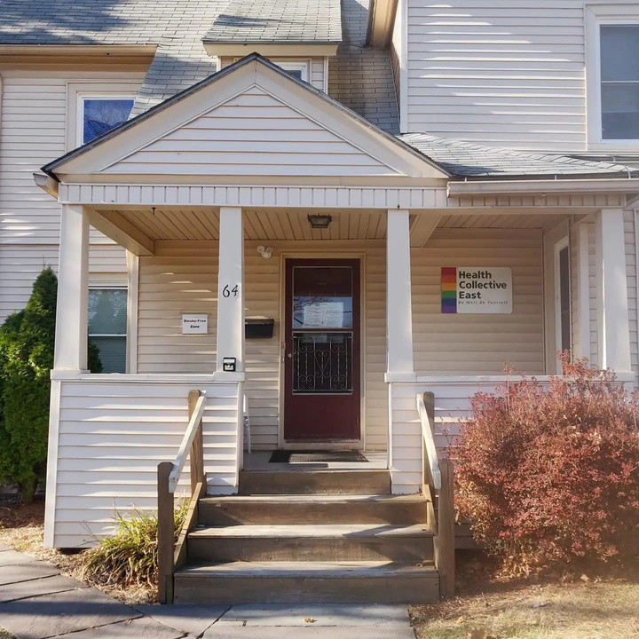
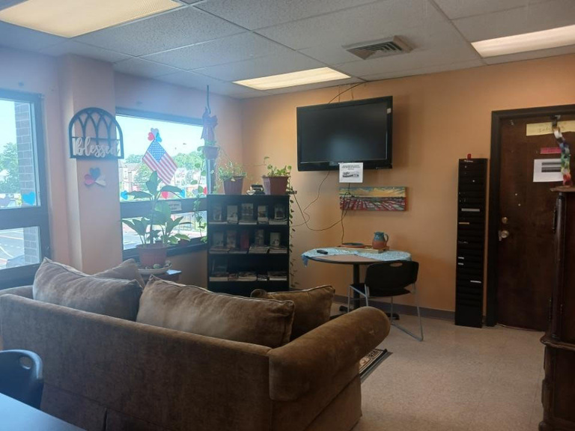
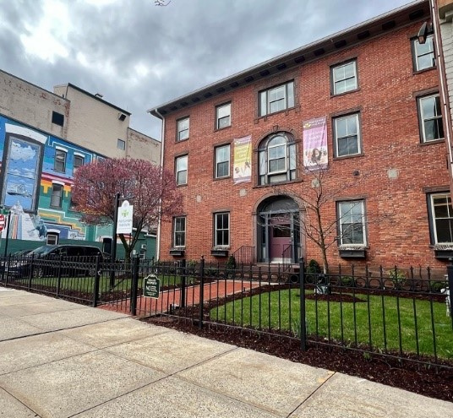
RW MCMs
2 Connections
1 CHC
2 HCE

Slide 4

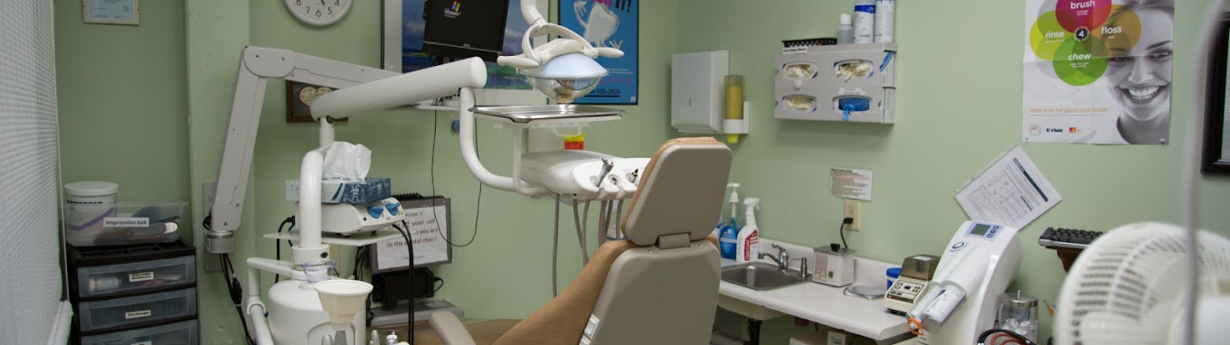
Hartford Gay and Lesbian Health Collective
Dental Clinic

Slide 5
Oral Health
General Overview
2023-2024
-Many clients reporting no dental provider or reporting that they haven't seen one in years
-Focus in our TGA to improve oral health measure
Started by having all MCMs submit client lists that detailed whether clients were receiving oral health care and where they were the services

Slide 6
﻿Mutual Clients
First
Second
Focusing on clients who are engaged in care at HGLHC
  30 confirmed clients so far
Ensured documentation for those clients is up to date for eligibility/referral and will be ensuring all service data sharing is in place

Slide 7
﻿Process
Step 1
Step 2
Step 3
Meet weekly with HGLHC
MCMs to be trained on how to further engage clients regarding oral health care
  Training scheduled for 10/24
Focusing on clients who have not engaged in their oral health care utilizing techniques learned in the training

Slide 8
Outside Oral Health Providers
Multiple Outside Providers So Far
Other providers include Dr. Dental, Aspen Dental, Columbia Dental, CHC
Utilize techniques taught by HGLHC to engage clients at other providers/ are out of care/ not adherent

Slide 9

Next Steps/Barriers
  Focus on MCM Clients
    Weekly Follow Ups
  Focus on MAI Caseload Next
  Move on to working on HSS clients as well
  Engage Peer Support Program
> Staff Turnover
>Difficult to track via CW reporting

Slide 10

Thank You

