Slide 1
The Center for Key Populations Maria Lorenzo, CKP Operations Manager Michael Judd, CKP PrEP Navigator

Slide 2
Using Quality Improvement to Increase PrEP Engagement and Retention

Slide 3
The Center for Key Populations: Our Mission
To ensure access to quality healthcare and support services for key groups who have experienced health disparities as a result of stigma and discrimination resulting in barriers to comprehensive, respectful and safe care.
To ensure that key populations in the communities that CHC serves have a central and cohesive focus.
To identify emerging trends in key populations and address their needs expediently.

Slide 4
Define the Problem
PrEP is a lifesaving resource for people at risk for HIV.
CHCI implemented a robust PrEP program to provide outreach, awareness, education, engagement and retention in PrEP services utilizing the expertise of 2 experienced PrEP navigators.
PROBLEM:
1)Patient initiation of PrEP is low.
2)Provider referral for PrEP and initiation of patients on PrEP is low.
3)Patients retention in PrEP services is low.

Slide 5
CHC Baseline Data for PrEP July 2022
Number of Unique PrEP patients at CHCI 387 Patients
Length of time on PrEP
Average 376 days
Max = 2795 Days
119 Patients with 1 Rx

Slide 6
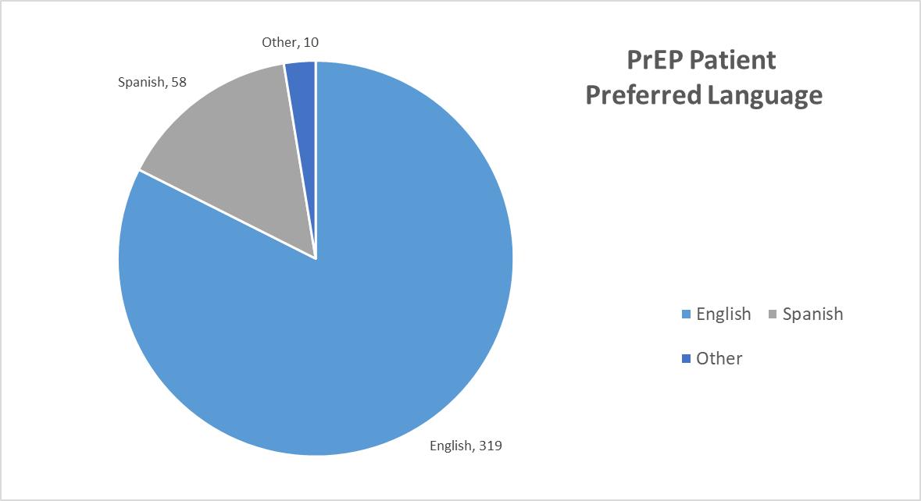
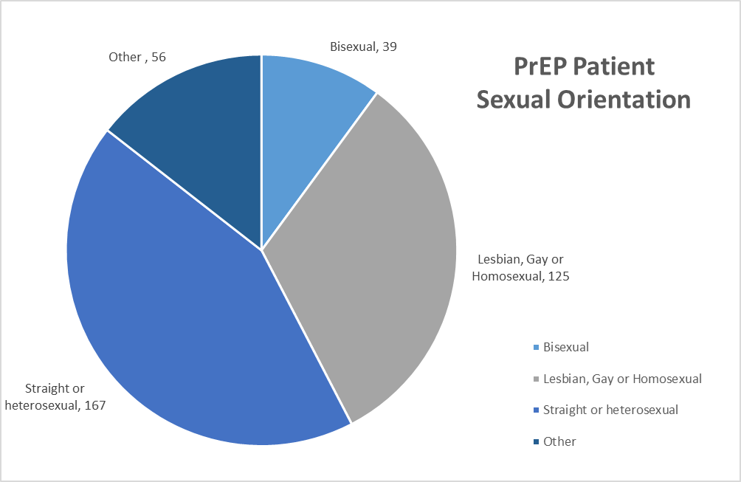

Slide 7
Global Aim Statement
We aim to improve the PrEP services at CHCI.
The process begins with identifying potential PrEP patients and ends with the initiation of PrEP for patients.
By working on the process we expect to:
Increase access to needed services, increase the number of patients on PrEP, Increase the number of patients aware of PrEP as an option, Increase the number of providers prescribing PrEP, Increase retention in care for PrEP patients.
It is important to work on this now because we hope to improve the quality of life for patients at risk, PrEP is a crucial tool in ending the HIV epidemic, and CKP has a responsibility to promote PrEP due to funding and mission of the organization.

Slide 8
Solution Storming Themes led to SPECIFIC AIM
We will increase the number/amount of documented conversations about PrEP that occur between providers and patients for 8 weeks beginning on February 6th at the Meriden site.

Slide 9
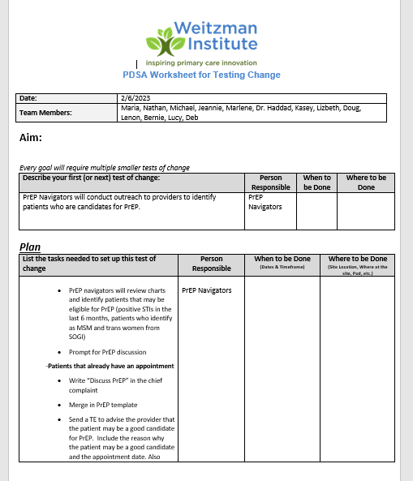
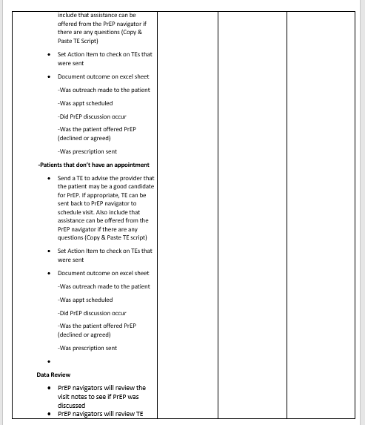

Slide 10
Key Steps and Outcome
Key Activity | Outcomes
Pull data on potential PrEP patients | Use SOGI, STI and other criteria to identify potential PrEP patients. Patient charts flagged by team.
PrEP Navigators contact providers to encourage PrEP discussion and documentation | Providers are proactively contacted to alert them of upcoming appointments with high risk patients and given tools to make referrals or seek assistance as needed.
Provider sends TE if they want PN to contact patients | Provider have expedited access to PN in order to get patients information and support asap.
Patients offered education and PrEP | PN calls or meets with patients to provide info and support and documents specifics for providers.
Monthly data is pulled | Team reviews data weekly or monthly in an effort to tweak system and make improvements.

Slide 11
Challenges
Providers lack time for real conversations and documentation
Providers competence and confidence in addressing PrEP
Ability of PN to initiative conversation without breaching confidentiality.
Patient willingness to address risk
Patient awareness and education was minimal
Time and effort for PN to address all concerns. (40 min per phone call)
Support staff awareness and education
Site wide support of initiative

Slide 12
Outcomes
51% increase in PrEP patients in 6 weeks
92% increase in awareness among CHCI providers and staff in Meriden
100% staff satisfaction in training provided by CKP
100% new patient satisfaction in PrEP Navigation services
1,200 new PrEP interactions were created as a result of the PrEP Project
192 new patients received specific information that may lead to eventual initiation in PrEP treatment

Slide 13
Steps Forward
Monthly on-going provider and staff education on PrEP and PrEP services
Weekly data pulls on potential patients for PrEP
Weekly outreach conducted to sites for PrEP awareness and support with patients.
Weekly PrEP meetings to discuss successes and challenges with team.
Monthly presentation to CHCI QI committee
PrEP goal in organization wide priority QI Plan.

Slide 14
Maria Lorenzo 475-224-1881 lorenzm@chc1.com Michael Judd 203-499-8208 juddm@chc1.com Julie Colon 860-347-6971 colonju@chc1.com
Check out our CHC website for more information and contact information for each program and service!
https://www.centerforkeypopulations.com
14

