Slide 1
Oral Health Screening RW Part A Data Integrity PDSA Region 4

Slide 2
Agenda
Region 4 (Stamford/Norwalk) RW Oral Health Performance Measures
PDSA Cycle
Process Mapping/Ishikawa Driver
Outcome
Next Steps

Slide 3
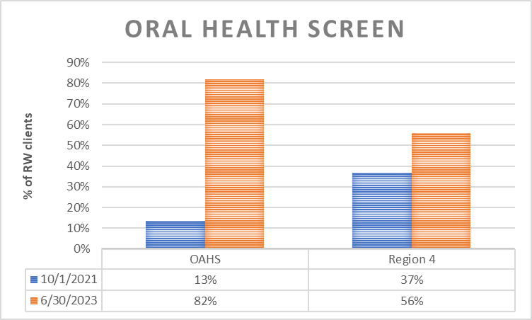
Performance Measure Data
Ryan White clients that received any Part A Service from 10/1/2021 to 6/30/2023
Baseline Numerator/Denominator: 16/120: 13% (OAHS)
Baseline Numerator/Denominator: 28/212: 37% (Region)

Slide 4
Oral Screenings PDSA region 4
PLAN
DO
STUDY
ACT
Agencies meet monthly at continuum to discuss oral health screening progress
Lead Agency will report PDSA to CQM for feedback
Lead will do monthly spot-check to monitor rates
Lead will run reports for improvement check
Agencies will discuss oral health screening and process to gather data
Collect/Enter data in CAREware
Agencies will collect data from clients and enter it in CAREware
Agencies will identify gap/factors in clients not receiving OH screenings
Identify possible factors affecting client’s screenings
Lead analyzes the demographics of clients missing OH screenings
Increase rate to 75%
Lead will provide clients monthly to agencies to f/u on clients
Identify/Stratify clients in need of screening
OH Referrals
Refer clients to OH
Follow up on identified gaps/hesitancy on OH screenings
F/U on clients that are a higher percentage of clients missing OH

Slide 5
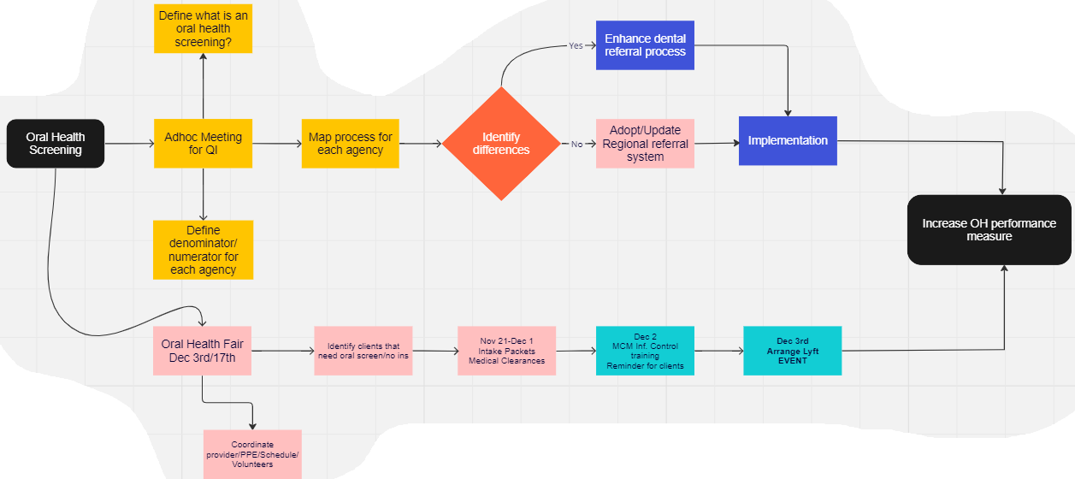
Oral Health Process Map
Learn new tools (Process Mapping/Fishbone Diagram)
Identified that each provider may have a separate process and there may be a need to create different process maps and either align for Region or improve each provider’s process.

Slide 6
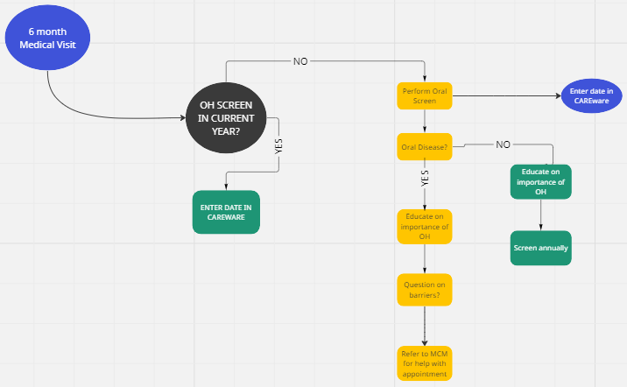

Slide 7
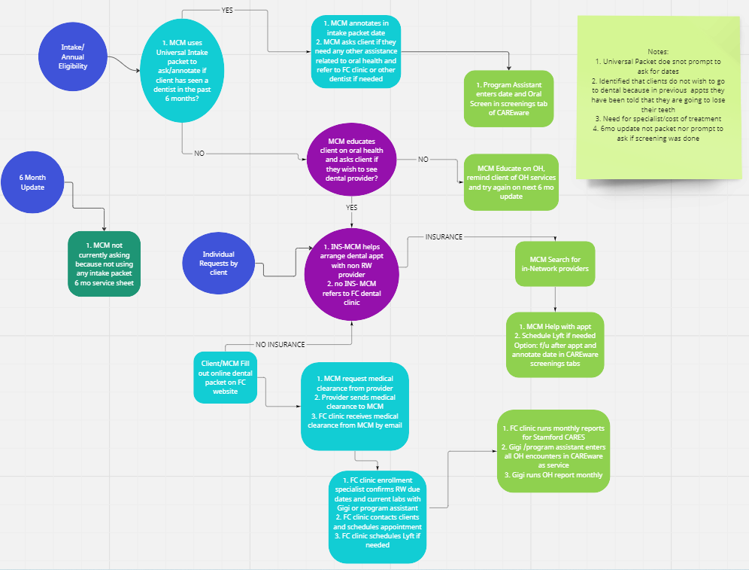

Slide 8
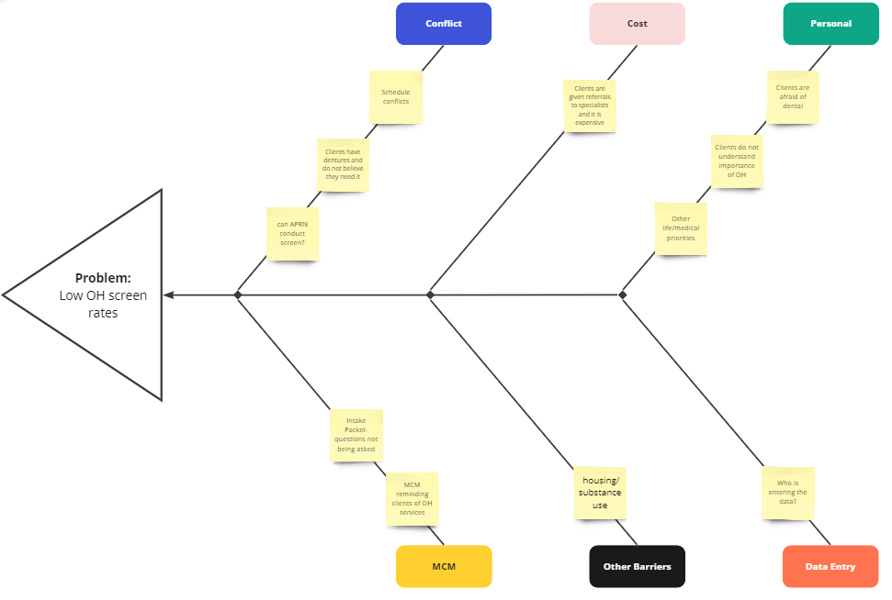

Slide 9
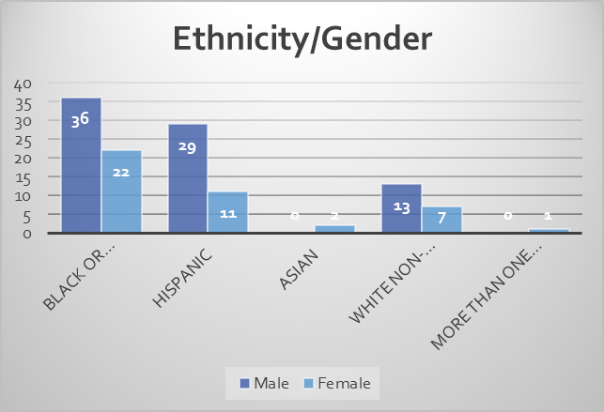
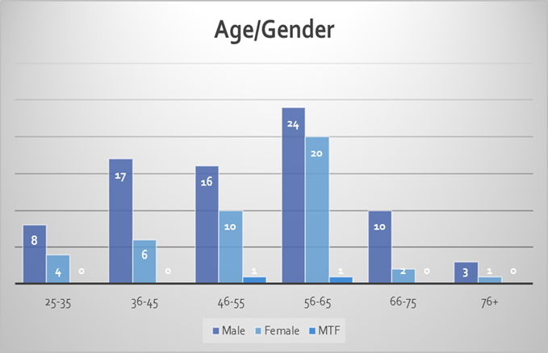
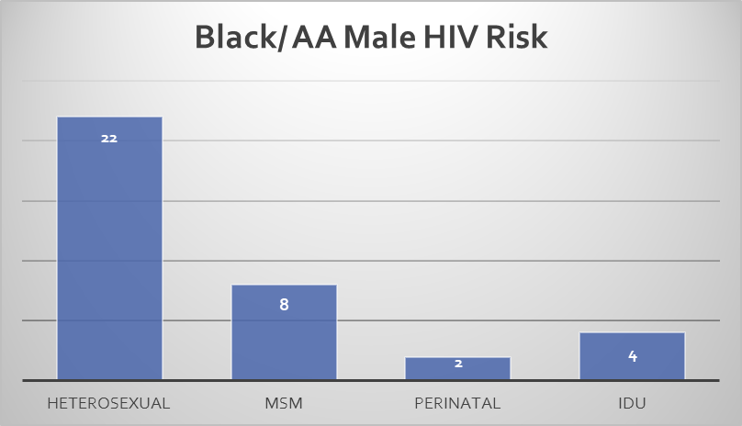

Slide 10
Outcome
Identified that Data Integrity was the major issue in the region.
After clarification was provided on what OH screen is, all providers were educated and supported so that all data was entered in a timely manner.
Collaboration within Region/OH Education awareness
Process improvement: Forms updated and OH is part of the physical process.
Dental Fair
Increase number of clients screened
Offer OH services

Slide 11
Next steps
Update our PDSA cycle
Monitor Performance Measure
Stratification of clients that have yet to meet measure
Continue to identify any trends/barriers
Continue to provide awareness to clients on OH

Slide 12
Questions?

