Slide 1
Leveraging a Data to Care Approach to Cure Hepatitis C within RWHAP
Lisa Nichols, MPH
Maximilian Wegener, MPH
October 18, 2023

Slide 2
Collaborators
Seven Health Department Jurisdictions
Ryan White HIV/AIDS Program Clinics

Slide 3
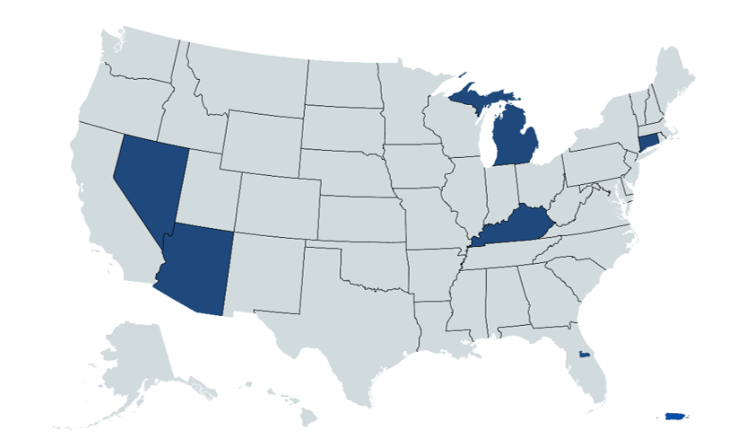
Project Overview
Two-year HRSA HAB initiative with third year no cost extension
Goals
Create sustainable methodologies for jurisdictions to create their own HCV clearance cascades for HIV/HCV co-infected persons
Improve existing collaboration between jurisdictional HCV surveillance programs and RWHAP care providers
To link people with HCV within the RWHAP to care, by leveraging existing public health surveillance and clinical data systems

Slide 4
Two Main Project Components
Health Departments
Jurisdictional clearance cascades
HIV Clinics
Outreach and Linkage to Care

Slide 5
Jurisdictional Viral Clearance Cascade

Slide 6
Importance for Jurisdictional HCV Clearance Cascade
Clearance cascade is a tool to help jurisdictions visualize diagnosis and treatment milestones
Identify gaps in care
Monitor micro-elimination efforts
Key step in 2025 National Hepatitis Strategy

Slide 7
Jurisdictional Clearance Cascades for HIV/HCV Co-infected Persons Using Surveillance Data: Core Steps
Improve HCV surveillance data completeness and quality
1
Match HIV and HCV surveillance data to develop HIV/HCV co-infected lists
2
Develop clearance cascades for defined cohort
3
Notes:
Dr. V
There are three key steps in developing clearance cascades. First HCV data have to be as complete as possible, particularly regarding lab data. Next, a matching approach has to be used to match HIV and HCV surveillance data to develop a jurisdictional clearance cascade. An additional match to RWHAP data enables jurisdictions to create a RWHAP specific clearance cascade.

Slide 8
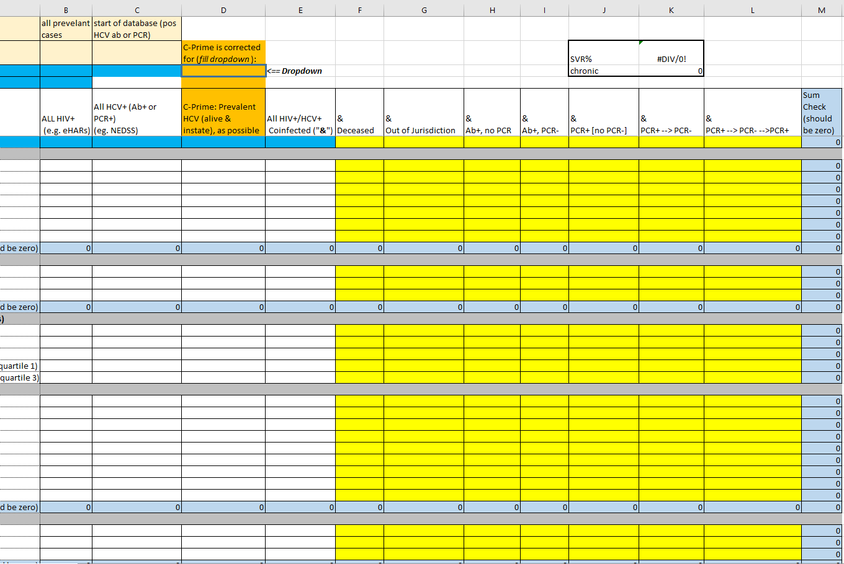
Creating the HCV Clearance Cascade: Key Steps
Define base period (cohort) and follow-up period
Assign individuals’ dispositions based on HCV surveillance labs
Select demographic characteristics to inform subpopulation analysis
Populate Excel template (see tool)
Review and analyze cascade
Implement action steps (D2C)

Slide 9
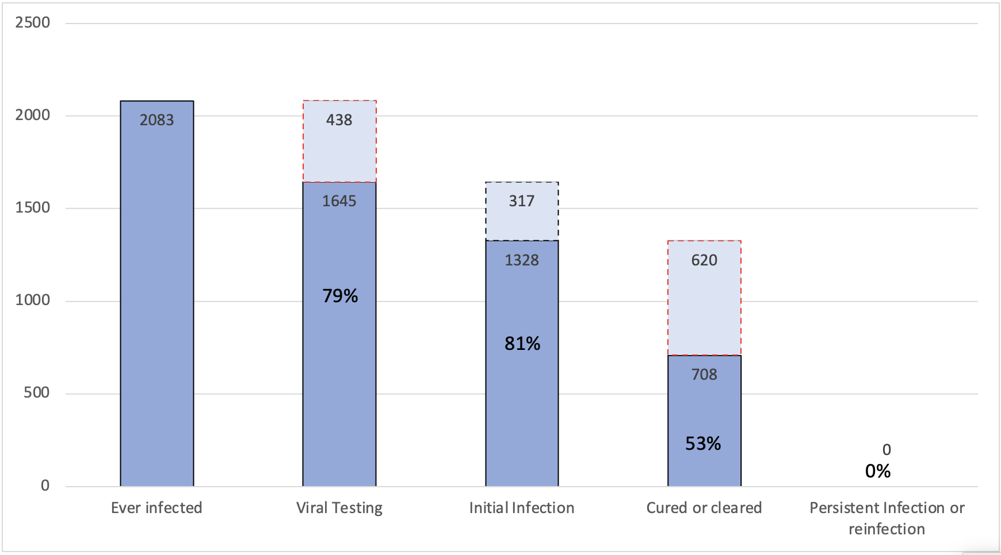
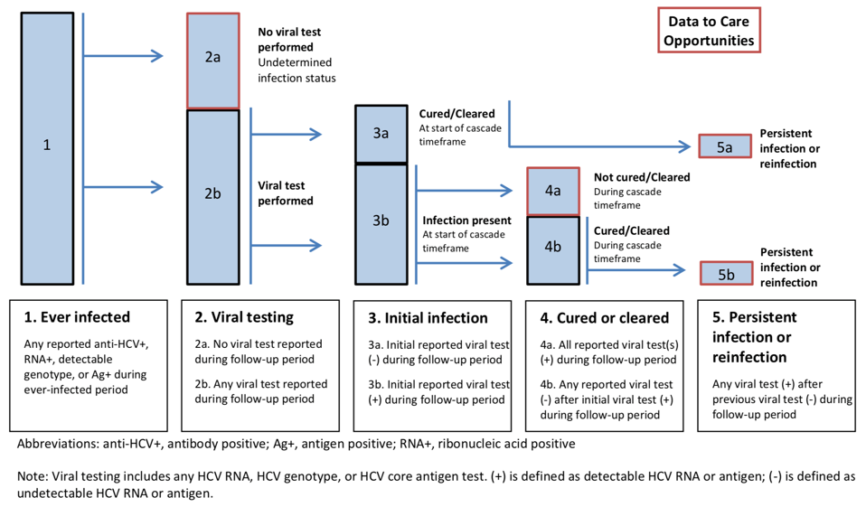
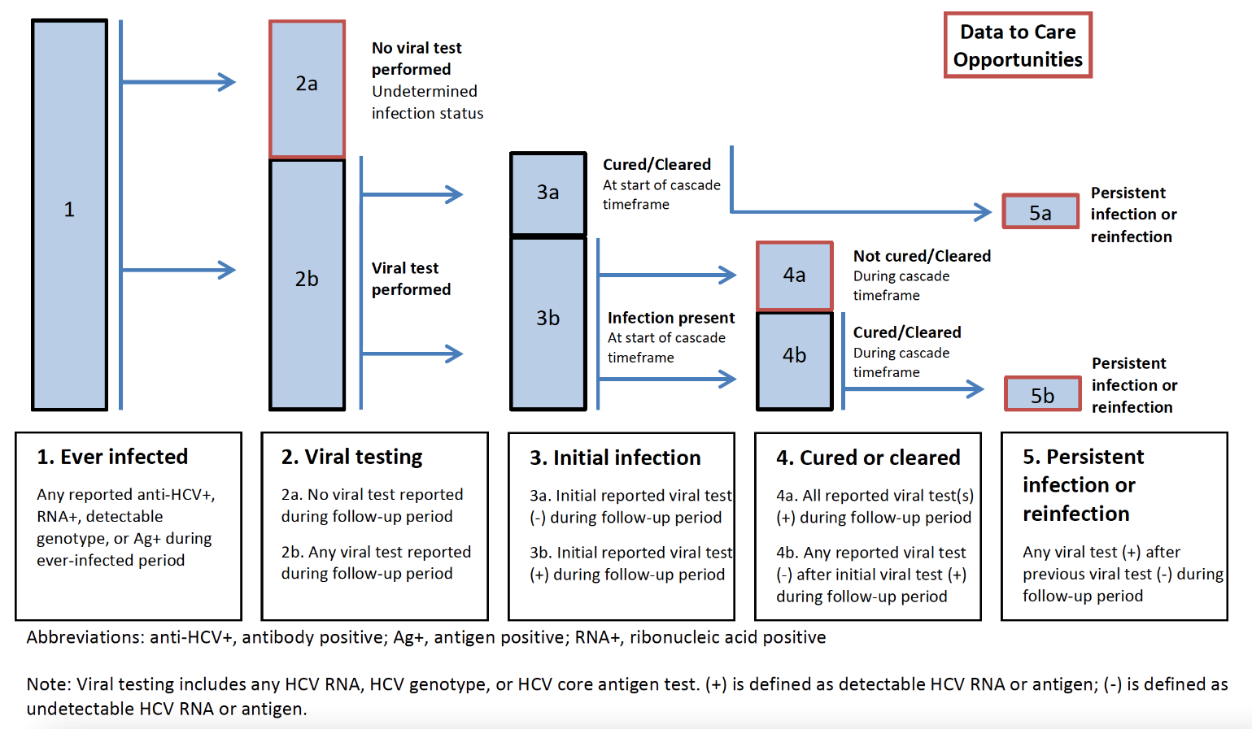
HCV Clearance Cascade for HIV/HCV Coinfection Connecticut (Cohort as of 12/31/2019 and status as of 12/31/2021)
Clearance Cascade Example
The figure below details the CDC’s HCV clearance cascade and steps
Noted gaps in viral testing (79% of ever infected tested) and
clearance (53% of initial infection)
Montgomery et. al. Public Health Reports, 2023
Notes:
Dr. V

Slide 10
Clinic Cascade of Care – Outreach and Linkage

Slide 11
Outreach and Linkage: Key Steps to Approach to Data to Care
Develop partnerships with clinics
1
Create clinic HIV/HCV co-infected lists
2
Conduct case conferencing, outreach and linkage activities
3
Notes:
Dr. V
Develop partnerships with clinics – identify clinics with whom you are working
Create clinic co-infected lists – Different approach. It may be based on a centralized RWHAP data system (e.g. CAREWare) or the clinic may develop a list of people they believe to be co-infected. The approach is impacted by state statute and other data sharing restrictions.
Conduct case conferencing

Slide 12
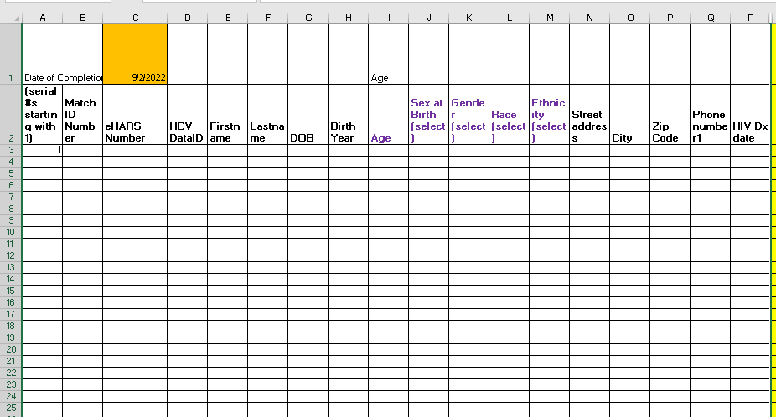
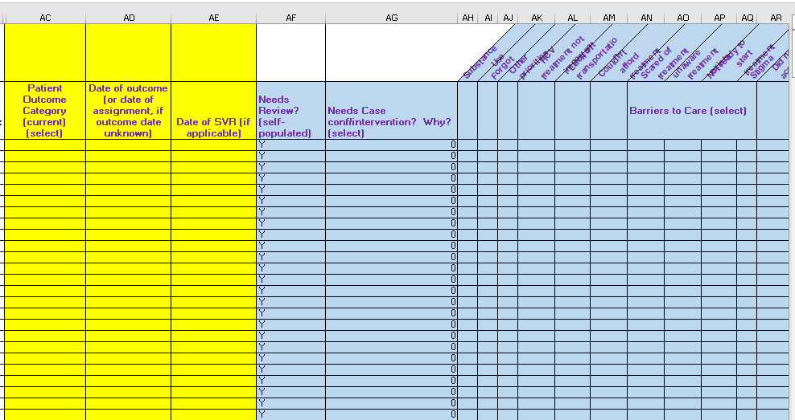
Review of Case Conference Methodology & Tool
Case Conferencing Data Tool
Demographics (for ID matching), Treatment Status, Barriers to Care
Data Tool automatically generates cascades
More granular than CDC viral clearance cascades
Yellow fields are minimum needed for cascade creation

Slide 13
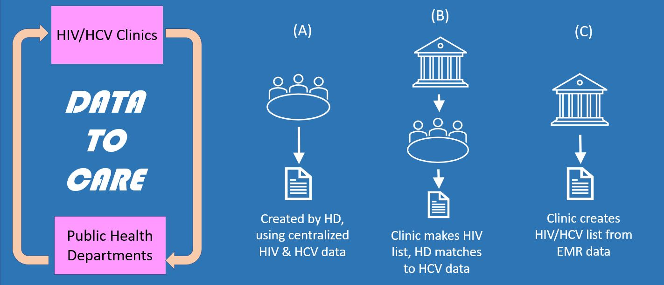
Case Conference Methodology
Create HIV/HCV
Co-infected List:
Different Models
Health Department Champion Meets with Clinic Champion
Review HCV Treatment Status
Create Clinic-Specific HCV Care Cascade
Assess Barriers and implement Linkage Plan

Slide 14
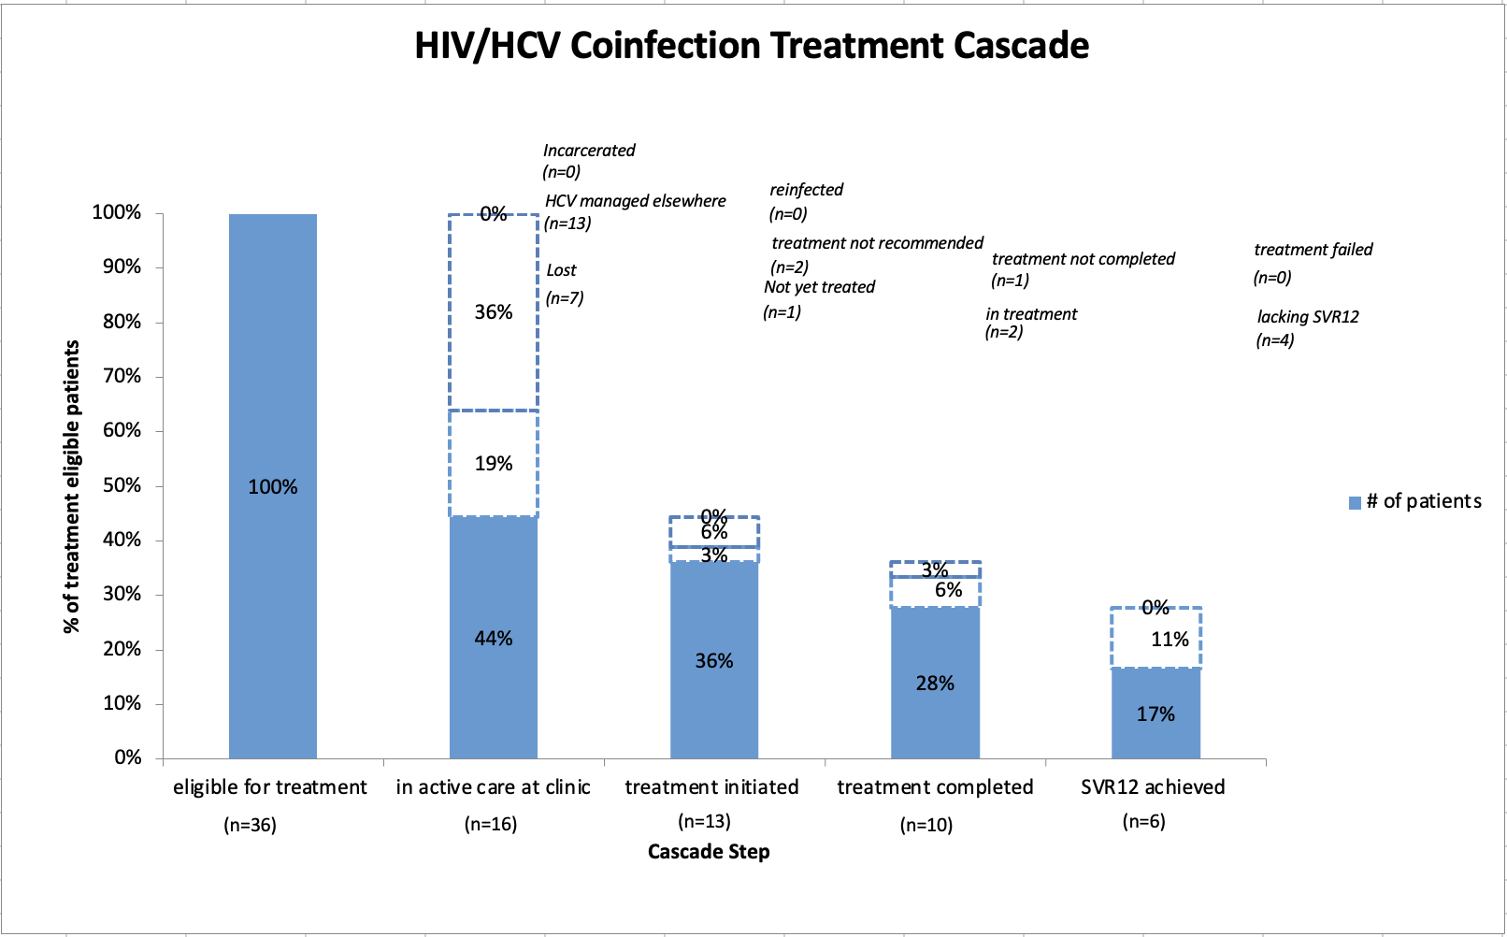
Example of Clinic-based Care Cascade using Case Conferencing Tool – Charter Oak (as of 12/31/2021)

Slide 15
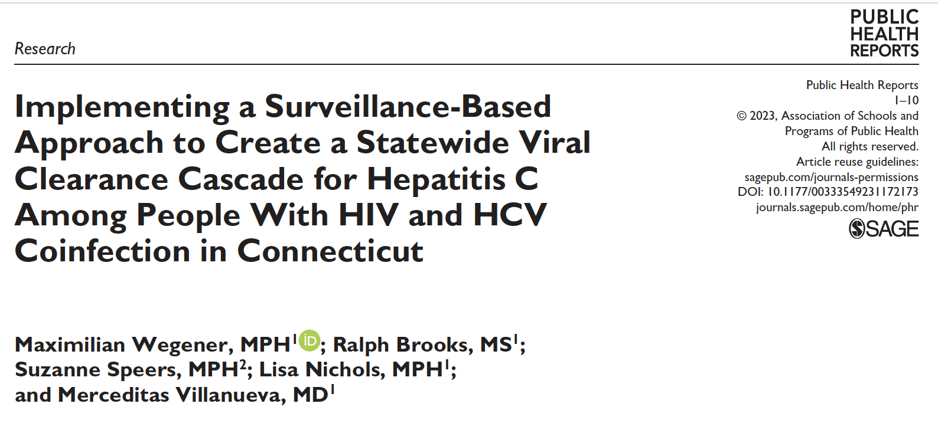
Highlights of our past research

Slide 16
Resources
Mini eLearning videos and written companion (TargetHIV website)
HIV/HCV co-infection clearance cascade data tool (TargetHIV website)
Clinic-based cascade of care data tool (TargetHIV website)
Implementation Manual (TargetHIV website)
TargetHIV website https://targethiv.org/spns-hcv-dtc
Patient educational app Connecticut AETC (aetcct.org)

Slide 17
Thank You!
Contact Us
Maximilian.Wegener@yale.edu
Lisa.Nichols@yale.edu

