Slide 1
Laser Laws
Do you know your scope of practice

Slide 2
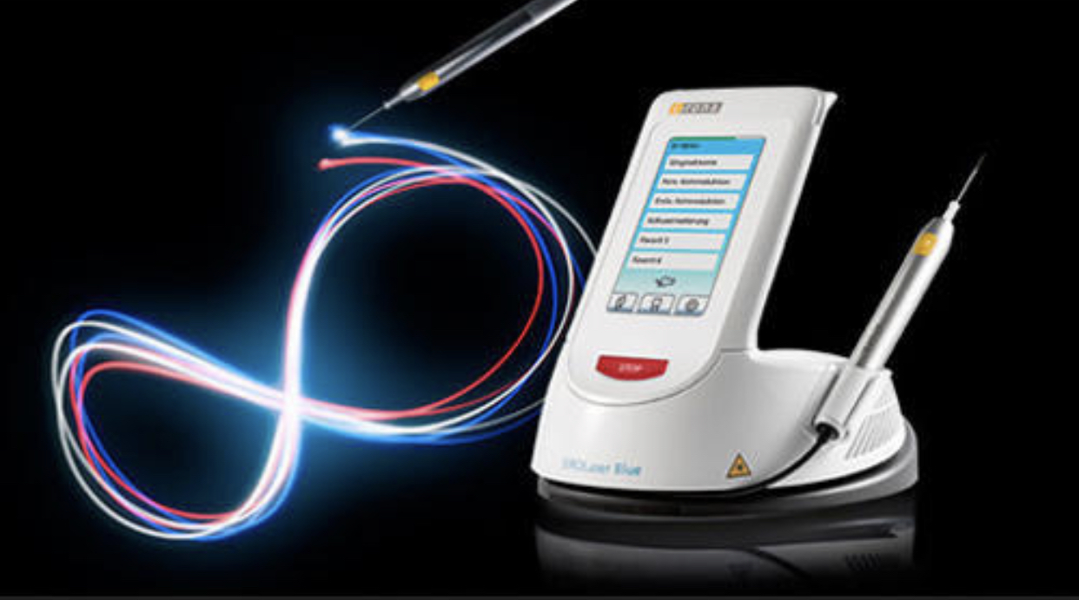
LASER: Class IV Non-ionizing MEDICAL DEVICE
State dental board
Scope of Practice
Level of Supervision
Proof of Training
CE Requirements
Notes:
When we read the practice laws of each state, we see 4 common references

Slide 3
Texas Dental Laser Laws

Slide 4
Texas laser laws : Dentist Rule :115.2
(3) A dentist who supervises a dental hygienist in the use of lasers must have laser education and training sufficient to adequately supervise the dental hygienist, including but not limited to meeting the continuing education requirements required of dental hygienists in subsection (b)(1) of this section. Pursuant to §258.003 of the Dental Practice Act, the delegating dentist is responsible for all dental acts delegated to the dental hygienist, including the use of lasers. (4) The dental hygienist must comply with the Dental Practice Act and Board Rules in the use of lasers. The dental hygienist may be subject to disciplinary action for any act that violates the Dental Practice Act or Board Rules.

Slide 5
Texas : Hygienists
ADOPTED: May 29, 2015 TSDBE Rile 115.2 : Use of Lasers
Dental Hygienist s may use lasers in the practice of dental hygiene under the direct supervision of a dentist, so long as they do not preform any procedure that is irreversible or involves the intentional cutting of soft tissue or hard tissue.
Use of lasers by dental hygienists must be in accordance with the minimum standard of care and limited to the dental hygienists scope of practice.

Slide 6
TEXAS LASER LAWS CONTINUED
Laser Bacterial Reduction
Laser Degranulation / Sulcular debridement – By Dentists Directive ( removal of dead tissue )
Root Desensitization
Herpetic Lesions_ stay within the vermillion border
Aphthous ulcers
Pain therapy
Notes:
By Doctor’s directive : If your Doctor states a hygienist can remove the

Slide 7
Texas Hygienist TSBDE Rule 115.2
A dental hygienist shall successfully complete a course of study that meets the following criteria ;
12 hours of in person cont. ed. In laser utilization specific to the procedures to be performed by dental hygienist using the laser.
3 of the 12 hours must include clinical simulation laser training similar to the procedures to be performed by the dental hygienist.
Must provided by an educational course provider recognized by the board.
Dental hygiene must maintain documentation of the satisfactory completion of the required continuing education course.
Notes:
This is a one-time certification, you do not have to maintain any CE course to keep your certification for laser, but I do suggest you take new advanced courses for any updated techniques.

Slide 8
Texas: Dental Assistants
A dentist may delegate to a DA the authority to perform only acts or procedures that are reversible. An act or procedure that is reversible is capable of being reversed or corrected.
A dentist may not delegate or otherwise authorize a DA to preform any task for which a certificate is required under tis section, unless the DA holds the required certificate

Slide 9
Texas Dental Assistants
An assistant cannot perform any irreversible procedure
MUST HAVE A CERTIFICATE OF COMPLETION
DA covered under the dentists’ direct supervision
At this time, there are no complaints documented
Whitening
Pain Therapy of TMJ
Lesions: Herpetic; Aphthous
Pre-Lase /Post-Lase of Surgical Sites
Root desensitizing

Slide 10
Laser Laws continue
Laser Class IV non-ionizing Medical Device State Radiation regulatory Agency
Laser Safety retaining
Registration of Laser
Office compliance protocols
Notes:
When your laser was/is purchased the salesperson or company you bought it from may help your Dr file out the pape work

Slide 11
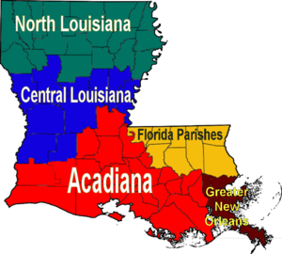
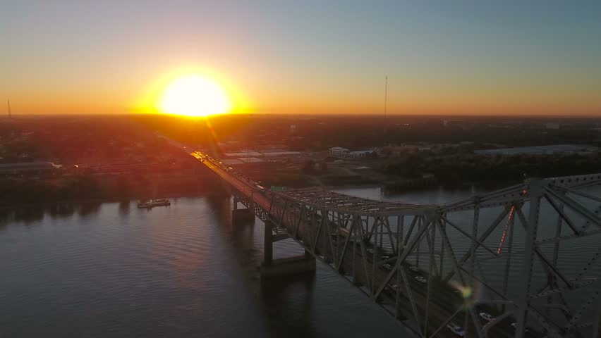
Louisiana : Laser Laws
This Photo by Unknown Author is licensed under CC BY-SA
This Photo by Unknown Author is liensed under CC BY-SA

Slide 12
Louisiana Ruling : Louisiana Scope of Practice: §701(B)(2) & §1301
Louisiana Scope of Practice: §701(B)(2) & §1301
A dentist may not delegate to a dental hygienist: a surgical or cutting procedure on hard or soft tissue including with a laser. A laser capable of the removal of hard or soft tissue may be employed in the treatment of a dental patient only by a licensed dentist..

Slide 13
Laser Laws
States that currently prohibit laser use by dental hygienists include Florida, Louisiana, Mississippi, North Carolina, and West Virginia.
The remaining states don't have regulations on the use of lasers by dental hygienists. They're considered No Regulation States.

Slide 14
Arizona

Slide 15
Arizona : Dentist
A dentist who supervises a dental hygienist whose duties include the use of emerging scientific technology must have training on the use of the emerging technology that is equal to or greater than the training the dental hygienist is required to obtain

Slide 16
Arizona: Hygienist Certification
a dental hygienist shall successfully complete a course of study that meets the following criteria:
1. Recognized CE provider: AGD Pace
2. Includes didactic instruction with a written examination:
6 hours
3. Includes hands-on clinical instruction; and
4. Is technology that is scientifically based and supported by studies published in peer reviewed dental journals.
5. Covers minimum laser physics, safety and appropriate

Slide 17
Arizona : Dentist
A dentist who supervises a dental hygienist whose duties include the use of emerging scientific technology must have training on the use of the emerging technology that is equal to or greater than the training the dental hygienist is required to obtain

Slide 18
Arizona Dental Asst
An assistant cannot perform any irreversible procedure
DA covered under the dentists’ direct supervision
At this time, there are no complaints documented

Slide 19
OHIO

Slide 20
OHIO No Regulation
Laws neither prohibit nor regulate laser usage
Until there are clear laws and regulations in place; it is assumed the RDH can perform all procedures within the scope of their practice

Slide 21
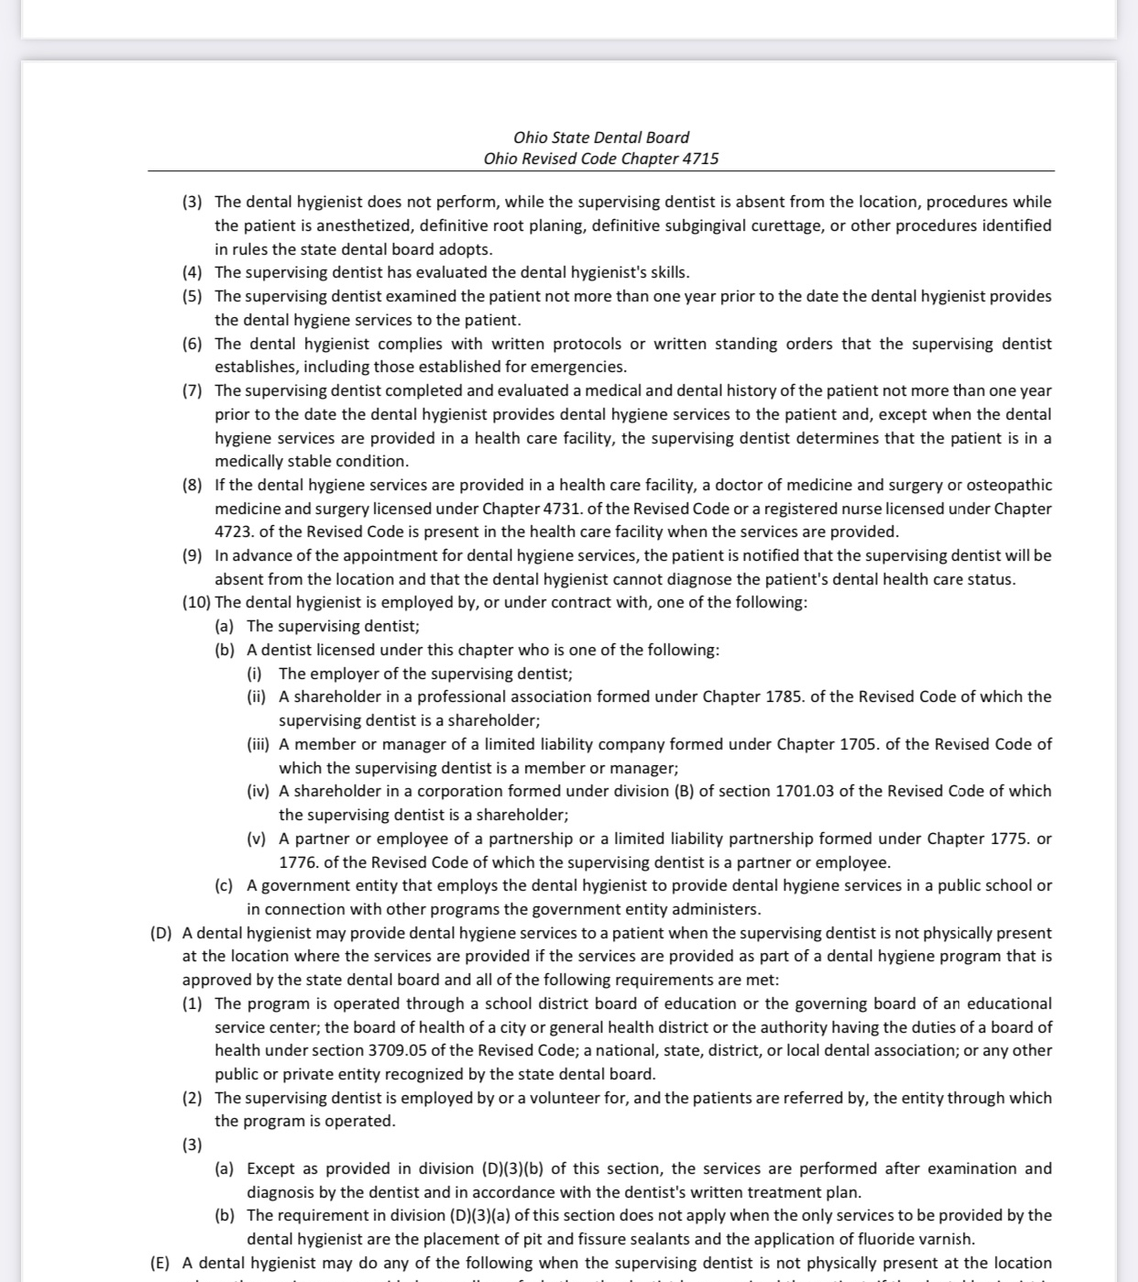
OHIO
Letter of revision on Laser usage in the dental hygiene

Slide 22
HAWAII
This Photo by Unknown Author is licensed under CC BY
Notes:
Hawaii is another stated I have gone to to teach

Slide 23
Hawaii Laser Regulations
Dentist
Non – Ionizing Medical Device
Follow Standard Precautions
Hawaii Radiation Rule Guide
Download Laser Safety Packet
Hygienists
Can you ”curettage”? YES
Level of Supervision: DIRECT

Slide 24
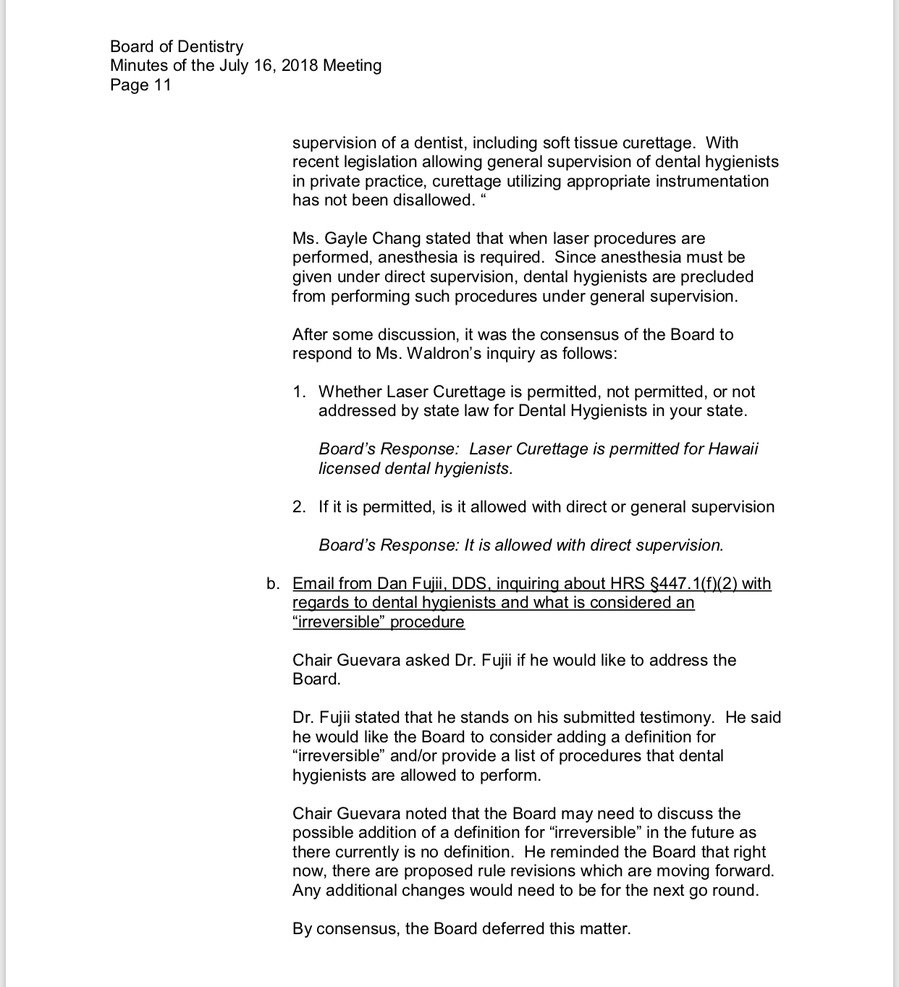
Hawaii
This discusses the use of anesthesia ( injectables)
But you can still preform dental hygiene procedures using a topical ( TAC 20, or a compound formulated mix
That numbs the tissue

Slide 25
COLORADO
This Photo by Unknown Author is licensed under CC BY-SA

Slide 26
Colorado Board Rule XXIV & XXIV(D): use of lasers
dental hygienist shall successfully complete a course of study that meets the following criteria:
1. Recognized CE provider: AGD Pace
2. Includes didactic instruction with a written examination:
NO SET AMOUNT OF HOURS
3. Includes hands-on clinical instruction; and
4. Is technology that is scientifically based and supported by studies published in peer reviewed dental journals.
5. Covers minimum laser physics, safety and appropriate use
Notes:
In colorado this course is 8 hrs

Slide 27
Colorado Hygienist: INDIRECT & DIRECT Supervision
Laser Bacterial Reduction
Laser Degranulation (CAN PERFORM)
Root Desensitization
Soft Tissue Lesions[‘-pol;
Whitening
Pain Therapy
"Closed subgingival curettage" means the removal of the inner surface of the soft tissue wall of a periodontal pocket in a situation where a flap of tissue has not been intentionally or surgically opened”

Slide 28
Laser Laws by state
Please visit your dental board website for your state
Or www.ald.com

