Slide 1
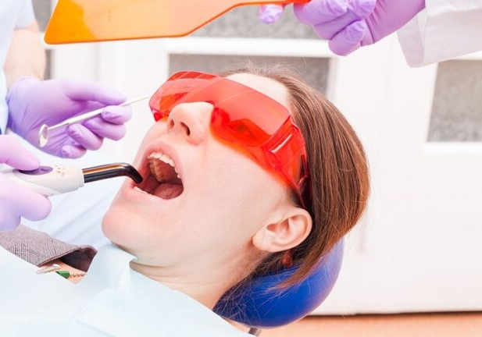
Laser Safety
Laser safety for the entire office
This Photo by Unknown Author is licensed under CC BY-NC

Slide 2
Laser safety
Texas Laws require a Laser Safety office be assigned for each office
Texas Laws require that everyone in the office go through a laser training.
Laser registrations should be in plain view & copy placed in the laser safety binder.

Slide 3
Laser Safety : Dental Hygienist
Dental Hygienist may use laser in the dental practice under direct supervision of the dentist, so long as they do not perform any procedure that is irreversible or involves the intentional cutting of soft or hard tissue.
Use of lasers by dental hygienist must be in accordance with the minimum standard of care and limited to the dental hygienist scope of practice

Slide 4
Laser Safety : Dental Assistant
A dentist may delegate to a dental assistant the authority to perform only acts or procedures that are reversible.
A dentist may not delegate or authorize a dental assistant to perform any task for which a certificate is required under this section, unless the dental assistant holds the required certificate.
Whitening
Pain Therapy
Cold sores/ canker sores
Pre-lase surg site / post -lase surg site

Slide 5
Laser Safety Officer
American National Standards Institute ( ANSI Z 136) requires the following protocol to be put in place when using lasers in the dental office.
Laser Safety Officer needs to be assigned
Safety mechanisms
Operatory Environment
Laser Operational Requirements
Cautions
Eye Protection
Adverse Effects Reporting Mechanisms
Laser log

Slide 6
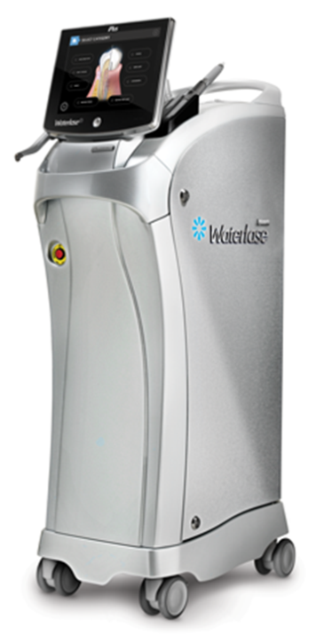
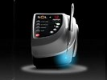
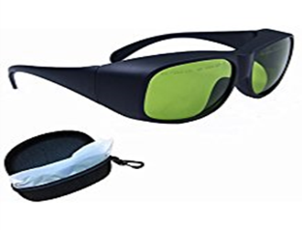
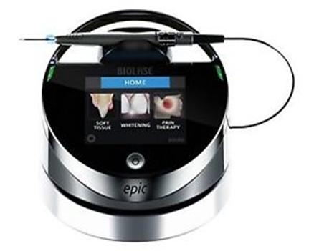
Laser safety Officer
Determines Controlled Laser surgical site
Over sees window facility filters
Ensures that the laser protective barriers and curtains are used when applicable.
Sets up (written format) Standard Operating procedures
Performs Hazard evaluation of the work area in which the laser is being used
Supervises Laser maintenance, alignment and updates and calibration

Slide 7
Laser Safety Officer
Adheres to Laser manufacturer’s recommended service schedule
Oversees personal protective wear and .1-micron masks
Ensures that laser googles used cover the work beam of the laser.
Ensures that only authorized and trained personnel use the laser, within the scope of their license
Maintains a log of recorded laser use
Maintains a familiarity with the laser’s biological( and other potential ) Hazards

Slide 8
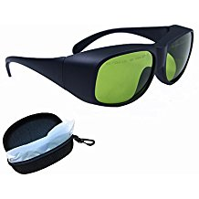
Laser Safety Mechanisms

Slide 9
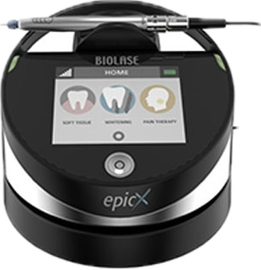
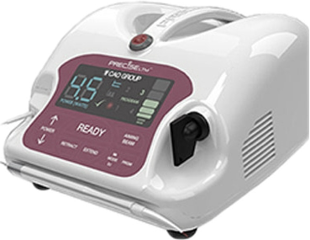
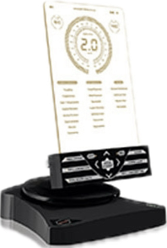
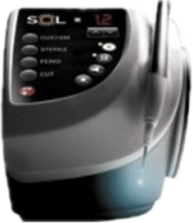
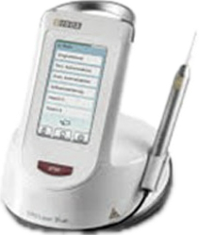
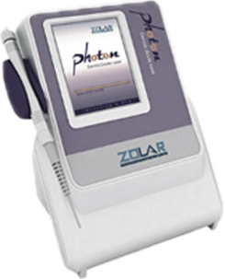
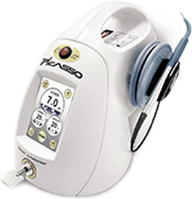
Laser Safety Mechanisms
On/ Off keys
Access code
Interlocking components
Guarded foot switch
Emergency shut off switch
System time out
Notes:
All Lasers have a emergency stop button. Get your self familiar with the laser you are using.

Slide 10
Laser Treatment Room
All laser release forms should be signed and scanned prior to patient’s procedure.
Warning sign should be posted outside the room where laser procedure is being preform.
Minimize reflective surfaces
Scatter can travel up 6-8 ft from the source
Everyone in the room needs to have protective eye wear
Eliminate flammable liquids
No Alcohol soaked gauze
No petroleum jelly
Dispose of the Laser tips in sharps container
Notes:
Laser release form are important because they explain in writing the treatment that will be preformed on the patient and the patient gives their consent by signing that form. Scan it into the patient’s chart.

Slide 11
Laser Safety
All Laser treatment rooms should have a warning sign
Curtains, window coverings or doors if needed
Safety glasses for Every one that will be in the treatment room
Laser Consent forms signed prior to use of the laser
Notes:
Warning sign should be posted once the patient is in the chair and removed when the laser treatment is completed.
Everyone in the treatment needs to have laser goggles and everyone that may enter should have a pair of laser goggles prior to entry of the treatment room.

