Slide 1
Public speaking
Quick tips to enhance Speech and vocal skills
By Jenny Fusco MA CCC-SLP

Slide 2
It’s Not just “what” you say, but “how” you speak that matters for effective communication
Studies show that your voice is a very important part of communication message- even twice as important. Your voice, words and body language should match in order to sound credible and authentic. These quick tips will address the often over-looked part of your public speaking- your voice!

Slide 3
Speech and voice skills
Four skills are involved in speaking:
1. Respiration (breathing)
2. Phonation (sound, voice)
3. Resonance
4. Articulation (moving the jaws, lips, mouth , tongue to create specific sounds)

Slide 4
Respiration- the power source
Diaphragmatic breathing is critical to good speech production for public speaking. This means breathing deeply from the diaphragm (rather than shallow breathing from the rib cage only). We must get a deep enough breath to produce all sounds without clipping any off, creating enough volume, energy and resonant quality).

Slide 5
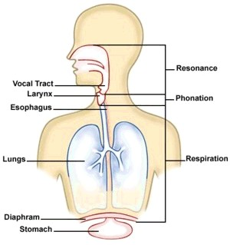
Anatomy and physiology, cont.

Slide 6
BREATHING EXERCISES
SAFETY FIRST/CAUTION
To project our voice, we need to take in a full breath of air before speaking, enough to make the diaphragm move. We speak on exhalation, so when we only fill our lungs, or take a shallow breath, we do not have enough air to get us through our sentences. This can lead to reduced intelligibility, particularly at the end of the sentence, decrease our volume of voice, or make our voice appear weak.
Check your posture- make sure you are tall and straight with shoulders back and down over your hips, chin parallel with floor.
Put one hand on your chest, one on your diaphragm (under the rib cage). Imagine a “balloon” in your stomach area (diaphragm) and expand it as you inhale. Make sure that the expansion is in your diaphragm, not your chest or shoulders. Your shoulders should NOT rise, and there should be limited “puffing out” of your chest. The movement should be in the diaphragm.
Gently, naturally exhale
Practice through several cycles of breath.
Practice: speech using deep breaths. Take a deep breath, then read from a book out loud. How many sentences can you make on one breath? Repeat, try to make a few more words.

Slide 7
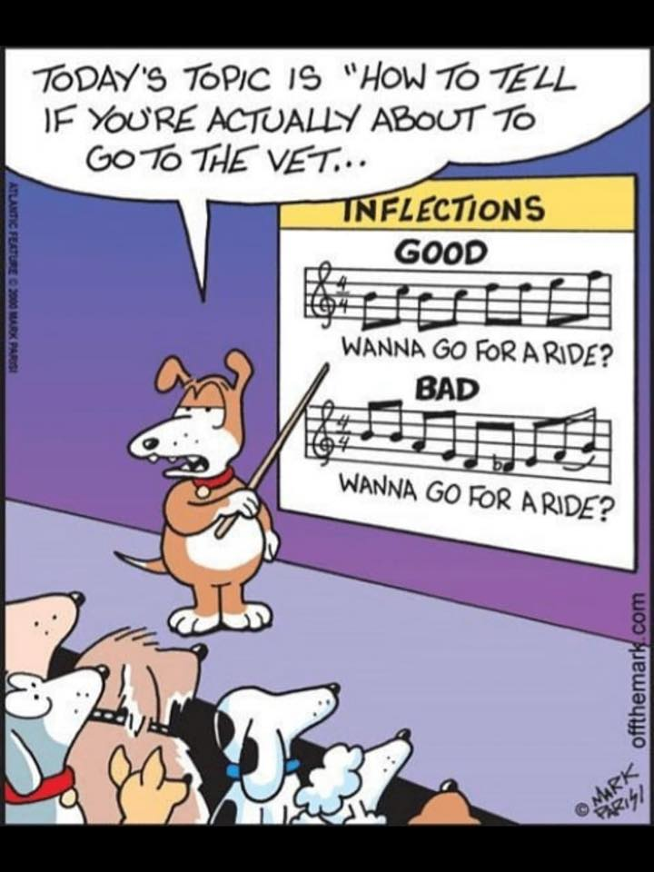
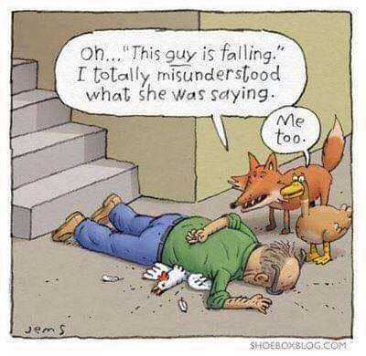

Slide 8
Phonation: sound quality, Resonance
Phonation is the sound that is produced from the vocal folds, and resonates through the vocal tract creating your own unique “voice”. It can be further described by both pitch, resonance and volume.
1. Pitch
Natural/resting pitch. What is your natural resting pitch? Say “ah” with the least amount of tension at the throat, keeping it as relaxed as possible. That is your resting pitch. Use a wide range of pitches when speaking to add variety and prevent from being monotone.
2. Resonance It is related to the optimum vocal quality of the voice. The sound created by the vocal folds as it passes through the various vocal tract and cavities. A fuller, richer tone of voice can be achieved by creating a forward resonance, and letting the sound resonant through the oral, laryngeal and nasal cavities. Tor example, Create a sound (such as “ooh”) with a buzzy, vibration at the lips. Practice this forward resonance in words and sentences.
3. Volume- (loud/soft) use volume carefully to highlight, show emotion. Good breath support will allow you to maintain volume, good resonance will also allow you to project your voice without straining the vocal cords.

Slide 9
resonance Exercises
Feel the vibration on the lips as a buzzing sensation as you hum in a warm-up exercise, and then learn to sense resonance forward in connected speech. That takes the weight off the vocal folds so they’re able to project with as rich of a resonance as possible
Practice saying “ah” while opening up the throat as much as possible, by lowering the back of the tongue. Does the sound change as you change the shape of your mouth?
Say “Ahng” and feel the vibration at the nose (nasal resonance). Say “2, 3, 4, 5, 6” pinch your nose at 5 and 6. Does the quality change? If so, you may have a hypernasal quality. Try engaging your soft palate a little more when you speak. (your soft palate is the soft moveable part of the roof of your mouth, back toward your throat. It moves up and down when you hold your breath without pinching the nose.
Practice saying the word “holm” with a forward resonance and buzzy vibration at the lips. You should have light contact with the lips and stretch out the /m/ sound. It might sound like you are chanting “Holmmmmm”.

Slide 10
articulation
Once the sound is created from the airflow (respiration), vocal folds (phonation) and further shaped by your resonating cavities of your vocal tract which gives you, your unique voice. We further shape the sound into words using “articulation”. We use the lips, jaw, tongue, muscles in the throat and mouth to shape these sounds.
One of the most important aspects of clear, concise articulation is to produce all sounds, particularly the final sounds in words and at the ends of sentences.

Slide 11
Dropping the ends of words
Many words differ only by the last sound of the word (see below). Therefore, make sure you always pronounce the last sound in a word.
Bat bad
Sat sad
Rice rise
Back bag
Eighteen eighty
We must also make sure we have enough breath to carry us through the final words/sounds in sentences when speaking, so we end as strong as we started!

Slide 12
Articulation: Verbal warm ups
You use muscles in your tongue, lips, face, mouth and throat when speaking! To keep your muscles strong, flexible, and your pronunciation clear, you may warm up before speaking with various articulation exercises. Try to say the following:
Pa ta ka (10x faster and faster)
Ba da ga (10 x faster and faster)
Raspberries ( brings resonance forward too).
Tongue twisters…
Unique new York
Red leather yellow leather
Peter piper picked a peck of pickled peppers
She says she shall sew a sheet

Slide 13
Adding vocal variety
We add vocal variety to keep our speech and voice interesting. We can use our voice to capture and maintain attention when we follow some simple strategies.
1. Word stress
Word stress- vary your pitch and duration to highlight important words. Some important words may be highlighted by making them longer and higher in pitch. Say “banana” , then “ba NAAA na”. Notice a change in stress?
2. Phrasing/ “thought chunking’:
When speaking at length, group thoughts together. Use a brief pause between thought groups to give listeners time to process. For example: "Four score and seven years ago our fathers brought forth on this continent a new nation conceived in Liberty and dedicated to the proposition that all men are created equal”.
It Can be read as one long sentence (above) or broken into thought chunks (below):
"Four score and seven years ago (pause) our fathers brought forth on this continent a new nation, (pause) conceived in Liberty,(pause) and dedicated to the proposition that all men are created equal”.

Slide 14
Vocal variety, cont.
3. Strategic Pausing- use a pause before and after very important words or phrases to highlight. “It is important to read (pause) ALL (pause) the directions first before beginning”
4. Rate of speech: Keep your rate at a good pace. Not too fast, or too slow. 150-180 Words per minute is ideal. Use Variation of rate across words and sentences for added interest.
5. Eliminate use of “filler” words such as “like, uh, um, you know, just” by using pauses instead.

Slide 15
Stairstep speech (changing pitch throughout your sentence)
Imagine you are at the bottom of the stairs. Each step you take is one note higher, and corresponds to a word. Now imagine, going down the stairs. Within each sentence below, say the first 1-2 words at neutral pitch, then go up a few notes and work your way down the “steps” and/or go down a few notes and work your way up. Try to end the sentence on a low note. Play around with your pitch to see what it sounds like. Remember, Go Up and/or down the stairs but don’t stay on the landing! Statements always end on a low note, while “yes/no” questions will always end on a high note.
The glass is on the table.
The carton is in the refrigerator, but the glass is on the table.
I like to pizza with my friends.
After work on Friday, I like to eat pizza with my friends.
Lets go to the store.
Lets go to the store, then we can make dinner.
The numbers look good.

Slide 16
Pulling it all together
Practice reading from your favorite book, or practicing your presentation/speech using the following skills:
1. Diaphragm breathing- take a deep breath before speaking and at strategic pauses.
2. Us balanced resonance
3. Thought chunking- group thoughts together
4. Pause strategically between thought chunks or punctuation breaks, before or after important words or thoughts.
5. Help processing by summarizing, using repetition, slowing (or speeding up) rate, or pausing at dry/important information.
6. Use vocal variety: change rate between sentences, use stairstep speech, use pitch changes and duration on important words, and vary your volume throughout your speech.
7. Pronounce all words clearly, including all word endings, and end the sentence as strong as you started.

Slide 17
Thank you !!
For more information, or individual coaching check out
www.jennyfusco.com
Copywrite, 2023
All rights reserved

