Slide 1
18th Century Palace Hotel in the
Vibrant Heart of the Princely State of Jaipur

Slide 2
Jaipur: The Pink City
Jaipur rekindles the romance and mysticism of a bygone era of the Rajputana. Poetry in pink stone transcending time, a city that has remarkably retained its pulse and vitality. A labyrinth of fascinating bazaars, opulent palaces, colourful streets where camels jostle for space with motorbikes. Amber Fort is situated on a forested hill premonitory, above the Maota Lake near Amber village, about 11 kilometres (6.8 mi) from Jaipur city, the Capital of Rajasthan.
Jaipur derives its name from its illustrious ruler Maharaja Jai Singh. The city was undoubtedly one of the best planned in India. The city’s architect, Vidyadhar ensured that he first approved all building plans before being cleared for construction; one of the reason's why the old city has developed so harmoniously. The original plan still exists, and it bears a strong resemblance to the grid pattern of modern cities in the west.

Slide 3
Jai Mahal Palace, Jaipur: Recall of a Bygone Era

Slide 4
The Palace of Victory
Jai Mahal Palace: The magnificent royal edifice traces its origin to 1745.
Former residence of the Prime Minister of princely state of Jaipur
The majestic palace, a vast complex of regal rooms, pretty pavilions and charming colonnades set amidst 18 acres of landscaped gardens
The heritage palace has been painstakingly restored and recently refurbished to offer guests the exclusive experience of a royal lifestyle complemented by legendary hospitality.
The stately Mughal Gardens, resonant with the call of peacocks, is a formal, multi-level, quartered garden with pavilions, water channels, flowerbeds, ponds and stone pathways.

Slide 5
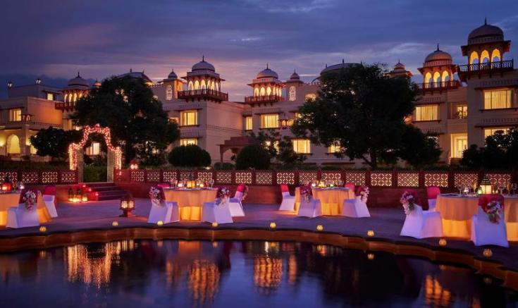
The Natani-ka-Bagh at Jaipur, nucleus of present Jai Mahal Palace was the garden house of an 18th century Rajput chieftain Hargovind Natani. The garden house became a monument to fame 124 years later, when Dr. Thomas Hendley came to live here, and became Jaipur 's most prolific historian and art patron, of the 19th Century.

Slide 6
Accommodation

Slide 7
Accommodation
Jai Mahal Palace offers 100 palatial rooms including 6 suites. Colonial style furniture, miniature paintings, gold-hued silks, sheer curtains and stylish bathrooms offer contemporary comfort with a regal touch. All the rooms have tea/coffee maker, minibar, safe, LED TV, Direct dial telephones, with satellite programs and hair dryer. Wi-Fi connectivity is available.
The L-shaped Palace has most of the rooms overlooking a beautiful gardens which replicates an 18th century garden laid out by a Mughal emperor, 200 km east of Jaipur.
04 Deluxe Premium Suite
02 Deluxe Suite
20 Luxury Rooms with sit out
65 Luxury Rooms
9 Deluxe Rooms

Slide 8
Deluxe Premium Suite

Slide 10
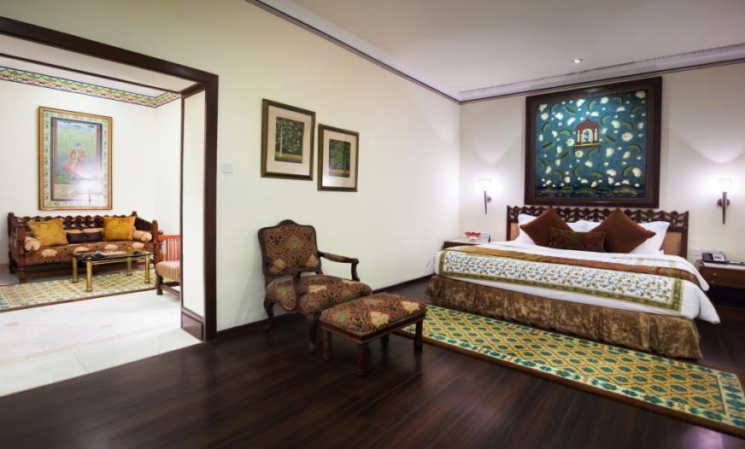

Slide 11
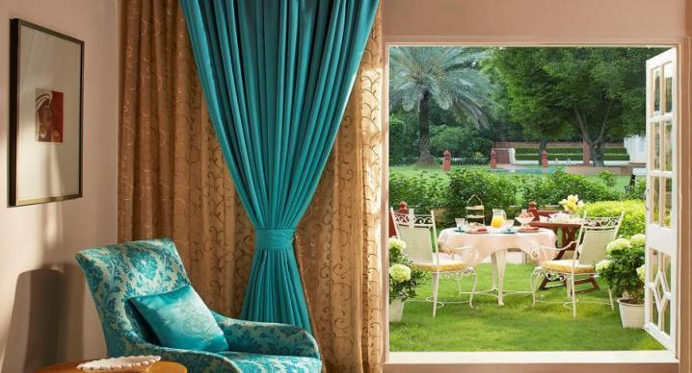
Luxury Room with Sit Out
The New Luxury Rooms with private sit-out, located on the ground floor, offer the same decor and amenities as the Luxury Rooms with the additional advantage of a private sit-out with tranquil views of the beautifully landscaped lawns or the pool

Slide 13
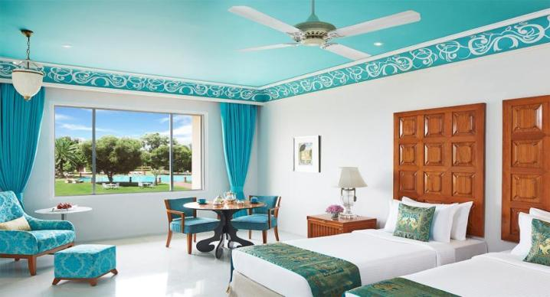
Luxury Room
The Luxury Rooms, evoke the rich colours of Rajasthan. The rooms seamlessly blend contemporary and traditional style and offer modern facilities such as cordless phones and an LED TV. The Stylish bathrooms have state of the art fittings, a separate shower cubical and a separate bath tub. These rooms offer a spectrum of moods in their design elements.

Slide 15
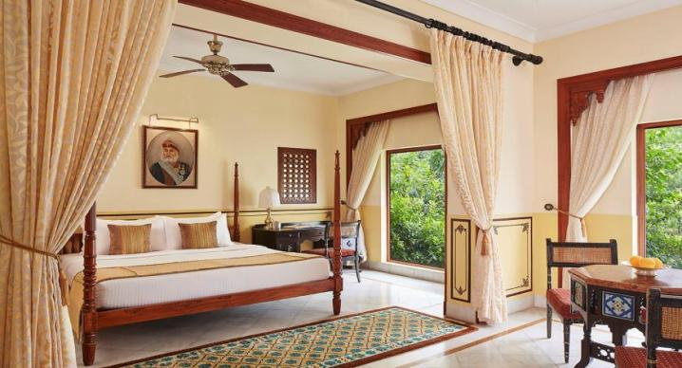
Deluxe Room
The 10 Deluxe rooms are tastefully decorated in traditional Rajasthani decor with marble flooring and reflect ancient Rajput culture and heritage. Original paintings by contemporary Indian artists or prints of classical and mythological themes by famous Indian artists enhance the ambience.

Slide 16
Culinary Experiences

Slide 17
Culinary Experiences
At Jai Mahal Palace, luxurious living and fine dining find common ground to offer guests an eclectic culinary experience by providing a choice of 4 restaurants
Cinnamon: Indian Cuisine Specialty Restaurant
Giardino: Italian fine dining Restaurant
Marble Arch: All Day Dining Restaurant
Marigold Bar: Cocktails and Cuban Cigars
La Patisserie: The Cake Shop
In Room Dining: 24 Hours

Slide 18
Cinnamon
The Indian gourmet restaurant, creates an aura of a royal celebration with its plush décor, impeccable service and traditional lightly cooked specialties of the Rajasthani and Mughal India.

Slide 19
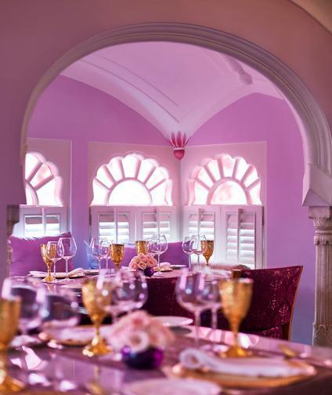

Slide 20
Giardino
Giardino, the fine dining restaurant near the poolside serves traditional Italian food paired with the finest old and new world wines.

Slide 21
Marble Arch
The Marble Arch is a charming all day dining restaurant overlooking the Mughal Gardens, serves a variety of Indian, Continental and Oriental specialties as well as a fine selection of spirits.

Slide 22
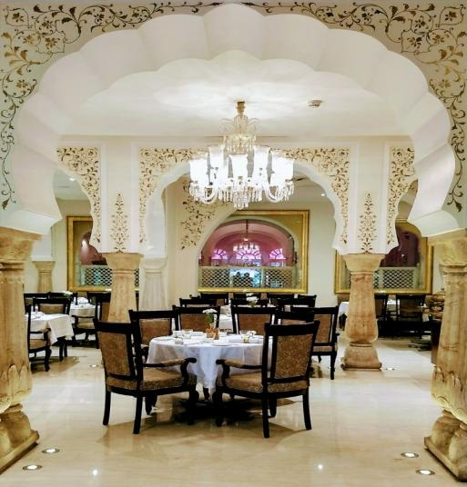
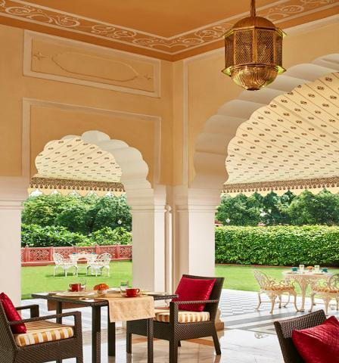

Slide 23
Marigold Bar
The new trendy Marigold Bar serves a variety of the finest international and Indian liquors, cocktails, beverages and cigars.
Situated at the lobby level, overlooking the lush green landscaped Mughal gardens.

Slide 24
Unique Dining Experiences

Slide 25
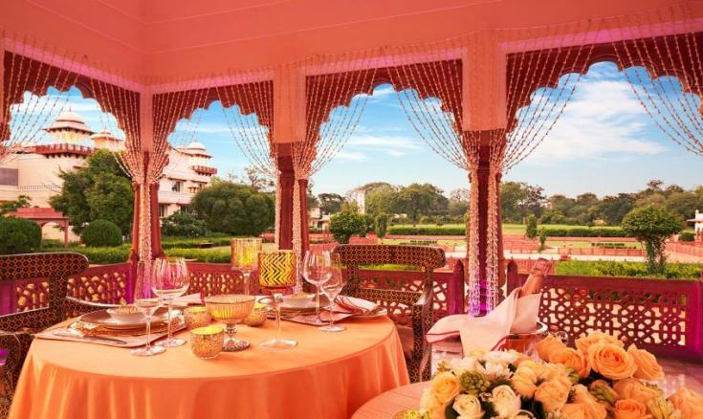
This fine dining area in the center of stately Mughal gardens is subtly lit with special lights and decorated with petals. Guests can enjoy this special occasion at this exclusive celebration table with exquisite table settings, a gourmet meal and personalized service. With the heritage Palace in the backdrop, this venue becomes ideal for a memorable celebration.

Slide 26
Wellness

Slide 27
Jiva Spa
The JIVA Spa, set in a stylish tent near the swimming pools, offers a choice of exotic Indian wellness treatments. Guests are welcomed with a footbath ritual. The treatments include traditional anointments, royal aromatic massages and holistic facials. Yoga sessions are held on the lawns.

Slide 28
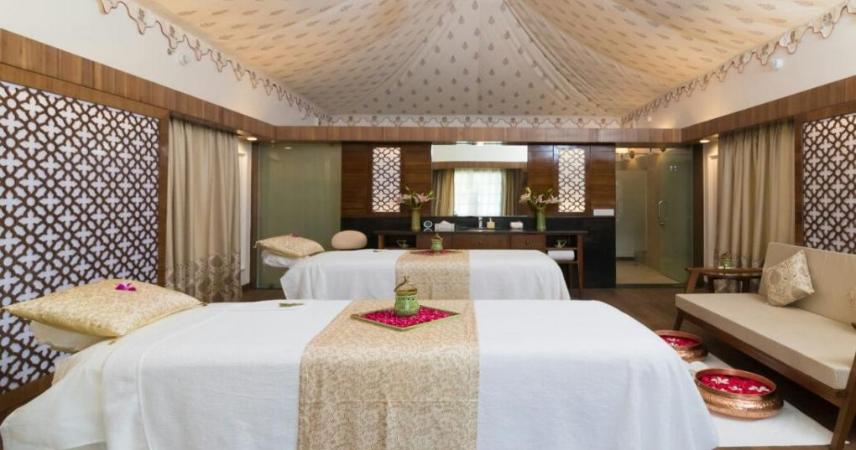

Slide 29
Meet and Celebrate

Slide 30
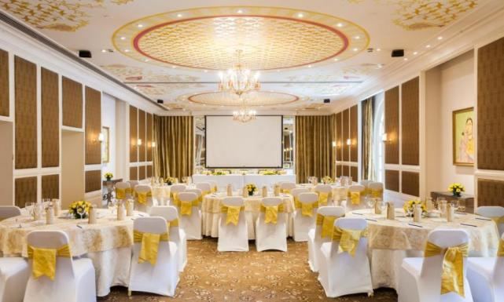
Durbar Hall
Durbar Hall, the banquet hall offers modern features like remote controlled projection screens, variable lighting to meet different requirements, soundproofing and an integrated audio system. The hotel has 1 meeting room and 2 board rooms

Slide 31
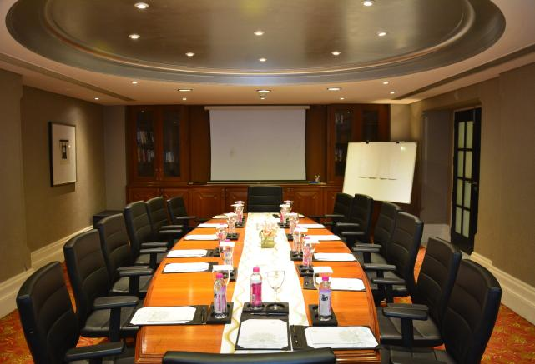
Silver Oak Boardroom

Slide 32
Timeless Weddings at Jai Mahal Palace, Jaipur
Jai Mahal palace is not only one of the finest examples of Indo- Saracenic architecture, it also dates back to 1745 A.D. You can take advantage of its history and its landscaped gardens, all 18 acres of them, as you plan a truly grand wedding for up to 2,500 guests.
18 acres of Mughal gardens show Jaipur in its best avatar, with your guests breathing in the rarefied air of this authentic sandstone palace. You can make the most of Jaipur and take your guests vintage sari shopping, peacock spotting or palace hopping. You can also add a spectacular Ghoomar performance to your wedding functions or even make this authentic palace hum with the strains of live instrumental music on your wedding night.

Slide 33
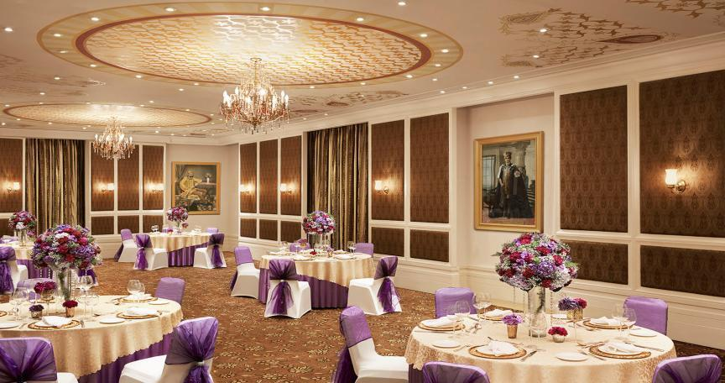

Slide 34
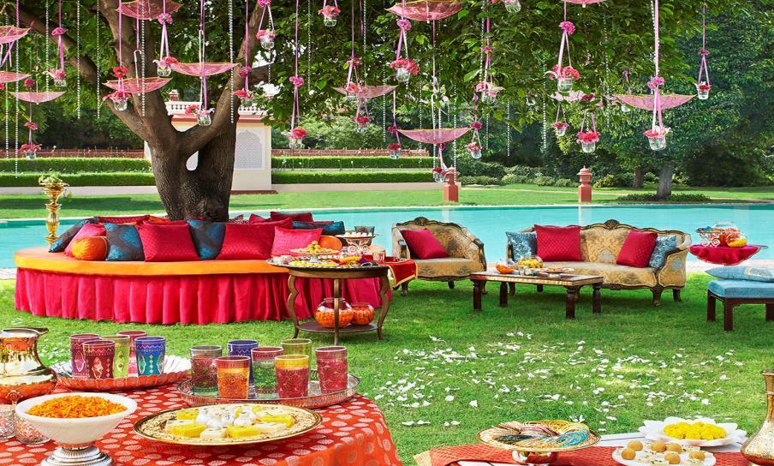

Slide 35
Venues
VENUE | SEATING CAPACITY |  |  |  |  |  | DIMENSIONS
 | Theatre | Class Room | U - Shape | Cocktail | Sit - Down | Cluster Seating | Metres L x B | Feet L x B | Height Mt & Ft
Durbar Hall | 130 | 50 | 50 | 200 | 80 | 80 | 18.5 x 6.5 | 60 x 20 | 3.5 / 11.5
Silver Oak Board Room |  |  | 12 |  |  |  | 8.2 x 4.9 | 30 x 16 | 2.2 / 7.5
Sterling Board Room |  |  | 12 |  |  |  | 8.2 x 4.9 | 30 x 16 | 2.2 / 7.5
Baradari Lawn |  |  |  | 200 | 80 |  |  | 5184 Sq.ft
Lotus Pond |  |  |  | 250 | 100 |  |  | 6200 Sq.ft
Fountain Lawns |  |  |  | 500 | 150 |  |  | 25344 Sq.ft
Poolside Lawns |  |  |  | 500 | 200 |  |  | 33792 Sq.ft
Palace Lawns |  |  |  | 2500 | 1000 |  |  | 40176 Sq.ft

Slide 36
Themes at Jai Mahal Palace
Maharaja Welcome
Grand Royal Procession
Arena horse Polo
Rajput Wedding
Village Fair Theme
Sit down silver service
Grand Rajasthani Soiree
Baradari dinner / Celebration Table
Bajot Theme
Candle and Jal Tarang Theme

Slide 37
Recreation
Board Games
Badminton
Card Table
Carrom
Lego Station
Cricket
Croquet
Folk Dance evening
Football
Gymnasium
Jogging Track
Kids Movies
Pool Table
Little Wonderland-Kids Room
Outdoor chess with life-size chessmen
Puppet Show evening
Outdoor Swimming Pool
Kids’ Pool
Table Tennis
Travel Desk-Ticketing, Tours
Video Games
Workshops for kids

Slide 38
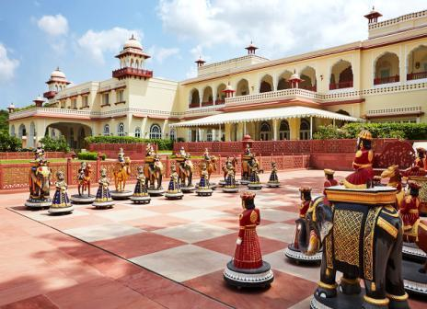

Slide 39
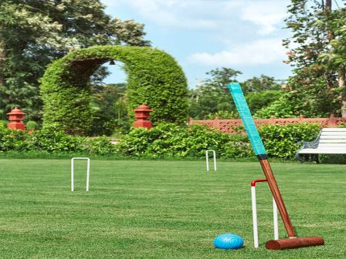

Slide 40
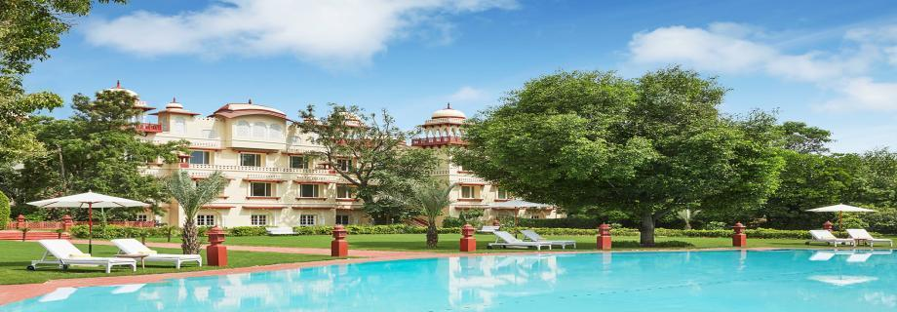

Slide 41
Services And Facilities
Airport Transfers
Baby- Sitting Arrangements - on request
Business Centre Facilities
Travel Concierge
Currency Exchange
Health Centre
Hotel Safe
Wi -fi internet connectivity
Laundry Services
Luggage Storage
Medical Services-Doctor on Call
Postal/Parcel Services
24-hr Room Service
Barber Shop
Beauty Salon
Facilities For the Physically Challenged
Excursions: • Ajmer 150 kms • Alwar 160 kms • Agra 240 kms • Jodhpur 350 kms • Ranthambore 180 kms • Ramgarh 45 kms

Slide 42
Places of Interest
Hawa Mahal (Palace of Wind)
The City Palace
Jantar Mantar (Observatory)
Nahargarh Fort
Central Museum
Jaigarh Fort
Amber Fort

Slide 43
Connectivity
Jaipur is well connected with prominent cities in India and it also has an international airport for international connectivity.
Located close to the mail shopping centre and historical monuments, Jai Mahal Palace is ideal for exploring the fascinating city of Jaipur. With its blend of history, elegance and Luxury the heritage hotel is a perfect destination for visitors to Jaipur.
Jai Mahal Palace is 14 Km from the airport and 1.5 Km from the railway station, with good air and surface links to all major destinations within the country and abroad.

Slide 44
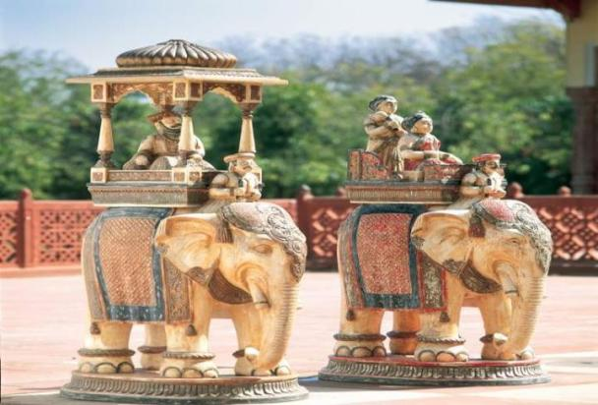
Jai Mahal Palace Civil Lines, Jaipur -302006 Tel: +91-0141-6601111; Fax: +91-0141-222 0707 , jaimahal.jaipur@hotels.com | www.tajhotels.com

