Slide 2
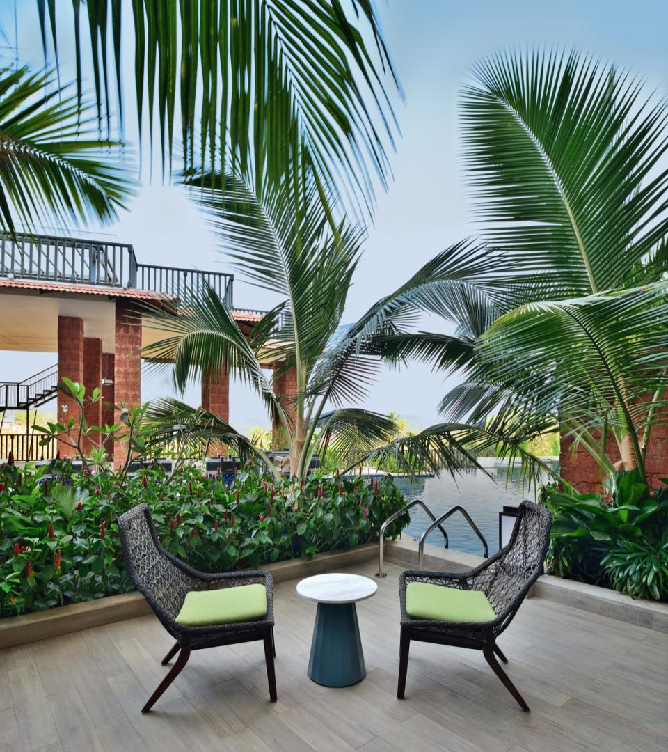
THE SUSEGAD WAY OF LIFE
INVITES YOU
The Westin Goa in Anjuna is nestled amidst an idyllic sanctuary serenading your senses from the moment you are welcomed in our haven.
The Westin Goa offers rejuvenating experiences in one of the most stunning travel destinations in India.
Meanwhile, serenity beckons from our beautifully appointed 171 hotel rooms, suites and deluxe patio rooms where you can fuel your energy.
Susegad - Tranquil Living

Slide 3
ATRIUM LOBBY

Slide 4
Guest Rooms
171 rooms
96 King Rooms
51 Double Rooms
Four Family Studios
10 Patio, Pool Access
Nine Executive Suites
One Presidential Suite
Guest Room Features
Four fixture washroom
Room service, 24-Hour
Heavenly® Bed
Heavenly® Bath
White Tea Aloe bath amenities
55 inch LED Smart TV in all rooms
Complimentary High Speed Wi-Fi

Slide 5
DELUXE KING

Slide 6
DELUXE DOUBLE

Slide 7
FAMILY STUDIO

Slide 8
EXECUTIVE SUITE

Slide 9
POOL PATIO

Slide 10
Four Food and Beverage Venues
The Market - All Day Dining
Lobby Level | 130 Covers
Anjuna Coffee and Co. - Deli and Patisserie
Lobby Level | 24 Covers
Haven - Hotel Bar
Lobby Level | 40 Covers
Drift - Sunset Deck
Lobby Level | 40 Covers
Thyme & Ash - Rooftop Grill
Second Floor | 56 Covers

Slide 11
The Market is a based on a nourishing atmosphere conceptualized on ethical and sustainable ingredients.
It stays true to Westin’s Eat Well philosophy through a balanced and healthy offering.
The live kitchens, each with an individual identity, are integrated in different zones within the outlet’s modern and open design.

Slide 12
HAVEN
Guided by the principles of biophilic design, Haven brings nature into the space to create an atmosphere of rejuvenation and enhance guests’ well-being.
Our Haven offers small bites and an eclectic mix of local, Western and Asian favorites.

Slide 13
Anjuna Coffee and Co. is our in house patisserrie with a variety of house-made breads, desserts and confectionaries throughout the day along with a selection of roast coffees made by our barista.
It also offers a culinary delights in our Deli section with artisanal sandwiches, savoury and revitalizing drinks at Westin Fresh by Juicery programme along with a retail option.

Slide 14
The Drift is a space for guests to unwind and have a great bite and drink while lounging by the pool with a sheesha at the perfect sunset glow and soothing music.
This open space is divided into two zones, a quiet zone for a relaxed time by the bar or a more buzzing one by the DJ booth.

Slide 15
THYME & ASH
A casual take on global and honest cooking within a white tone centric for a spacious and inviting feel, accentuating the luxury of simplicity.
The highlight is on regionally sourced
produce – freshest vegetables, meat, poultry and fish, prepared in-house and cooked on live fire display ovens and grills.

Slide 16
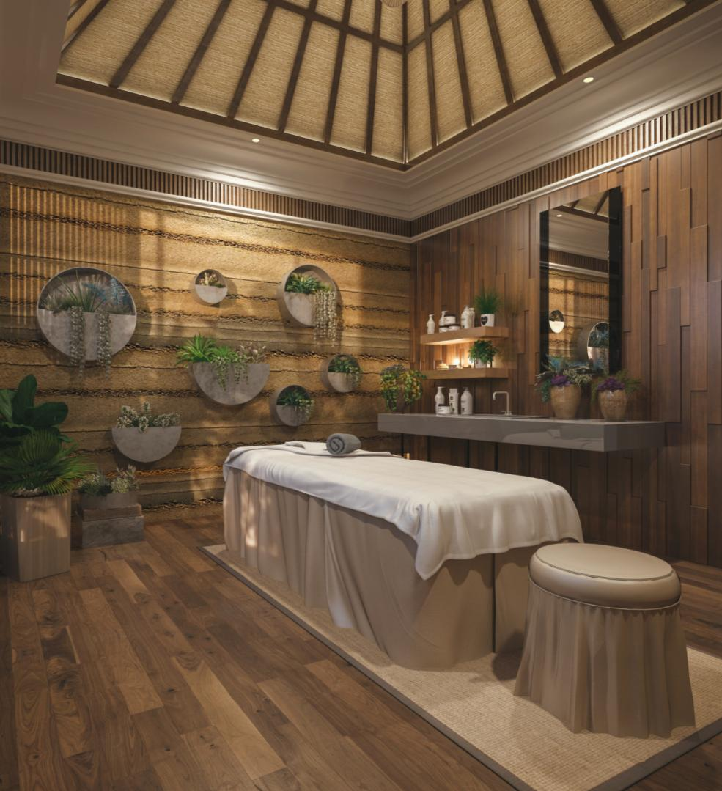
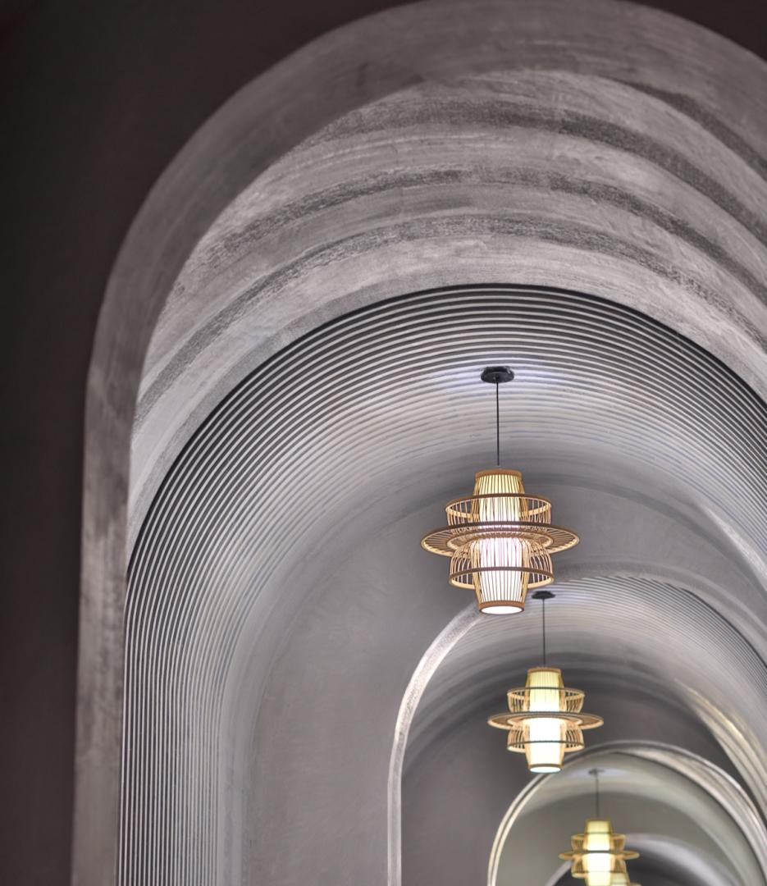
Our Spa allows you to replenish your mind and body with a personal sensory experience.
Located at the lobby level, each treatment room offers a recharging steam area and a choice of healing massages, invigorating bath rituals, body wraps, facials & exfoliation treatments where we cover all the five human senses.
TREATMENT ROOM
HALLWAY

Slide 17
Westin®WORKOUT
FITNESS STUDIO
Maintain your focus on fitness at our 24 hour gym with all essentials to power up your performance.

Slide 18
MEETINGS AND EVENTS
Create and innovate in our contemporary and versatile event venues in The Westin Goa.
Kashti is our largest event venue at The Westin Goa, offering a space of approx 14,000 sqft including a sprawling lawn and a pre-function area.
Kashti is a flexible event venue of 4682 sq.ft. featuring a pillarless ballroom, state of the art AV equipment and high-speed Wi-Fi.
Chapora offers a space of approx 1400 sqft appropriate for an interactive gathering and can be styled into a board room or breakaway space.
Thyme & Ash
Celebrate your special moments, both big and small at our Thyme & Ash Outdoor spaces of 4600 sqft curated for all your needs.

Slide 19
KASHTI

Slide 20
MEETINGS AND EVENTS
LENGTH
WIDTH
HEIGHT
AREA
CONF.
SCHOOL
THEATRE
BOARDROOM
KASHTI
KASHTI 1
KASHTI 2
PFA 1
PFA 2
LAWNS CHAPORA
THYME & ASH
95
62
32
101
85
-
54
-
49
49
49
20
16
-
27
22
22
22
14
14
-
14
4682
3067
1615
2020
1360
5786
1458
4600
200
150
50
-
-
-
42
-
180
135
45
-
-
-
38
-
350
250
100
-
-
-
75
-
74
40
34
-
-
-
32
-

Slide 21
Westin Family Kids Club®
Westin Family kids club features fun activities at The Westin Goa such as origami, sand castle making, magic show, dancing, baby zumba dancing and much more to cater to children along with a playful kids activity area.
We also offer a separate pantry, diaper station, and additional washrooms for a holistic approach for any requirement.
.

Slide 22
REJUVENATE AT THE ADULT ACTIVITY AREA
.
When you are tempted for stimulating activities,
The Westin Goa offers a variety of welcoming diversions such as snooker table etc.
Unwind beyond your living room with a customized beach bag filled with replenishing goods or take a sustainable healthy ride along the shores in an E-Bike.

Slide 23
LOCATION
Complimentary Coach Service from the Airport
Electric Car Charging Stations
Complimentary Cycle rides to the Beach (subject to availability)
43.9 kilometers - Dabolim Airport
15 kilometers - Thivim Train Station
2.1 kilometers - Anjuna Beach
2.1 kilometers - Vagator Beach
9.5 kilometers - Calangute Beach
12 kilometers - Candolim Beach
15 kilometers - Ashvem Beach
29 kilometers - Old Goa
82 kilometers - Dudhsagar Falls

Slide 24
EXPERIENTIAL ACTIVITIES
There is no doubt in that Goa has been a favorite destination for all, with all the exciting activities and the serene beach of Anjuna, attracting travelers from far and wide.
With a protracted coastline, blustery shorelines and splendid skies, Goa gives sufficient chances to experience what life is all about with a touch of mindfulness.
Explore vibrant flea markets, indulge in various water sports or take a selfie at the famous Parra.

Slide 25
08.322.271.300
Survey No 204/1 Sub Division 1, Dmello Waddo,
Anjuna Bardez, Goa 403509 India

