Slide 1
Underhill School and Children’s Centre
Understand * Uplift * Unite
Year 1
Notes:
Insert year please :)

Slide 2
Meet the team
Class | Teacher | Support staff working within the year group
1 Oak | Laura Turner | Jannine Cheryl Corinne Amanda
1 Willow | Abbie Hennessey - Clifft

Slide 3
The Underhill Way
At Underhill, we have 4 BE words;
Be Caring
Be Confident
Be Curious
Be Cooperative
These enable all children to become happy, successful 21st Century learners both while they are in school and in their future.
We also instill a positive and determined attitude though our school chant:
I can, you can, we can.
If you are ever visiting the school, it is likely that you will hear this chant coming from the classrooms to energise the children for their learning.
Notes:
We will have half termly themes - this half term ‘Future Me’ . We will discuss our own ambitions.

Slide 4
Notes:
There will be a focus every half term - this half term the focus is future Me , we will be speaking lots about our ambitions and what we would like our future to look like.

Slide 5
Curriculum

Slide 6
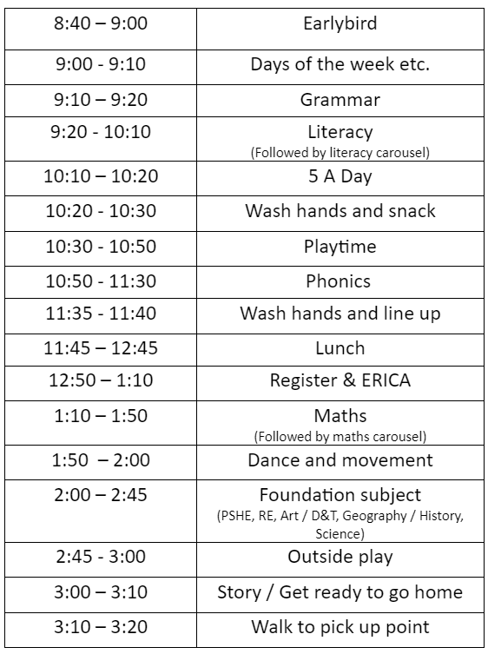
The School Day
Earlybird - Don’t miss out!
5 x 15 minutes = over an hour of lost learning time
Notes:
Discuss what the day looks like and what topics are taught each day. Explain importance of being on time - wasted learning time!

Slide 7
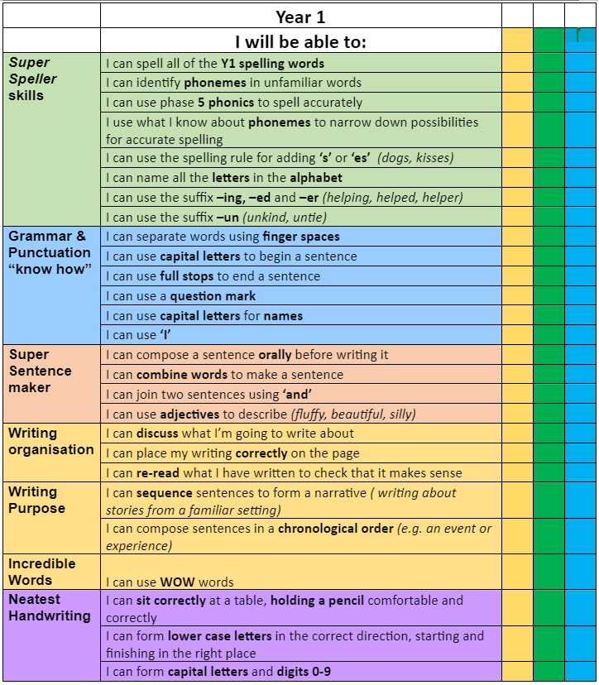
Year 1
Expectations in writing
Notes:
No need to read out, they're on the website.

Slide 8
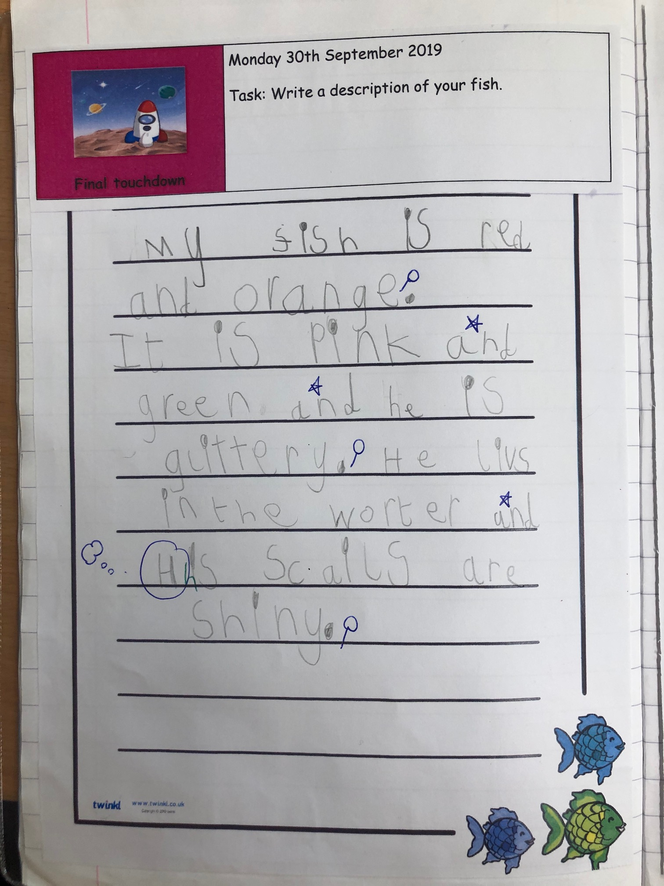
Writing
Year 1
Example
Notes:
End of year example, this is what we are working towards.

Slide 9
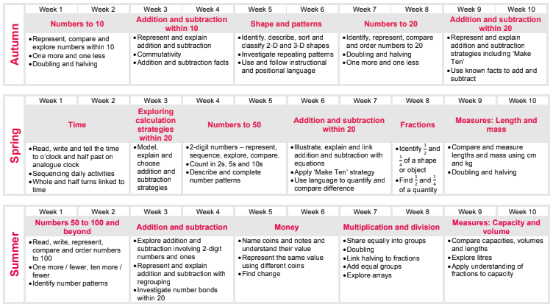
Maths
Year 1
Expectations in maths
Notes:
Insert the curriculum overview for your year.
Mention there is no streaming this year.
Only if asked why - research says that is only benefits the higher achieving children, does nothing to support low ability or lower income families. Our higher achieving children will be supported by adapted , more challenging tasks.
Maths is taught daily.
Discuss structure :
Mental maths , vocabulary, new teaching, talk task, independent work.

Slide 10
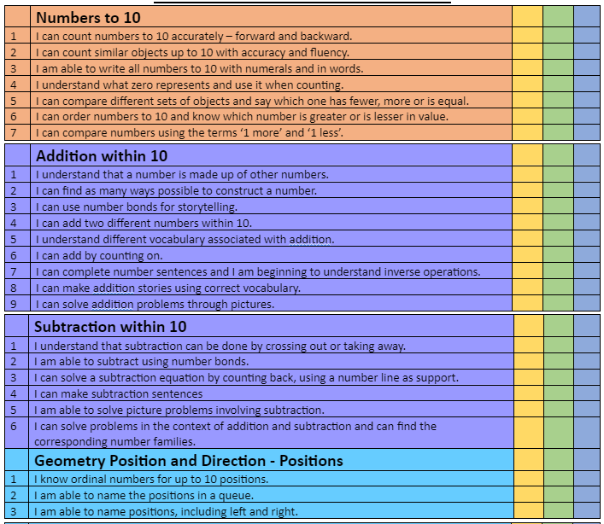
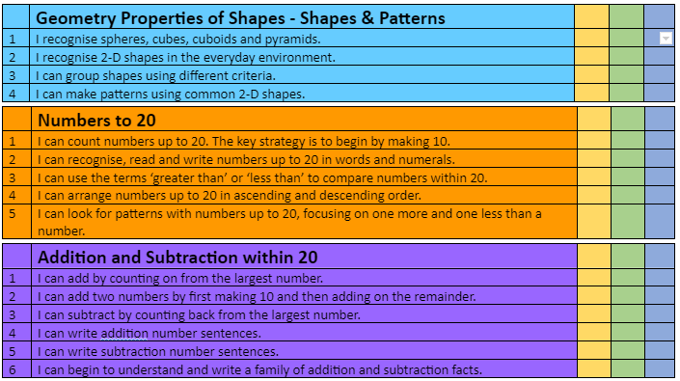
Maths
Year 1
Expectations in maths for Autumn
Notes:
Insert I CANs for maths in your year group.

Slide 11
MathsCraft
To further improve our pupils’ arithmetic skills, we are starting new programme called MathsCraft.
This will allow pupils to work on, and improve, arithmetic at their own level.
They will have an arithmetic test at the end of each half term to allow them to move onto ‘the next level’.
Children will receive a certificate every time they move onto the next level.
Parents will be informed what skills their child need to practise.
Notes:
Children will explore arithmetic skills, we have created this to make it more exciting. Start with writing numbers to 10,

Slide 12
PSHE
As a part of your child’s education at Underhill, we promote personal wellbeing and development through a comprehensive Personal, Social, Health and Economic (PSHE) education programme.
PSHE education is the curriculum subject that gives children the knowledge, understanding, attitudes and practical skills to live safe, healthy, productive lives and meet their full potential.
PSHE is a statutory subject that will include lessons on a range of topics such as keeping safe, health, friendships, growing and changing.
Notes:
Tell parents that they will be informed of their PSHE topic every half term.

Slide 13
School Trips
All classes will go on at least three school trips per year. Please look out for any emails regarding these as we will need parental permission for your children to attend.
We try to ensure that all trips are free, or hold a very small cost to parents/carers. You will be able to pay for any trips via School Money.

Slide 14
Assessment

Slide 15
Assessments
Children are assessed throughout the year in all areas of the curriculum. Last week of each half term is assessment week, when we focus on the children’s attainment and progress in a slightly more formal way from our daily formative assessments.
This is to enable us to monitor the progress of the children and ensure that they are receiving the correct support they need. We will discuss all assessments with you at parents’ evenings.
Notes:
Currently doing baselines.

Slide 16
Behaviour

Slide 17
Underhill Behaviour
I can, You can, We can… | This means that we…
BE Caring | Look after ourselves and others, are kind, are honest, look after our school and our things, respect each other, stand up for what’s right, show good manners, are tolerant and show compassion, support each other, understand different feelings
BE Confident | Solve problems, use our voice, ask questions, have a go, are organised, are honest when things go wrong, take responsibility for making a mistake, feel proud, are brave, try to do our best every day, are active learners
BE Curious | Know our learning style and how to do our best, challenge ourselves to see how far we can go, are resilient, understanding the learning pit, know how to help ourselves achieve, listen, ask questions
BE Co-operative | Work together, are a team, follow instructions, share, support others, are responsible citizens, understand our community and our world,

Slide 18
Underhill Rewards
We have 4 houses at Underhill
Balmoral * Sandringham * Holyrood * Windsor
Rewards
House Dojos
Star of the Week
Marbles and marble parties
Book of Excellence
Our Unsung Heroes
Yes Days

Slide 19
Parents as Partners

Slide 20
Parents as Partners
Parent partnership and communication is very important so that we are all working on the same page.
Parents evening will take place both this term and in the Spring term, please look out for more information about how to book nearer the time.
Parents evening this half term will be on Wednesday 18th October and Thursday 19th October.
Each class will have a class assembly this year (watch out for the dates on the webpage).
Please make sure you read the newsletter , there is lots of important info.
Please make sure you come and talk to us if you have any problems or concerns.

Slide 21
Home learning
Given out every Friday via SeeSaw.
Children complete work in Homework Books (will give these out).
Return to school by Wednesday.
Homework will be acknowledged and sent home.
Maths - a worksheet linked to what children have been learning about.
English - grammar and reading comprehension
Spellings - 10 spellings per week (Latter part of Year one)
Notes:
KS 1 - can you change this to SeeSaw.
Re: marking. Misconceptions will be addressed. Try not to use the work ‘marked’ as the feedback will not be very detailed. No need to bring this up though.
Tell parents : Homework will NOT have to be printed at home. Children can see it on google classroom and write answers in the homework book (which is then returned to school).
NOTE:Homework books are new to most children so explain how they work.

Slide 22
ERICA - Reading at Underhill
Dedicated reading session every day after lunch.
Guided reading - Children will read with an adult once a week.
Notes:
Explain we read scheme books in school.

Slide 23
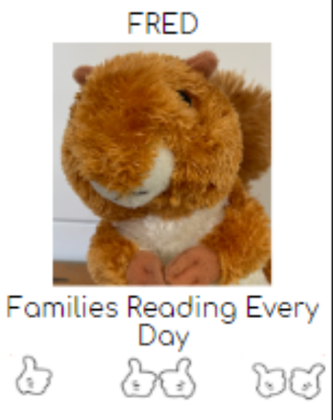
FRED - Reading at home
Children need to read at home every night.
KS 1 - Reading Scheme book.
Bring this to school at the end of each month when completed to exchange for your new one.
If home reading is not happening, a class teacher or Reading Lead will be in contact.
Notes:
Talk about reading speed. Reading regularly is the only way to get faster.
By year 6 120 words per minute. If they don’t read regularly, they won't be fast enough to finish their SATs papers.

Slide 24
Notices:

Slide 25
Uniform
Order though Schoolmoney.
Children should also wear black skirts, trousers or pinafores and black shoes.
Find more information here:
https://underhillschool.co.uk/uniform

Slide 26
Uniform
Your child will have PE on Tuesdays.
Notes:
Add PE day.

Slide 27
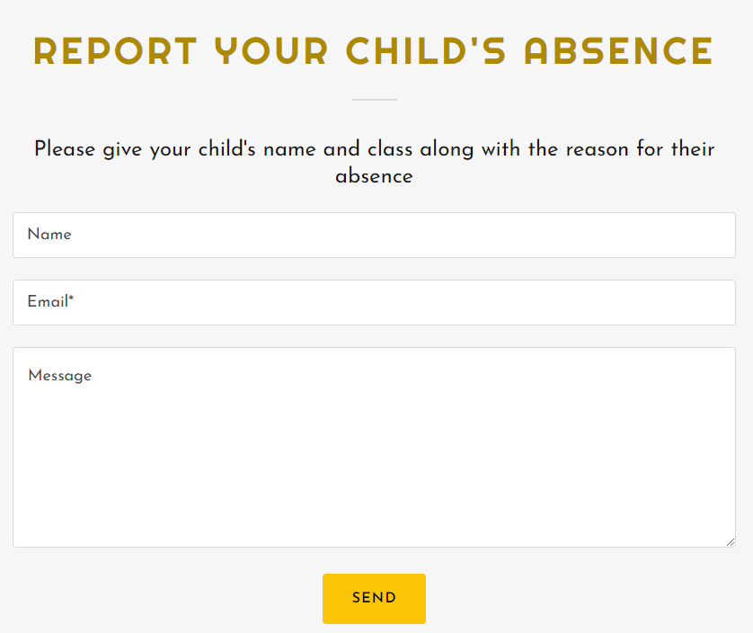
Absences
If your child in unwell, please inform the office in the morning.
https://underhillschool.co.uk/report-an-absence
Or you can call 020 8449 2423

Slide 28
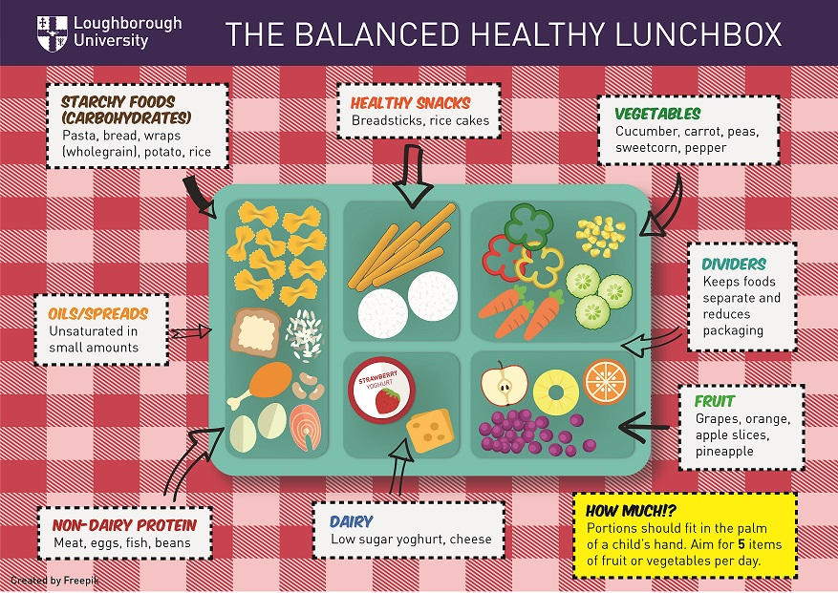
Snacks and Lunch
We are a healthy, nut free school. Children should bring in fruit or vegetables (e.g. cut up carrot, pepper or cucumber) to eat at break time. They are not permitted to bring in anything else.
ALL CHILDREN ARE ENTITLED TO A FREE SCHOOL MEAL.
If your child has packed lunch, please
ensure that it is healthy and nutritious.
Please do not give your child any sweets,
chocolate or fizzy drinks.
All lunch boxes should be named.
Please send your child into school
everyday with a named water bottle.

Slide 29
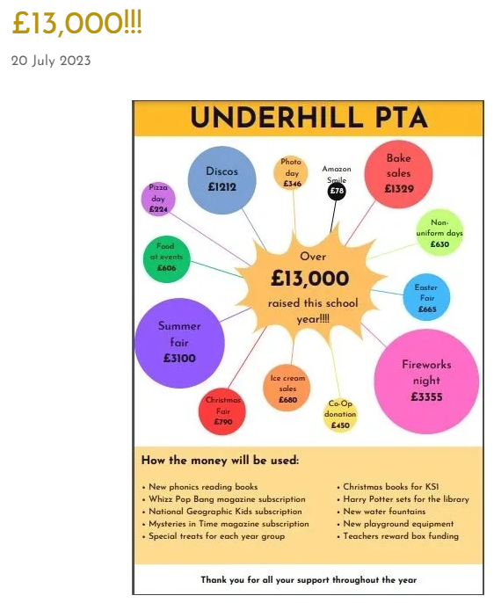
PTA
If you are interested in supporting the PTA, please talk to the school office or Anna in Nursery.
Notes:
We want to build on the last year’s success of PTA. Discuss some of the events.
We need parents to support. We will ask volunteers to sign up . Any events that do not have enough volunteers, need to be cancelled.
Summer Fair turn up was amazing.
Cake sales were very popular - these will be run by parent volunteer and class teachers.

Slide 30
Any questions?

Slide 31
Underhill School and Children’s Centre
Understand * Uplift * Unite
Thank you for coming!

