Slide 1
Meet the coaches
SherborneStormASC© 2017 – All Rights Reserved

Slide 2
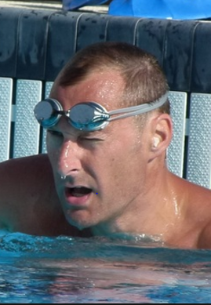
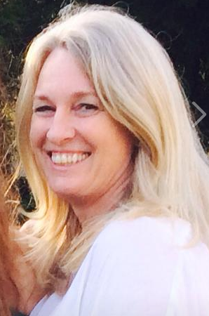
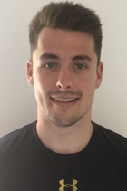
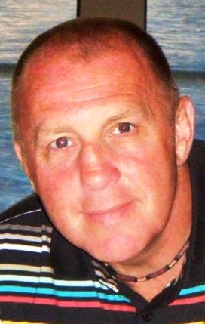
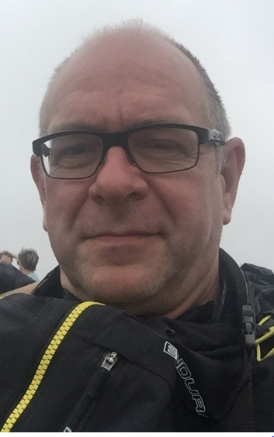
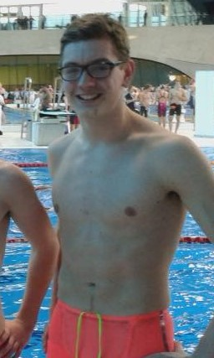
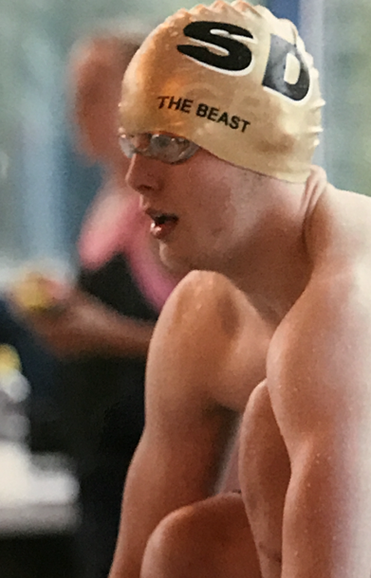
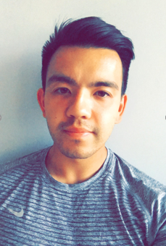
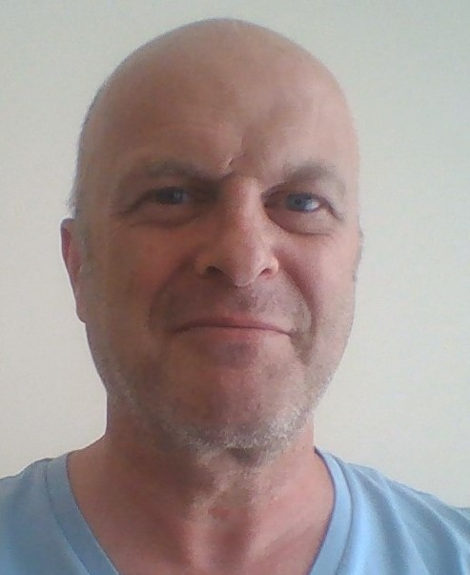
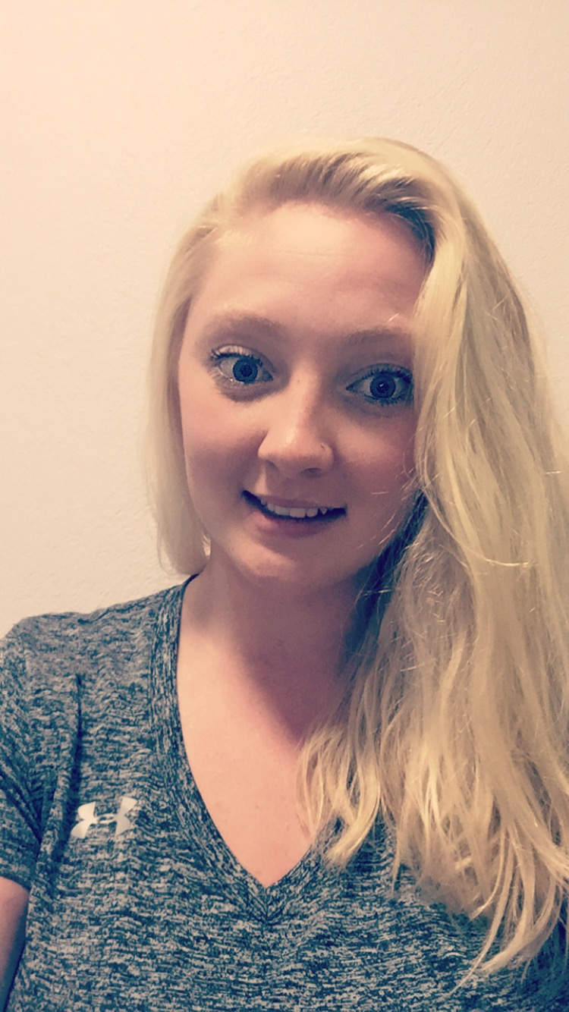
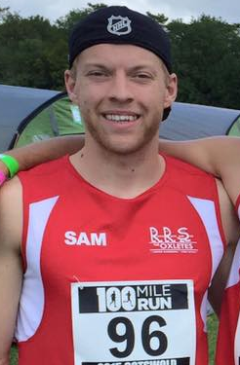
The
Coaching Team
By Sea…
By Land…
Nick Gillingham MBE, FIOS
Director of Swimming Strategy
Ryan Clayton
Wendy Flack
Kevin White
Philip Allen
Keir
Graham
Joe
Kerslake
Tom
Liu
Steve
Johns
Ellie Green
Zoe Pollard
Sam
Hill
SherborneStormASC© 2017 – All Rights Reserved

Slide 3
Nick Gillingham MBE – Director of Swimming Strategy
As founder of NGSA it is my mission to support competitive swimming careers for athletes and coaches. With determination and passion I believe anything can be achieved. Nothing is impossible. Attitude and choice can quite literally create Olympic success. Sherborne Storm’s mission is consistent with my ethos which is to develop people:
“To be better today than I was yesterday and better tomorrow than I am today”
I am proud to educate and develop aspiring swimmers, parents and coaches; not only in swimming specifics but across other subject related areas to help all individuals reach their full potential. Stroke development is an interesting subject area and NGSA strives to develop optimum stroke efficiency for the individual through developmental coaching. Each swimmer has an individual technical blue print; my role is to assess how to further develop your blue print into effective and efficient performance.
Primary Expertise
Professional Coach
Former Olympian
Coach Educator
Swimming Mentor
Qualifications
ASA Aquatics Professional
ASA Performance Coach
ASA Licenced Tutor
ASA Licensed Assessor
Additional Experience
Double Olympic Medallist
Former World, European and Commonwealth Champion
Commonwealth Champion
SherborneStormASC© 2017 – All Rights Reserved

Slide 4
Wendy Flack – Head Swim Coach & Club Secretary
I am a Level 2 qualified swimming coach . I have coached and managed teams on a part-time basis for the last 7 years and bring a highly organised
yet relaxed approach to Sherborne Storm. My role as Head Swim Coach is not to dictate the programme or manage the team. I have learned from
numerous coaches Nick Gillingham MBE – World Champion, Steve Cryer – Swimpodium, Nick Baker – 92’ US Olympic Coach and Don Gibb – Head
Coach NTC Aquatics, Florida, David Parker – IMove Training, Louise Clayton Swindon Dolphin, Richard Smith Marlborough Penguins.
Coaching is a passion for me but not a career, I want to help to develop coaches careers within our team so that every coach ,multisport , swim athlete fulfils their potential not mine! I will have the pleasure of working with Nick who will provide our swim strategy, season plan, drills and technical guidance and a check balance on our athletes throughout the season which I will implement.
My moto is “work hard play hard” - I will work hard with the team to change the business model towards lowering the cost burden of high performance and give children better opportunities to leave Storm and play elsewhere in scholarships, bursaries and placements with Elite programmes home and abroad.
Primary Expertise
Swim Coach
Swim Teacher
Team Manager
Club Official
Business Woman
Qualifications
Level 1 Coach Aquatics
Level 2 Coach Aquatics
Level 1 Teach Aquatics
Level 2 Teach Aquatics
Additional Experience
Experienced coaching S14 classification
SherborneStormASC© 2017 – All Rights Reserved

Slide 5
Ryan Clayton – Head of Land Coaching
I have 4 years experience as a Personal Trainer working with more than 40 clients, many of whom are performance swimmers. Helping different people, with varied objectives and of all ages to achieve their full potential is both rewarding and challenging – this really motivates me. I understand how athletic today’s swimmers, pentathletes and tri-athletes need to be and how best to develop that athleticism on land to cope with the rigours of training and racing whilst retaining a work-life balance.
I develop individual land programmes for every athlete to support their swimming / sports. To be a swimmer you need to have fantastic aerobic fitness but it is equally important to be strong and maintain flexibility for performance and injury prevention. My programmes incorporate functional body weight movements to strengthen and mobilise the swimmers during pre-pool session. We develop marginal gains in all areas by getting swimmers focussed on movement and tempo that is relative to the specific needs of strokes, starts, turns and finishes. Young athletes perform better when they are happy, motivated and can relate their effort to a better result. For this reason we have some fun and keep things simple, focussing on 2 or 3 themes at a time.
Primary Expertise
Personal Trainer
Fitness Instructor
Class Instructor
Lifeguard
Qualifications
Level 2 Fitness instructor
Level 3 Personal trainer
Level 2 and 3 BTEC
(Sport and Exercise)
NPLQ: Lifeguarding
Adv. nutrition for athletes
Studio cycling
FA Coaching Level 1
Additional Experience
One to One Personal Training
Football coach
Fitness class instructor
Owner of Atlas PT
SherborneStormASC© 2017 – All Rights Reserved

Slide 6
Tom Liu – Swim and Land Coach
I swam and coached at Yeovil Swimming Club before moving on to become Director of Swimming at Sherborne Prep School. I also led the Programme at Sherborne Prep for 3 years taking multiple swimmers to Nationals in each of these years. My training, race and teaching experience will be of considerable assistance to Sherborne Storm as it mobilises – for most I am a familiar face.
I want to play a major role in the Development of the Junior athletes in Sherborne. I can also lead by example in areas like fitness and nutrition – I take both very seriously and balance work, life and health. The Storm is a club that can work with local schools to help pupils on their way to better experiences in sport and education – The athletes are the priority, their ambitions are our focus.
Primary Expertise
Swim Coach
Swim Teacher
Personal Trainer
Qualifications
Level 1 Swim Teacher
Level 2 Swim Teacher
Level 1 Swim Coach
Additional Experience
Recent competitive swimmer
Fly specialist
Sports training and nutrition
SherborneStormASC© 2017 – All Rights Reserved

Slide 7
Kevin White – Swim Coach & Chairman
Kevin was a swimmer himself who competed at County and Reginal level as a teenager and has been involved in swimming for 50 years, he joined the Royal Air Force in 1979 and competed for the RAF in both swimming and waterpolo at Inter-Service competitions. He has been involved in Club administration and Club coaching for 12 years and is vastly experienced within the club environment.
He feels it is extremely important to him that young swimmers are taught and coached correctly in skill and stroke development, I would like to think that I can use the knowledge and experiences gained over many years within the swimming family to help nurture and develop our young children in the correct way not only in the swimming environment but helping them acquire life skills that will help as they develop into young adults.
Primary Expertise
Chairman
Swim Teacher
Team Manager
Qualifications
ASA/UKCC L1 Certificate for Teaching Aquatics
ASA Team Manager Training Module 1 – Passed
ASA Team Manager Training Module 2 – Passed
Additional Experience
Team Leadership Qualifications
Team Management Qualifications
SherborneStormASC© 2017 – All Rights Reserved

Slide 8
Steve Johns – Swim Coach & Membership
I got into Swimming as a result of my four children swimming competitively and for fitness, having only learned to swim myself when I was 11 years old. I was keen to know more about the Art of Swimming and started this learning journey by becoming a Licenced Official learning the intricacies of what swimmers can and cannot do in a race. Being Poolside at Competitive Galas is an education in itself and since becoming licenced in 2010 I still enjoy watching the high standard of swimming. With my Son being a Para Swimmer in 2017 I added the Disability Swimming Judge qualification to my Licence.
The next stage was to learn how children get to swim so well, so I started helping poolside and am now a Qualified Level 1 Coach and am pursuing my Level 2 Coaching qualification. My greatest satisfaction is seeing young swimmers, with my help, visibly improving their swimming strokes through improved techniques.
Primary Expertise
Swim Coach
Swim Official
Disability Swimming
(Liaison)
Qualifications
L1 Coach Aquatics
L2 Coach Aquatics
Judge L2S Official
(including para swimming)
Additional Experience
Team Leadership Qualifications
Team Management Qualifications
SherborneStormASC© 2017 – All Rights Reserved

Slide 9
Philip Allen – Swim Coach & Competitions
Rugby was my main sport historically with swimming as a secondary for fitness and endurance. This has flipped in recent years, in part due to my daughter and wife swimming at a regional / national level.
I am a swim teacher, meet official and active in the running of the club as competitions secretary. I have often provided support to coaches poolside in training and am now formalising my coach qualifications with Sherborne Storm.
I enjoy all aspects of swimming but am most rewarded by playing my part in helping swimmers of all ages and abilities exceed there goals and get to where they are aiming for and beyond. As a PADI Dive Master I may also be helping with stroke analysis from the depths of Leweston!
Primary Expertise
Swim Teacher
Swim Judge
Scuba Diver
Qualifications
Coach 1 (from 17/09/17)
Level 2 Swim Teacher
Level 1 Official
PADI Divemaster
Additional Experience
Assisted coaching (regional and national)
Teaching adults from beginner to advanced.
Deep water helium diver
SherborneStormASC© 2017 – All Rights Reserved

Slide 10
Ellie Green – Swim & Land Coach
I am a competitive Triathlete and will be competing at the Ironman 70.3 World Championships this September in Tennessee. So far in my triathlon career I have raced and completed 5 70.3 ironman events and a number of sprints and Olympic distances. I currently rank 4th in the country in the female 10-24 age category. Knowing what is necessary to train for and compete at this level is something I want to share and contextualise for our athletes. Helping with goal setting, training and meet preparation are really important in settling the team and helping them to race with confidence and a smile.
I am a gym instructor and personal trainer at work so am used to supporting people on an individual or group basis in making improvements in fitness and sport. My approach to teaching is to be constructive, clear and precise with my instructions and offer equal time to all of the group, without compromise. My primary focus will be on Land Performance and Team / Meet management and in the short term I am looking to qualify as a Level 2 swim coach to support my land-based qualifications. For those more introverted in the squad, I want to increase self-confidence within the team with an enthusiastic, fun and outgoing approach.
Primary Expertise
Fitness Instructor
Class Instructor
Swim Teacher
Lifeguard
Triathlon
Qualifications
Level 1 Swim Teacher
Level 2 Fitness Instructor
Level 3 Personal Trainer (sports/exercise/nutrition)
Qualified to teach:
- Enhanced KettleBells
- Indoor Cycling
Additional Experience
Local tri-club coaching
Squad swim coaching (ages 8-14)
Running Bootcamps
Teaching HiiT classes
Training Yeovil and Sherborne Hockey Club
SherborneStormASC© 2017 – All Rights Reserved

Slide 11
Zoe Pollard – Swim and Land Coach
I've been a teacher for 5 years and have experience at all stages of development from beginners through to squad level. I’ve worked with people with water confidence who are now swimming at County standard and higher. I have been a lifeguard for 7 years and have worked in the sports and leisure industry since the age of 16.
I've am a people person and am qualified in customer care and leisure management. My own love of fitness and associated transformation has motivated me obtain the qualifications and skills to help others. I am a swim coaching, fitness instructor and netball coach (having played for Yeovil and captained my school team).
I will continue to train and will be Swim Coach 2 qualified before the year end.
Primary Expertise
Swim Teacher
Fitness Instructor
Lifeguard
Netball Coach
Qualifications
Level 1 Swim Teacher
Level 2 Swim Teacher
BTEC (Sport and Exercise)
NPLQ: Lifeguarding
Level 2 Customer Care
Level 1 Leisure Managem’t
Level 1 Netball Coach
Additional Experience
Ex-Competitive swimmer
Squad swim teacher (ages 8-14)
Netball coach
SherborneStormASC© 2017 – All Rights Reserved

Slide 12
Joe Kerslake – Swim Coach
I am a former double national qualifier in the 100m and 200m backstroke, and have committed many years to swim skills expertise as both a teacher and coach to be able to develop swimmers to compete at an elite level. My own recent practical experience of training, preparation and racing puts me in a good position to help the squad with sound advice and support to give them the motivation they need to succeed. I am also happy to listen to parents and pass on their wisdom as a third party.
I have been involved in both teaching and coaching swimming for 9 years and have had the opportunity to gain experience and knowledge from highly respected mentors and international coaches and swimmers. These include American Swimming Coach Association Hall of Famer Bud McAllister, GB’s Andi Manley, and Olympian Commonwealth Medallist Chris Cook.
Primary Expertise
Swim Coach
Swim Teacher
Qualifications
Level 1 Swim Teacher
Level 2 Swim Teacher
Level 1 Swim Coach
Level 2 Swim Coach
Additional Experience
Ex-National Swimmer
Backstroke Specialist
SherborneStormASC© 2017 – All Rights Reserved

Slide 13
Sam Hill – Land Coach
I have 5 years experience as a Personal Trainer working with many clients, including performance swimmers. I am delighted to volunteer support to The Storm and will be working to get strength and endurance levels up within the squads and help with lifeguarding.
The more holistic approach to strength, endurance and flexibility will help all athletes in all disciplines and we will also be working on injury prevention and functional training specific to the swimmers events – from sprint swimmers to Iron Man triathletes.
Primary Expertise
Fitness Instructor
Class Instructor
Lifeguard
Qualifications
Level 2 Fitness Instructor
Level 3 Personal Trainer (sports/exercise/nutrition)
Qualified to teach:
- Enhanced KettleBells
- Indoor Cycling
Additional Experience
[ADD]
[ADD]
Running Bootcamps
Teaching HiiT classes
[ADD]
SherborneStormASC© 2017 – All Rights Reserved

Slide 14
Keir Graham – Swim Coach
I have previously been a swimmer at a regional level having been a regional medalist in the 100m Breaststroke. I have also swam at the National Relay Championships. As well as this I have had the opportunity to swim for 4 different clubs. Firstly spending 6 years with Taunton Deane where I also gained experience being a Volunteer coach, during this time I had a brief spell with Tiverton to support them in the Arena League. After this I moved to Yeovil and had 2 years followed up by last season being spent here at Storm.
I have completed my Level 1 Coaching Course and by the end of September will have hopefully completed my Level 2. I also have experience in helping run meets, with knowing how to run meet manager and having announced at a few meets over the years. Currently I work as a Duty Manager at a swimming pool in Taunton and have done for 2 years.
Primary Expertise
Swim Coach
Lifeguard
Qualifications
Level 1 Swim Coach
Level 2 Swim Coach
Additional Experience
Leisure Manager
Meet Manager
Announcing
SherborneStormASC© 2017 – All Rights Reserved

Slide 15
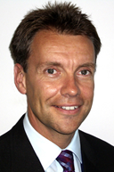
The
Committee
Kevin White
Chairman
Kelly Allen
Welfare
Wendy Flack
Secretary
Philip Allen
Competitions
Danny Flack
Treasurer
Steve Jones
Membership
SherborneStormASC© 2017 – All Rights Reserved

Slide 16
For 2018/19 our coach to swimmer ratio will be:
Less than 5 swimmers to 1 coach
We are inclusive but are rapidly approaching our membership limit, come and swim with us soon and see if we can help.
SherborneStormASC© 2017 – All Rights Reserved

