Slide 1
Sandy Anderson,APRN-BC Family Practice
7271 N Main Street Suite 2, Dayton, Ohio 45415 (P) 937 991 0082 (F) 937 991-0089
Feel good. Feel better. Be happy.
DERMATOLOGY CHALLENGE

Slide 2
Dermatology in Family Practice
Assessment of Dermatology Complaints
1. History History History (Chart, Loved Ones, Patient)
Get in the habit of asking yourself could this be something that We are doing to the patient?
WE includes:
Primary Care Provider Emergency Room Provider Specialist
Home Health Nurse Family Members acting as patient's provider
Herbalist

Slide 3
Dermatology in Family Practice
Assessment
Narrowing down possibilities:
Age of patient Location of complaint Anyone else with complaint
Systemic or Local Occupation and hobbies
Bilateral or Unilateral

Slide 4
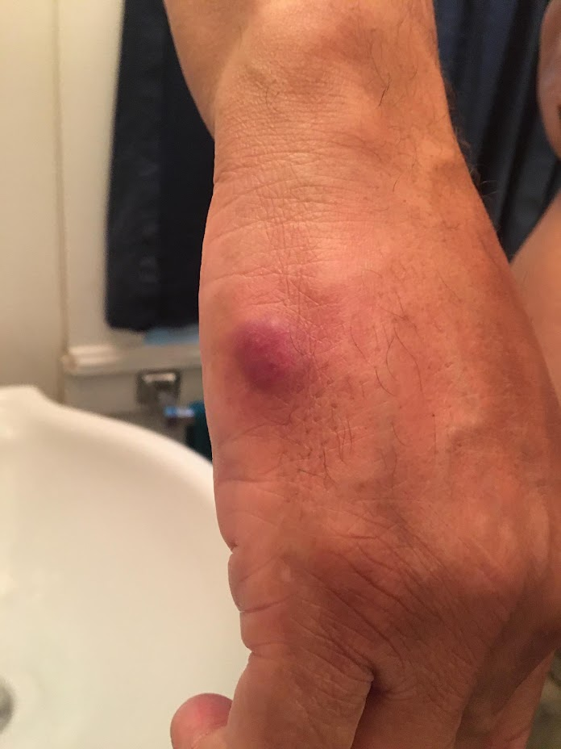
DERMATOLOGY
HOW WOULD YOU DOCUMENT THIS LESION?
WHAT IS YOUR FIRST THOUGHT OF WHAT
COULD BE CAUSING THIS DIAGNOSIS?

Slide 5
Dermatology
Assessment Red macular papluar rash well delineated on right forearm.
Differential Diagnosis: Contact Dermatitis
Eczema
Hives

Slide 6
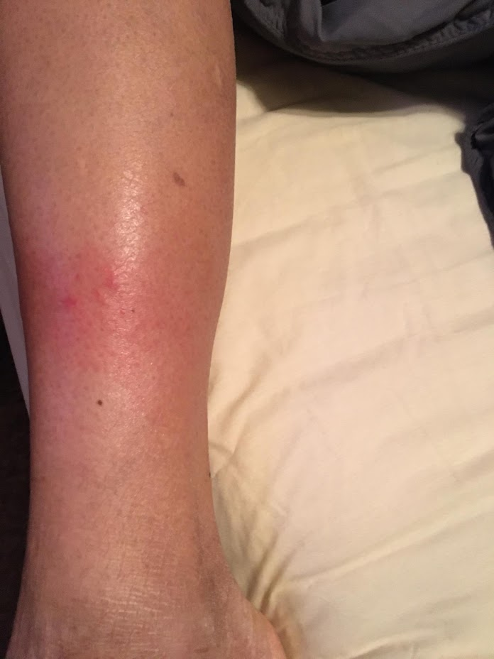
DERMATOLOGY
HOW WOULD YOU DOCUMENT THIS LESION?
WHAT IS YOUR FIRST THOUGHT OF WHAT
COULD BE CAUSING THIS DIAGNOSIS?

Slide 7
Dermatology
Assessment Red macular papluar rash well delineated on right forearm.
Differential Diagnosis: Contact Dermatitis
Eczema
Hives

Slide 8
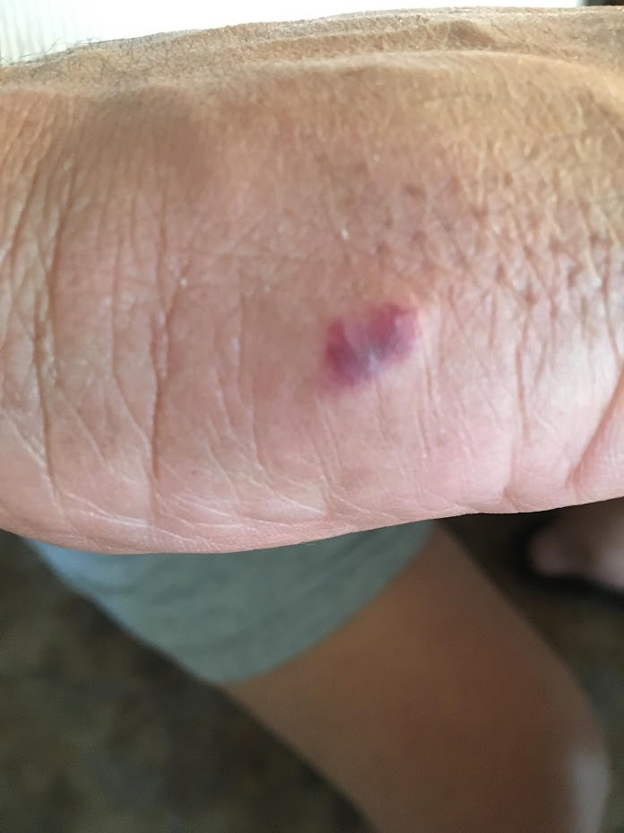
DERMATOLOGY ASSESSMENT
HOW WOULD YOU DOCUMENT THIS LESION?
WHAT IS YOUR FIRST THOUGHT OF WHAT
COULD BE CAUSING THIS DIAGNOSIS?

Slide 9
Dermatology
Purplish/red papular lesion measuring .5 cm raised non tenderno fluid. surrounding tissue is wnl no other lesions noted
Benign lesion
Hive
Contact dermatitis

Slide 10
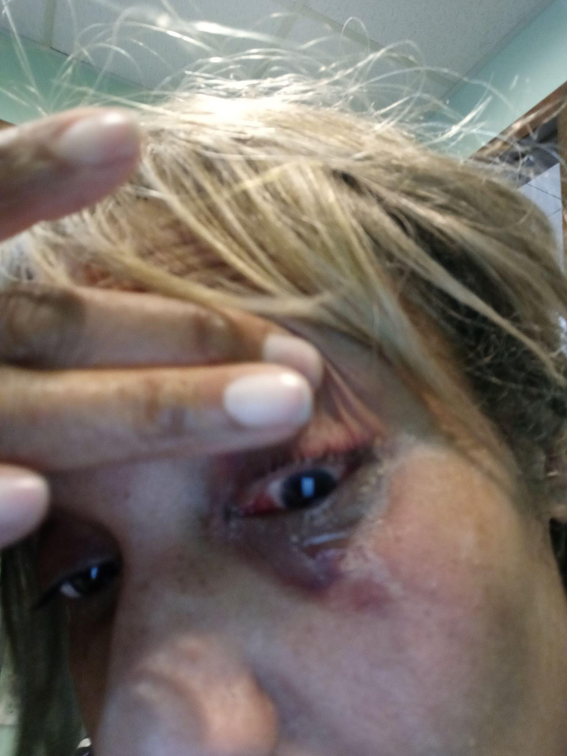
DERMATOLOGY ASSESSMENT
WHAT INITIAL HISTORY QUESTIONS WOULD
YOU HAVE FOR THIS PATIENT?
WHAT ARE YOUR OBJECTIVE FINDINGS?
HOW WOULD YOU TREAT THIS PATIENT?

Slide 11
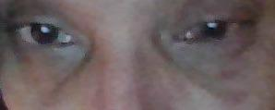
EYE INFECTION
THIS IS A 51 YEAR OLD BLACK FEMALE WHO WOKE UP WITH THIS PRESENTATION. HISTORY OF INSOMNIA AND BINGE EATING DISORDER.
WHAT HISTORY DO YOU NEED?
WHAT ARE YOUR OBJECTIVE FINDINGS?
WHAT ARE YOUR DIFFERENTIALS?

Slide 12
Eye Complaint
History
No vision changes, no new meds, no illnesses works as a FNP but no acute patients or loved ones with similar presentation. No eye injuries. Lasik surgery about 20 years ago. Painful but no intolerable. Bruising started in right eye and then left.
Objective: PERRLA bil, red reflex noted bil, EOM wnl bil, discharge noted bil
Assessment: Conjunctivitis bil unspecified (neg viral screen) the bacterial screen was not processed.
Plan: Tx with Cortisporin gtts IV ea eye 4 times a day each eye x 5 daysPred forte 2gtts twice a day for 5 days each eye
Patient a month later started to urinate gross blood could this be related?

Slide 13
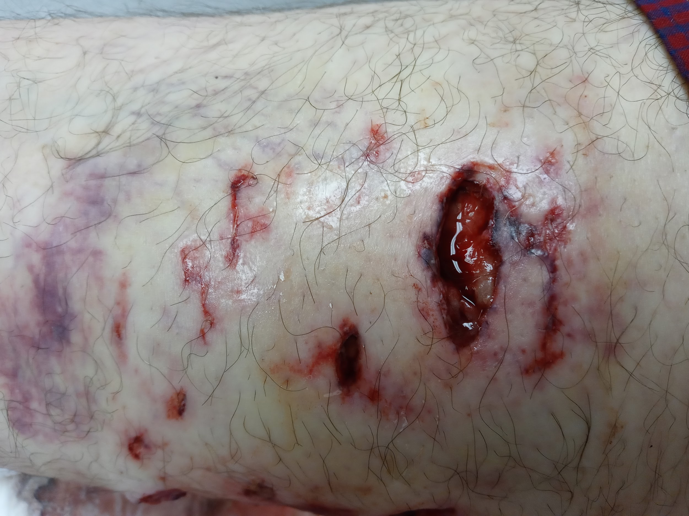
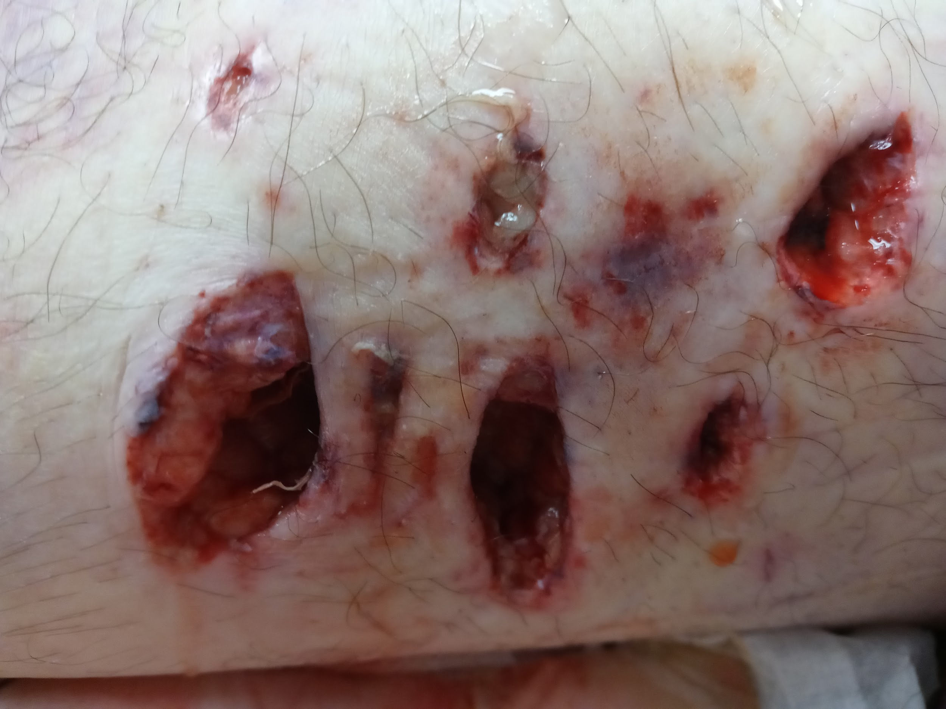
DERMATOLOGY
WHAT IS THE MOST LIKELY CAUSE OF THIS
INJURY ON THE PATIENTS THIGH?
WHAT INFORMATION DO YOU NEED TO TREAT
THESE WOUNDS?
WHAT WOULD BE YOUR TREATMENT PLAN?

Slide 14
DERMATOLOGY
DOG BITE BUTTOCKS AND THIGH -- DO NOT CLOSE DOG BITES IF HUMANLY POSSIBLE
AUGMENTIN OR DOXYCYCLINE FIRST LINE
CHECK TETANUS STATUS AND RABIES STATUS OF DOG
WOUND ANTIBACTERIAL SOAP WET TO DRY DRESSING CHANGES ONCE A DAY IF NOT USING DUODERM OR EVERY 2-3 DAYS IF DRAINAGE IS NOT HEAVY.
DOCUMENTATION SHOULD INCLUDE NUMBER OF WOUNDS DEPTH, WIDTH LENGTH, DRAINAGE, ANY SIGNS OF INFECTION LOCATION OF WOUND

Slide 15
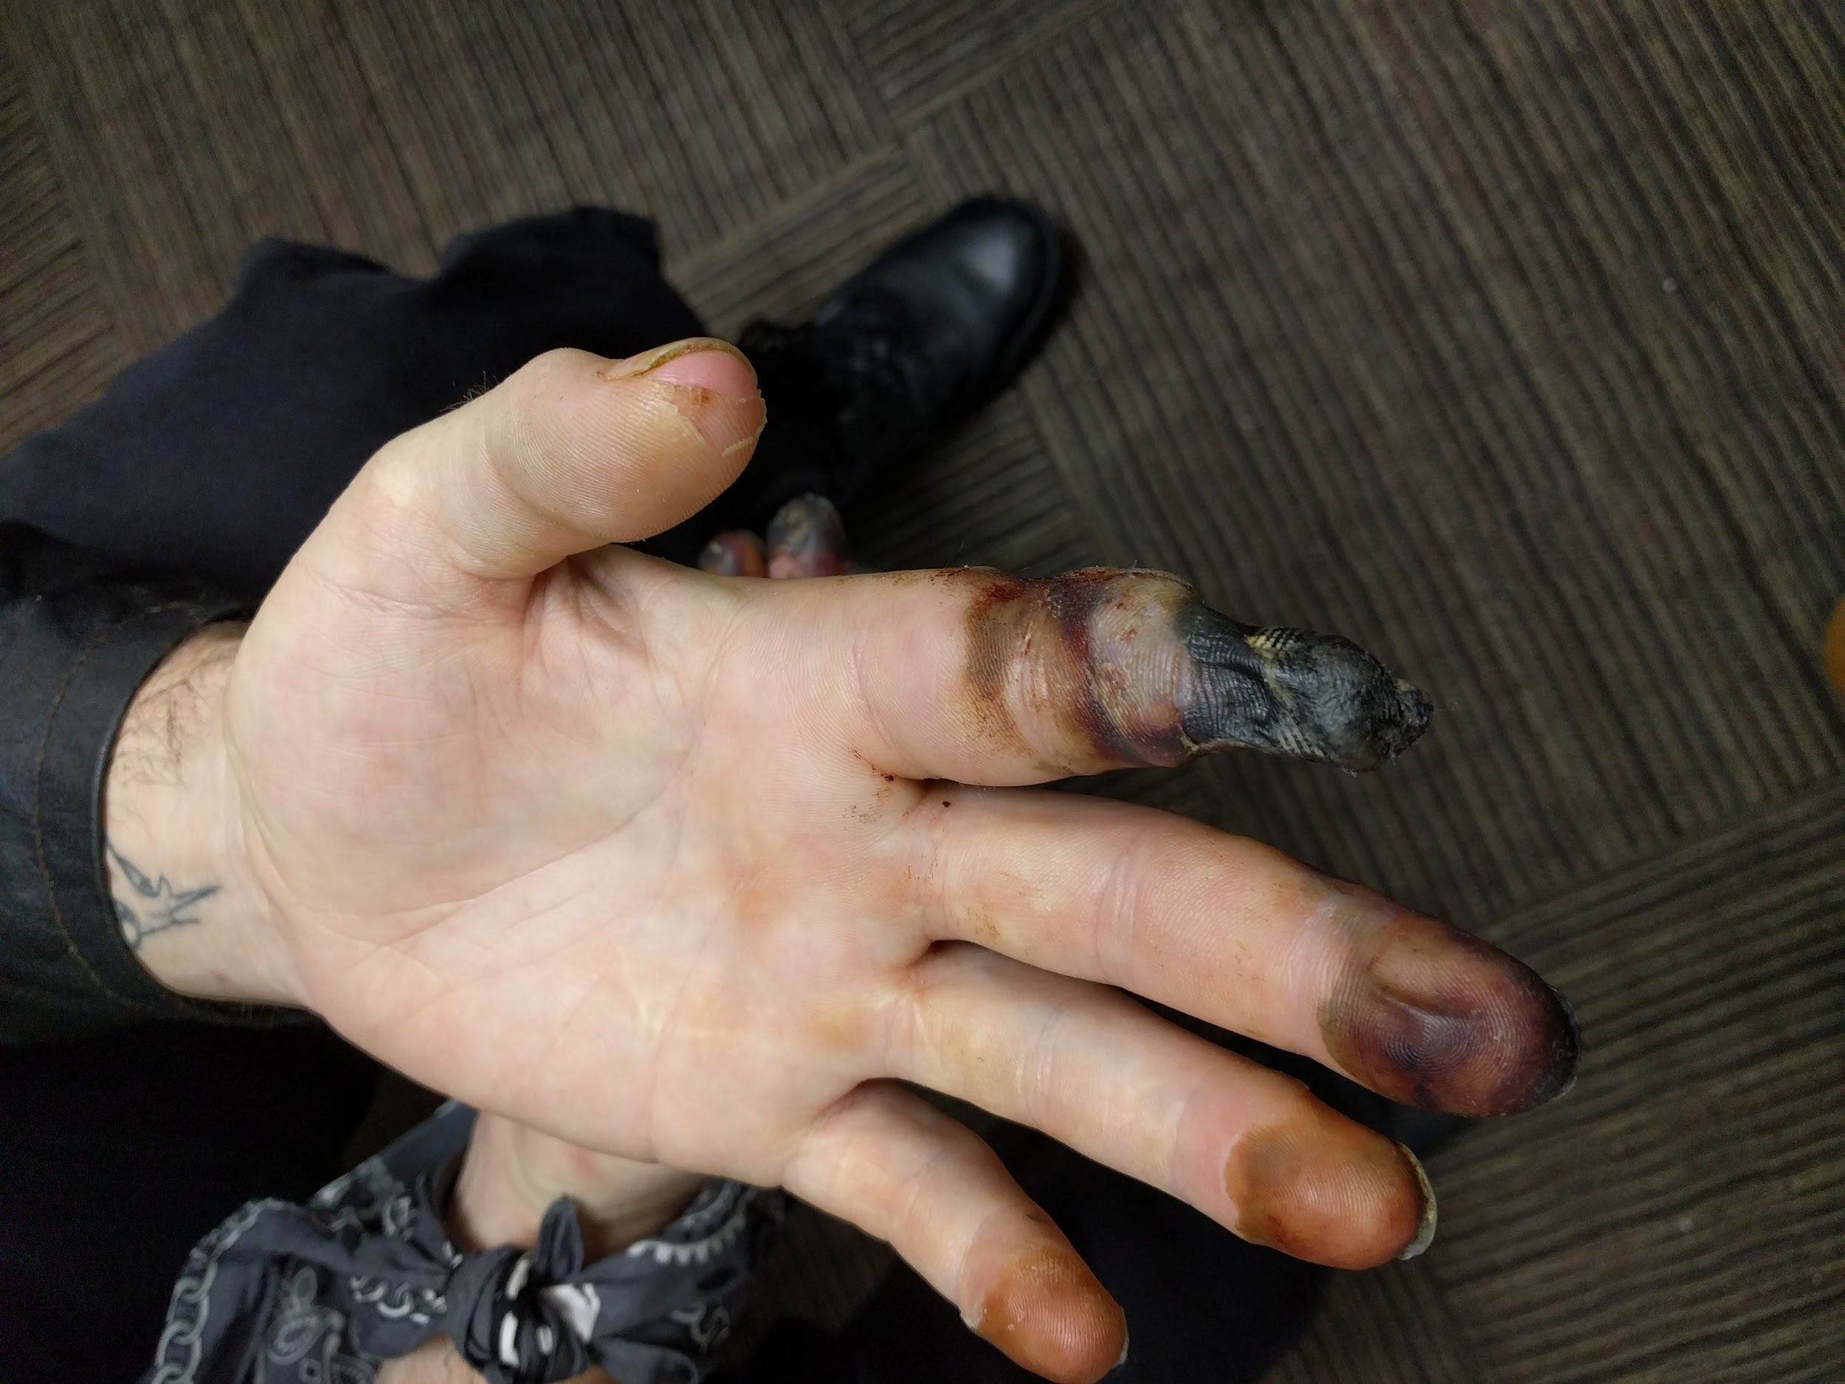
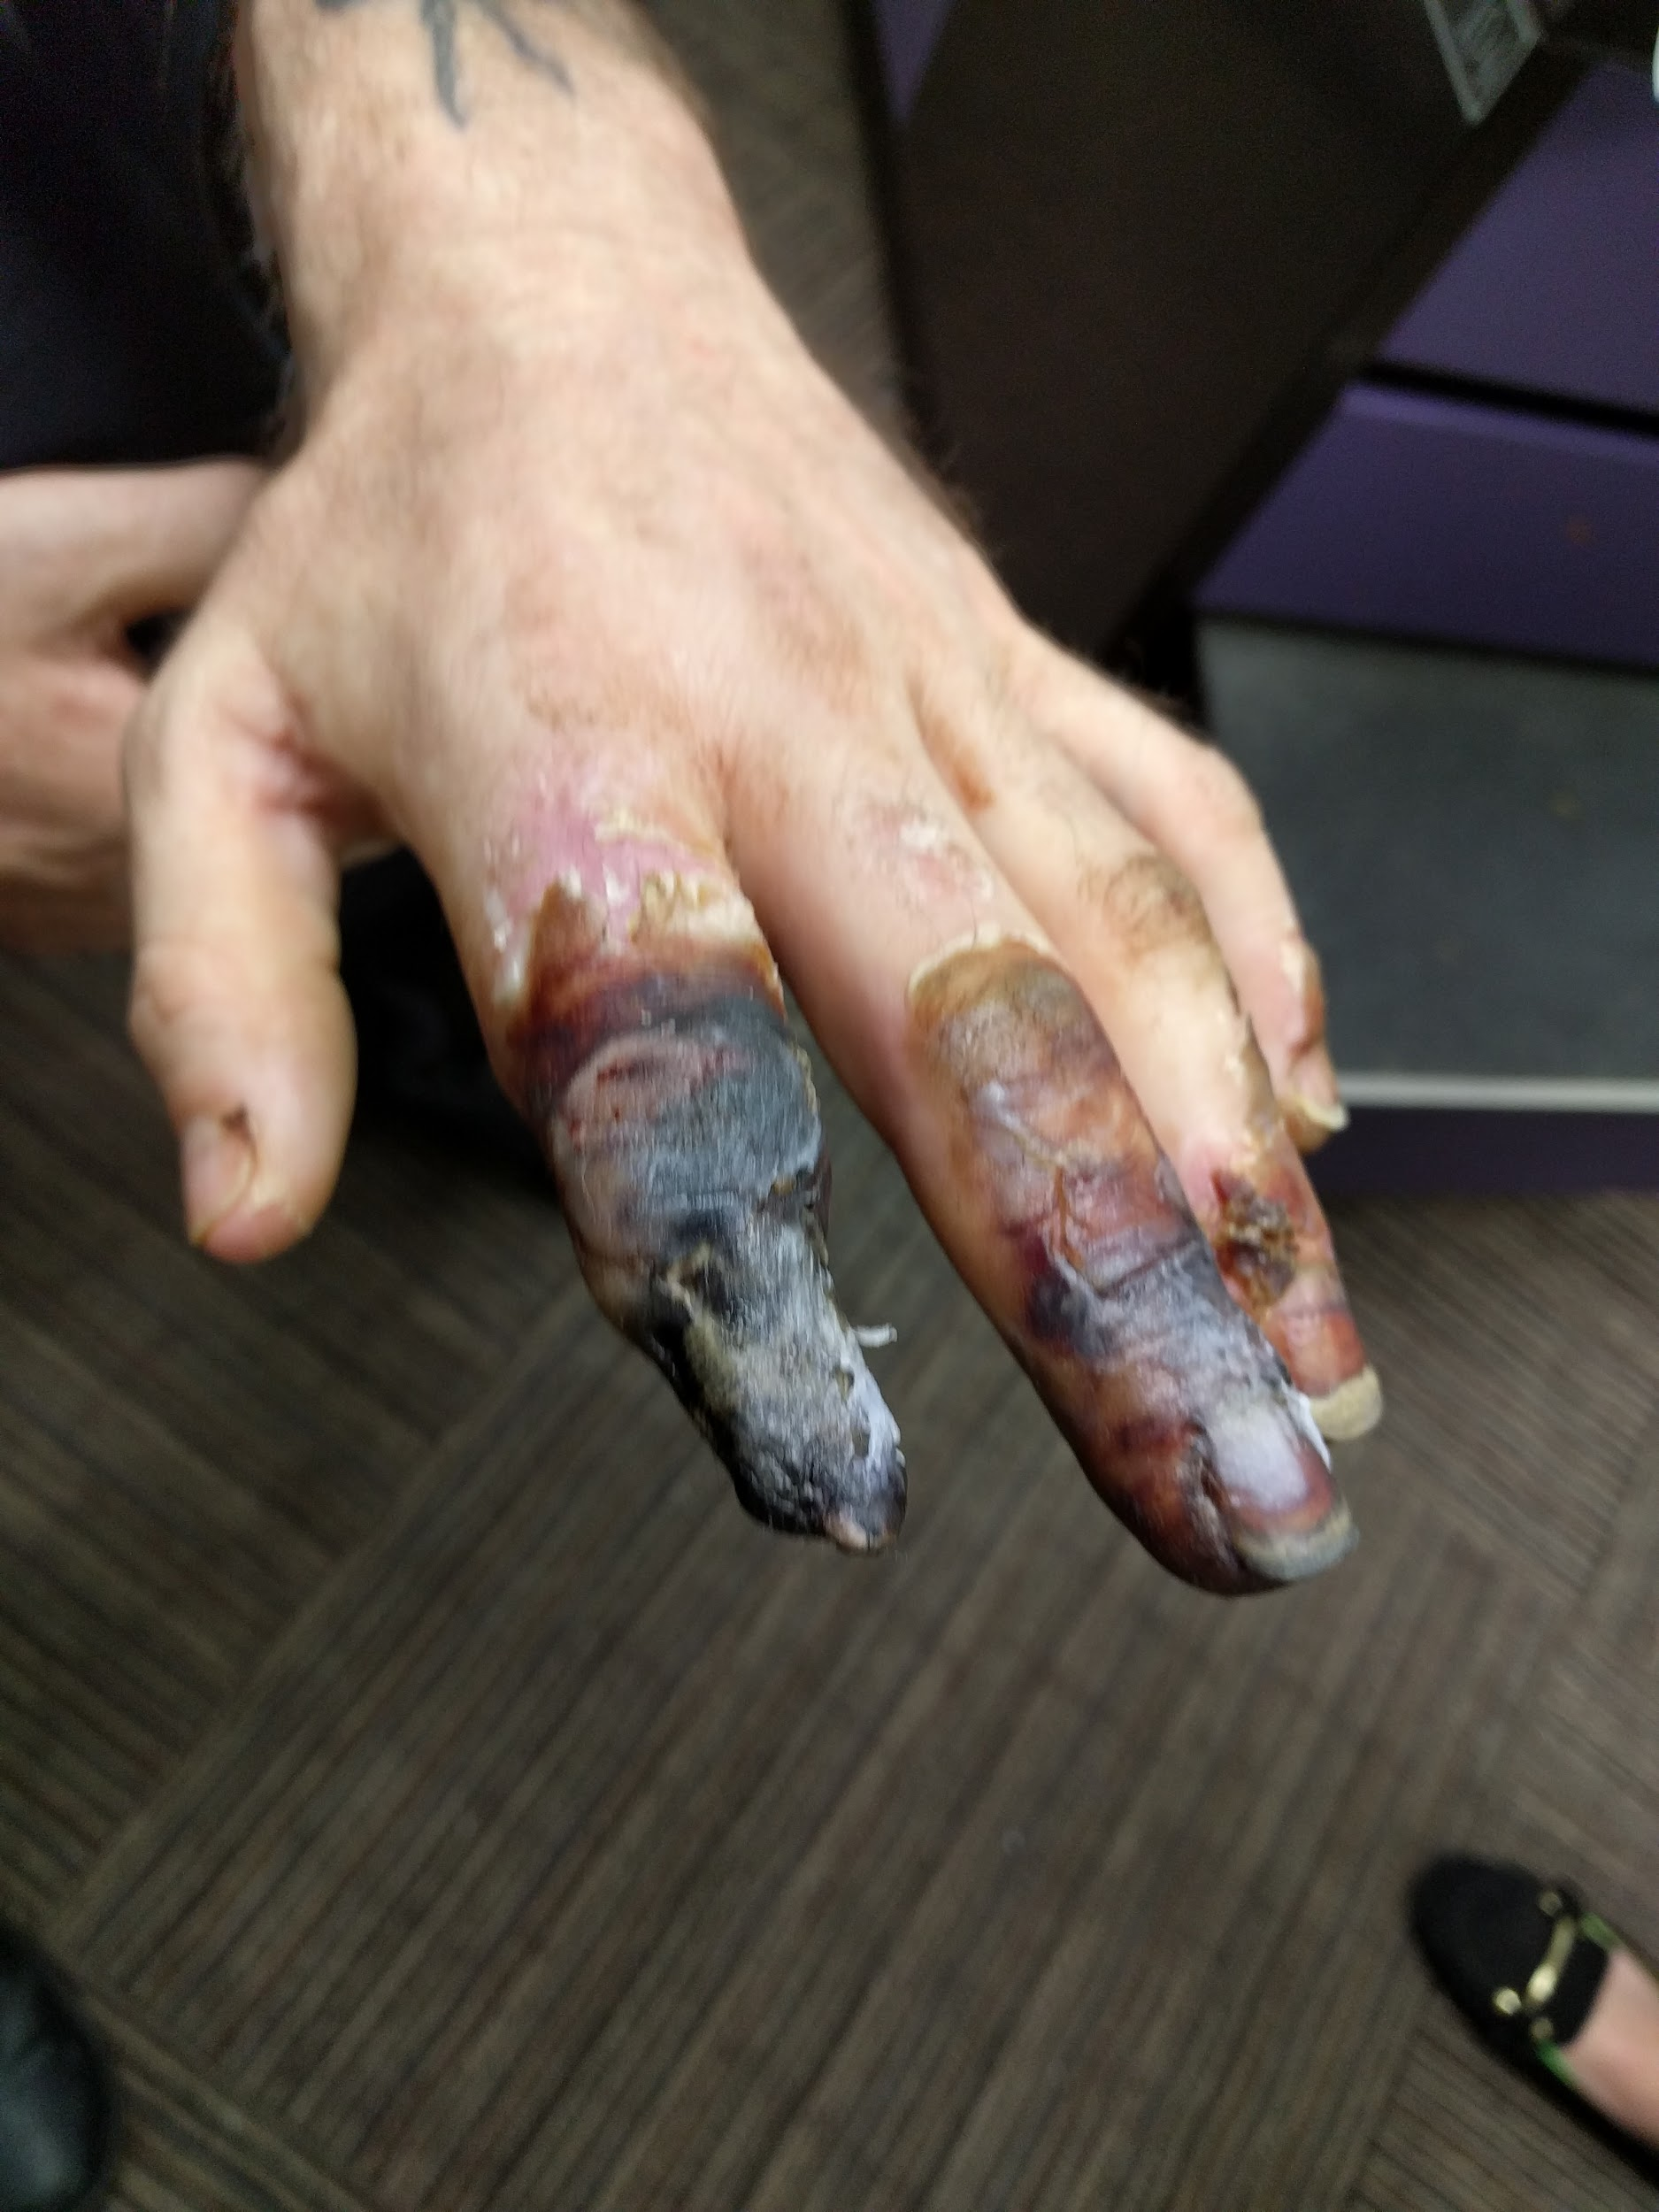
DERMATOLOGY ASSESSMENT
WHAT IS YOUR INITIAL
DIAGNOSIS OF THIS
PATIENT'S INJURY?
WHAT IS THE MOST LIKELY
CAUSE?
WHAT WOULD BE YOUR TREATMENT PLAN?

Slide 16
Dermatology
Patient homeless and was sleeping outside.
Diagnosis frostbite
He was given silvadene. Educated on dressing changes (supplies given) Referred to hand surgeon.
Amazingly patient only lost the fingertip of his right fourth finger.

Slide 17
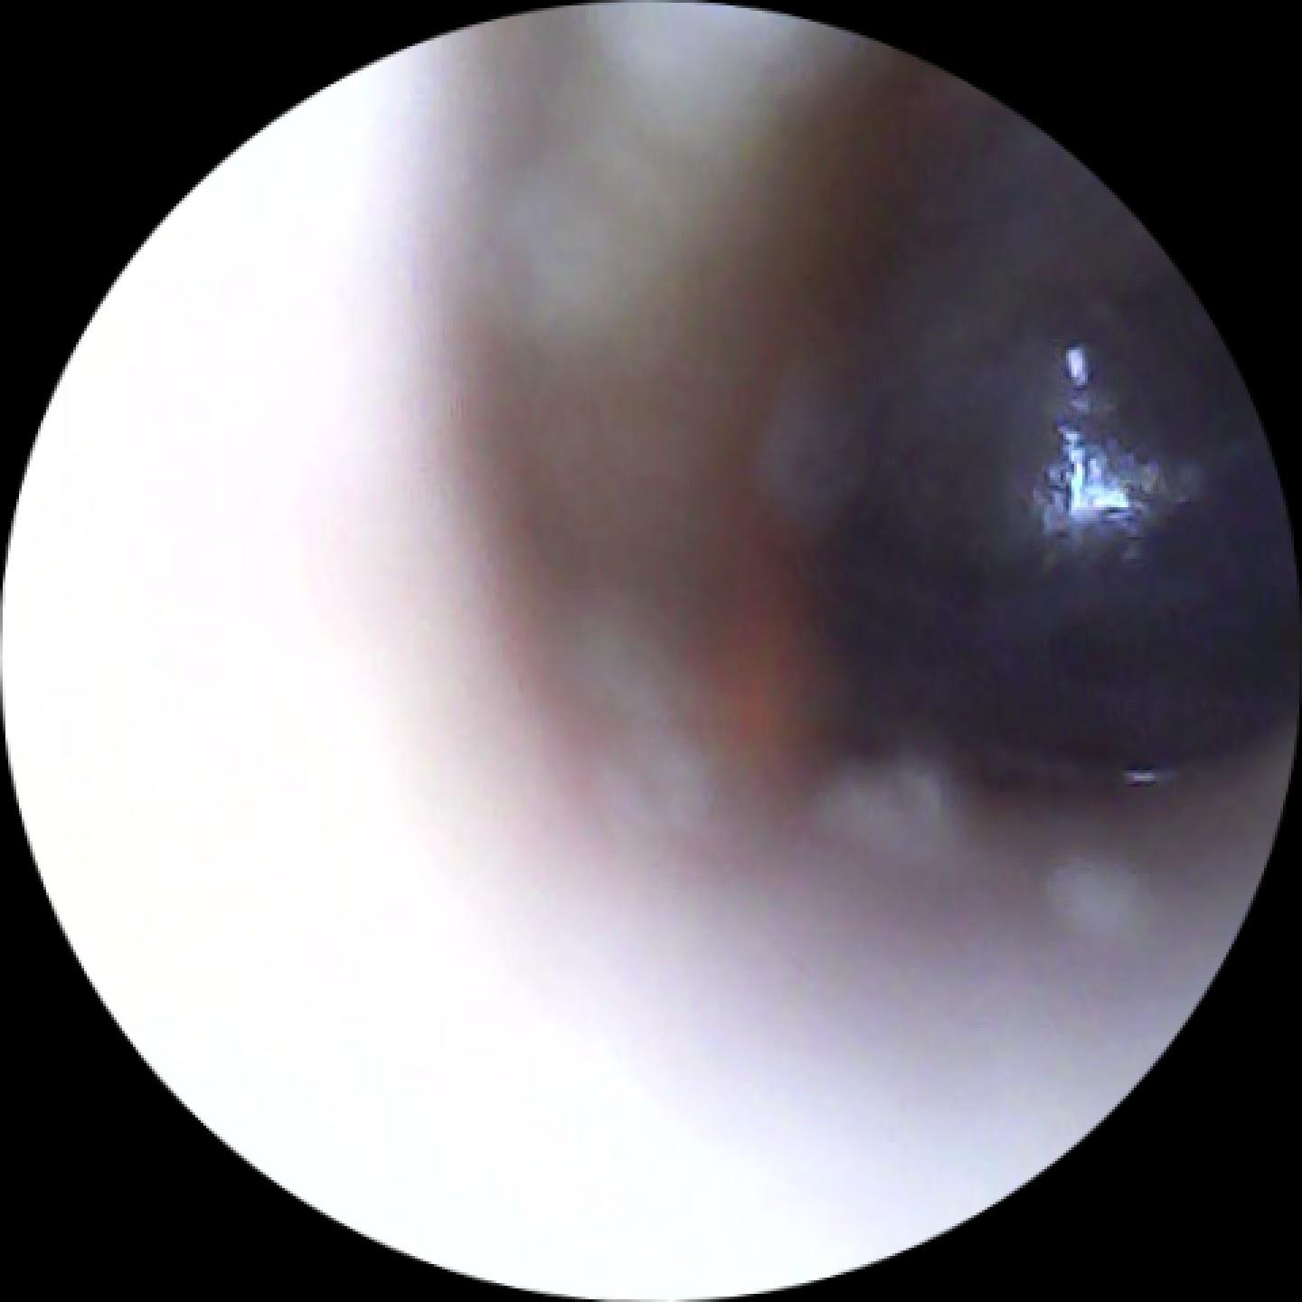
DERMATOLOGY ASSESSMENT
Looking at this eardrum
what do you think was the person's
initial complaint?
What would be your treatment?

Slide 18
Dermatology
Ringing in his ear and muffled hearing.
Diagnosis otitis serous
Treated with singulair 10 mg i tab po q hs
(Patient already taking over the counter allergy medication -- left the patient on OTC)
What other medications could be used to treat?

Slide 19
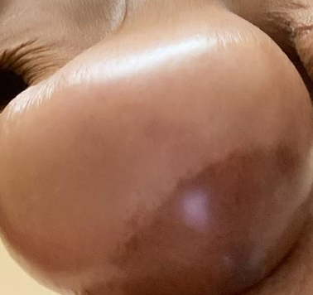
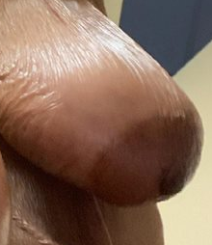
Dermatology Assessment (see next slide) (slide a)

Slide 20
DERMATOLOGY ASSESSMENT
See slide a
This is a 51 year old black female admitted for malnutrition. She was on IV therapy and woke one morning with the presentation in her breast.
She was on farxiga, norvasc, lasix, seroquel and gabapentin. Routine mmg was normal 8 months ago.
What history questions do you have pertaining to her breast?
What are your differential diagnosis?
Bonus question: Pat has an issue with her abdomen. Can you see it?

Slide 21
History
Consider the medications that the patient is taking and why?
When did she start these medications? Are they new or have they been recently added?
Consider is the new finding is related to why she was admitted?
(The two were unrelated)
Diagnosis (Adverse reaction to norvasc stopped medicine she lost 15 lbs one day and her breast were down to normal size in 2 days)
Dx Hiatal Hernia

