Slide 1
News Sources in New Zealand
The need for a SUSTAINED professional reflection
JEANZ Annual Conference
Wintec, Hamilton
June 29-30, 2017
Akhteruz Zaman, PhD
Massey University
a.zaman@massey.ac.nz
@Akhteruz_Zaman

Slide 2
NEWS SOURCES
News sources are of interest for long
Professional: find the best way to access and deal with them
Scholarly: understand the structure of source-journo relationship
These two interests are not mutually exclusive
Young reporters are often lectured on the importance of sources
These lectures may contain an explicit reference to the structure

Slide 3
News Source Studies
Sigal (1973): Reporters and Officials
Gans (1979): Deciding What’s News
Tuchman et al. (1993): Hearth and Home
Lack of diversity in news sources
Dominance of officials and experts (authorised knowers)
Continued gender imbalance
Tuchman et al. (1993): “Symbolic annihilation”;
Two men over a woman
Craitics even explain why diversity in sources should not be expected: routinization of news work
Diversity and multiplicity: a core value in democratic system

Slide 4

News sources
The Age (Vic.), Apr 18, 2010 Sunday
  News source: individual, organisation or any other source of information
Types of sources:
  Politicians (ministers, political leaders, spokespersons)
  Government officials (public bureaucrats)
  Other officials (businesses, civil organisations)
  Experts (academics, researchers, technicians, artists)
  Common people (affected people; eyewitness, vox pop etc.)
  Others (organisations/reports/individuals)

Slide 5
Number of news sources
The Age (Vic.), Apr 18, 2010 Sunday
Total number of news stories | 40
Types of news stories | Hard news Human interest items Features
How many sources? | 135
Types of sources | Individuals Organisations Research reports
Items without a source | 4

Slide 6
News sources by Type
The Age (Vic.), Apr 18, 2010 Sunday
Sources | Number
Politicians | 26
Government officials | 22
Other officials | 24
Experts | 20
Common people | 32
Others | 11
Stories without a source: 4 (Comedy Fest; Car seizure; China funeral; Red Shirts)

Slide 7
Pie Chart: News Source by Type
The Age (Vic.), Apr 18, 2010 Sunday

Slide 8
News sources by Gender
The Age (Vic.), Apr 18, 2010 Sunday
Male sources | Female sources | Gender not clear/relevant
81 | 38 | 16

Slide 9
Number of News Sources
New Zealand Herald, Manawatu Standard & Dominion Post
May 10, 2017 Wednesday
Total number of news stories | 166
Types of news stories | Hard news Human interest items Features
How many sources? | 241
Types of sources | Individuals Organisations Research reports
Items without a source

Slide 10
News Sources by Type
New Zealand Herald, Manawatu Standard & Dominion Post
May 10, 2017 Wednesday
Sources | Number
Politicians | 14
Government officials | 26
Other officials | 54
Experts | 48
Common people | 58
Others | 41

Slide 11
News sources by Gender
NZH, MS & DP, May 10, 2017 Wednesday
Male sources | Female sources | Gender not clear/relevant
144 | 51 | 45

Slide 12
That was the trigger!

Slide 13
My Study
Slightly bigger empirical scope
I like to see
  If this trend has a sustained pattern across NZ news media scene
  If this numerical pattern has any qualitative equivalence
  Equivalence: whether source attributions
    Replicate the importance of “authorised” knowers
    Diminish the standing of “unauthorised” knowers

Slide 14
Method: Data Collection
Quantitative; Qualitative
Three newspapers: NZH, MS, DP
Three months; one random day in each month
Three websites: stuff.co.nz; scoop.co.nz; newsroom.co.nz
Three broadcasting: one news; newstalkZB, newshub.co.nz
Other potential news sources

Slide 15
News Sources by Type
NZH, MS & DP,
June 28, 2017 Wednesday
Sources | Number
Politicians | 38
Government officials | 34
Other officials | 72
Experts | 68
Common people | 23
Others | 23

Slide 16
News Sources by Gender
NZH, MS & DP, June 28, 2017 Wednesday
Male sources | Female sources | Gender not clear/relevant
159 | 61 | 38

Slide 17
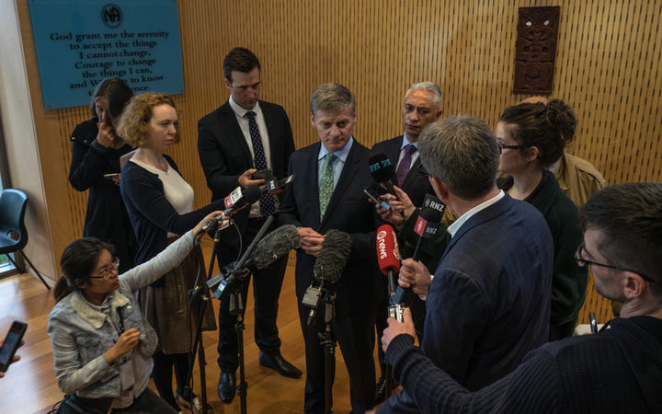
June 22, 2017; Photo: Brad White/RNZ www.radionz.co.nz

Slide 18

Natasha Frost, RNZ/BBC Paris https://paydesk.co/journalist/natasha.frost

Slide 19
Is a lack of diversity in news sources acceptable?

Slide 20
Democracy-diversity-journalism nexus
Diversity
Journalism
Democracy

Slide 21
Is time running out before we take the lack of diversity in NZ news sources seriously?
120
80
160
40
200
MPH
0
km/h
240
9
9
9
9
9
Diagram featured by http://slidemodel.com

Slide 22
Thanks!
Any questions?

Slide 23
References:
Armstrong, C. 2004, The influence of report gender on source selection in newspaper stories, Journalism & Mass Communication Quarterly, 81:1, 139-154
Comrie, M. 1999, Television news and broadcast deregulation in New Zealand, Journal of Communication, 49:2, 42-54
Gans, H. 1979, Deciding what’s new, Vintage Books, New York
Manning, P. 2001, News and news sources: A critical introduction, Sage, London.
Park, D., Kim, G., & On, B., 2016, ‘Understanding the network fundamentals of news sources associated with a specific topic’, Information Science, 372, 32-52.
Ruper, V. 2006, ‘How did you find that out? Transparency of the newsgathering process and the meaning of news, Journalism Studies, 7:1, 127-143.
Sigal. L. 1973, Reporters and officials: The organization and politics of newsmaking, D.C. Heath, Lexington. Mas.
Tiffen, R. Jones, P., Rowe, D., Aalberg, T., Coen, S., Curran, J., Hayashi, K., Iyengar, S., Mazzoleni, G. Papathanassopoulos, S., Rojas, H. & Soroka, S. 2014, ‘Sources in the news’, Journalism Studies, 15:4, 374-391.
Tuchman, G., Arlene K. Daniels, A. and Benet, J. 1978, Hearth and Home: Images of Women in Mass Media (New York: Oxford University Press, 1978), 28.

