Slide 1
1876 - 2017
Is there a constant in the world of journalism?
The only constant is change…but that change is constant
(apologies to Heraclitus)

Slide 2
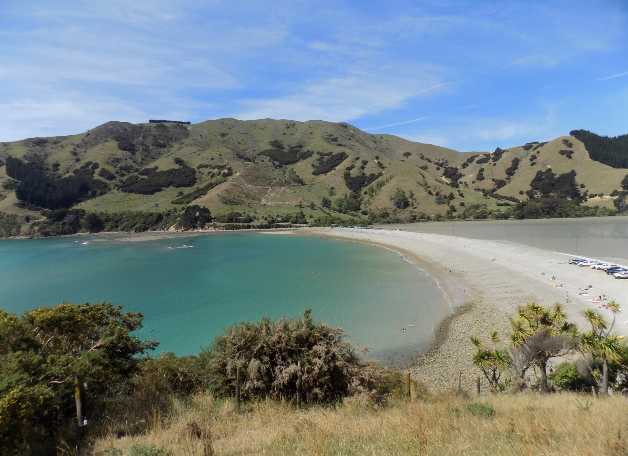
Cable Bay today

Slide 3
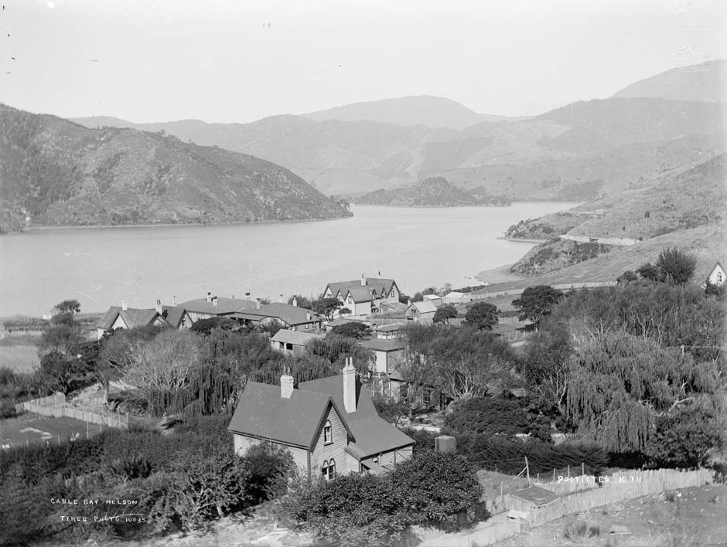
Cable Bay circa 1900

Slide 4
So what’s new?
A dynamic environment of
tight deadlines?
Rapidly evolving news values?
Pre-conceptions
How to make $$ from “news”

Slide 5
Pre-1876 quandary: sourcing overseas news
Meeting boats which came into all the ports and begging or borrowing newspapers from the crew and passengers
The Press employed a boatman to ferry a reporter out to the ship to gather up the newspapers
Healthy competition between papers even then

Slide 6
How to move forward?
With help from the Mother Country?
Not likely!
Disraeli referred to Australia and NZ as “these wretched colonies which are a millstone around our neck” and “colonial deadweights”

Slide 7
Enter Julius Vogel
Vogel emigrated from Britain via Australia to NZ in 1861 (editor ODT)
He entered politics and became Telegraph Commissioner.
He had a cable between both islands and Australia on his to-do list – achieved in 1876

Slide 8
No optic fibre then
Consider the feat of engineering laying a cable between La Perouse on the shores of Sydney town to a small bay east of Nelson
Meanwhile there were predictable wrangles over ownership and funding (papers and govt); and negotiations with the local iwi to rent some land on which to build a telegraph office

Slide 9
Move aside for the aspiring ‘press barons’
NZ was well served by newspapers and the owners could see a money making opportunity opening up before them
NZ Press Agency v ODT
(some dispute which orgs when)
In 1880 the United Press Agency was formed with 44 member papers

Slide 10
Several parties claimed a stake
UPA was well positioned to stake its claim for the news which would come in on the cable
Established a presence at Cable Bay, leased land and built a small two roomed cottage – an office and home.

Slide 11
One (newspaper) man’s view as Cable becomes operative
“The public mind craving as it does for news will be unhealthily excited unless at the onset a corrective, judicious, even though oppressive (??) be administrated.
The public will crave for news and wax clamorous but it rests with the purveyors of news to regulate the quality in more precise proportion than now prevails with the price paid for it.
To the newspaper proprietors around the country the additional facilities for obtaining speedy news will bring perplexity rather than profit, a lessening of hard-earned gains rather than an increase”.
-Westport Evening Star

Slide 12
6 months in Cable Bay
Two UPA journalists took turns at manning the “office”. Something of a Siberia. Not necessarily appointed on merit or their journalistic skills
Pressure from shareholders and editors for the “kind” of news they particularly wanted to publish
Lonely life which resulted in a lot of children and some heavy drinking

Slide 13
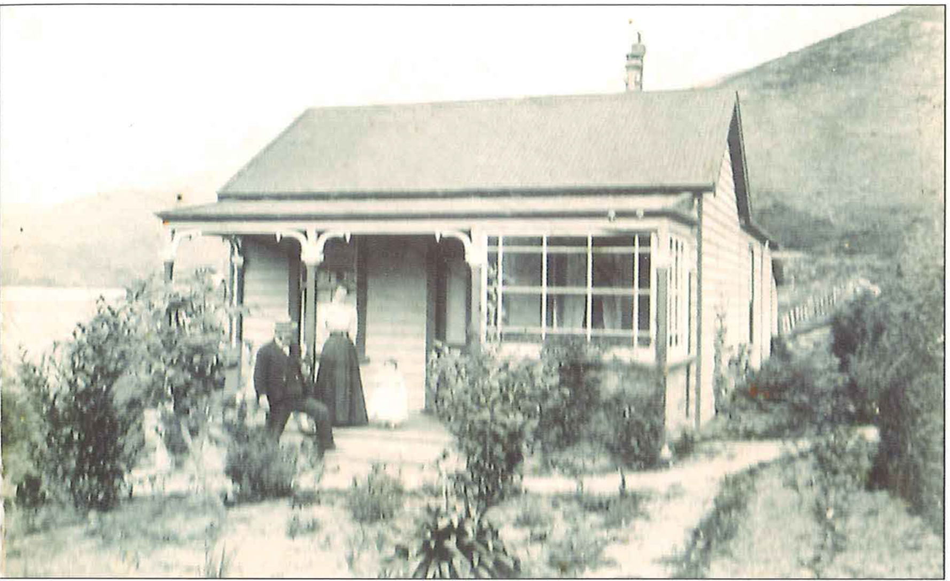
Subs’ room

Slide 14
$64K question?
How to make money from this tide of news?
Sending stories to the members papers round the country via telegraph was expensive
Messages came in as “skeletons” and the NZPA/UPA man would flesh them out – economically. Outrage from editors if not deemed useful stories.

Slide 15
A, B or C
Sliding scale of news “values” A B or C the more a paper paid the more high grade stories they received. These were attached to “vides” (blacks)
Sharper editing was constantly required to save money – cable-ese
Mistakes: Court report in which “a man threw his wife over the furniture” subbed and transmitted as “ he threw his wife some superfurniture” transcribed by journo as “threw his wife some high-class furniture”

Slide 16
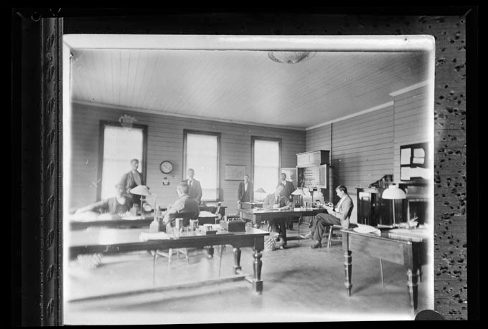
News hub 1876 style

Slide 17
What constituted news?
Hard news became more crisply written in an effort to save money
Competition for space increased as more news became available
Which news values came into play?

Slide 18
NEM pre cable
An analysis of the Nelson Evening Mail pre the Wakapuaka cable
Hard news, court news, some sport, politics and a weather report.
Post cable: suicides – detailed inc methods; crime, particularly murders and unusual crimes

Slide 19
1909 all over for Cable Bay
In 1909 a new cable was laid between Canada and Northland and UPA took its news clearing house to Wellington as the fore runner to the NZ Press Association.

Slide 20
Last Word…
Editor of the West Coast Times…
……“news will come at marvelous speed and bulletins of the areas of nations will be considered necessary concomitants* of each morning and eventide meal”.
*naturally occurring phenomenon.

Slide 21
References
Airey.E. (2005) The Taming of Distance, New Zealand’s First Internationals Telecommunications. Dunmore, Wellington.
Astwood, K. (2014) Trans-Tasman Telegraph Cable Numbers 1 and 2. IPENZ Engineering Heritage Register Report.
Bentley. E. L. (1909). Bentley’s Complete Phrase Code. New York: Bensinger.
Byrne, J. (1999). The Comparative Development of Newspapers in New Zealand and the United States in the Nineteenth Century. American Studies International, 37(1).
Fraser, D. (2016) Getting To Know My Grandfather, The New Zealand Genealogist (Feb) 23.
Hannis, G. (2008). The New Zealand press association 1880-2006:The rise and fall of a co-operative model for news gathering. Australian Economic History Review. 8 (1), 47-66.
Harvey. R. Bringing the News to New Zealand: The supply and control of overseas news in the nineteenth century. Media History 8.1 21-34
Joyce, B. (1976, February 18) Cable Bay NZ’s Ear, Nelson Evening Mail, p.15.
Newport, JNW (1973). Wakapuaka: Nelson Historical Society Journal 2(6).
Oosterman, A. (2013) From Picardy to Picton. The Great Adventure Ends: New Zealand and France on the Western Front. Christchurch: John Douglas Publishing. pp.223-240.
Rees-Jones. M. (2015) Printer’s Progress. A New Zealand Newspaper Story 1840-2014. Gisborne: Gisborne Herald.88.
Sanders. J. (1979) Dateline:NZPA. Auckland:Wilson and Horton.
Increased Telegraphic Facilities. (1876, February 18 ) Westport Times. Volume X, Issue 1355,
Wilson. A.C. Wire and Wireless (P.N. Dunmore Press 1994) pp 50-51.
Wilson, A.C. (2012). Telecommunications - Early telegraphy and telegrams. Wellington:Engineering Heritage NZ.

