Slide 1
Teaching social media to the social media generation

Slide 2
About me
A recent graduate
Waikato Times
North Waikato News
Stuff’s digital team
Wintec

Slide 3
Social media
May 2017:
Every 60 seconds on Facebook: 510,000 comments are posted, 293,000 statuses are updated, and 136,000 photos are uploaded.
(is important)

Slide 4
There’s a need for social media education for journalists

Slide 5
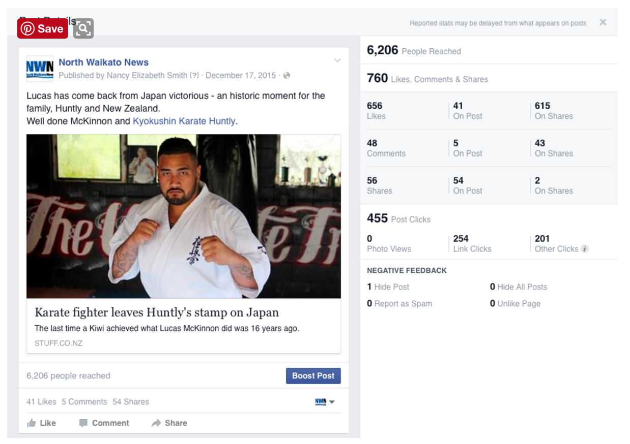
News
Spreading News
Finding colour/UGC
Real, live stories

Slide 6
Verifying sources
Mining for information
Identifying “fake news”
Is their voice heard?

Slide 7
Limitations
Algorithms
Confirmation bias
How other people use social media

Slide 8
All about the sell
- Protection and credibility
Consumers =/= journalists

Slide 9
Questions?

