Slide 1
OBTAINING ACEJMC ACCREDITATION FOR YOUR JOURNALISM SCHOOL
Associate Professor Grant Hannis
School of Communication, Journalism and Marketing
Massey University, Wellington, New Zealand
Paper presented at Jeanz conference
June 2017

Slide 2
Introduction
Why accreditation?
ACEJMC (incl. controversial)
The accreditation process
Main issues for Massey
Tips, more resources
Overall view

Slide 3
Why accreditation?
Competenz has decided to leave the journalism education sector in NZ
Competenz was a signal as to the quality of NZ journalism schools
What happens now? Should we replace the Competenz system with some other form of independent endorsement?
One option is accreditation

Slide 4
Why accreditation?
J school accreditation is now becoming global.
In context of today's crowded, internationalised and challenging market for journalism education, J schools, including my own, are obtaining accreditation from leading US accrediting agency the Accrediting Council on Education in Journalism and Mass Communications (ACEJMC).

Slide 5
Why accreditation?
Massey University's journalism programmes obtained ACEJMC accreditation in 2016, making Massey the first school in Australasia to do so.
Make the course more attractive to international students; help the school set the highest standards for itself in terms of teaching, research and industry engagement; replacement for Competenz.
Undergrad and postgrad

Slide 6
ACEJMC
ACEJMC is not AEJMC!

Slide 7
ACEJMC
Established in 1945
Professionals and educators (weighted towards educators)
Fees not large - several US$1000s - but lengthy process (months, if not years)

Slide 8
ACEJMC
ACEJMC accredits over 100 journalism schools, including some of the US’s leading journalism schools (eg, Columbia). But some, such as Rutgers, not accredited
Until recently, ACEJMC has mostly only accredited US-based educational institutions (about 20% of all US J schools). However, ACEJMC is increasingly accrediting overseas schools.

Slide 9
Controversial
Some argue ACEJMC’s accreditation requirements restrict curriculum development.
Some US J schools say accreditation confers no significant benefits to students and small schools’ limited resources mean they cannot meet ACEJMC’s various demands
Accrediting J schools in restrictive societies (Middle East)

Slide 10
ACEJMC process
Familiarise yourself with ACEJMC’s requirements (acejmc.org)
Prepare draft Self-Study Report
Pre-site team visit
Self-Study Report
Site team visit, draft report (draws on meetings and Self-Study)
Recommendation goes to ACEJMC board
Accreditation lasts for 6 years, reaccreditation

Slide 11
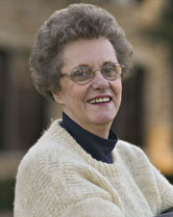
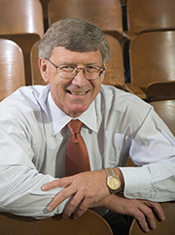
ACEJMC process
Pre-site visit
Susanne Shaw, Professor, School of Journalism, University of Kansas
Has worked as a newspaper editor
Trevor Brown, Professor Emeritus, School of Journalism, Indiana University
Worked as a reporter in South Africa

Slide 12
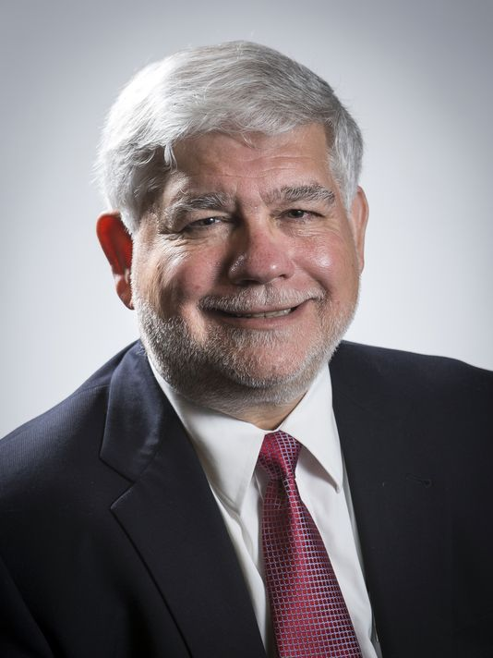
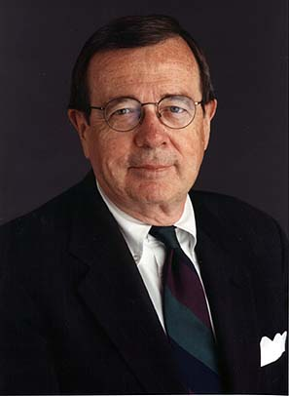
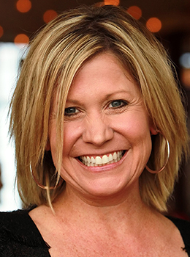
Site-visit team
Peter Bhatia (chair): Editor, Cincinnati Enquirer
Marie Hardin: Dean, College of Communication, Penn State
John Paluszek: Senior, Ketchum
Jennifer Sizemore: Senior Comms, Cancer Research Centre

Slide 13
Nine standards
Governance
Curriculum, incl. 72 semester hours outside J and MC (60% of total hours) for bachelor’s degree
Diversity and inclusiveness (incl. staff)
Faculty (balance of academic and professional, 20:1 ratio in tutorials, core teaching by full-time faculty)
Research
Student services (incl. advising students)
Resourcing
Service (incl. links with industry)
Assessment, employability

Slide 14
Main issues for Massey
US degrees are 4 years, NZ are 3. Convinced ACEJMC that final year of High School equals Freshman year (NZ has 13 years of high school, against 12 in US). This, plus fact students minor in another college and can take some electives, meant 60% outside J and MC.
Lack of strong student media (good leverage since)
Lack of diversity in staff and students
More multimedia for undergrads

Slide 15
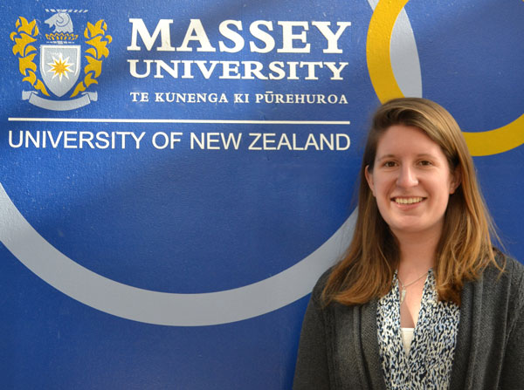
Marketability
Massey Master of Journalism US international student Audrey Seaman was delighted we obtained accreditation. Help her career back home.
But has hardly led to sudden influx of international students
Perhaps longer term
Enhances reputation of
staff

Slide 16
Tips
Meaning of assessment (capstone important)
“Closing the loop” important (leading to enhancements of course), moderation, university reviews
Use US terminology and English
Self-Study Report played key role
Our links with industry played major role in success

Slide 17
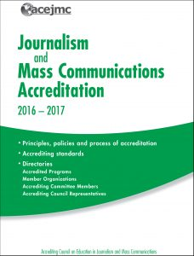
More resources
ACEJMC website has guides, examples of good Self-Study Reports and all accredited schools’ final reports
YouTube has videos on site visit
Can meet with ACEJMC seniors beforehand

Slide 18
Overall view
Positive experience
Greater marketability of school, especially with Competenz leaving the sector
Enhanced status (esp. within university)
Our house in order
Not a silver bullet

Slide 19
OBTAINING ACEJMC ACCREDITATION FOR YOUR JOURNALISM SCHOOL
Associate Professor Grant Hannis
School of Communication, Journalism and Marketing
Massey University, Wellington, New Zealand
Paper presented at Jeanz conference
June 2017

