Slide 1
Chico First Membership Meeting
Monday, April 2, 2018
Chico, CA

Slide 2
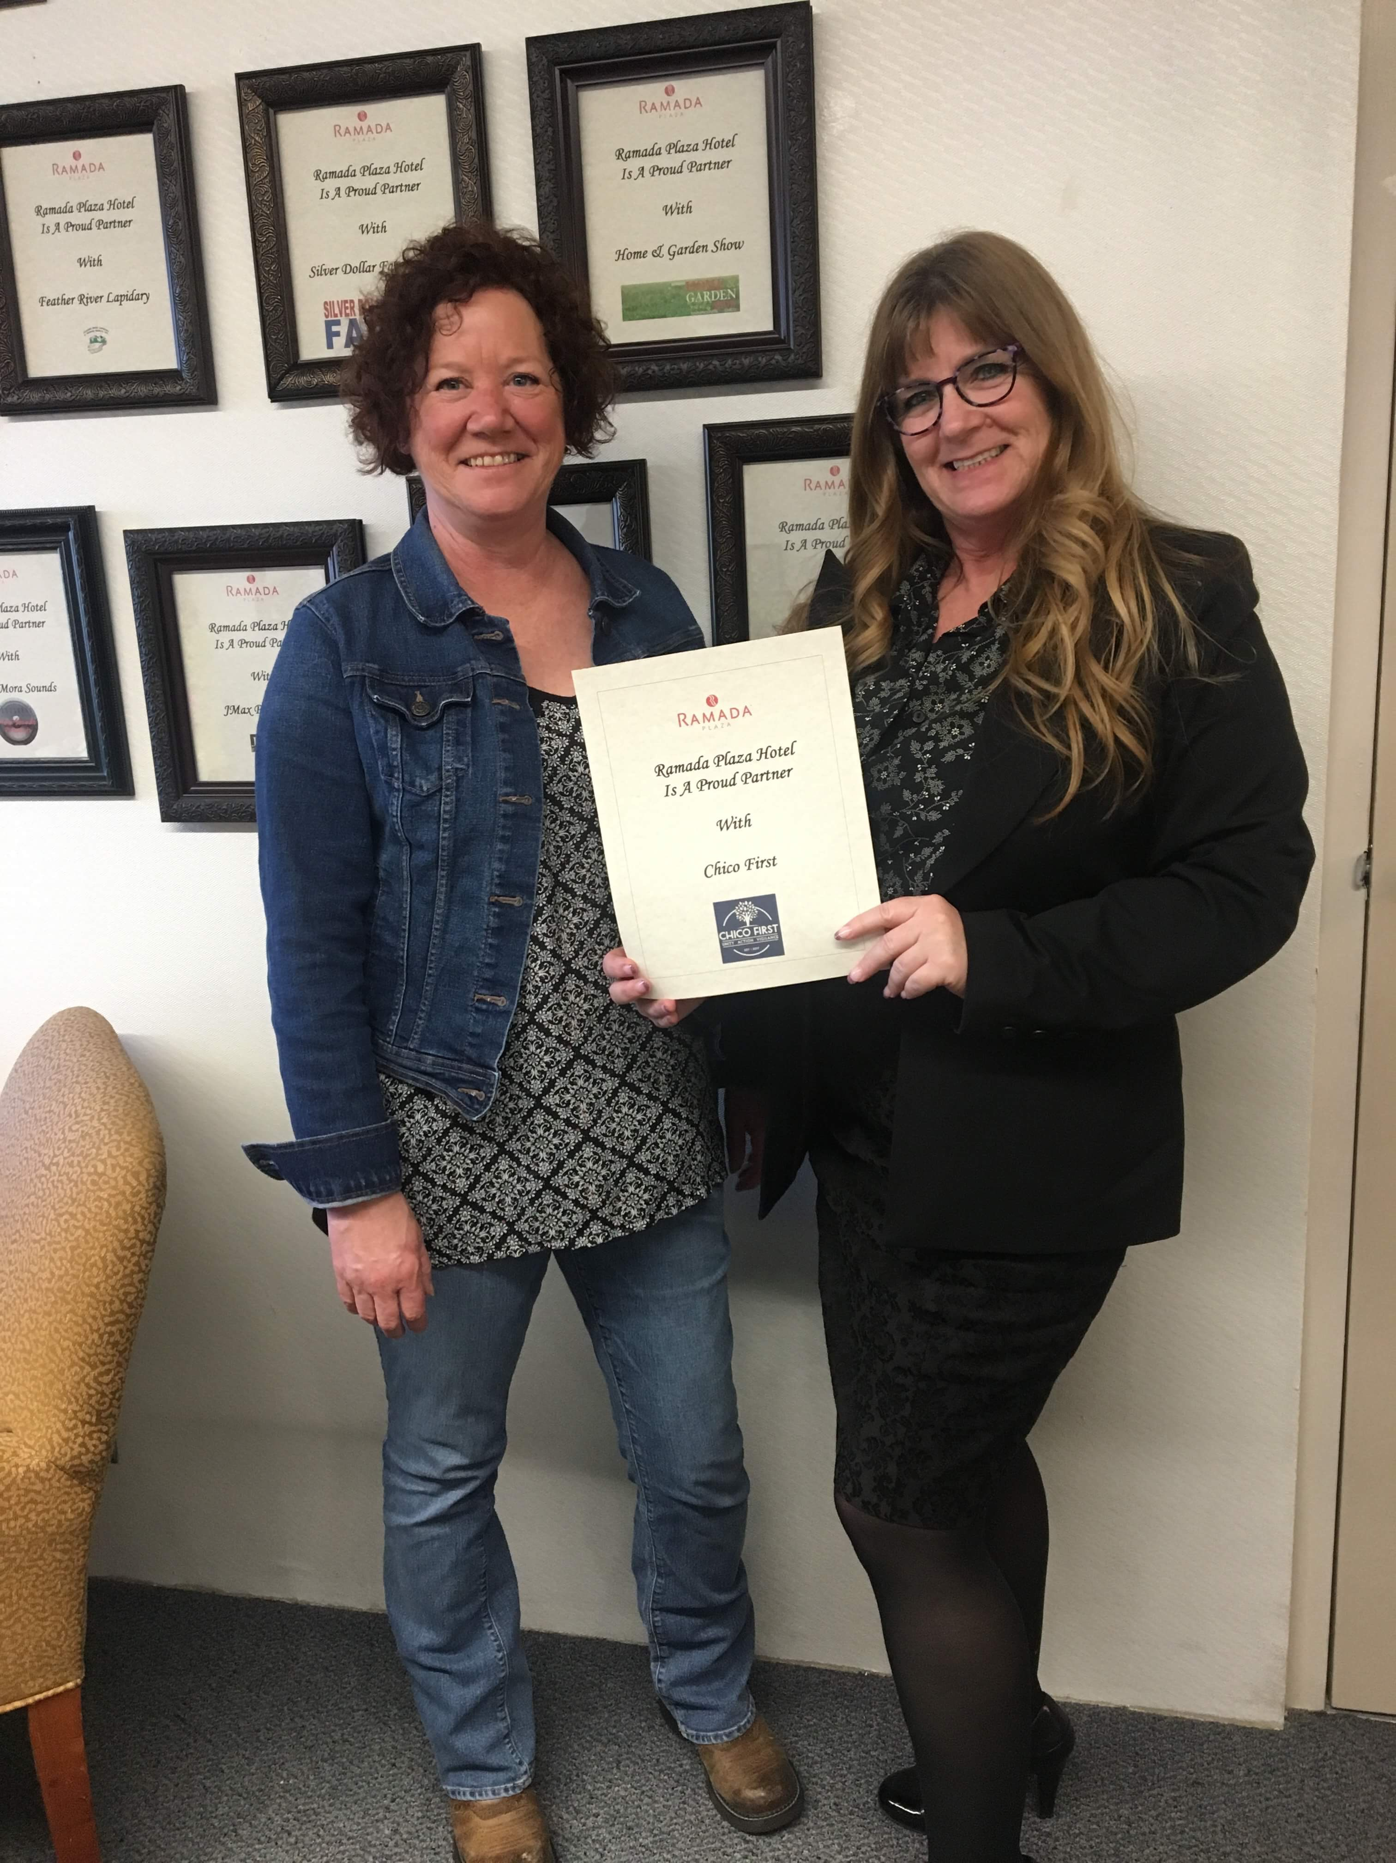
Housekeeping Items
Safety Moment
Acknowledgments:
Thanks to Ramada Plaza for donating the conference room- Robyn Martin, Director of Sales & Events; GM Albert Bashir; & Diane Adams, Event Designer (Food)
Special thanks to our Chico First Art Cover Photographer- Juan Cortez Photography & to Sam Piper for our Logo!
Corporate Sponsors: WalMart, Home Depot, Lowes, West Coast Plumbing, Ferguson Supply Co., Chico Grocery Outlet, Butte County Teamsters, Fifth Sun & Dragon Graphics
Individual Sponsors: Donna Marler, Del Travis, John Kermen, Francine Picillo, Vera Carillo, Christine Hall, Kate Mutter, Brett Bayma, Suzanne Gray-Wong, Jeff & Kathy Shimizu, & our Anonymous Donors!

Slide 3
Agenda:
Brief overview of Chico First (10 Min)
Contact, Enforcement, Accountability (20 Min)
Tools Needed for Increasing Enforcement Effectiveness
Additional City Ordinance Recommendations
Special Guest: Mayor Sean Morgan (30 Min)
ACT: Accountability, Compassion, Together
Community Court Status
Public Safety, Staffing, Enforcement/Regulation Strategies
Resources: Re-alignment, Priorities, Revenues
Question and Answer Period (30 Min)
Write questions on cards and raise hand to have them picked up
Discussion Period- (30 Min)

Slide 4
Welcome all! – From your Chico First Admins

Slide 5
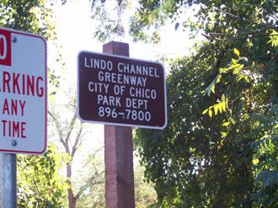
What is in the Chico First Pipeline?
Cleanups; every Saturday at 9:30 AM; weather permitting- Location: Little Chico Creek starting at Cypress heading west to Orange.
Ordinances- Aimed at Making Chico Clean, Safe & Beautiful!
Petition Drives- Current: Reducing Crime & Keeping California Safe Act
Town Hall Forums- Educational, Interactive, & Action-Oriented!
Opioid/Cannabis Education- Monday, May 21-22, 2018- CSUC BMU- Keynote Speaker: Sam Quinones, Author of ‘Dreamland’.
Chico First Town Hall: Substance Abuse and the Justice System
Water Quality- Storm Water Resource Plan
Chico First Group Bike Rides & Free Bike Registration Event
Chico First Kids Cleanup & Social Event- Saturday, June 16th Time: TBD
Chico First Internet Site & Hot Spot/Cleanup Tracker Pin Map

Slide 6
Cleanup Tracker

Slide 7
Chico First Mission
WHY: Beautiful, Clean and Safe Community
WHAT: Public Safety and Quality of Life
HOW: Unity, Action, Vigilance
POLICY: Contact, Enforcement, Accountability

Slide 8
Contact, Enforcement, Accountability
CONTACT: No one lives in Chico anonymously:
Door #1: Engage with Shelter, Health, Rehab- Voluntarily
Individual choice; Services Outreach; Volunteer Outreach
ENFORCEMENT: All laws must be vigorously enforced :
Door #2: Police, Code Enforcement, Community Service Officers
ACCOUNTABILITY: Meaningful consequences for offenses:
End catch and release revolving door
Mandate for Treatment: Mental Illness: Court Order to Door #1: Laura’s Law
ACT- Community Court: Treatment Triage and Community Restitution

Slide 9
Proposed Additional Enforcement Tools
Increased police, code enforcement, Community Service Officer, Park Ranger Presence;
Closer alignment between City and County Agencies;
Door #1: Public Health, Behavioral Health, Medical Services, Rehab, Shelters
Door #2: Police, Sheriff, DA, Judges, Jails, Probation
Community Court: Misdemeanor Crimes/Meaningful Outcomes;
Additional Ordinances: (See list);
Revised State Laws: (i.e. Keep California Safe Initiative)

Slide 10
Proposed Ordinances
Property and material distribution requiring permits for public spaces;
Non-Interference with City workers/agents;
Shopping Cart Control;
Dumpster Security;
Earlier Curfews in Parks and public spaces;
Exchange of any item from a vehicle on public streets;
No loitering near children’s playgrounds unless supervising a child;
Regulation of Improper use of Public Storage
Sit/Lay: Sidewalks, bus stops, public property
Revise some Infractions to “Wobblettes”-Misdemeanors

Slide 11
Mayor Sean Morgan-(inquiring minds want to know)
ACT-Accountability, Compassion, Together
Community Court
Enforcement and Resources
Ordinances
Keep California Safe Initiative

Slide 12
QUESTIONS AND DISCUSSION

Slide 13
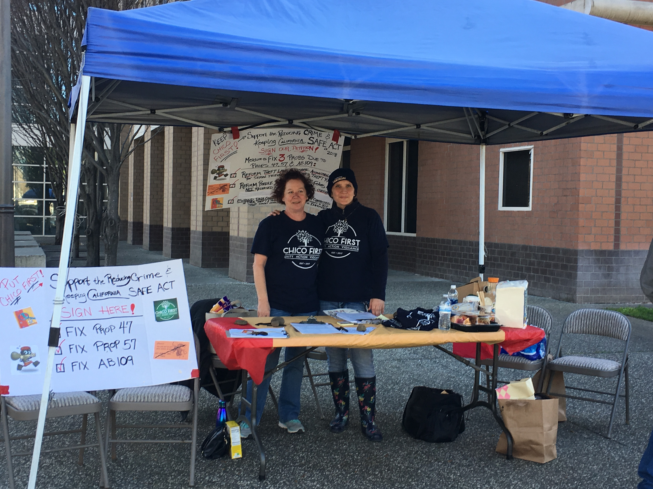
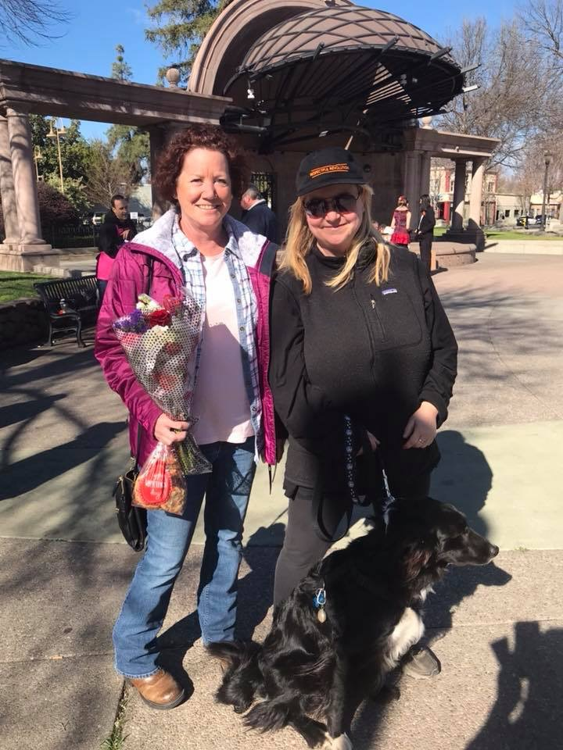
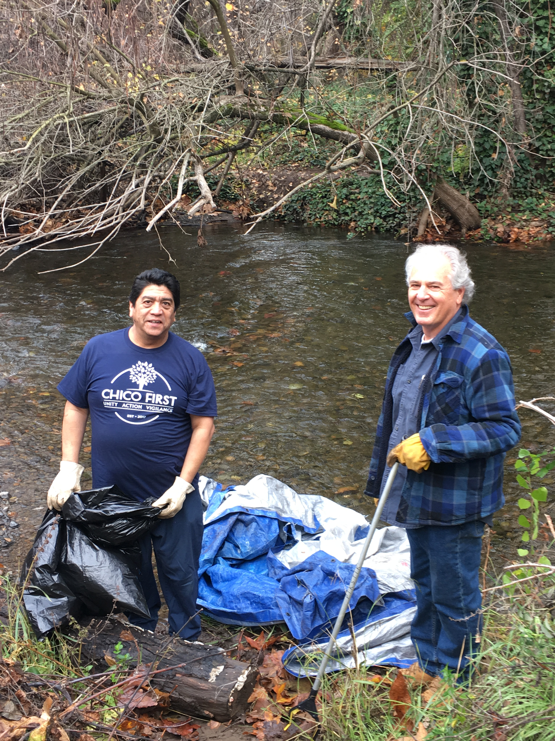
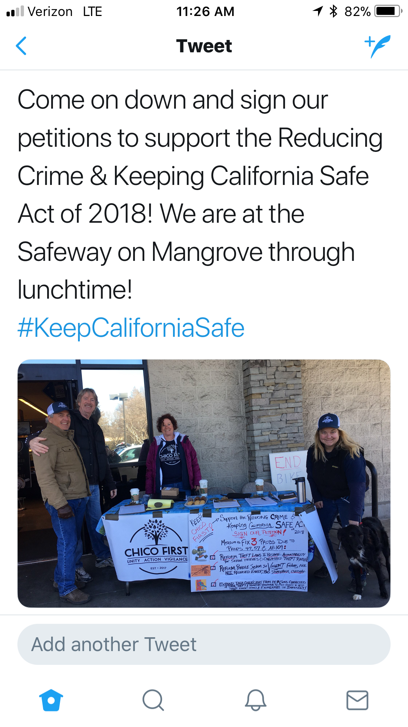
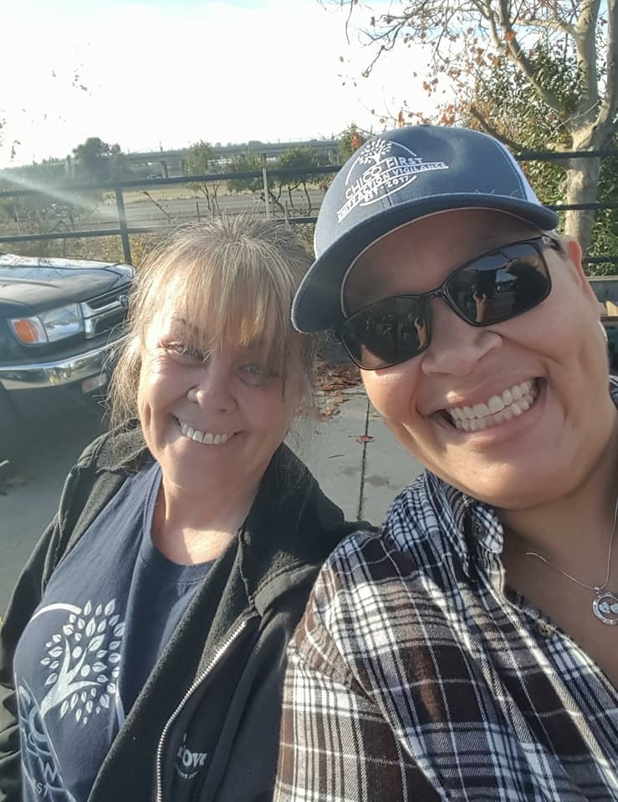
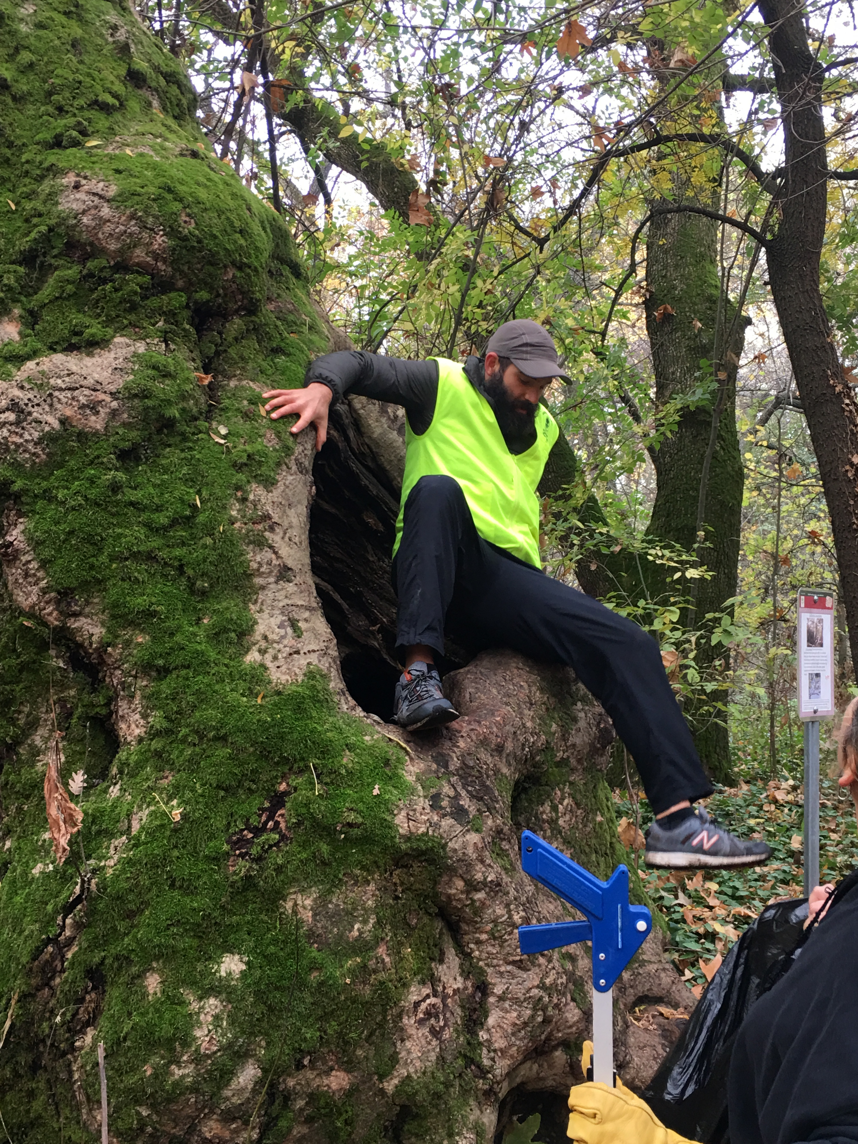
Chico First Membership Meetings- 1st Monday of every month- 6:00pm at the Ramada Plaza- Shasta Room.
Next Meeting: Monday, June 4th, 2018
Thanks for attending!

