Slide 2
Station 1: Jesus is tempted
From St. Mark’s Basilica, Venice, 12th century mosaic

Slide 3
Station 2: Jesus is betrayed
“Judas Betrays Jesus with a Kiss” by Chris Cook, 2014

Slide 4
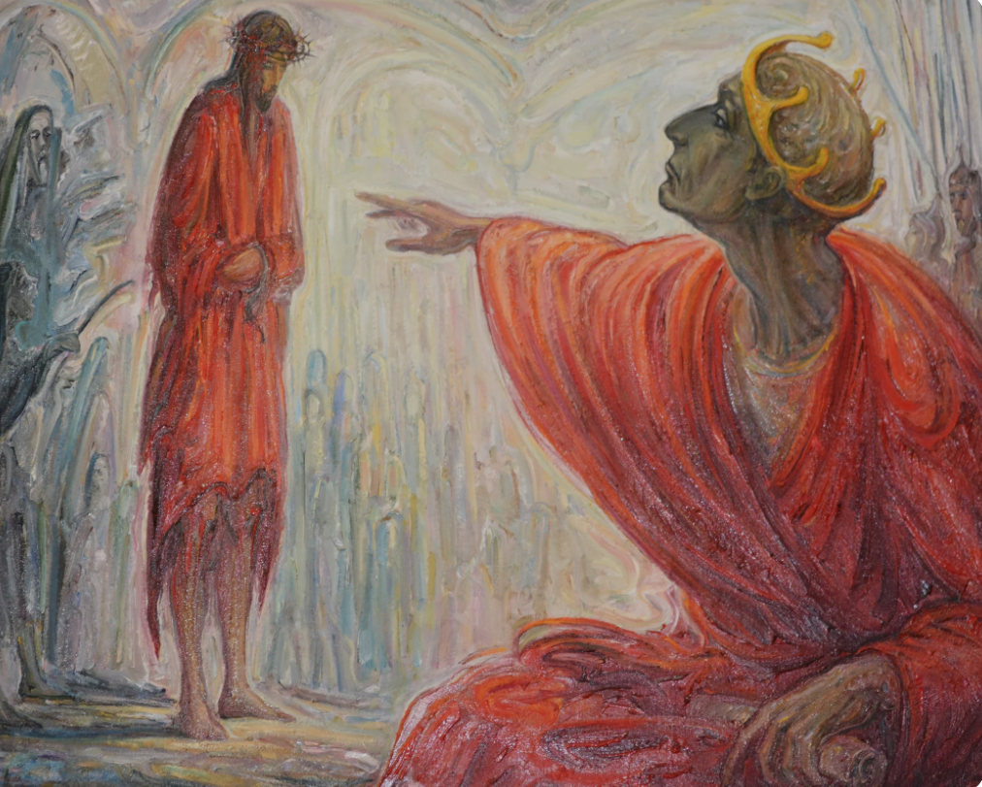
Station 3: Jesus is condemned
“Jesus is condemned” by Virginijus Kasinskas

Slide 5
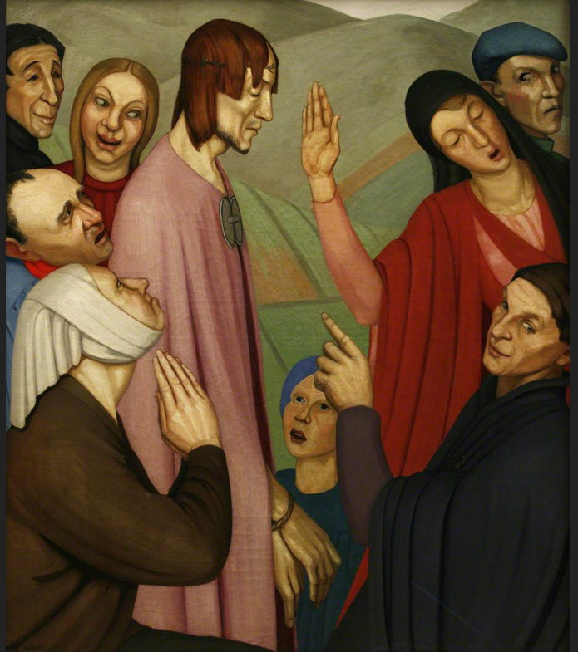
Station 4: Jesus is mocked
“Christ Mocked” by Annie Fearon Walke, 1924

Slide 6
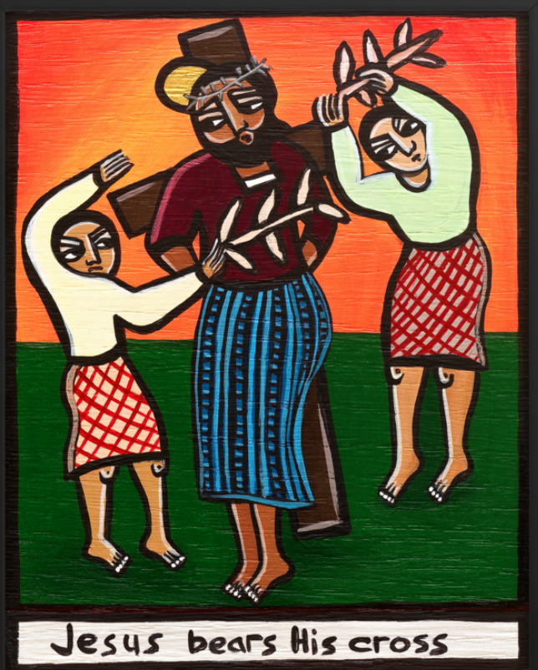
Station 5: Jesus is given his cross
“Jesus bears his cross” by Laura James

Slide 7
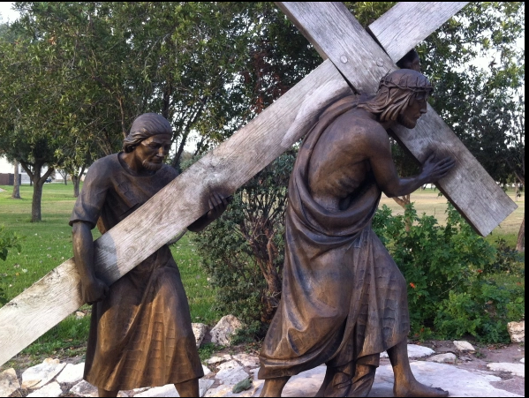
Station 6: Simon carries Jesus’ cross
Sculpture, unknown

Slide 8
Station 7: Jesus is stripped
“Jesus is stripped” by Sara Hayward 2017

Slide 9
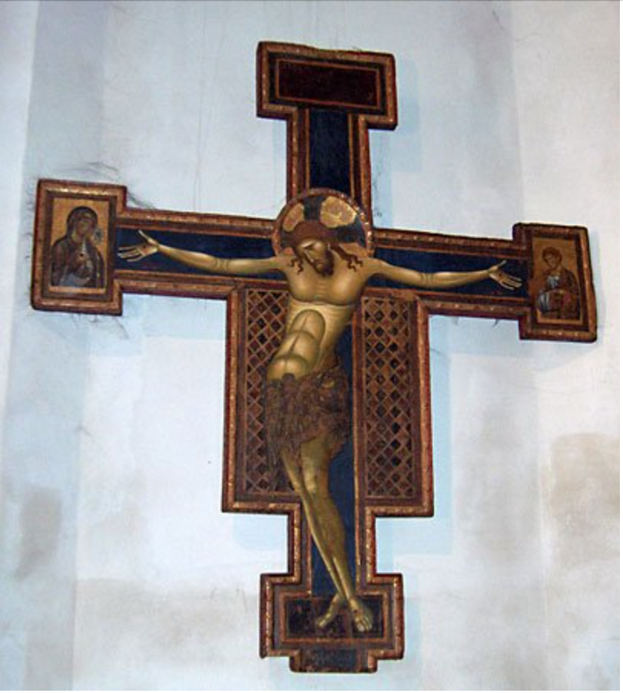
Station 8: Jesus is nailed to the cross
“Crucifixion” by Giunta Pisano, circa 1250

Slide 10
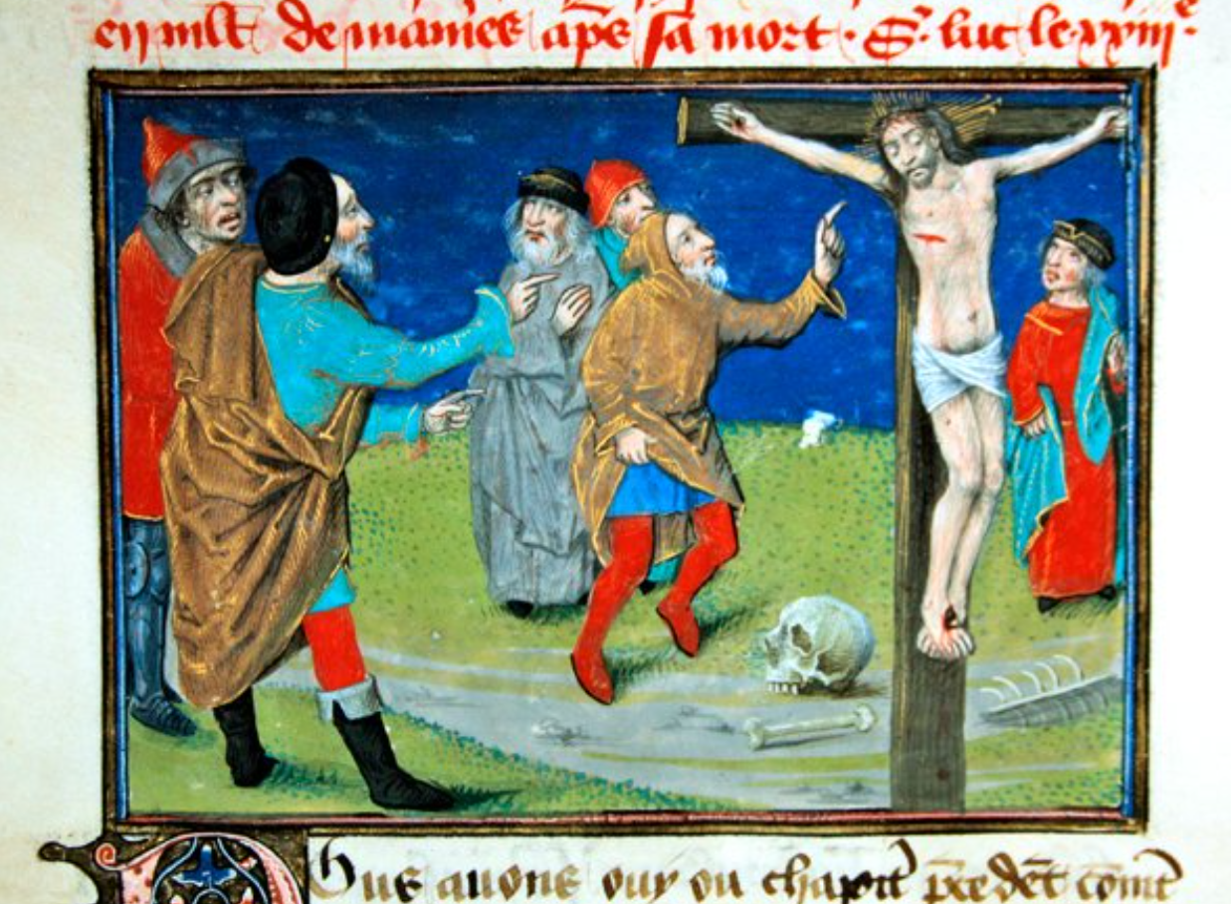
Station 9: Jesus is mocked on the cross
From the Mirroir de l’humaine salvation, anonymous, early 14th cent French

Slide 11
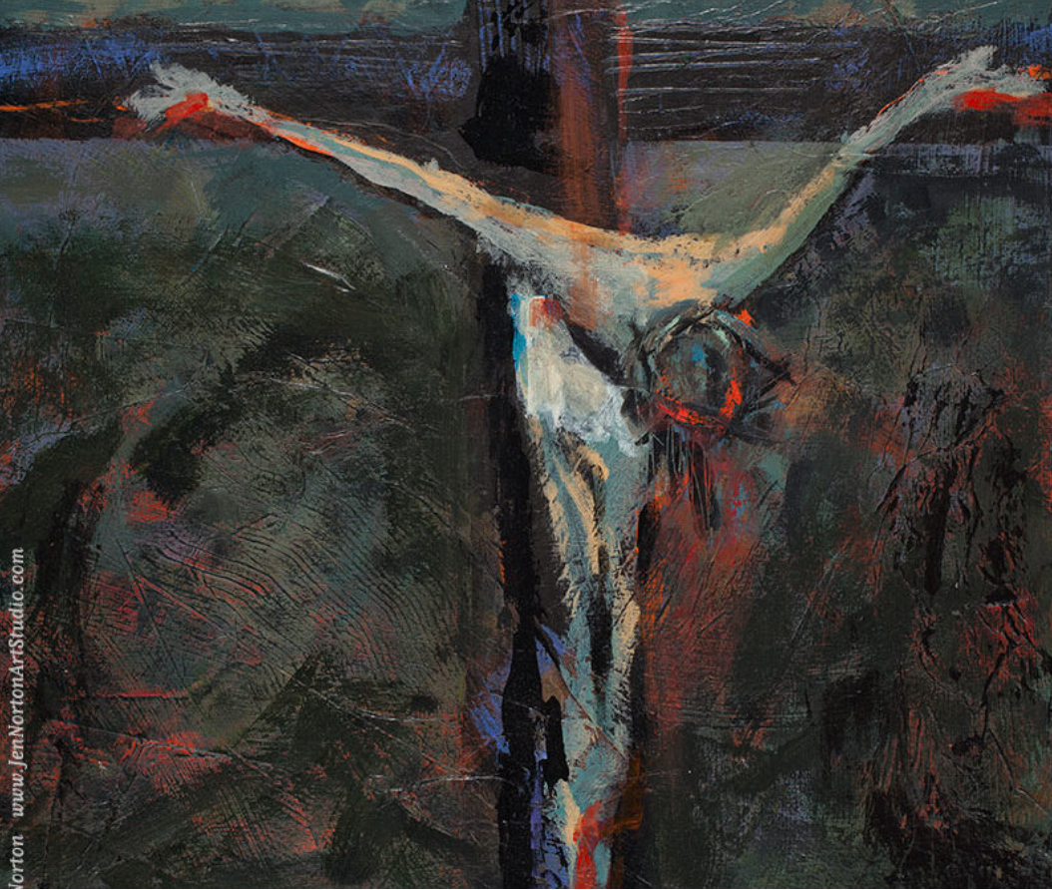
Station 10: Jesus dies
“Station Twelve: Death” by Jen Norton copyright 2019

Slide 12
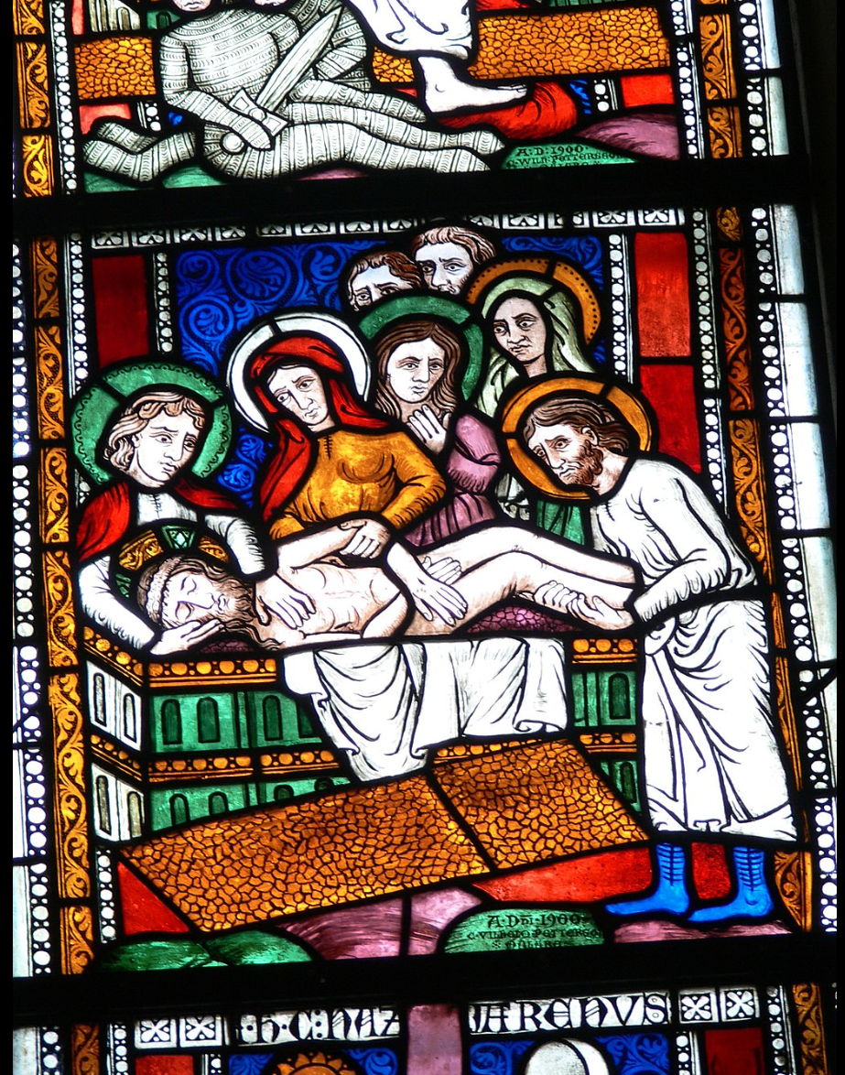
Station 11: Jesus is buried
“The Entombment” in stained glass, 1300s

Slide 13
Station 12: Jesus rises
“Resurrection Jesus Christ” icon, from the Holy Art Hagiography, Greece, 21st cent

