Slide 1
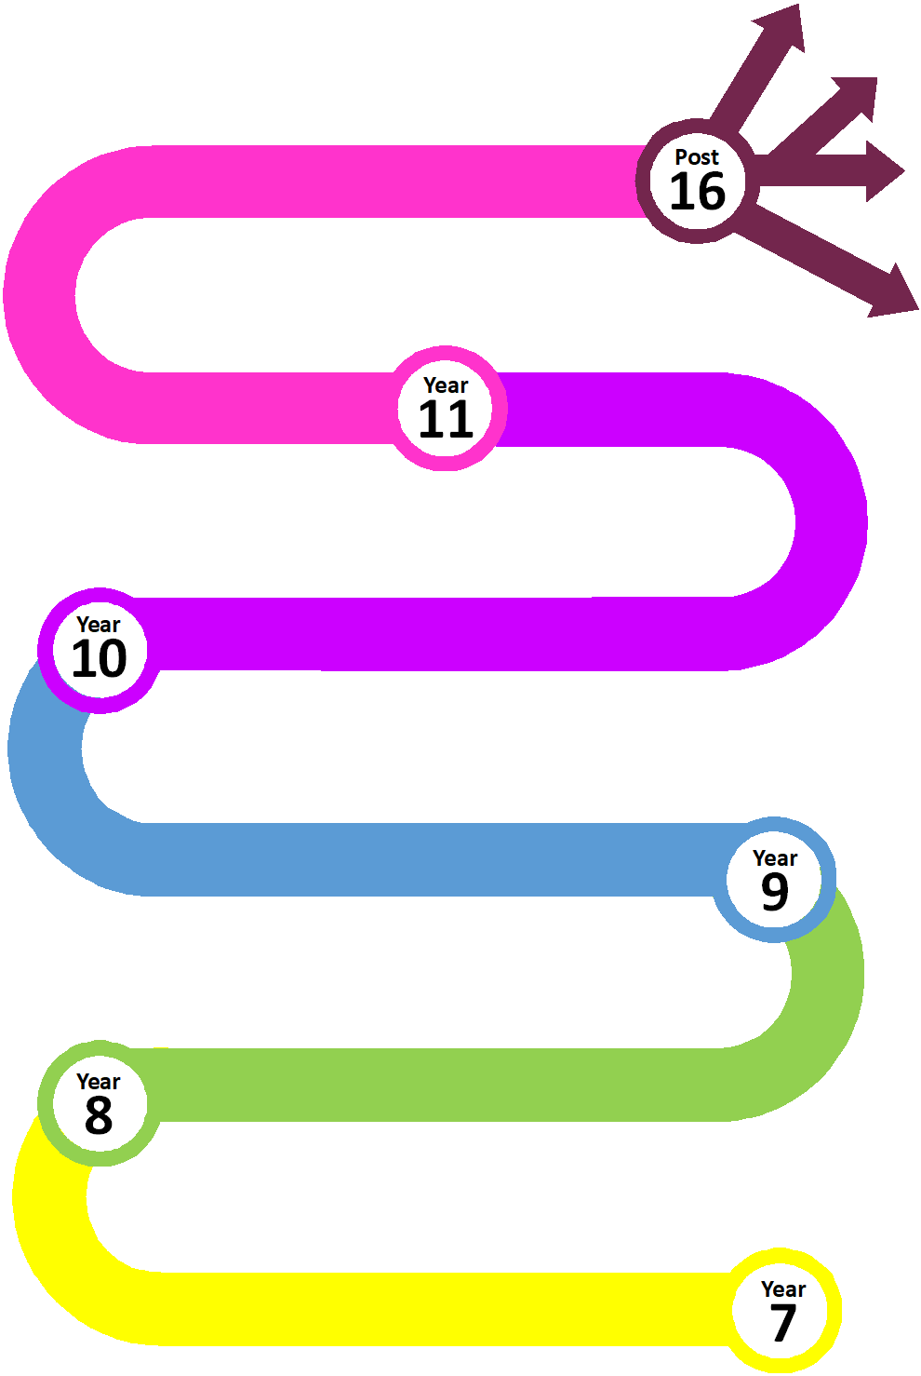
PHSE, SRE and Citizenship at Thomas Estley
SRE
PSHE
CITIZENSHIP
Contraception and Parenting
Healthy Lifestyle
What makes a good relationship?
Post 16 Module
What I Need to Know
Healthy
Relationships
Healthy relationships Module
What Happens Next?
Mental Health
Relationships
and Consent
Personal safety Module
Good vs Evil
Drugs and Gangs
STEM Module
Careers Drop down day
Healthy Lifestyle
Crime
Careers
The Equality Act
Drop down day
Personal Safety
Relationships
Diversity Module
Diversity and Respect
Safety
Community and Me
TUTOR PROGRAMME – CAREERS PROGRAMME
TUTOR PROGRAMME – READING PROGRAMME
TUTOR PROGRAMME – VOTES FOR SCHOOLS

Slide 2
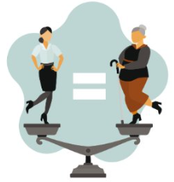
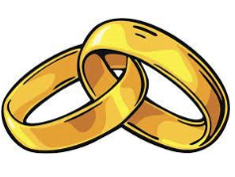
 | Race | Religion | Sexuality | Gender | Age | Marriage | Pregnancy | Transgender | Disability
Year 7 | Diversity & Respect Year 7 module Year 7 drop down day Black history month | Diversity & Respect Year 7 module | Diversity & Respect PRIDE | Diversity & Respect Year 7 drop down day World womens day | Diversity & Respect | Diversity & Respect | Diversity & Respect | Diversity & Respect | Diversity & Respect
Year 8 | Equality Act Black history month | Equality Act | Equality Act PRIDE | Equality Act World womens day | Equality Act | Equality Act | Equality Act | Equality Act | Equality Act
Year 9 | Black history month |  | Year 9 module PRIDE | World womens day |  |  | Year 9 module | Year 9 module

Slide 3
 | Race | Religion | Sexuality | Gender | Age | Marriage | Pregnancy | Transgender | Disability
Year 10 | Black history month |  | Year 10 module PRIDE | Year 10 module World womens day |  |  | Year 10 module | Year 10 module
Year 11 | Black history month |  | PRIDE | Healthy Relationships World womens day |  | Healthy Relationships | Healthy Relationships

