Slide 2
2Timothy 2:20-26

Slide 3
2Timothy 2:22-24
“Flee also youthful lusts: but follow righteousness, faith, charity, peace, with them that call on the Lord out of a pure heart. But foolish and unlearned questions avoid, knowing that they do gender strifes (Create Conflict). And the servant of the Lord must not strive (be divisive);

Slide 4
2Timothy 2:22-25a
“Flee also youthful lusts: but follow righteousness, faith, charity, peace, with them that call on the Lord out of a pure heart. But foolish and unlearned questions avoid, knowing that they do gender strifes (Create Conflict). And the servant of the Lord must not strive (be divisive); but be gentle unto all men, apt to teach, patient, In meekness instructing those that oppose themselves”

Slide 5
2Timothy 2:25b-26
“if God peradventure (Perhaps) will give them repentance to the acknowledging of the TRUTH; And that they may recover themselves out of the snare of the devil, who are taken captive by him at his will.”

Slide 6
2Timothy 2:20
“But in a great house there are not only vessels of gold and of silver, but also of wood and of earth; and some to honour, and some to dishonour.”

Slide 7
2Timothy 2:20-21
“But in a great house there are not only vessels of gold and of silver, but also of wood and of earth; and some to honour, and some to dishonour. If a man therefore purge himself from these, he shall be a vessel unto honour, sanctified, and meet for the master's use, and prepared unto every good work.”

Slide 8
2Timothy 2:20-26
“But in a great house there are not only vessels of gold and of silver, but also of wood and of earth; and some to honour, and some to dishonour. If a man therefore purge himself from these, he shall be a vessel unto honour, sanctified, and meet for the master's use, and prepared unto every good work.”
Encouraged to Become Uncommon

Slide 9
Encouraged to Become Uncommon
In other words Paul indicates to Timothy that one of the challenging tasks he must take on as a pastor is helping the church see ways in which they have been shaped more by the culture than the Lord.
And then turn to the Lord for Identity

Slide 10
Encouraged to Become Uncommon
In other words Paul indicates to Timothy that one of the challenging tasks he must take on as a pastor is helping the church see ways in which they have been shaped more by the culture than the Lord.
Common – Demonic
Uncommon – Holy

Slide 13
Modern Identity
Traditional Identity

Slide 14
Traditional Identity Formation
In the past, most people got their identity from how well they related to normal… from family, neighborhoods and nation.
Identity was forged by
discovering what our family and neighbors expected of us
getting positive and negative feedback about our choices
re-arranging our lives in accordance with those expectations so we could get regular validation and affirmation from our face-to-face community.

Slide 15
Traditional Identity Formation
One way to illustrate this is in how we tell our stories
Traditional Story telling has
A Hero
A Problem/Villain
A Guide to Help
A Plan to Follow
A Call to Action
Which Ends in Success

Slide 16
A Hero
A Problem/Villain
A Guide to Help
A Plan to Follow
A Call to Action
Which Ends in Success

Slide 17
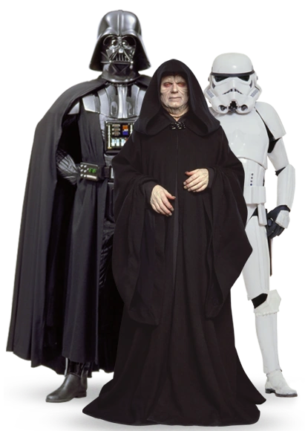
A Hero
A Problem/Villain
A Guide to Help
A Plan to Follow
A Call to Action
Which Ends in Success

Slide 18
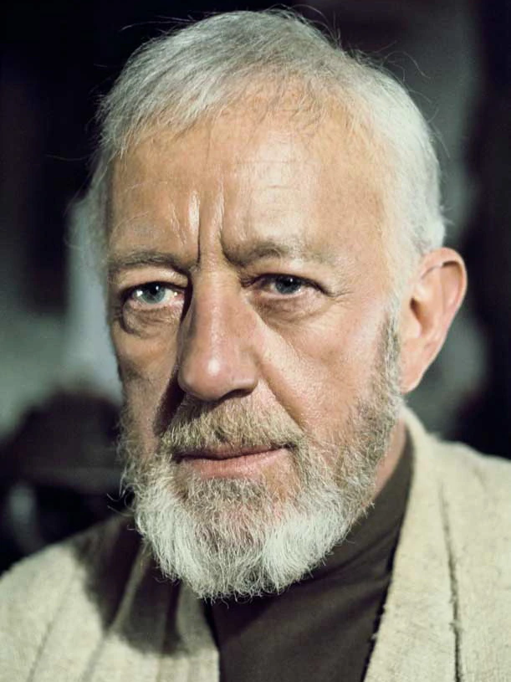
A Hero
A Problem/Villain
A Guide to Help
A Plan to Follow
A Call to Action
Which Ends in Success

Slide 19
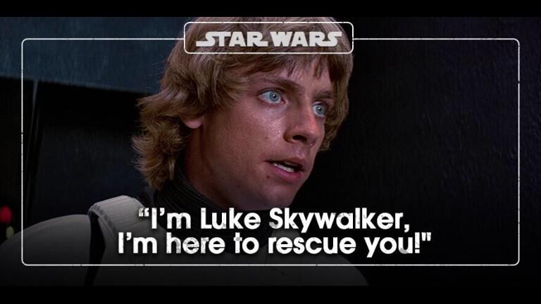
A Hero
A Problem/Villain
A Guide to Help
A Plan to Follow
A Call to Action
Which Ends in Success

Slide 20
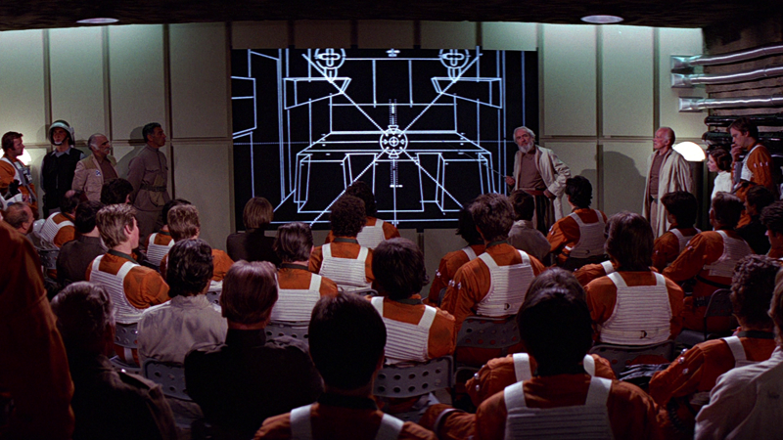
A Hero
A Problem/Villain
A Guide to Help
A Plan to Follow
A Call to Action
Which Ends in Success

Slide 21
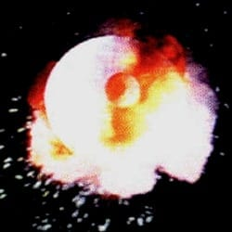
A Hero
A Problem/Villain
A Guide to Help
A Plan to Follow
A Call to Action
Which Ends in Success

Slide 23
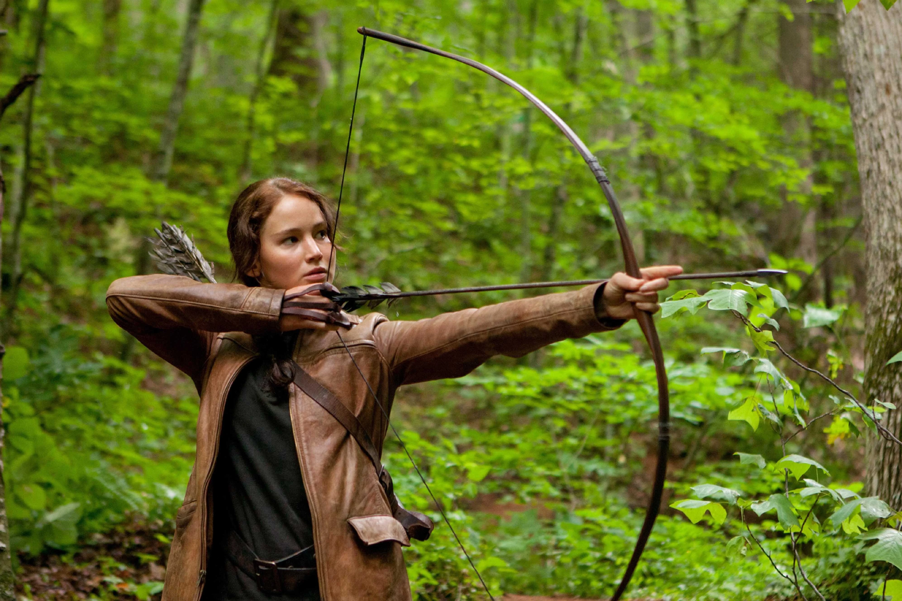
A Hero
A Problem/Villain
A Guide to Help
A Plan to Follow
A Call to Action
Which Ends in Success

Slide 24
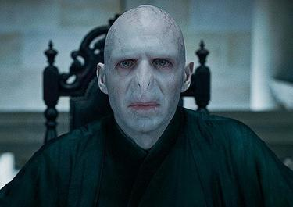
A Hero
A Problem/Villain
A Guide to Help
A Plan to Follow
A Call to Action
Which Ends in Success

Slide 25
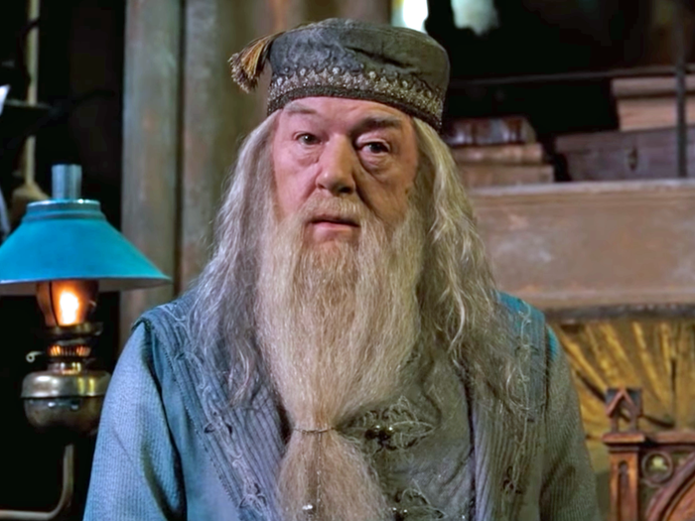
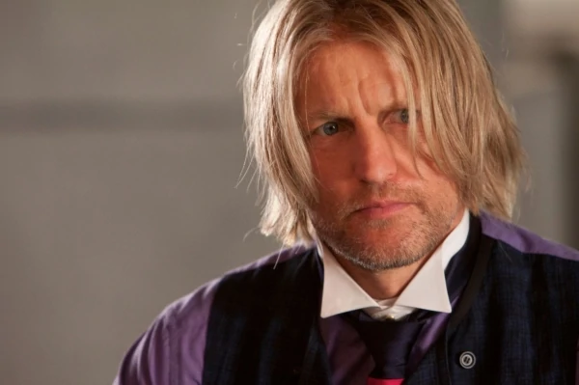
A Hero
A Problem/Villain
A Guide to Help
A Plan to Follow
A Call to Action
Which Ends in Success

Slide 26
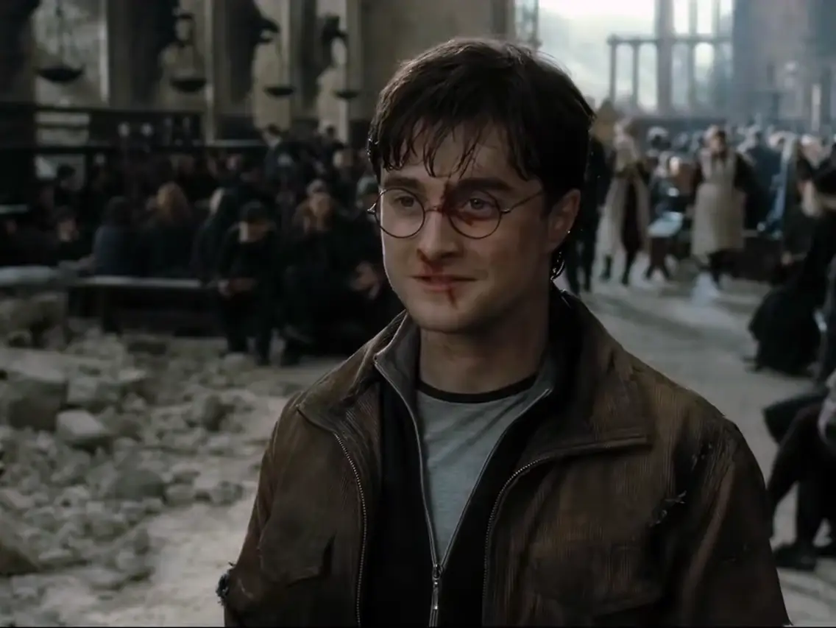
A Hero
A Problem/Villain
A Guide to Help
A Plan to Follow
A Call to Action
Which Ends in Success

Slide 27
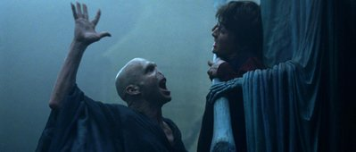
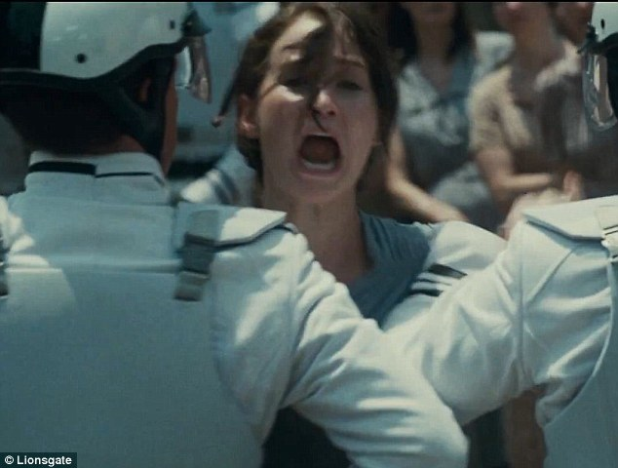
A Hero
A Problem/Villain
A Guide to Help
A Plan to Follow
A Call to Action
Which Ends in Success

Slide 28
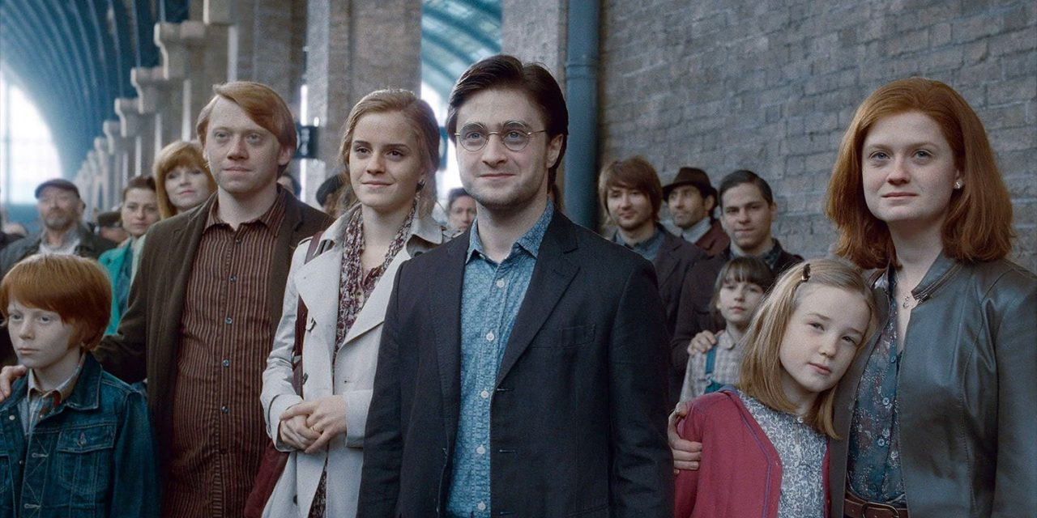
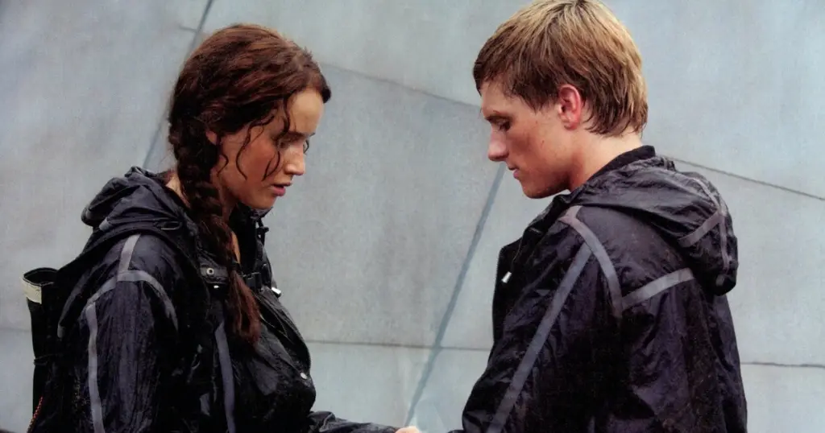
A Hero
A Problem/Villain
A Guide to Help
A Plan to Follow
A Call to Action
Which Ends in Success

Slide 29
Traditional Identity Formation
Could Be…
Coercive and Disruptive
Rigid and Confusing
Pressure filled and Life Consuming

Slide 30
Traditional Identity Formation – Pastor Tim Keller
“If our identity is in our work (Title, Performance, Legacy) rather than Christ, success will go to our heads, and failure will go to our hearts.”
“If anything becomes more fundamental than God to your happiness, meaning of life, and identity then it is an idol.”

Slide 31
Traditional Identity Formation
A Hero
A Problem/Villain
A Guide to Help
A Plan to Follow
A Call to Action
Which Ends in Success

Slide 32
Modern Identity
Currently many people get their identity from within. How they feel and what they experience as positive in their lives.
Identity is stumbled upon by
Following one’s feelings and affections
Expressing our “individuality” publicly w/o judgment
re-arranging our lives in accordance with acceptance, approval, and pleasure so we could get regular validation and affirmation from our desired community. (in person or virtual)

Slide 33
Modern Identity Formation
One way to illustrate this is in how we tell our stories
Modern Story telling has removed the traditional standards of heroism and replaced them self-awareness
A Hero - Sad/Lost/Confused
A Problem/Villain - Other’s Expectations
A Guide to Help – Themselves/ The Hero’s Real Self
A Plan to Follow – Reject Outside influence and embrace self
A Call to Action – Love Yourself
Which Ends in Success – Others affrim your ___________

Slide 34
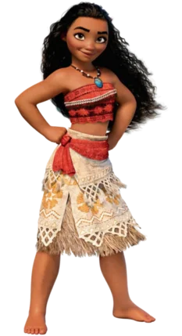
“The wind is howling like this swirling storm inside Couldn't keep it in, heaven knows I tried Don't let them in, don't let them see Be the good girl you always have to be Conceal, don't feel, don't let them know Well, now they know
It's funny how some distance makes everything seem small And the fears that once controlled me can't get to me at all It's time to see what I can do To test the limits and break through No right, no wrong, no rules for me I'm free”
n

Slide 35
Modern Identity formation
Is…
incoherent
unstable
(3) illusory
(4) crushing
(5) excluding

Slide 36
Modern Identity formation - Pastor Tim Keller
“Our need for worth is so powerful that whatever we base our identity and value on we essentially 'deify.' We will look to it with all the passion and intensity of worship and devotion, even if we think ourselves as highly irreligious.”

Slide 37
Modern Identity
Traditional Identity
Which Do We Trust

Slide 38
2Timothy 2:20-26
“But in a great house there are not only vessels of gold and of silver, but also of wood and of earth; and some to honour, and some to dishonour. If a man therefore purge himself from these, he shall be a vessel unto honour, sanctified, and meet for the master's use, and prepared unto every good work.”
Encouraged to Become Uncommon

Slide 39
Modern Identity
Traditional Identity
Gospel Identity

Slide 40
Modern Identity
Traditional Identity
Gospel Identity
Religion: 'My identity is built on being a good person.’
Gospel: 'My identity is not built on my record or my performance but on Christ's.'

Slide 41
“To be loved but not known is comforting but superficial. To be known and not loved is our greatest fear. But to be fully known and truly loved is a lot like being loved by God. It is what we need more than anything. It liberates us from pretense, humbles us out of our self-righteousness, and fortifies us for any difficulty life can throw at us.”

Slide 42
“ For we are his workmanship, created in Christ Jesus unto good works, which God hath before ordained that we should walk in them.” Ephesians 2:10

Slide 43
“ For we are his workmanship, created in Christ Jesus unto good works, which God hath before ordained that we should walk in them.” Ephesians 2:10
Poiēma – Poem, We are something crafted, with skill and intent, by God, for His purposes

Slide 44
“ For we are his workmanship, created in Christ Jesus unto good works, which God hath before ordained that we should walk in them.” Ephesians 2:10
The word “for” connects verse 10 with what precedes it, especially the fact that we have been saved by grace. Salvation is not only deliverance from death into life. It also involves being newly created in Christ.

Slide 45
“ For we are his workmanship, created in Christ Jesus unto good works, which God hath before ordained that we should walk in them.” Ephesians 2:10
We don’t have to settle for the restrictive, driven, pressure filled Traditional Identity or the empty, fragile, pressure filled Modern Identity. Rather, we can begin to live now in Christ and with Christ. We can begin now to live as God’s workmanship, contributing to God’s work in the world and, finding rest for our restless identity.

Slide 46
Who Am I?

Slide 47
Who Am I?
I am a Recreated work of art (Eph. 2:10)

Slide 48
Who Am I?
I am a Recreated work of art (Eph. 2:10)
I was Conceived in the heart of the Master Artist long ago (Eph 2:10)

Slide 49
Who Am I?
I am a Recreated work of art (Eph. 2:10)
I was Conceived in the heart of the Master Artist long ago (Eph 2:10)
I am Crafted with care, by His Hand through the tools of my own unique as well as community experiences. (Rom. 8:28-29)

Slide 50
Who Am I?
I am a Recreated work of art (Eph. 2:10)
I was Conceived in the heart of the Master Artist long ago (Eph 2:10)
I am Crafted with care, by His Hand through the tools of my own unique as well as community experiences. (Rom. 8:28-29)
I am free to do His Good Works (Eph.2:10)

Slide 51
Who Am I?
“The gospel reveals that I am so sinful that Jesus had to die for me, yet so loved and valued that Jesus was glad to die for me. This leads to deep humility and deep confidence at the same time. I can’t feel superior to anyone, and yet I have nothing to prove to anyone.”

Slide 52
I am free to do His Good Works
God chose us to be holy so that we might belong to him and be devoted to his purposes (Ephesians 1:3)

Slide 53
I am free to do His Good Works
God chose us to be holy so that we might belong to him and be devoted to his purposes (Ephesians 1:3)
God determined that we should exist “for the praise of his glory” (Ephesians 1:12, 14)

Slide 54
I am free to do His Good Works
God chose us to be holy so that we might belong to him and be devoted to his purposes (Ephesians 1:3)
God determined that we should exist “for the praise of his glory” (Ephesians 1:12, 14)
God has called the community of the faithful to do good together (Ephesians 4:16)

Slide 55
I am free to do His Good Works
God chose us to be holy so that we might belong to him and be devoted to his purposes (Ephesians 1:3)
God determined that we should exist “for the praise of his glory” (Ephesians 1:12, 14)
God has called the community of the faithful to do good together (Ephesians 4:16)
In fact, the book of Ephesians may serve as the Christian handbook on living from a gospel identity.

Slide 56
Will You Embrace Your Gospel Identity?
Our story is not written based our nationality, ethicity, language, occupation, or value to the community. We are not validated by worldly perceptions.
Our story is also not written based on our internal feelings, affections, pleasures or affirmation of our individuality. Again, we are validated by worldly perceptions.
Our story is written by God, in which Jesus alone is the Hero, and we are they one’s rescued. We are validated by his words, his love, his acceptance, his grace, his mercy, etc.

Slide 57
Will You Embrace Your Gospel Identity?

