Slide 1
Stand in Light and Shadow: Seeing Ourselves Through Text and Image

Slide 2
Midrash
Midrash מדרש‎ refers to the imaginative collection of stories created for the last 2000 years to explain passages in the bible. Midrash is a method of interpreting biblical stories that goes beyond the simple meaning of religious, legal, or moral teachings. It fills in gaps left in the biblical narrative regarding events and personalities that are only hinted at.

Slide 3
Hiddur Mitzvah
The concept of Hiddur Mitzvah is derived from commentary on the verse, "This is my God and I will glorify Him" (Exodus 15:2). The rabbis explained that the way human beings can glorify God is to carry out all the mitzvot, all actions, in beauty.

Slide 4
Tikkun Olam
Tikkun Olam means “fixing the world”, and is interpreted as our human responsibility to leave the world a better place than we found it.

Slide 5
Silkscreen poster

Slide 6
Silkscreen poster

Slide 7
Early papercut

Slide 8
Linoleum Cut Illustration Had Gadya : Passover folk song

Slide 9
Chinese papercuts

Slide 10
Mexican papercuts

Slide 11
Modern Jewish Papercut Tsirl Waletzky

Slide 12
Modern Jewish Papercut Martin and Joann Farren

Slide 13
Modern Jewish Papercut Yehudit Shadur

Slide 14
Traditional Jewish Papercut: Eastern Europe Mizrah / East Wall Marker

Slide 15
North Africa Mizrah / East Wall Marker

Slide 16
Eastern Europe Purim

Slide 17
Italy Shiviti

Slide 18
Eastern Europe Memorial Plaque

Slide 19
Eastern Europe Learning Society Plaque

Slide 20
Eastern Europe Amulet

Slide 21
Traditional Jewish Papercut: Eastern Europe Omer Counter

Slide 22
Eastern Europe Roisele

Slide 23
Illustrated Hebrew Alphabet

Slide 24
Hebrew Calendar

Slide 25
Whoever saves one life saves the whole world.

Slide 26
Tree of Life

Slide 27
High Holiday Prayer: “Show us righteousness and kindness.”

Slide 28
Book of Jonah

Slide 29
Sefirot Tree of Life from Tales of the Zohar, Aryeh Wineman

Slide 30
Illustration of Sefirah Hod Splendor

Slide 31
Jewish Women’s Archive

Slide 32
Torah Cover

Slide 33
Mizrah Multilayered, Silkscreened Galss

Slide 34
Congregation Kerem Shalom Concord MA

Slide 35
Temple Shalom, Newton MA

Slide 36
Shaarei Tefilah, Newton MA

Slide 37
Sandblasted windows, Summit NJ

Slide 38
Temple Sinai, Summit, NJ

Slide 39
Ner Tamid (Eternal Light) Nahalat Shalom, Albuquerque NM

Slide 40
Shandon Methodist Church, Columbia, South Carolina

Slide 41
Ketubah

Slide 42
Ketubah

Slide 43
Ketubah

Slide 44
Ketubah

Slide 45
Ketubah

Slide 46
Ketubah

Slide 47
Ketubah

Slide 48
Ketubah

Slide 49
Ketubah

Slide 50
Road to North Carolina

Slide 51
Woman’s Blesssing

Slide 52
Reading Ruth Your people shall be my people.

Slide 53
Duke Divinity School Goodson Chapel

Slide 54
Duke Divinity School Goodson Chapel

Slide 55
Duke Divinity School Goodson Chapel

Slide 56
Stand in Light and Shadow: Seeing Ourselves Through Text and Image

Slide 57
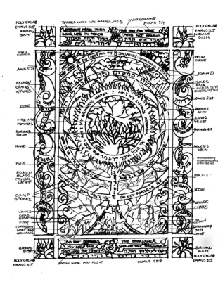
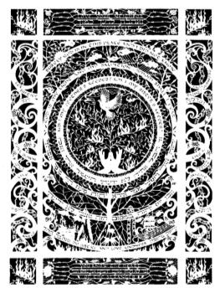
Sketches to final image

Slide 58
Stand in Light and Shadow: Seeing Ourselves Through Text and Image

Slide 59
Seeing Ourselves Through Text and Image

Slide 60
Tree of Life Genesis 4:9 Psalm 27:1 Genesis 28:16 Micah 6:8

Slide 61
Neighbor and Stranger Leviticus 19:18 / Micah 4:4 Exodus 23:9 / Bread and Roses

Slide 62
Justice and Righteousness Amos 5:24

Slide 63
Burning Bush

Slide 64
Rabbi Abraham Joshua Heschel, who lost most his family in the Holocaust and who linked arms with Martin Luther King in Selma on March 21, 1965, said: “The question about Auschwitz is not where was God, ­but where was man.” In this piece, the questions are about the choices we make, about the absence or presence of our own recognition of holiness, about our own actions, compassion, and courage.

