Slide 1
THE CORRECT HAND STRUCK COIN TO BUY
It is your decision step by step
TO Maximise value in purchasing
FROM: THE COINS OF INDIA with the NUMISMATICS FOUNDATION
https://numisfou.in

Slide 2
THIS IS A DISCUSSION FOR COLLECTORS OF HAND STRUCK COINS.
THERE IS A FUNDAMENTAL DIFFERENCE BETWEEN COLLECTING MACHINE STRUCK COINS AND HAND STRUCK COINS

Slide 3
MACHINE STRUCK COINS
SHOULD BE PERFECT AND WELL CENTRED
IF IMPERFECT THIS MIGHT BE DUE TO WEAR, POST MINT DAMAGE OR MINT PRODUCTION DAMAGE
IF MINT PRODUCTION DAMAGE CAN BE PROVEN THESE ARE COLLECTED BY SPECIALISTS AND MAY BRING A PREMIUM IN VALUE

Slide 4
HAND STRUCK COINS
BEING HAND STRUCK THEY MAY NOT BE WELL CENTRED
AT TIMES, THE DIES ARE BIGGER THAN THE COIN FLANS
ALL THE DETAILS MAY NOT BE SHOWN ON THE COINS
FULL AND COMPLETE ATTRIBUTION MAY NOT BE POSSIBLE
JUST BECAUSE THE COIN IS “PRETTY” AND CANNOT BE FULLY ATTRIBUTED DOES NOT MEAN IT SHOULD BE WORTH MORE THAN A POORLY STRUCK FULLY ATTRIBUTABLE COIN

Slide 5
ENSURE THAT YOU HAVE THE BEST RESEARCH MATERIAL
MONEY SPENT HERE WILL SAVE YOU MONEY IN THE LONG RUN

Slide 6
IS ALL THE INFORMATION ON THE COIN ?
The coin flan is often larger than the coin dies.
All relevant information should be available.
Here we clearly can see both dates, the mint name and epithet and the full text can also be seen.
Illustration from one of our books. It shows clearly on this coin that it can be FULLY attributed.

Slide 7
CHECKING AGAINST THE ILLUSTRATION
CHECKING THE COIN OBVERSE, THE FRONT, FOR FULL CONFIRMATION

Slide 8
CHECKING AGAINST THE ILLUSTRATION
CHECKING THE COIN REVERSE , THE BACK, FOR FULL CONFIRMATION

Slide 9
THE FUNDAMENTAL POINT
NO MATTER HOW PRETTY THE COIN LOOKS IF IT DOES NOT HAVE ALL THE ATTRIBUTION DETAILS THEN IT IS AN INFERIOR COIN TO THOSE THAT HAVE.

Slide 10
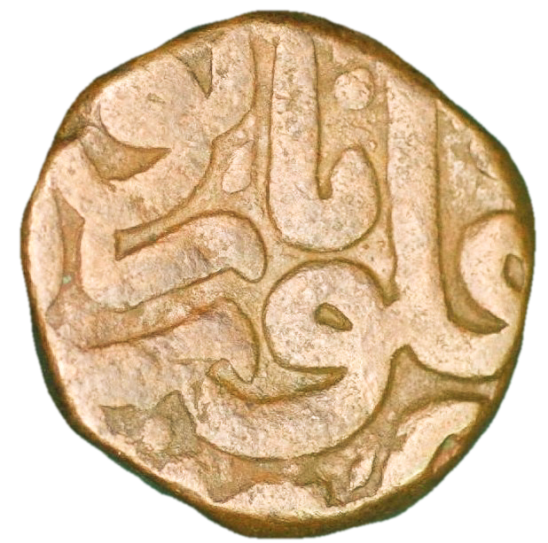
OBVERSE OF A “COMMON” AKBAR COPPER COIN. “COMMON” BECAUSE THE MINT WAS A MAJOR PRODUCER

Slide 11
NOW NOT SO COMMON AFTER ALL. FULL DETAILS OF THE OBVERSE CAN BE IDENTIFIED. THIS IS MISSING FROM MOST COINS FROM THIS SERIES. THE MINT NAME CAN BE CLEARLY READ.
The mint name is clearly outlined in our standard colour for mint name in our work GREEN
The colour coordinated text overlay was pioneered in numismatic illustrations by Tariq and Needham

Slide 12
IN SUMMARY
COLLECTING PREFERENCE SHOULD BE FOR COINS THAT CAN BE FULLY ATTRIBUTED

Slide 13
YES! WE UNDERSTAND THIS IS CONTRARY TO CURRENT GRADING (SLABBING) IDEAS BUT IT IS NOW TIME FOR COLLECTORS TO STAND AND DEMAND THAT ATTRIBUTION IS THE FOREMOST IDEAL FOR COLLECTING NOT JUST “PRETTINESS”

