Slide 1
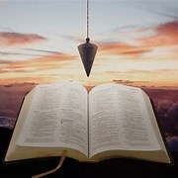
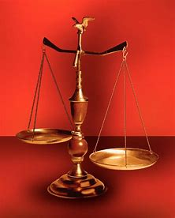
Straight and Balanced
(Luke 3:4-6)
Twelve series
#1 – 12 Helps to Prevent God’s Judgment of Sin with Amos
#2
#3
#4
#5
#6
#7
#8
#9
#10
#11
#12
OT: Ps 5:8, Pr 4:25-27
Amos 7:7-8, Is 28:13, 17
NT: Mt 3:3, Acts 9:11
Hebrews 12:13
OT: Deut 25:13-16
Pr 16:11, Da 5:25-28
NT: Hebrews12:1
1 Cor 3:11-15
Fellowship Church, February 11, 2024, by Bill Heath

Slide 2
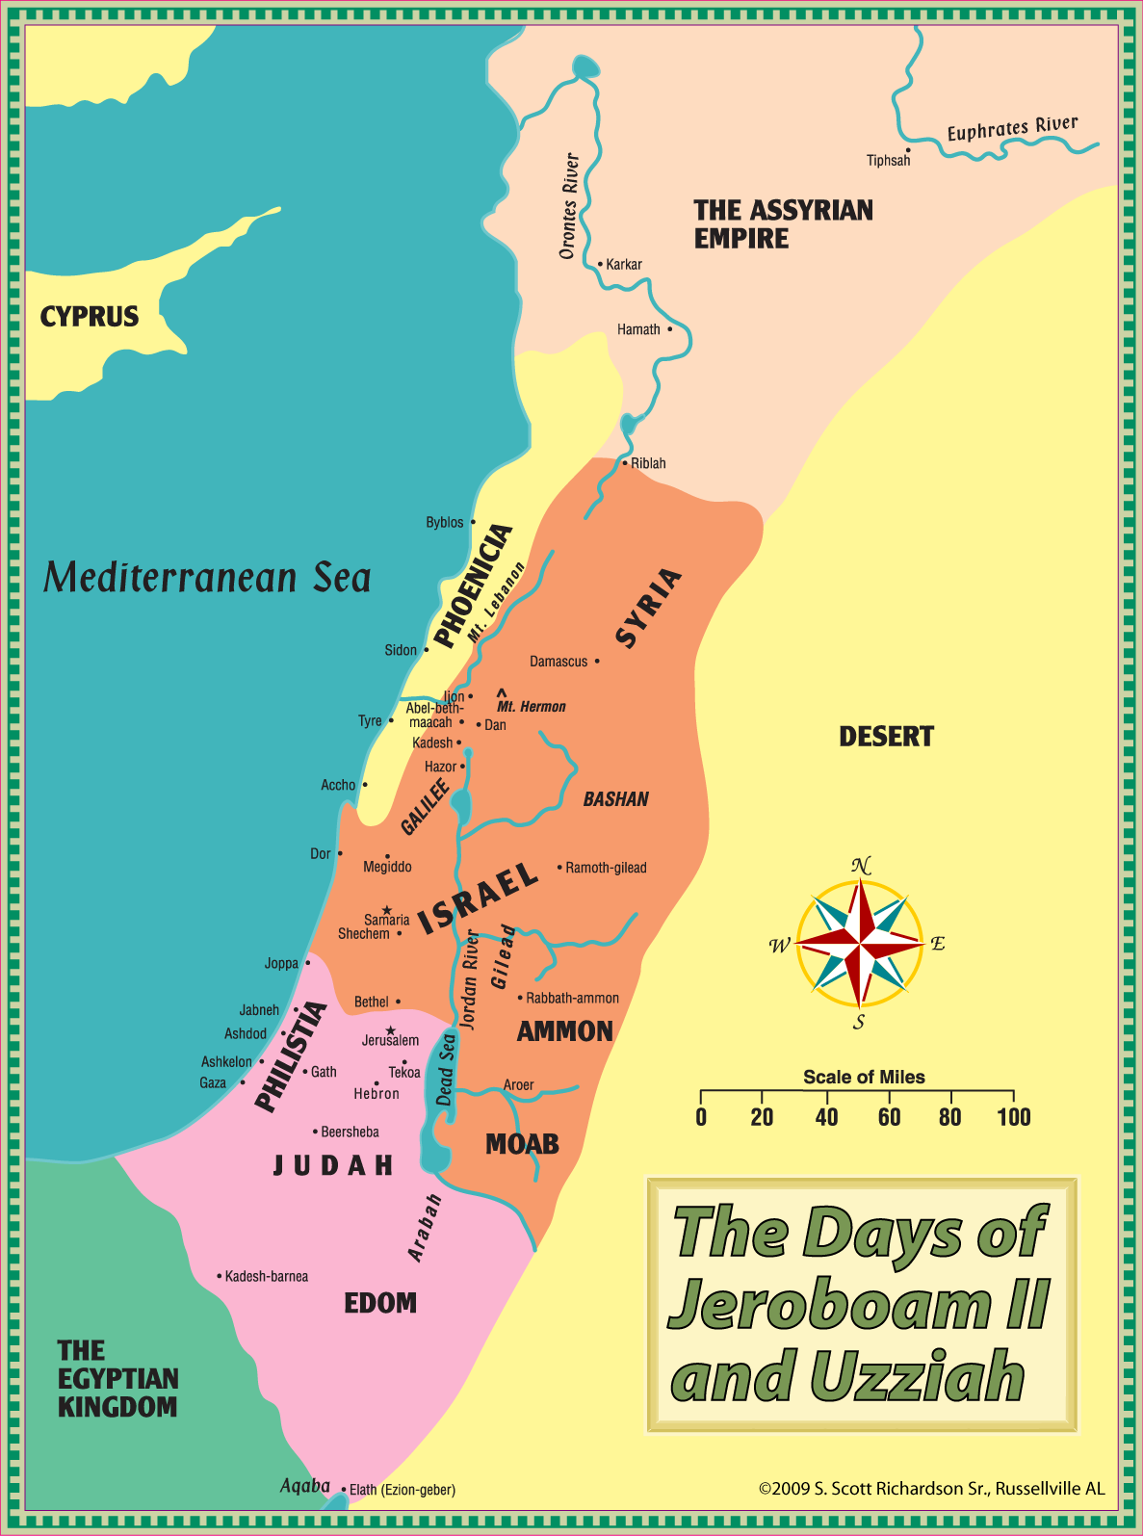
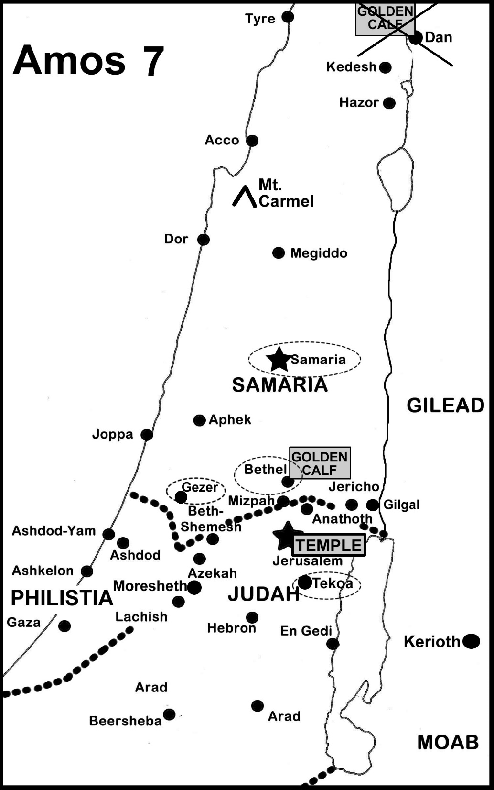
Notes:
-

Slide 3
Overview: 12 Helps to Prevent God’s Judgment of Sin with Amos
Time: 762 BC, 2 years before the great earthquake (Zechariah 14:5, 250 years later)
Contemporary of King Uzziah and Isaiah. Read in 30 minutes.
King Jeroboam II, time of greatest prosperity and military since Solomon.
722 BC, Assyria conquers Israel. > 90% of the northern kingdom will die.
Places: Tekoa (SE of Bethlehem), Bethel & Dan, Samaria. Prophecy for the northern kingdom.
Writer: Amos, an ordinary farmer of sheep and sycamore trees (1:1-2, 7:14-15)
Keywords: transgression (10x, most frequently in the Bible, also mighty sins 5:12)
Farmer terms: shepherds, cows, lion, spoiled summer fruit, sycamore tree
Content: 8 Judgments (1-2), 3 Messages (3-6), and 5 Visions (7-9)
Straight: I must prevent personal sin and repent promptly when I sin (Romans 6-8)
Balanced: God’s love includes judgment of sin because He is holy (2 Thes 2:3)
Notes:
-

Slide 4
12 Helps to Prevent God’s Judgment of Sin with Amos
Introduction (1:1-2)
Eight (8) Judgments (1:3-2:16) on the Surrounding Nations, then Judah and Israel 1. Know that for three transgressions and four, God will not turn away judgment (1:3 – 1st of 8x, NT 1 John 5:16, Mt 18:15-20)
2. We must not profane His holy name by our sin (2:6-8, NT Acts 5:1-11, 1 Cor 5-7, 2 Cor 7:9-16)
Three (3) Messages (3-6) of Sin and Punishment Against Israel “hear this Word” 3x
3. Know we can’t walk together, except we be agreed (3:3)
4. Be prepared to meet our God (4:12)
5. Prudent keep silent, hate the evil, and love the good, and establish judgment in the gates (5:13-15)
6. Let judgment roll down as waters, and righteousness as a mighty stream (5:23-24)
7. Don’t rest in the false comfort of music and instruments (6:5)
Five (5) Visions (7-9) of Approaching Judgment
8. Pray for God to repent of judgment of His people (7:3, 7:6)
9. God sets a plumb line in the midst of His people (7:7-8, It was built straight. Has it become crooked over time?)
10. Warning that worship has nothing to do with money and false scales (8:5)
11. If I continue in sin, a time will come when it is too late to hear and find the Word of God (8:11-12)
12. Know that sin causes judgment and destruction of a nation that was blessed in the past (9:8, 9:10, NT 1 Peter 4:17)
Prophetic Promise for Israel (9:11-15) the Tabernacle of David in the tribulation and 1000 (Romans 11, Ez 40-48, Rev 19)
Decision: Let the judgment of sin begin & continue with me, so revival begins & continues in me. (5:23-24)

Slide 5
Sunday School Schedule
Mas de Cristo class
Continue with the 12 series. Pray-pray. Pray for me.
You may request a Book of the Bible we have not completed
(completed: Philemon, James, Colossians, Jude, Proverbs, Ecclesiastes, Malachi, Mark, Amos)
Invitation to the 2024 daily Bible reading schedule. Mark from January 12 to May 8. Then, Isaiah from May 9 to Oct 18. Copies on the back table.
Next Sunday, February 18: 12 Ways to Glorify God with Psalms (5-hour read)
Notes:
-

