Slide 1
North Korea’s Economic Predicament Opportunities for Policy Adjustments For: GW North Korea School October 25,2022 William B. Brown NAEIA.Com

Slide 2
Pandemic or Not, North Korean Economy Under Great Strain
Expectations Matter. With 2018 summits, Kim raised domestic expectations. But since Hanoi these have been dashed. Admits plan and management failures. Apologizes. Turns to Self reliance.
Weak productivity, not lack of resources, makes North Korea poor.
UN sanctions and pandemic closing are having a large impact, external trade near zero.
Money stabilized but monetary, fiscal policy tight. Government is starving itself, privatizing a few assets. Little investment. Prices are volatile leading to speculation.
Pandemic controls likely stifling emergent markets. Some in Pyongyang no doubt approve.
Is there hope for reform under Kim Jong Un?
“Bottom Up” Marketization Underway
“Top Down” Macro / Micro Support Needed
2021 a lost year. Worst since “great famine”.
2022 trying to adjust, so far not well.
Notes:
I think North Korea’s economy is under quite some strain but maybe not in the way most people think. Are the sanctions working? Well yes, but again, maybe not in the way people expect. Amid the fire and fury, is there room to hope of a normalized North Korea? Absolutely. And a good part of the answer is the stealth marketization currently under way in North Korea.
First, a few definitions. We often limit our thoughts of marketization to marketplaces. In the Korean context, market towns and huge urban markets, like East Gate in Seoul. Many buyers and many sellers congregating to get their best possible deals; the buyer the cheapest price, the seller the highest price with arbiters forcing the action. It’s that competition that drives a market economy to efficient outcomes. Markets are organized, with rules on how to efficiently conduct transactions; for example, the day and time they will be open. But for an economist, markets mean much more than these places. We think of markets for goods, services, labor, capital, real estate, and foreign exchange. North Korea always had some marketplaces. Its challenge is opening these other kinds of markets disdained by Marx and prohibited by the Stalinist system.
Also, closely connected with markets is money, prices, and ownership. You can’t, or shouldn’t, trade what you don’t own. The socialist system prohibited private ownership of capital, and thus disallowed trade in “the means of production”, otherwise known as capitalism. And markets inevitably mean use of money and credit, also prohibited in North Korea’s formal socialism. Flexible prices and wages, equilibrating supply and demand, are the key dynamic of any market, not the fixed, policy induced prices of socialism. And, of course, the interest rate or return on capital is the price of capital, usually forced to zero in the socialism system lest “money make money” and the “rich get richer.”

Slide 3
Impact of Pandemic
Border Closing and Internal Restrictions must be impacting markets.
Fewer Chinese consumer products
Traders losing money
Private employment endangered
No investment
Decline in living standards
Some Benefits for the State
Less outflow of foreign exchange
Less competition for state enterprises
Stronger controls, especially movement.
But Economy now Depends on Markets
Plan Needs imports, capital goods.
Imports need exports
Financial instability
Happy Party, Unhappy population
Notes:
I think North Korea’s economy is under quite some strain but maybe not in the way most people think. Are the sanctions working? Well yes, but again, maybe not in the way people expect. Amid the fire and fury, is there room to hope of a normalized North Korea? Absolutely. And a good part of the answer is the stealth marketization currently under way in North Korea.
First, a few definitions. We often limit our thoughts of marketization to marketplaces. In the Korean context, market towns and huge urban markets, like East Gate in Seoul. Many buyers and many sellers congregating to get their best possible deals; the buyer the cheapest price, the seller the highest price with arbiters forcing the action. It’s that competition that drives a market economy to efficient outcomes. Markets are organized, with rules on how to efficiently conduct transactions; for example, the day and time they will be open. But for an economist, markets mean much more than these places. We think of markets for goods, services, labor, capital, real estate, and foreign exchange. North Korea always had some marketplaces. Its challenge is opening these other kinds of markets disdained by Marx and prohibited by the Stalinist system.
Also, closely connected with markets is money, prices, and ownership. You can’t, or shouldn’t, trade what you don’t own. The socialist system prohibited private ownership of capital, and thus disallowed trade in “the means of production”, otherwise known as capitalism. And markets inevitably mean use of money and credit, also prohibited in North Korea’s formal socialism. Flexible prices and wages, equilibrating supply and demand, are the key dynamic of any market, not the fixed, policy induced prices of socialism. And, of course, the interest rate or return on capital is the price of capital, usually forced to zero in the socialism system lest “money make money” and the “rich get richer.”

Slide 4
What We Think We Know
A Very Poor Country
GDP in 2021 about $27 bn. BOK estimate
Population 26 million
Per-capita GDP $1,000 - $2,000
NY Times reports $1,184.79 in 2020 !
Negative growth 2020-22
Malnutrition, extreme poverty is prevalent

Slide 5
Not Always This Way: 1945 in Good Shape
Probably in better shape then then any other part of Asia. No WWII in Korea.
1910-45 Japan built up infrastructure and industry in northern part of its Korean colony.
taking advantage of mineral resources and hydro.
avoiding US bombing
launchpad for invasion of China
Russians counted 1,400 factories taken over by socialist state in 1945
Korean War devastating but Soviet, EE, and Chinese aid built back quickly.

Slide 6
1956-1976 Golden Age of NK Socialism
By 1949 all industry socialized.
By 1956 all farms collectivized.
Central plan economy replaced ancient money/market economy
Trade was strong with bloc countries, Japan and Europe. US rules prevented trade.
Russians and Chinese criticized Kim Il Sung for too much investment, not enough attention to living standards, and weak exports but industry grew rapidly.
1976, prior to devastating default on western credits, probably peak year.
Downward spiral ever since.

Slide 7
Zhou En Lai and Kim Il Sung, circa 1960
Kim is visiting China trying to obtain more industrial aid
Zhou: ‘’We notice, looking across the river (Yalu) that you never have to turn off your lights. You have developed socialism far faster than we have.’’
KIS: ‘’Yes, but it is with your help.’’
Zhou: ‘’That is because you are holding down so many American forces, thus protecting the entire socialist world.’’ (Wilson Center Archives)

Slide 8
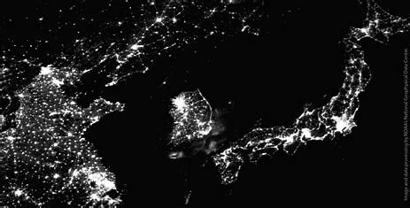
1997 Lights out

Slide 9
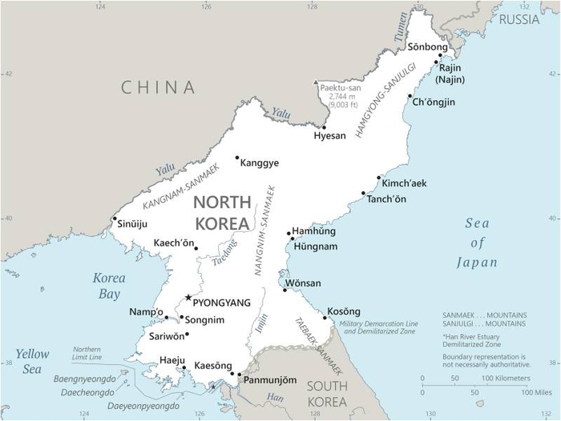

Slide 10
Why is North Korea So Poor?
Hint: Its not for lack of capital and resources, or culture
Excellent natural resources per capita
Nonferrous and iron metals
Hydro power
Coal
Relatively low pop density for East Asia
Excellent geography
Excellent human capital relative to income
Much industrial capital
Well organized ancient civilization

Slide 11
Answer—Weak productivity
North Korea’s system makes horrible use of its ample physical and human capital resources—probably the worst in the world.
Why? Two issues, one micro, one macro
Mixed command and market system delivers poor economic decisions. Two prices for everything.
Partial dollarization impedes monetary policy, starves state economy.
Trapped between both systems. Poverty trap plus transition trap.

Slide 12
Command or Planned Economy
Marxism
Results
Strong central state
Centralized Economy
Plan emphasizes industrial growth, at cost of consumption, living standards
State sets prices, high for consumption, goods, low for investment goods.
Allocation by central plan.
Divergent price systems prevents normal trade, investment with capitalist world.
Ownership of capital (means of production) is by state or collective, no private ownership. Includes land and human capital.
High share of investment rel. to consumption.
No personal financial savings.
Individual incentives weak, poor productivity
Limited gains from trade--COCOM
All Marxist economies experience massive famine, dissolution.
Except North Korea
Rejects market prices for capital and labor.
Labor is paid rations, not money.
No money economy creates dependent public.

Slide 13
Marketization Underway, Incomplete
What is a Market?
Marketization: Much more than “marketplaces”
Goods Markets
Services Markets
Labor Markets
Real Estate/Land Markets
Capital/Finance Markets
Foreign Exchange Markets
Many buyers
Many sellers
Rules, Structure
Time, currency, behavior
Compete for best price
Market clears with flex price
Usually most efficient outcome
Decentralized, Unplanned
Law of One Price

Slide 14
Kim Jong Un’s Inheritance
Kim Il Sung era. By 1956, NK had fully transitioned to a command economy system with no real money. Won circulated but was secondary to rations and state plan allocations and thus not a store of value or a required medium of exchange. Prices were set by state and designed to promote investment, not consumption.
Kim Jong Il era. Without Soviet and EE aid, by mid-1990s KIS’s command system had broken down. With resulting famine, ration distributions were not met and won came to be used as medium of exchange in illegal but pervasive markets. There was too much Won in circulation and hyperinflation ensued. Dollars and Yuan started seeping in. Nuclear program induced global sanctions.
2009 Currency Fiasco. With market and ration prices and wages differing by 50 times, and corruption endemic, state tried to suck up foreign money and unify prices at state-set levels, by redenominating won. People panicked as their won savings disappeared and the government relented, too late--a big lesson in finance for the young leader-in-waiting.

Slide 15
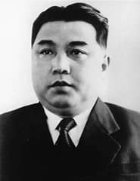
Kim Il Sung’s Juche Economy
Chapter 2 in new book on NK Economy, November 2022
Political Economy of North Korea, Chiang Min-Hua
Draws on Wilson Center Cold War Project.
Main Points
KIS inherited relatively industrialized economy in 1945. With much help, he takes it on bumpy downhill path until he dies in 1994, on verge of great famine.
Initial socialism brought in by Stalin’s red army. Korean War led to KIS full acceptance of strong central planning.
Constant large-scale aid from outside. Political or strategic aid, not aimed at true development needs. Case study in “immiserating’’ aid.
Big problems, to this day, dual “ration” prices versus “market” prices and state collective ownership of all “means of production”, including farms.
Conflict between socialism and “self reliance” at national and personal levels.
“Farmers’ markets are the death-knell of socialism. Someday they will be eliminated.” 1969

Slide 16
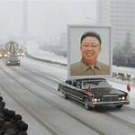
Kim Jong Il’s Economy
The Arduous March
Faced with collapse of Soviet Socialism and its preferential trade with NK and with China’s turn to markets, he fails to respond.
-- Massive famine. The command economy breaks, industry collapses, PDS fails, won notes replace rations. Foreign commodity aid pours in.
-- NK won inflates and US dollars and RMB seep in creating mixed economy. Markets expand at expense of state-owned enterprises. Corruption rampant.
-- Despite famine, no reform of collective farming.
-- Nuclear developments, including collapse of Agreed Framework, create severe international sanctions. China is only real partner. Dominates NK trade.

Slide 17
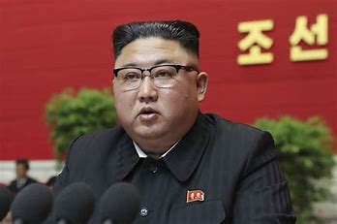
Kim Jong Un 2011-Present
Third son
Competitive, Risk Taker
Likely learned from father’s bout with financial panic, inflation.
Well trained, Swiss schooling
Liberal leaning ?
Chonan sinking?
See Jung Pak’s book.

Slide 18
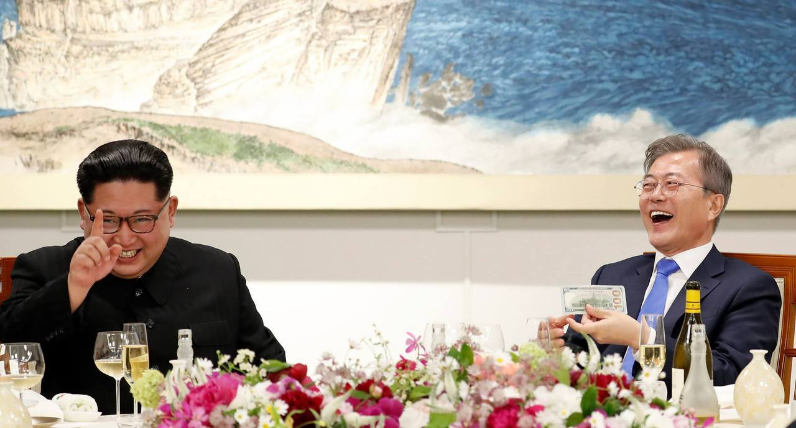

Slide 19
Kim Jong Un’s Half-Step Financial Reforms
Allowed foreign currency to circulate at will.
As in other dollarized economies, this dampened inflation.
Creates new “good” for citizens to use their won to purchase.
First time NK people had a financial savings vehicle—US dollars. Private savings must have soared, stopping inflation.
Encouraged factory autonomy, gave them pricing and production authority. How much is open to question.
Market pricing would increase productivity, dampen inflation by creating new products. Especially in tech sector.
New Central Bank law in 2015 gave CB authority for exchange rate and loan activity, not Finance Ministry.

Slide 20
But reform not extended to farmers and state employees—most of the population
Pilot program aimed to decentralize farms stalled out.
Many state enterprises excluded, required to support Plan.
State set prices for key goods, like electricity, remained far to low.
Most importantly, without property rights, private savings flowed to US dollars and yuan cash and not to productive investments. Exception was small scale entrepreneurs, donju, and housing.
Macro-economy thus shifted from (state) investment-led to (private) consumption-led. No increase in aggregate demand so no inflation.

Slide 21
And dual wages system exploded, leading to massive state corruption.
Most critically, state wages remained at fixed low rates while market, productivity related wages, soared.
State wages set at 3-5,000 won per month, with declining value of ration perquisites.
Private wages soared to 300,000 won per month with no ration privaledge. Investors could make much more.

Slide 22
Whatever they did, It worked to stabilize the won.

Slide 23
Then came sanctions and coronavirus
North Korea normally runs $500 million per-year in observable goods trade deficit that is probably offset by an equivalent services/transfers surplus. So current account is normally balanced.
But in 2017, collapse in exports to China led to $2 bn/ year goods deficits and thus a large current account deficit financed by an outflow of dollars and yuan Tight money policy would have required CB to reduce circulation of won to compensate, keeping won rate even.
By 2020 imports also collapsed, due to border closure and likely lack of hard currency funds or credit. So current account was again in balance. Continued tight monetary policy , however, caused won to reverse course and rise in value as economy fell into deep recession.

Slide 24
Basics, Is North Korean Won Really Money?
Medium of Exchange.
But state planning system and rations still exist on a large scale, especially in state employment and enterprise sector. Money usually works but often you also need a permission slip.
Measure of value, Numiere.
This is a big problem since it seems there are at least two prices for everything, state set price or value and market value.
Store of Value
This is what is changing, fast. Rations had no store of value, nor did inflation prone won. But dollars and yuan have store of value and are lending stability to won, making savings possible. A very big change.

Slide 25
History of Money in Korea: More sophisticated than we usually think.
Ancient Korea had sophisticated copper coin system using Chinese and Korean coins. Values often linked to rice and cloth by the King for tax purposes. Korea also probably used Chinese paper or fiat money long before West, but Kings inflated it away.
This degenerated in late Chosun Dynasty into a dollarized system much like today’s North Korea and for the same reasons. Poorly developed credit system unlike Japanese banking system. Ruling classes afraid ordinary people would use money, credit to buy their farms. Extensive curb market using pooled resources. Pawn shops created collateral.
Japanese era—Japanese, Korean banks and yen currency, well advanced.
1945-1993: Kim Il Sung socialist ration system replaced money by 1956, centrally commanded economy, multiple devaluations, huge drop in productivity, aid dependent, famine
1994-2010: KJI mixed ration-won money economy, hyperinflation, dollarization

Slide 26
Types of Money in circulation
North Korean Won
Largest notes 5,000 w (about 1 US$) cash denomination
Electronic debit card bank accounts
Use for government payments, wages, small purchases
North Korean Don-pyo
5,000 won only exchanged via FX.
Like FTC or military scipt
Chinese yuan
Used in markets for imported goods
1-100 Yuan notes (max about $15)
US Dollars
$100 max, Used for major purchases
Inter company payments
Some government fees
Other—phone money etc.

Slide 28
How Did Central Bank control the Won?
Dollarized economy creates huge constraints on monetary policy, much like currency board system.
In order to stabilize won, CB may have set an extremely tight monetary policy, restricting new loans to state enterprises and not printing new currency.
And the Finance Ministry thus may have required a very tight fiscal policy since CB would not finance new debt.
This would have shoved the economy into recession by 2017.
Evidence is observed shortage of won cash in markets, money “cleaning”, attempts to issue bonds, and fee increases by state organs.
State budget shows only a tiny increase in 2021-2 government budgeted expenditures, despite ambitious plan goals.

Slide 29
China-North Korea Trade Jan 2015-July 2022 China Customs (excludes Chinese crude oil exports)
Tight UN Sanctions

Slide 30
China Trade Surplus with North Korea Jan 2015 - July 2022 China Customs (excludes crude oil)
Conjectured non-trade net income

Slide 31
North Korea Won per US Dollar September 2020-August 2022 Asia Press (border towns)

Slide 32
North Korea Won/China Yuan Sep 2020 – Aug 2022 Asia Press (border towns)

Slide 33
Yuan/Dollar Pyongyang Cross Rate vs international rate Asia Press
Fed Reserve

Slide 34
Conclusion: Kim’s singular achievement is in danger.
Kim’s singular economic achievement, exchange rate and price stability, is in big danger with potential to disrupt the political and economic system. Inflation and money theft does that.
Tight monetary policy has pushed economy into severe recession.
Public has much more power than in previous regimes given their private holdings of foreign exchange, yuan and dollars. State has less control.
State budgets and wages are severely constrained due to need to protect won against circulating dollars and yuan.
Textbook solution is to sell state assets to private sector thus easing budget constraint, while raising state salaries, increasing prices of state supplied goods, and allowing property rights to encourage private sector productivity.
This could be done even in UN Sanctions environment.

Slide 35
Reform then Open
Chinese Construct, the order is important.
Reform in NK context means:
Unify price and wage system
Establish some private property rights
Decollectivize agriculture
Create new money and banking system, using interest rate to encourage private savings and direct investment to best uses. (SK model)
Raise pay but shrink size of huge bureaucracy and military
Privatize significant state assets including major factories.
Establish tax system and transparent budget.
This could put economy on moderate growth track, without foreign opening.
Reform then leads to Opening, and massive engagement with rest of world. Breakout economic growth would ensue.

