Slide 1
Happy is the After
Home Staging and Interior Restyling
It’s not just a restyle, it’s a lifestyle.

Slide 2
The Steps to Restyling
Step One
Have nothing in your home you don’t know to be useful or believe to be beautiful.
William Morris
Enter the room you are wanting to restyle and take notice of the FIRST thing that catches your attention. Is this feature a positive or negative in your space? Make this your number one priority when redoing your room. Also, know what function you want your space to provide. Is it for entertaining? Family game and movie night? Continue making notes of your space, jotting what you love and what you don’t love. You may know you don’t like the space but can’t pinpoint why. This list will help you narrow the reasons down.

Slide 3
Step 2 of Restyling
Shop Your Home
Go room by room, making notes of the different furniture and/or accent furniture you have. There may be a chair in your master bedroom or a piece in a guest room that would work in your restyling. Try to look at your furniture in a new light. This includes area rugs and art as well! Always “shop your home” before actually going shopping. You can save a ton of money this way.
Note: People get used to a piece being in a certain spot and feel the need to go shop for furniture when they may have a piece they can utilize in another room.
Notes:
Note: People get used to a piece being in a certain spot and feel the need to go shop for furniture when they may have a piece they can utilize in another room.

Slide 4
Step 3 to Restyling
Clear out as much furnishings, accessories, and ALL clutter from your space. Start out with a blank space (canvas).
When deciding whether you should keep an item or not, consider the following:
  Is it functional or needed in the space? Does it fit in your new design?
  Has the item been used in the past year?
It’s ok to have quite a bit in your storage bin, it can be hard to let go of things!

Slide 5
Step 4 to Restyling
When deciding where to place furniture, here are a few helpful hints:
Wherever your focal point is, that’s where your conversational area should be.
Make sure there is nothing blocking your focal point or walk ways in the room.
3 of the best floor plan shapes is the U shape, Square shape, and L shape.
Side tables should have no more than a 2 inch height difference, either higher or lower, than the arm of the chair or sofa.
Coffee tables should be 16-20 inches away from the sofa
There should be no more than 8 feet between conversation pieces.

Slide 6
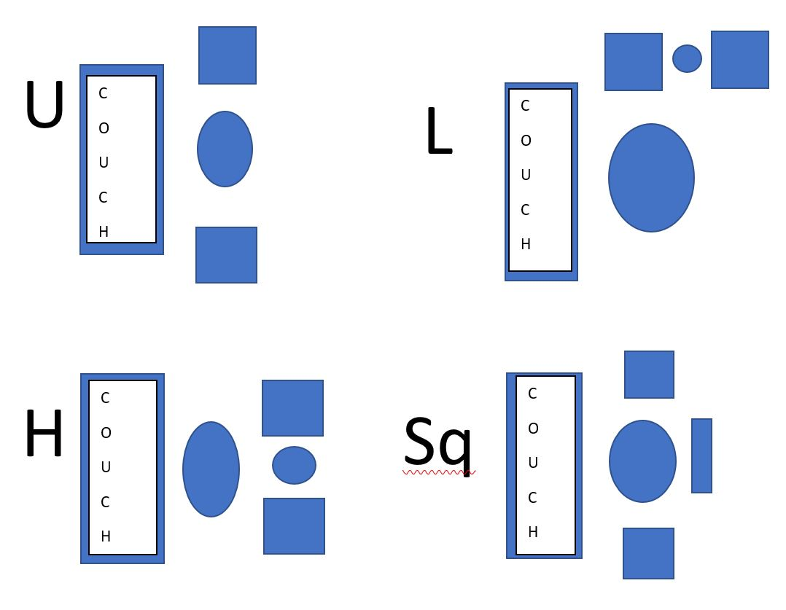

Slide 7
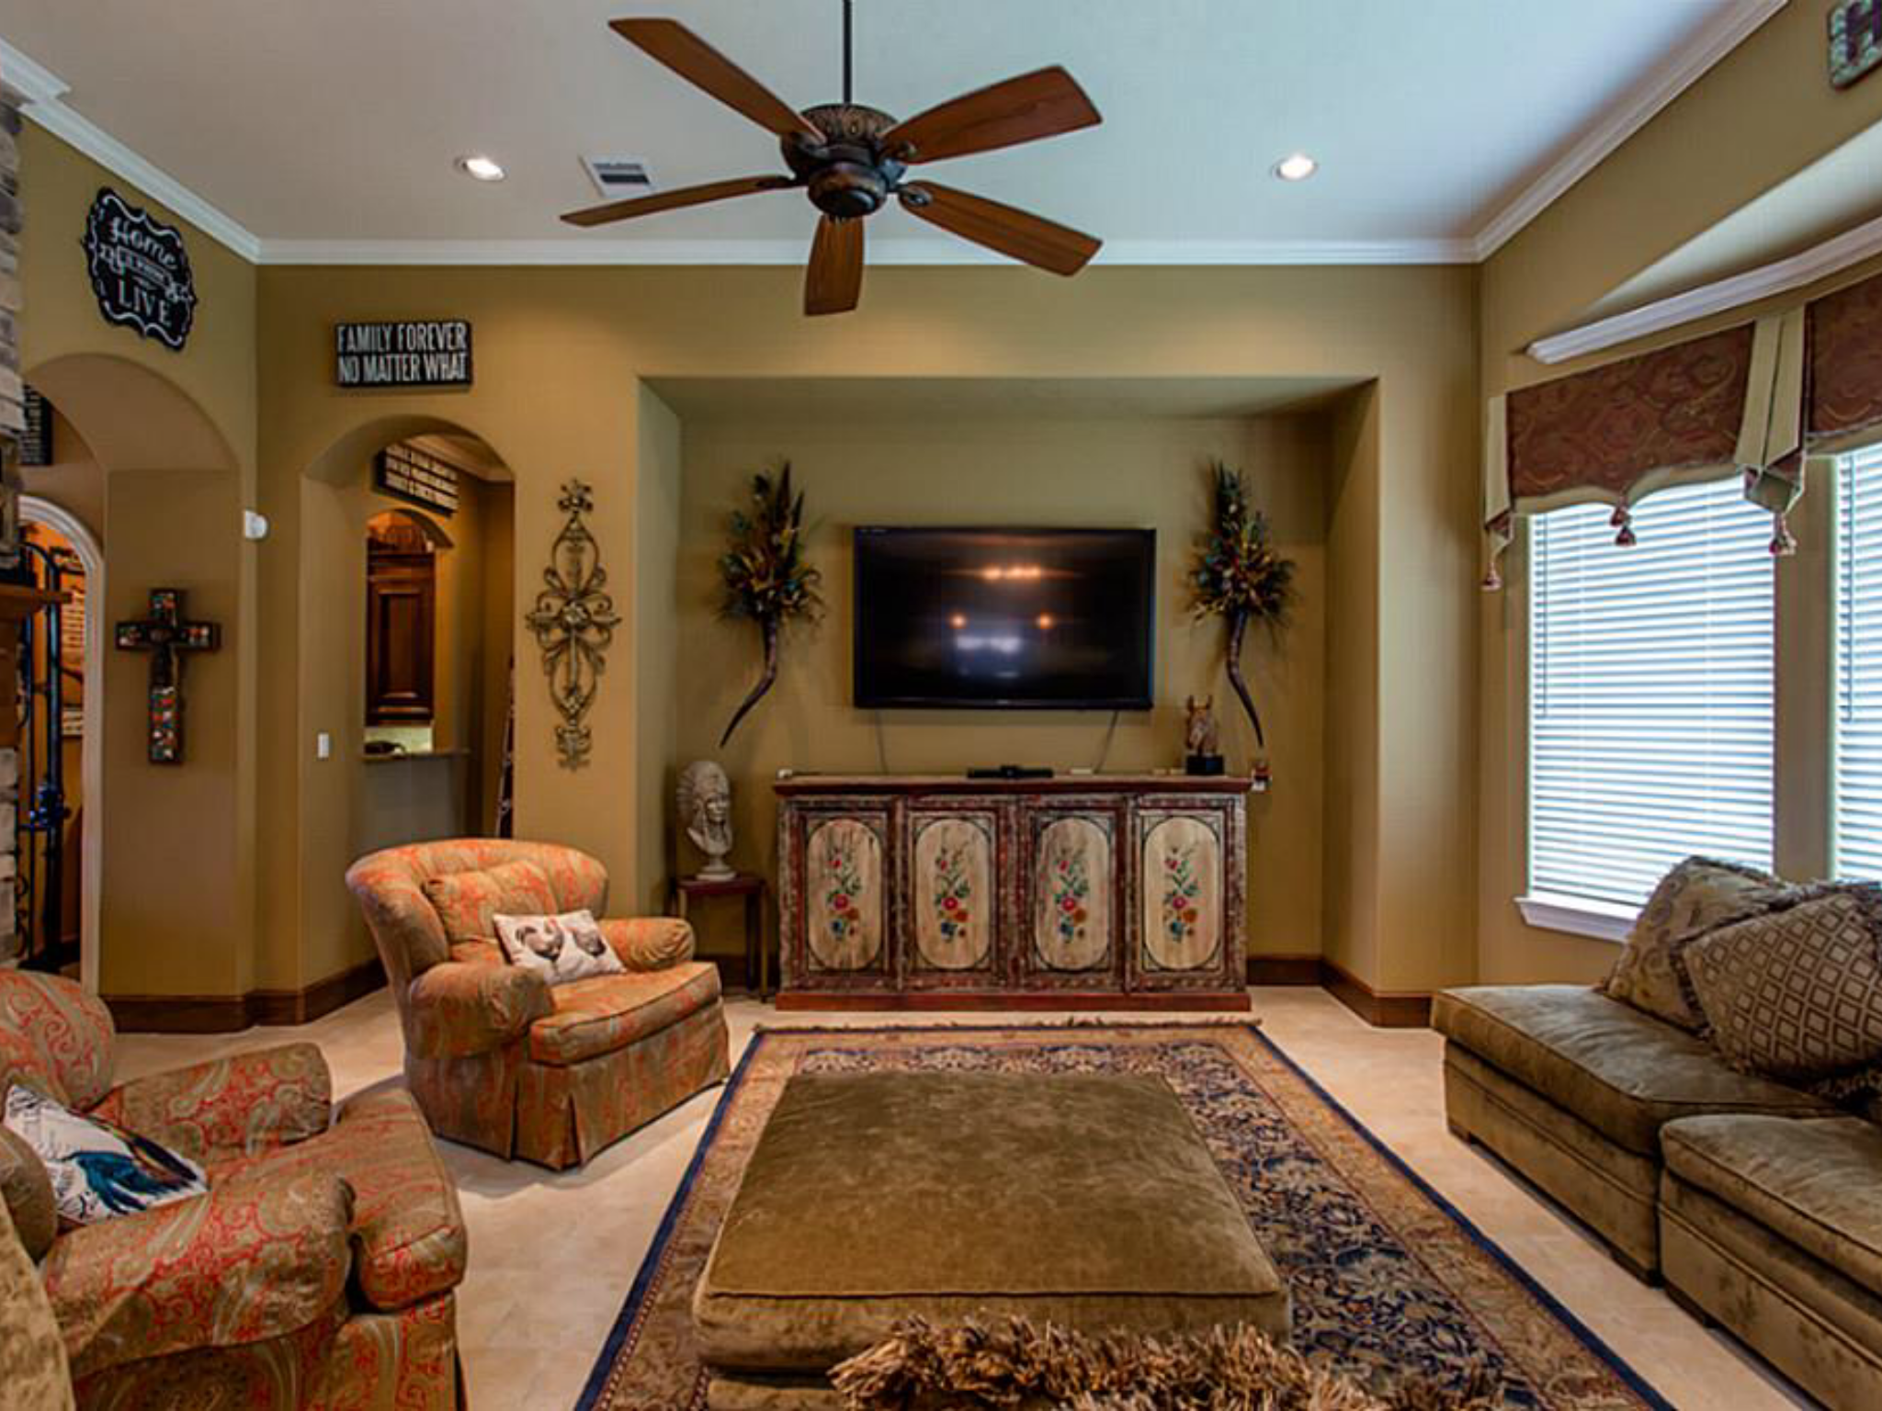

Slide 8
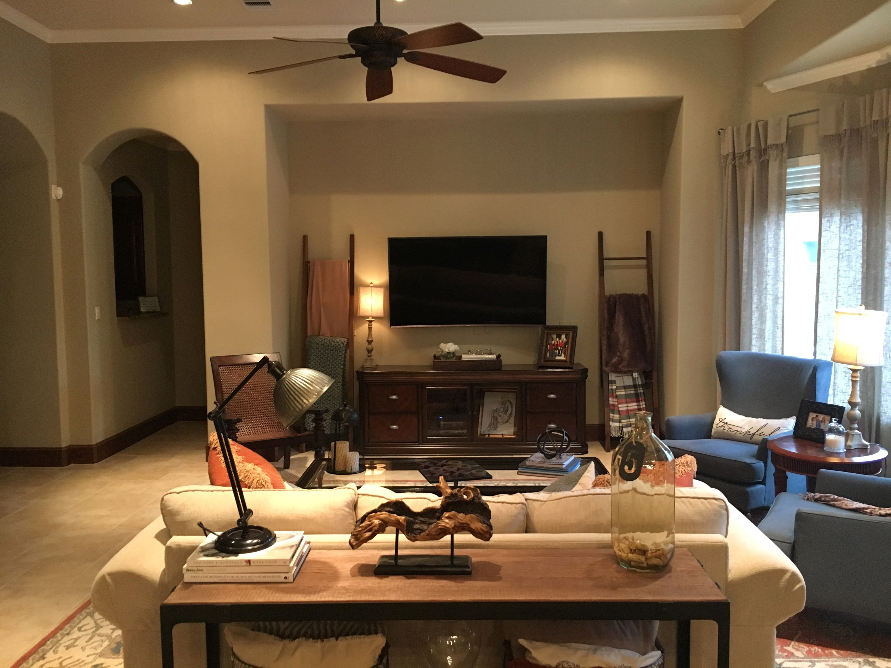

Slide 9
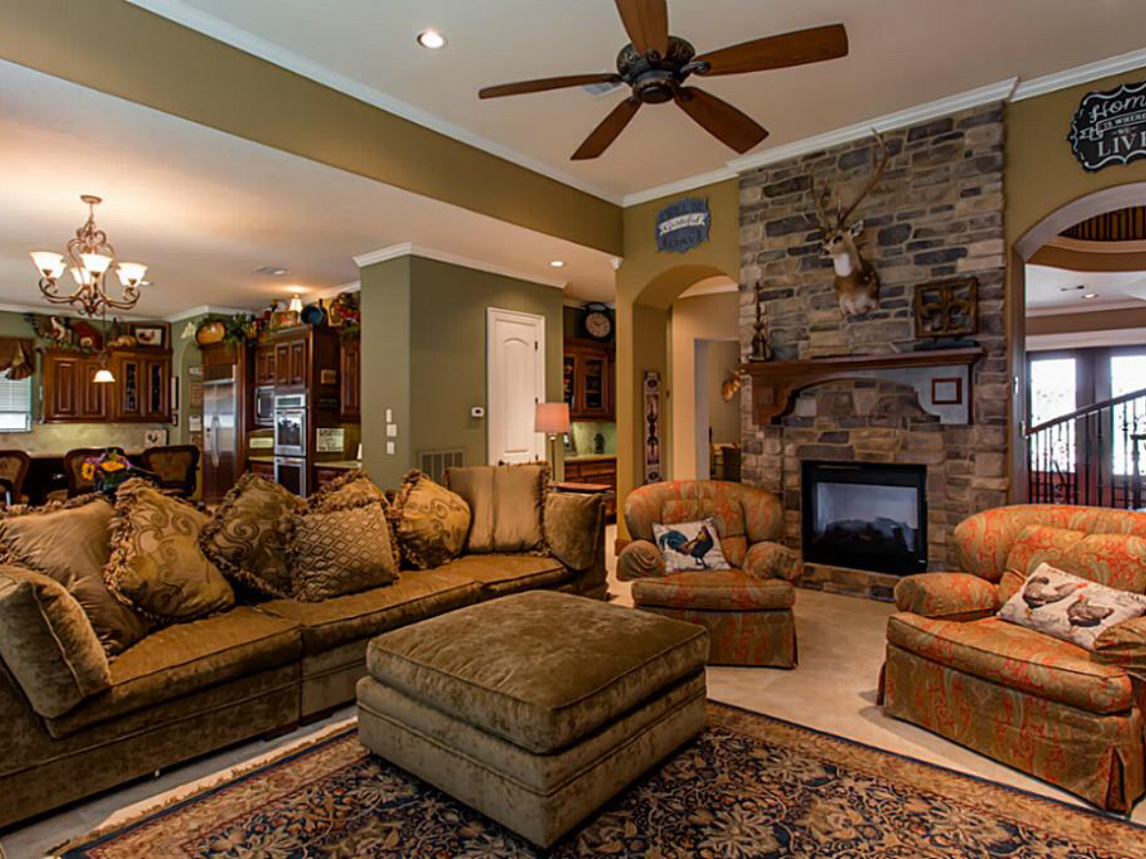

Slide 10
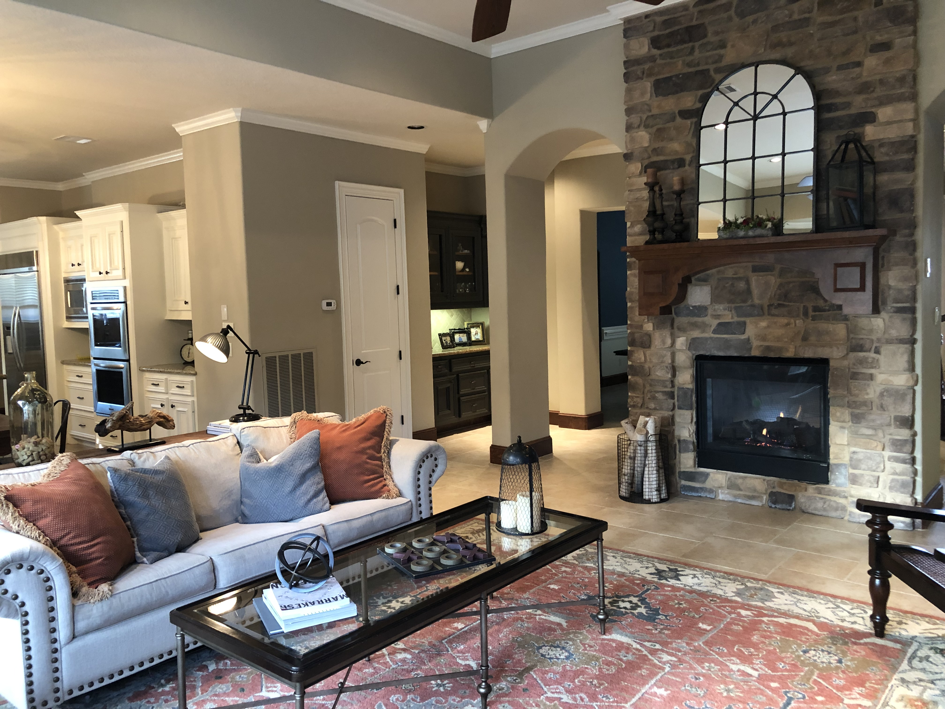

Slide 11
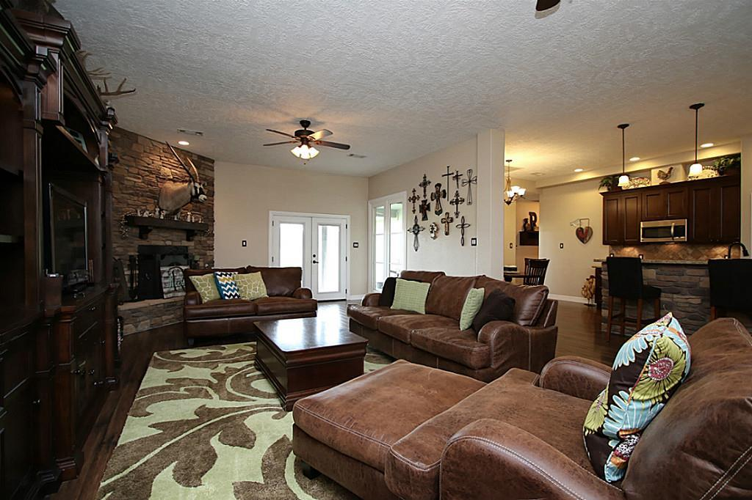
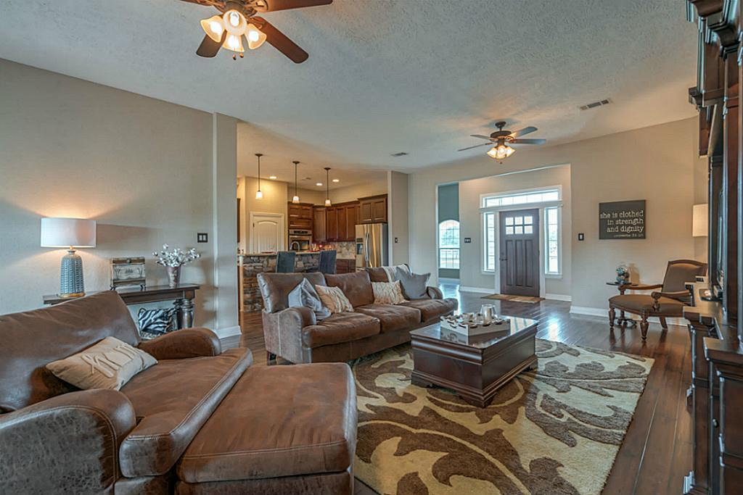

Slide 12
Stage 5 to Restyling
You have shopped your home, placed your furniture in the room, now it’s time to pull it together.
Tips For Accessorizing
Sometimes more is just…more. When accessorizing, less is best. Go with pieces that you love or mean something special to you. When you have a piece you love, try to place it by itself so it doesn’t get lost within the other accessories. If it’s a larger piece, place it on a shelf by itself; smaller, elevate it by placing it on top of a few books lying vertically or on a decorative box. Special pieces also can serve as great conversation pieces in your room.

Slide 13
Accessorizing Continued
Odd numbers are visually pleasing to the eye. Place objects in groups of 3s 5s and 7s. Within those groups try to have different shapes, sizes, and heights.
Investing in large coffee table books is never a bad decision. They never go out of style and you will use them time and time again.
Bring life into your space with greenery; LIVE greenery.
Make sure to use different textures. Wood, fur, and metal look great together. All one texture can make a room look cold (too much metal) or two dimensional (flat).

Slide 14
Tips for Styling Bookshelves
When styling bookshelves, consider the following:
Place large items on shelves first and usually by itself.
Place books vertically and horizontally
What ever you do on one side, replicate on the other shelf; balance is key.
If you have a certain color, use that color at least 3 times
Add depth. Have some pieces forward while others are toward the back.
Add family photos
If possible, add lighting above.
Remember, less is best!

Slide 15
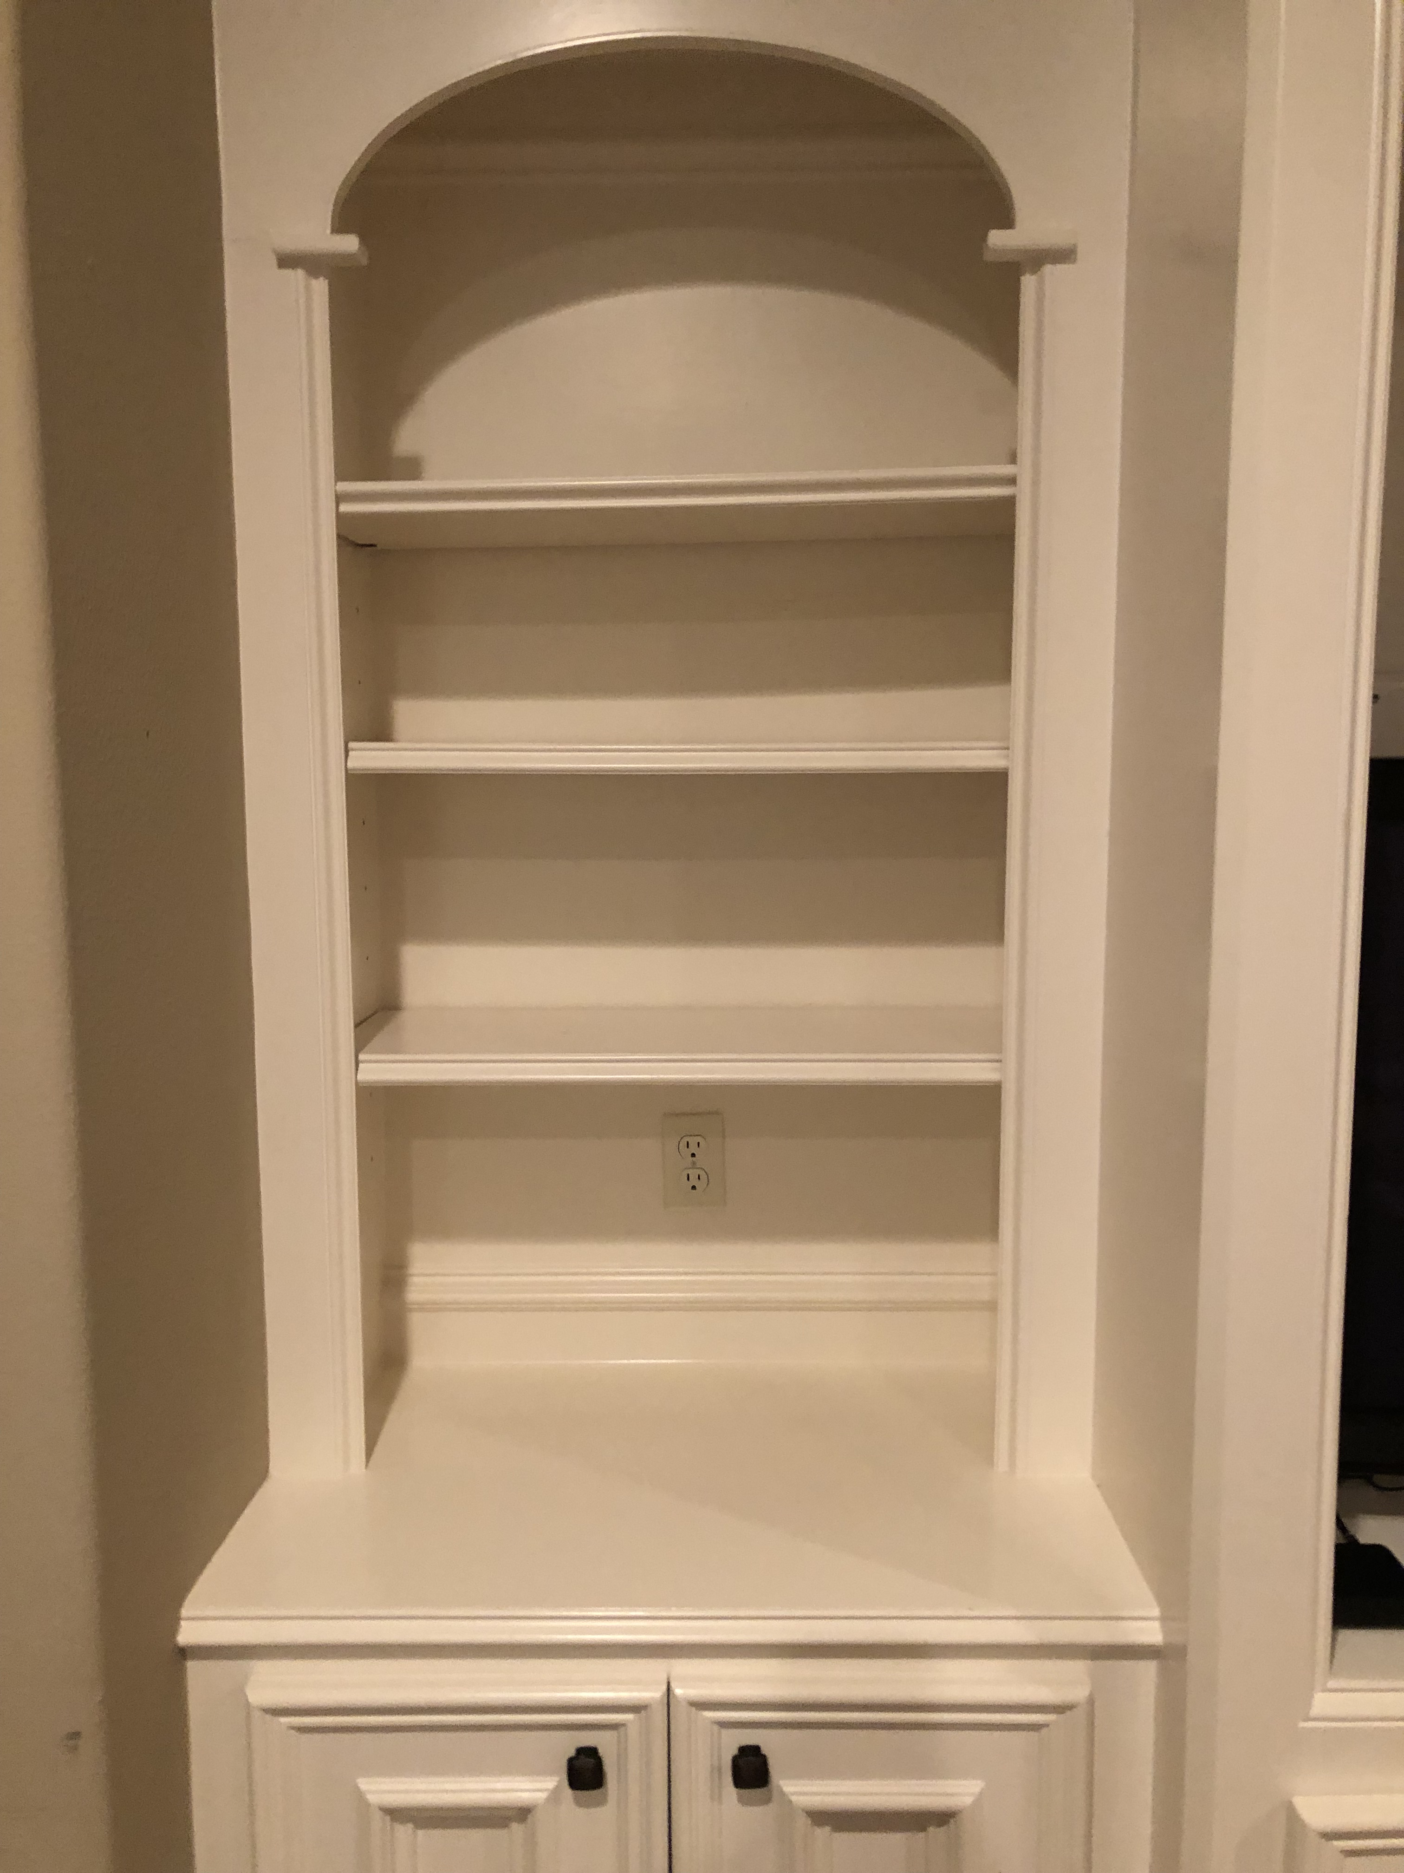

Slide 16
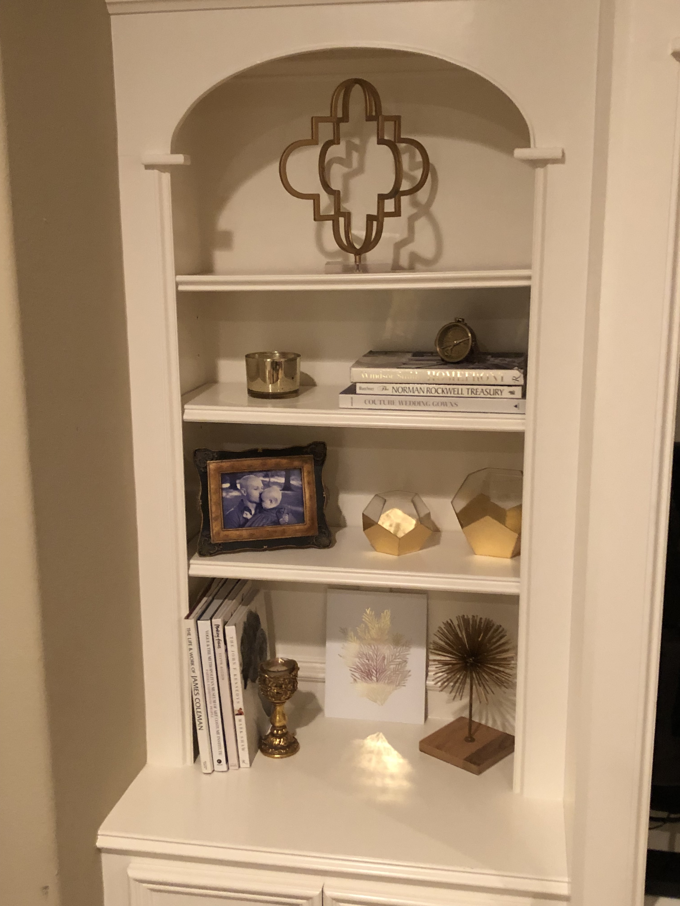
Use the same color at least 3 times.
Decorate using odd numbers.
Largest item by itself.
Different shapes and heights.
Books are vertical and horizontal.

Slide 17
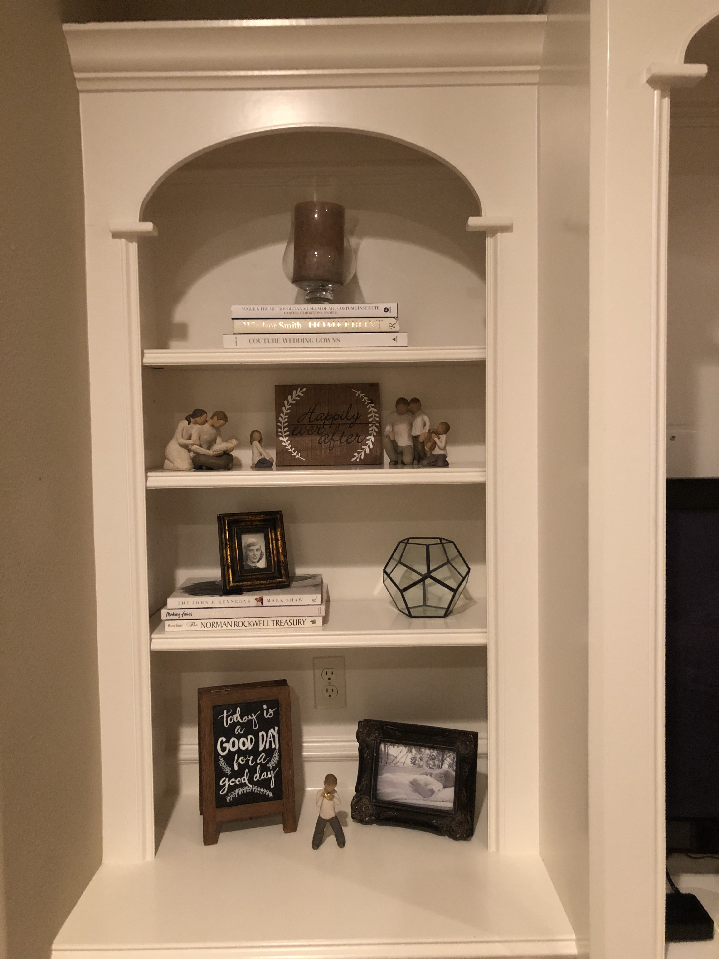
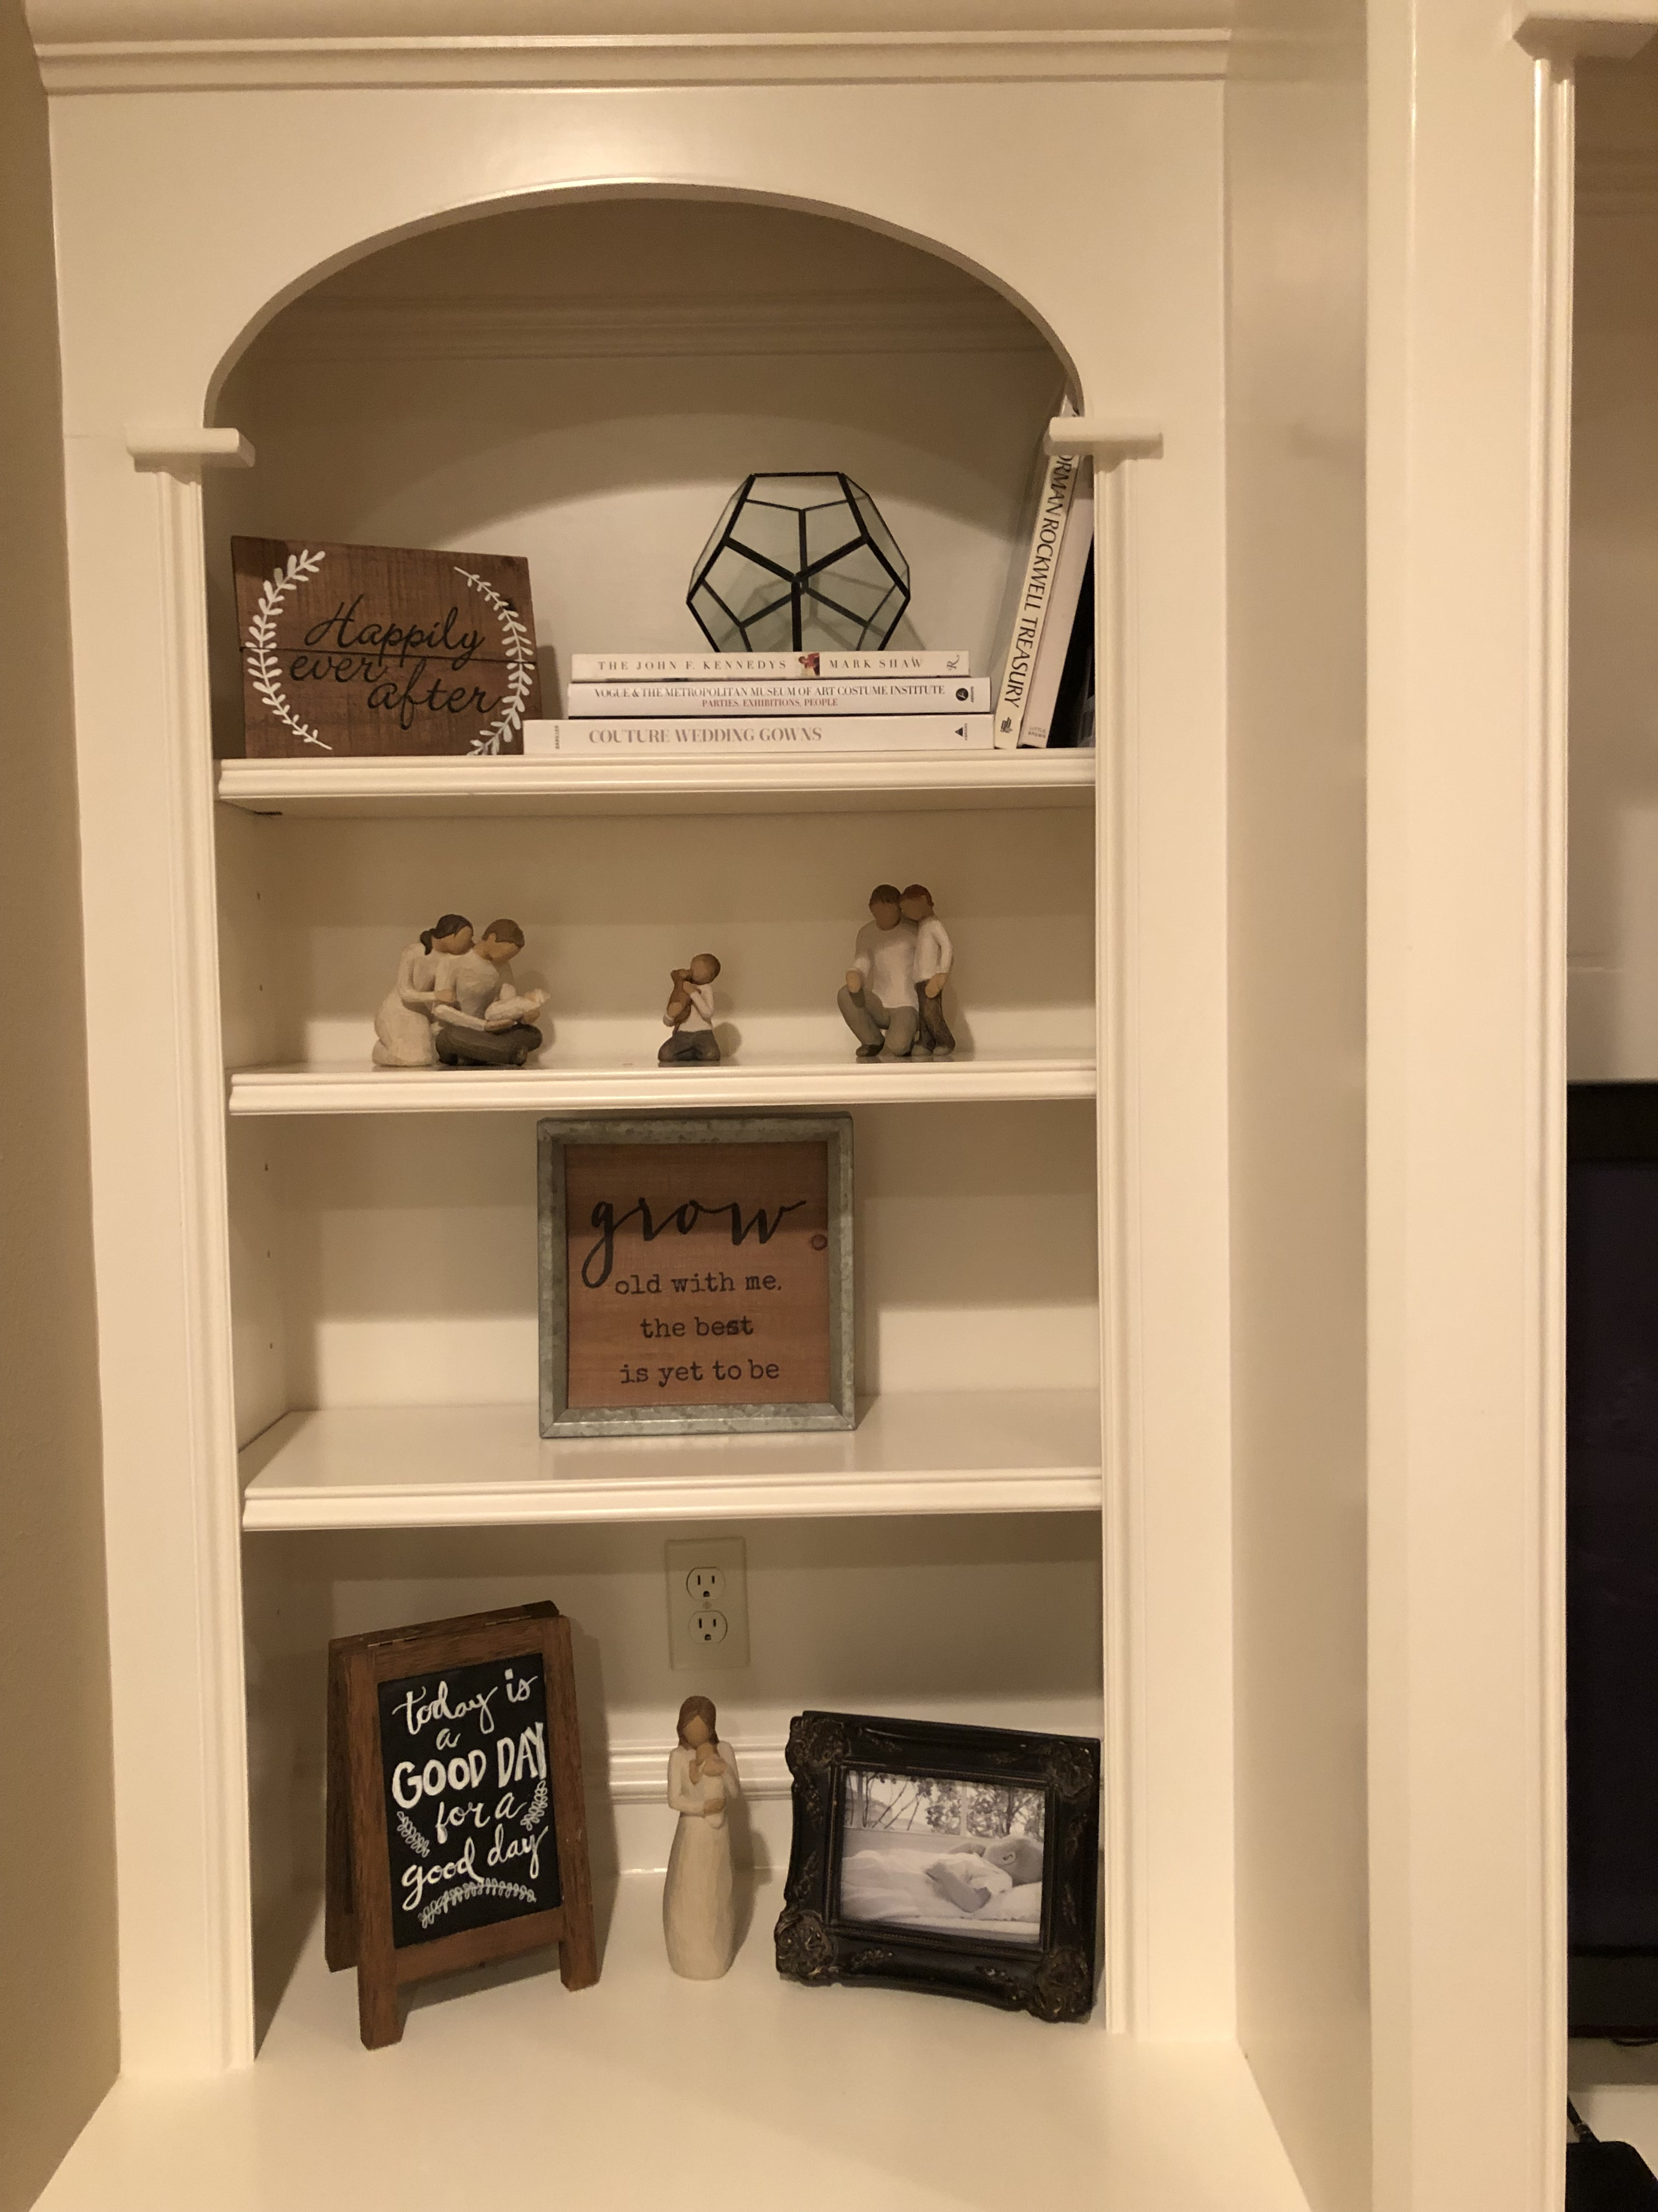

Slide 18
Emotional Connection Points
ECP are areas that bring about a sense of warmth and comfort subtly. It makes you feel like you are surrounded by things you love.
ECP is that one area in a room that is “yours”. Whether this is in your bedroom or living room, it’s your space.
Have your favorite throw blanket hung over the back of your chair.
Your side table has items on it that you LOVE. To bring emotion into a space incorporate personal items!
A lamp, either table or floor, provides you with soft lighting.
ECPs are what makes a room welcoming and makes people want to stay in that room!

Slide 19
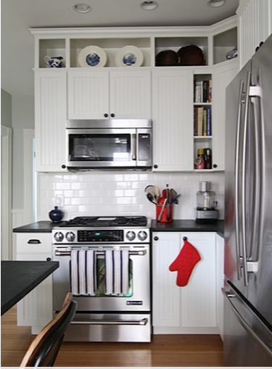
Inexpensive Refreshers
Paint! Repaint kitchen cabinets, hardware, and fixtures.
Take cabinet doors off and create open shelving
If you have open space above kitchen cabinets, add box cabinets

Slide 20
Refreshers Continued
Recover your kitchen chairs
Add glass fronts to a few of your cabinets
Slip cover your couch and/or chairs
Add new pillows
Paint the back wall of your bookshelf
Add crown molding. The MDF molding is a lot cheaper than the wood.
In the bathroom, frame out the mirror and change out the lighting.

Slide 21
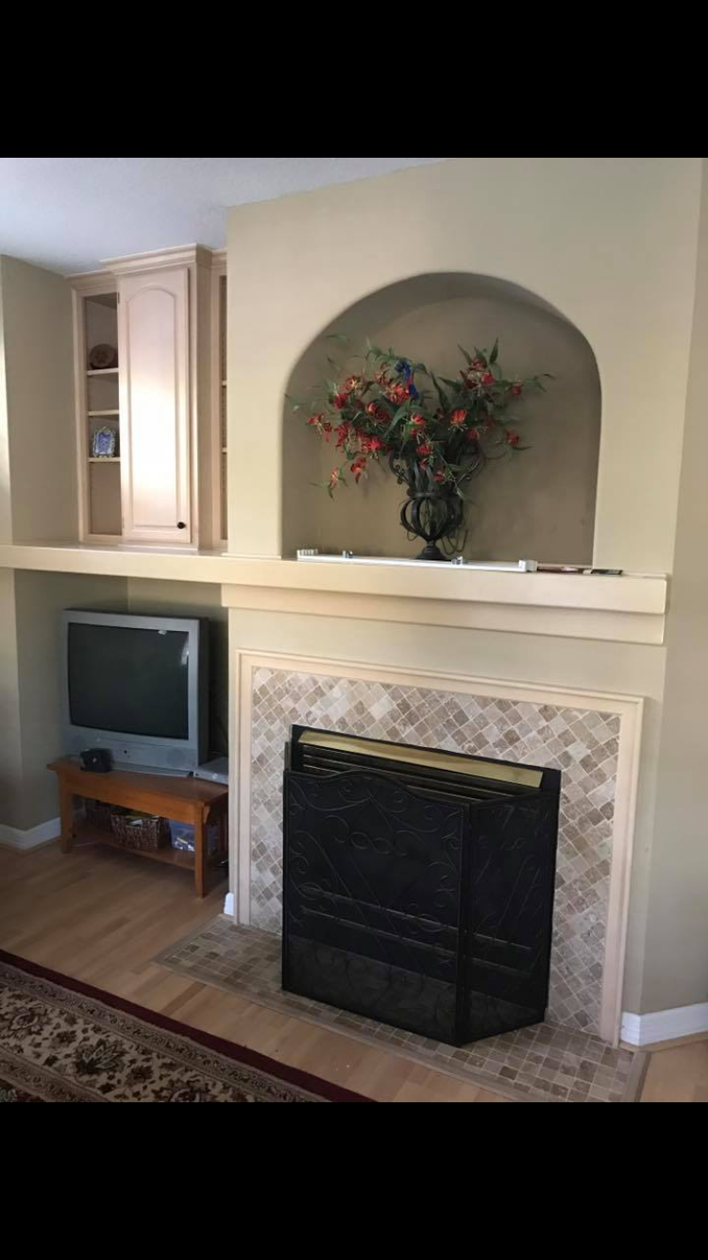

Slide 22
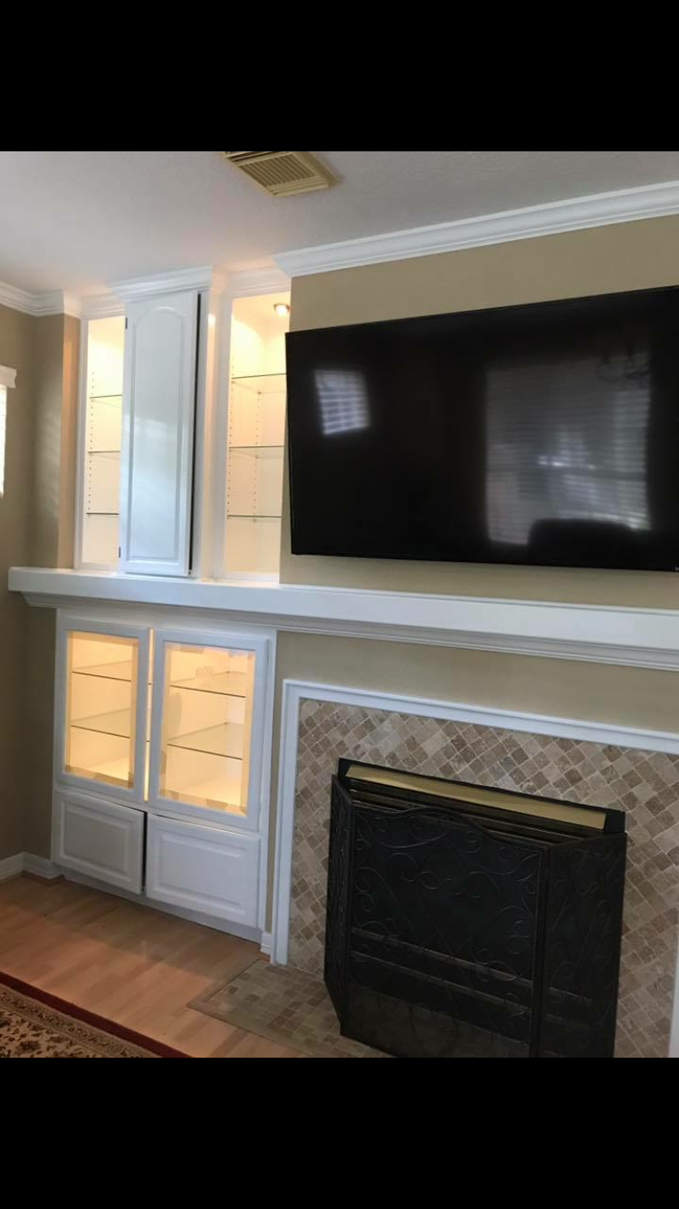

Slide 23
A Few Staging Tricks
Kitchen
  Create a vignette ( a small grouping of objects that create a pleasing focal point). A tray with a coffee mug, a container for coffee, a little towel, small plant, etc. looks great!
  Open a cookbook on a cookbook stand and place by prepping area.
  Only have 2-3 appliances out on your counters.
  You don’t have to decorate every surface in your kitchen.
  Don’t place your accessories or vignettes in each corner of your kitchen counter space.
  Don’t place your accessories in a straight line or by its lonesome.
  Table cloths visually eat up space!

Slide 24
Remember
It takes a while to create a space. Know that it’s not going to be magically transformed overnight, but by beginning the restyling process, you’re that much closer to getting the look you desire!
Don’t rush to buy something to fill a space. Buy it right the first time and you’ll only buy it once!!!
Function of the room should always take precedence over form (space).

Slide 25
Popular Go-To Paint Colors
Repose Gray
Mindful Gray
Kilim beige
Wool Skien
Sea Salt These paint colors are from Sherwin Williams.
Agreeable Gray
Anew Gray
Windsor Greige
Notes:
When trying to find a color, paint a sample on EACH

Slide 26
Happy is the After
www.happyistheafter.com
happyistheafter@gmail.com
281-450-6327
Like us on facebook!

