Slide 1
Beyond the Query Letter:
Finding an agent through conventional, and not-so-conventional, methods.
Carrie Howland
Literary Agent and President
Howland Literary, LLC

Slide 2
More and more authors are finding literary agents through unconventional methods like online pitch contests, twitter, blogs, and other social media platforms. In this talk, we’ll explore the many new and exciting ways to successfully find and pitch an agent.

Slide 3
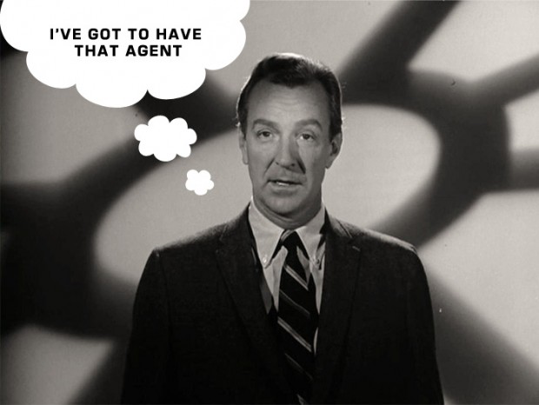

Slide 4
The Query Letter

Slide 5
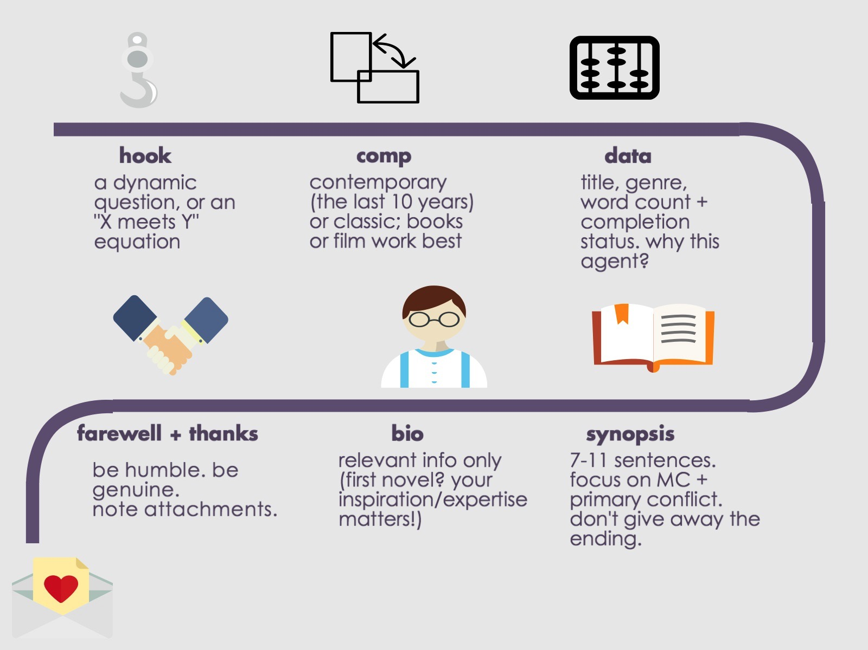

Slide 6
Query Letter Tips
Check Agent/Agency Guidelines
Be Brief (No more than a page!)
Personalize
Check for: names/spelling/what the agent represents
Don’t: be gimmicky/mass email/be pushy
“You get comps with a little help from your friends.”
Remember: this is a business document

Slide 7

Any Questions…
about the query letter?

Slide 8
Traditional
Querying Methods
Research!
Your favorite books
Databases:
  SCBWI: www.scbwi.org
  The Association of Authors’ Representatives: www.aaronline.org
  Poets & Writers Literary Agents Database: www.pw.org/literary_agents
  Publishers Marketplace: www.publishersmarketplace.com

Slide 9
Non-Traditional
Querying Methods

Slide 10
Manuscript Wish List
    Answers the question “What do publishing professionals wish they had in their inbox?”
    Agents/editors list what they’re looking for, so authors can find a match for their work.
    Search by agent/editor/genre/keyword
    Website: http://www.manuscriptwishlist.com
    Twitter hashtag: #MSWL

Slide 11
Pitch Contests
    Brenda Drake, www.brenda-drake.com, @brendadrake
      Pitch Madness: writers submit pitches, top 60 are chosen to participate, agents play against each other for submissions
      PitMad: runs on Twitter as #PitMad, anyone can participate with #PitMad and #YA, #MG, #PB, according to genre (see contest schedule on Brenda’s website)
      Pitch Wars: published/agented authors, editors, or industry interns read an entire manuscript and help polish for submission.
      Full schedule with dates available at: http://www.brenda-drake.com/contest-schedule/

Slide 12
What do you mean you CAN’T get ALL this great information down quickly enough???
Don’t worry…I’ve compiled it all in a single document and am happy to email it to you.

Slide 13
Pitch Contests, continued…
DV Pit: Pitch party for marginalized authors and illustrators only.
  Held annually in April
  Children’s Fiction/Nonfiction
  http://www.dvpit.com
  #DVPit
Revise and Resubmit:
  #RevPit
  Get feedback from professional editors
  http://www.reviseresubmit.com

Slide 14
Contests and Twitter Hashtags with websites and explanations:
#PBPitch picture book authors only. More info here: http://www.pbpitch.com/
#KidPit ALL children’s literature genres (picture book, chapter book, early readers, middle grade, and young adult). More info here: https://heidinorrod.wordpress.com/kidpit/
#AdPit Adult books only. This also includes “New Adult” which falls between young adult and adult literature. More info here: https://heidinorrod.wordpress.com/adpit/

Slide 15
Twitter Hashtags with websites continued…
#SFFPit is for Science Fiction and Fantasy Books only. That’s right! This is the contest where you get to sum up all that intricate world building in a single tweet. Fun, right?! More info here: http://dankoboldt.com/sffpit/
#PitDark Caters to work with darker themes. This isn’t limited to just horror, though – dark fantasies, murder mysteries, etc. can participate. More info here: http://jasonhuebinger.com/pitdark/
#KissPit is a new twitter pitch party that is specifically for romance writers. More info here: https://allthekissing.com/kisspitch/

Slide 16
Twitter Hashtags with websites continued…(the funny ones!)
#ISWSGPit is from the creatively named “Insecure Writer’s Support Group.” Participating in some of the newer pitch parties, like this one, will perhaps increase the likelihood that your tweet will be seen. More info here: http://www.insecurewriterssupportgroup.com/p/iwsg-twitter-pitch.html
#SonofaPitch (also know as #SOAP18) allows you to tweet a pitch every hour (many pitch parties only allow two tweet pitches a day, per manuscript). There is also a three week build up to this twitter pitch party, where you can get feedback and possibly even have editors and agents requesting your work. Currently only open to YA, New Adult, and Adult novels. More about this unique pitch party here: http://kjhstories.blogspot.com/2017/01/say-what-son-of-pitch-is-back.html

Slide 17
Ok, but how do you actually WRITE a twitter pitch??
280 character limit
Always use a qualifier: i.e. #WF = women’s fiction, #YA = Young Adult, #A = Adult, #MG = Middle Grade, #SFF = Sci Fi and Fantasy This allows agents to narrow their searches, to find exactly what we’re looking for, and to be sure that YOU are being seen by the right agents!
Mix it up!! Before the pitch day even starts, make sure you’ve varied your tweets about the same book. Have approximately three different pitch options and vary them throughout the day. Don’t repeat the same pitch 8x—we’ve read it already.
A Twitter Pitch is just your elevator pitch. It’s the hook. Be sure to include the motivation, crisis and the secret.
Comp titles: these are a great, quick way to pitch your book. I’m immediately grounded in what the book is, and it takes up very few characters in your tweet.

Slide 18
Sample Twitter Pitches
*Check out Carly Watters Website for examples like this and more!
The Lion, the Witch and the Wardrobe: When escaping WWII 4 children go to magical, tyrannical land through wardrobe to fulfill prophecy & save both worlds. #PitMad #SFF
The Three Little Pigs: Brothers devoured by a killer known as Big Bad Wolf, third pig fights for his life with a pile of bricks between him & death #PitMad #A
Alice in Wonderland: Girl abducted by rabbit from family picnic to fight war in magical dimension. When put on trial for her life, will she wake up? #PitMad #YA

Slide 19
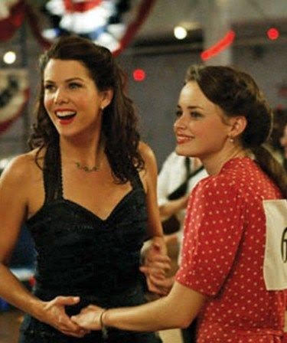
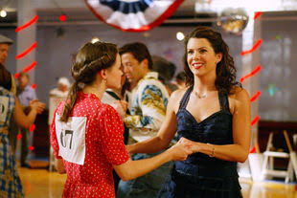
Now…grab a partner!
Anyone want to give the twitter pitch a try? Grab your neighbor—spend a few minutes working on this together! Like an elevator pitch, it helps to talk through it aloud!

Slide 20
Further Non-Traditional Sources…
  Publish your shorter work: Blogs/Websites
  Other Publications (printed/online journals)
  Conferences and Events (like…this one!)
    http://www.scbwi.org/events-home/
    Poets & Writers is a great rescouce for these
  Networking/Referrals (readings, MFA program, writing partners/friends, etc.)
  Freelance Editors (ex. Reedsy, reedsy.com)

Slide 21
Regardless of the method you choose…
It starts with the work!
  Finish and polish your manuscript before you even begin to write your query letter
  A beautiful query and all the research and twitter pitch contests in the world mean nothing if the work doesn’t hold up.
  Grab a partner! Whether that’s a beta reader or a freelance editor, we all need help and feedback for our work to ready it for querying

Slide 22


