Slide 1
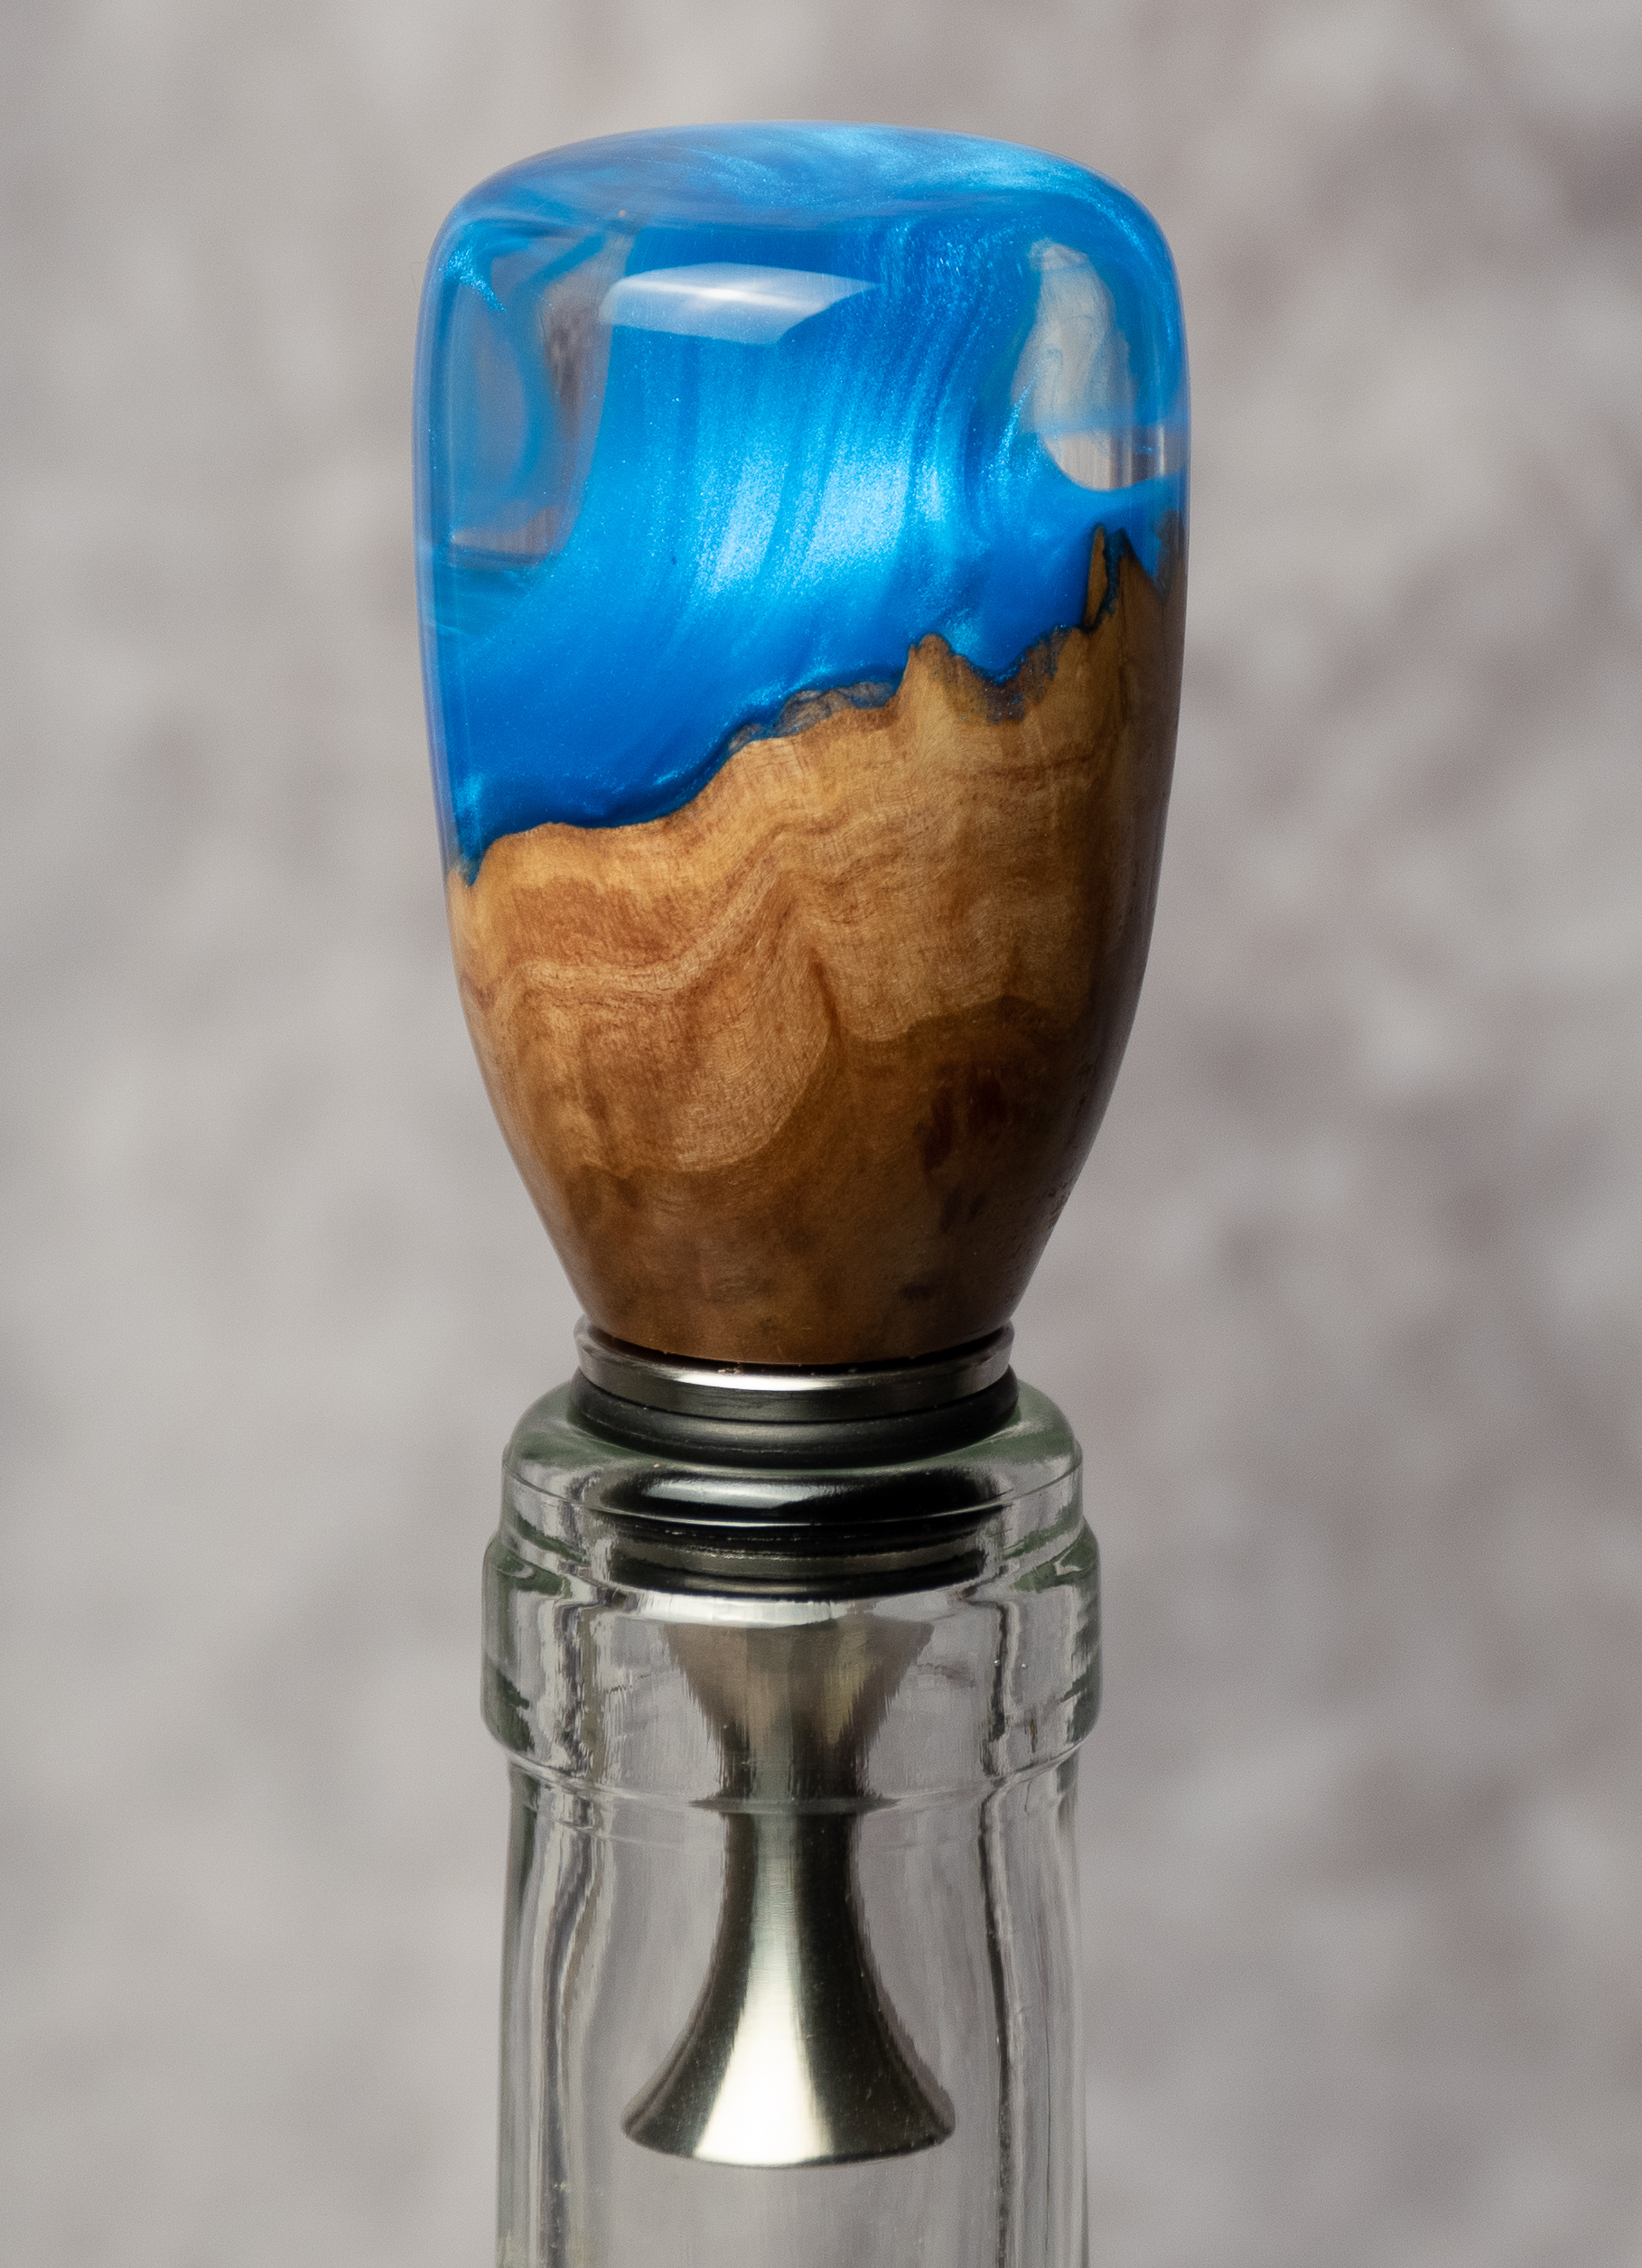
Woodturning with Resin
Making a Bottle Stopper
Notes:
Bottle stopper tree
Hollow forms

Slide 2
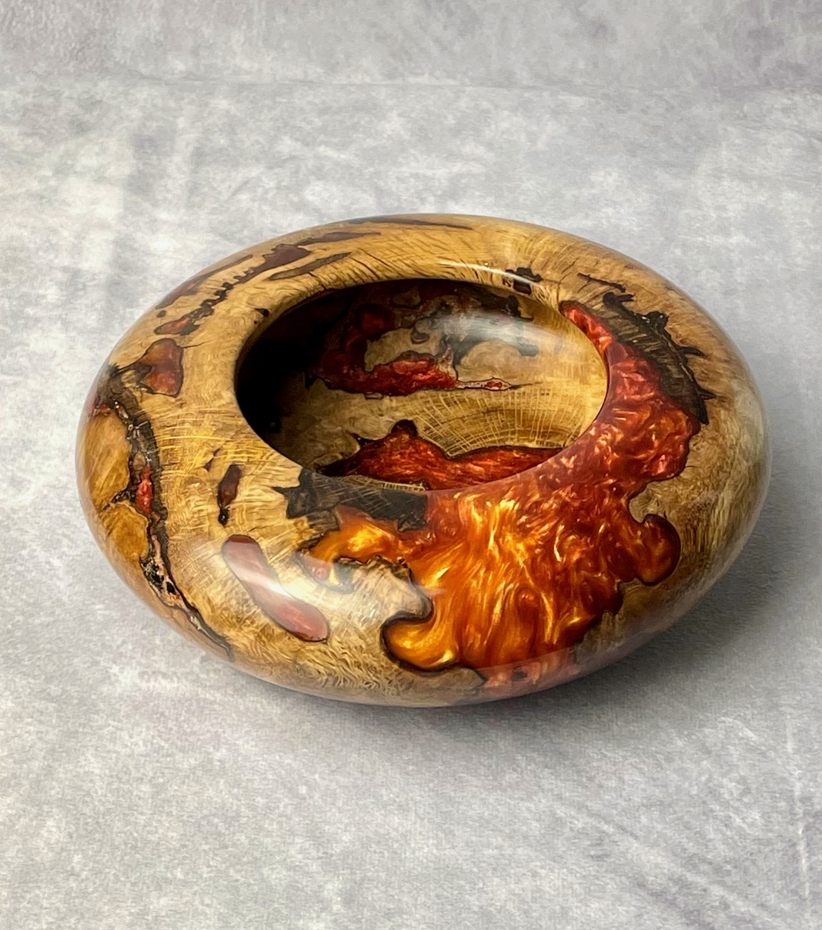
Today’s Presentation
Provide an overview and foundational knowledge of:
Resins
The process for coloring and casting blanks
How to turn a resin/hybrid piece
How to finish a bottle stopper

Slide 3
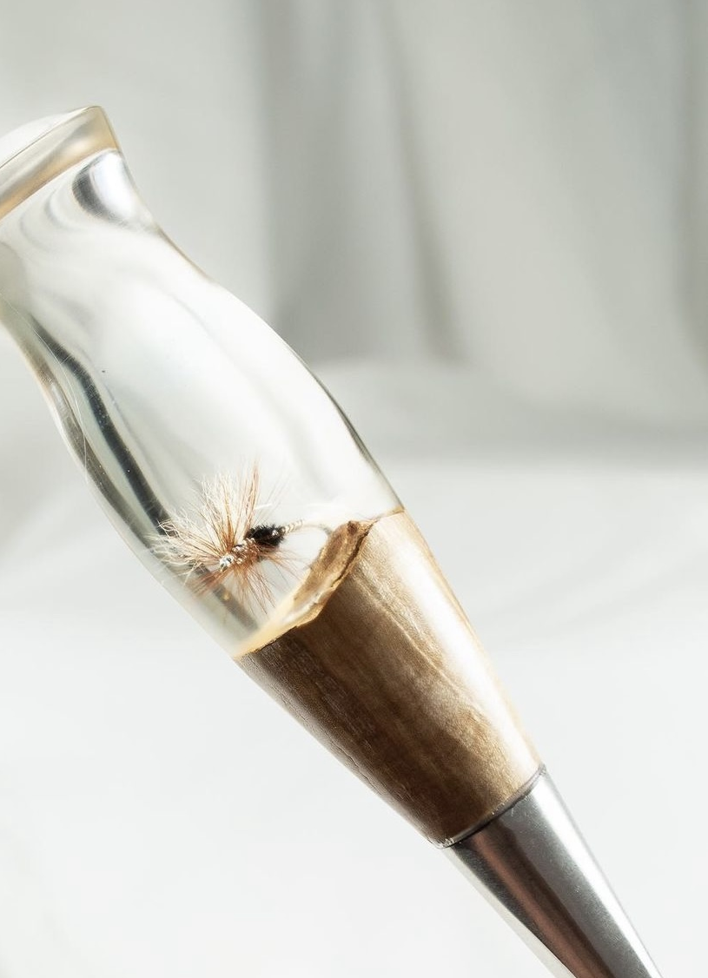
resins
Urethane vs Epoxy
Moisture Tolerance
Yellowing
Open time/Cure time
Mix Ratio
Depth
How they turn
Notes:
Jigger
Slab with bubbled resin
Cook in oven
enough pigment
Pink tee blank

Slide 4
Urethane NO moisture Short open time
CONSIDERATIONS
EPOXY Yellows
Not deep
Soft to turn

Slide 5
Resins
YouTube: Jake Thompson
Resin Shootout: Alumilite vs Total Boat vs. Liquid Diamonds

Slide 6
resins
Youtube – Alumilite Explains: How to choose an epoxy
Urethane: Alumilite Clear Slow
Epoxy:
Amazing Clear Cast and Clear Cast Plus
Amazing Quick Coat
Amazing Clear Deep Pour (2”)
Notes:
Quick coat piece

Slide 7
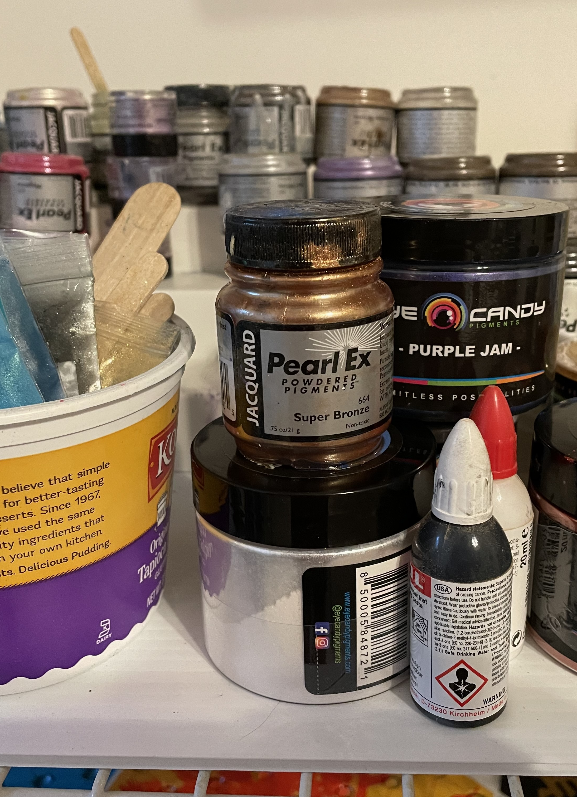
pigments
Powders
Inks
Dyes
(Pay attention to water based pigments in urethane resin)

Slide 8
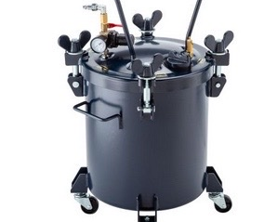
The pressure pot
YouTube Jake Thompson – Converting a Harbor Freight Paint Pot into a Resin Casting Pressure Pot
California Air Tools
5 Gallon
10 Gallon
Notes:
Pressure Pot

Slide 9
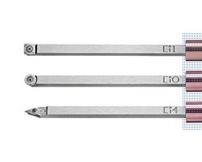
Negative rake carbide cutters
Brands
Easy Wood Tools
Savannah
Simple Hollowing System
Style
Round, Square, Diamond
Negative Rake vs flat
Notes:
tools
easy to sharpen flat
turn on side
blooper reel

Slide 10
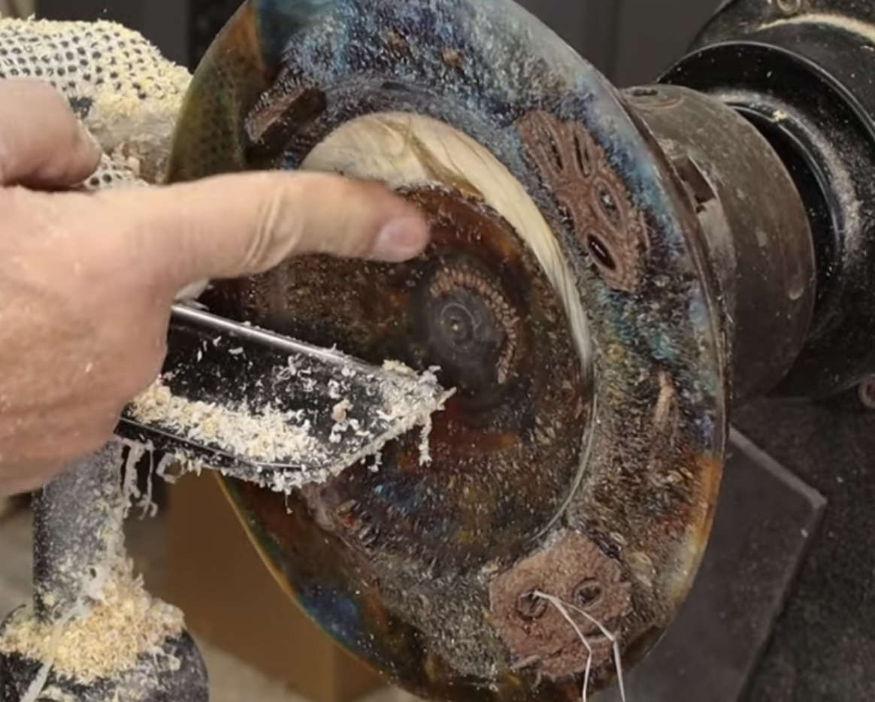
Chatter, chipping, and cracks, oh my

Slide 11
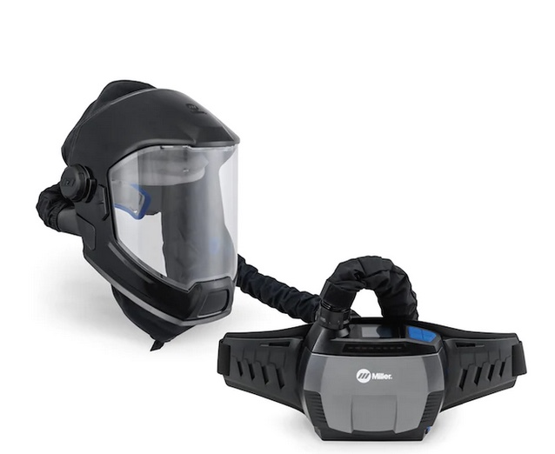
Face protection
Peke mask
3m respirator (need fine particulate protection, not fumes)
Trend face shield
Notes:
Peke mask

Slide 12
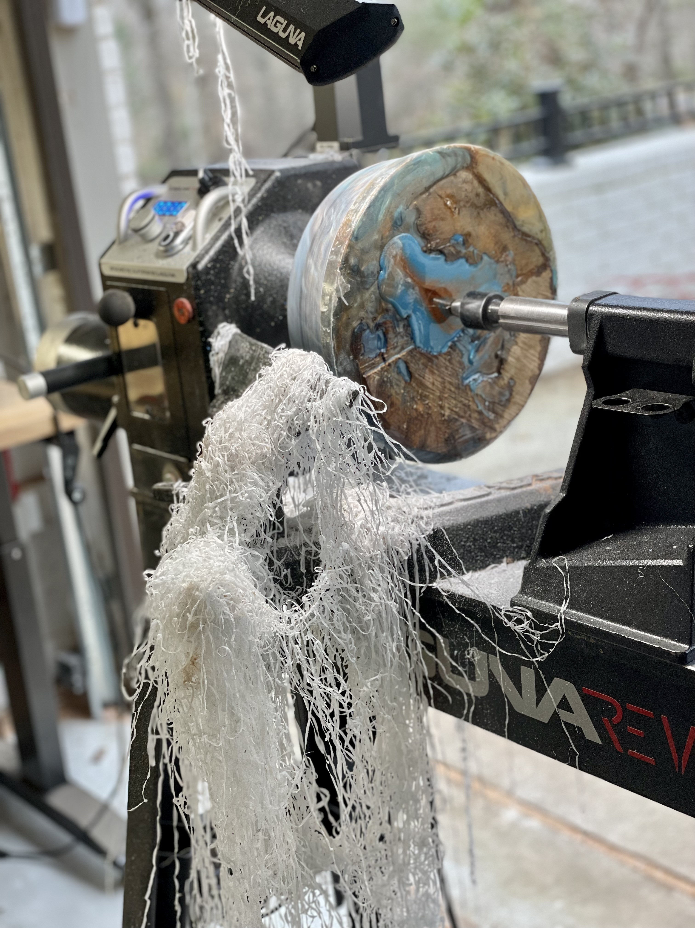
The process
Dry the wood
Put it in a form or bucket
Mix the resin and add pigment
Pour into the container with the wood
Put it a pressure pot at 40psi
Remove from pot after a few hours
Turn and finish
Notes:
Bucket w wood
Blanks
Bs blanks

Slide 13
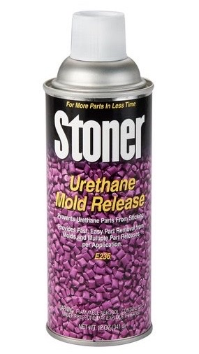
Mold Release
Stoner
Zip 301
Polytek Pol-Ease 2500
SmoothOn Universal Mold Release
Notes:
Stoner

Slide 14
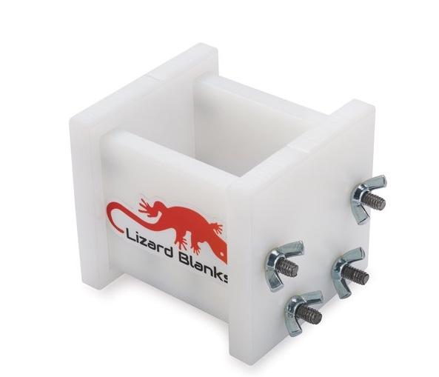
Bottle stopper blanks
Lizard Blanks
PVC and plug or blue tape
Other
Notes:
Bottle stopper molds
lizard
other
pvc with painter’s tape
clear pvc and plug

Slide 15
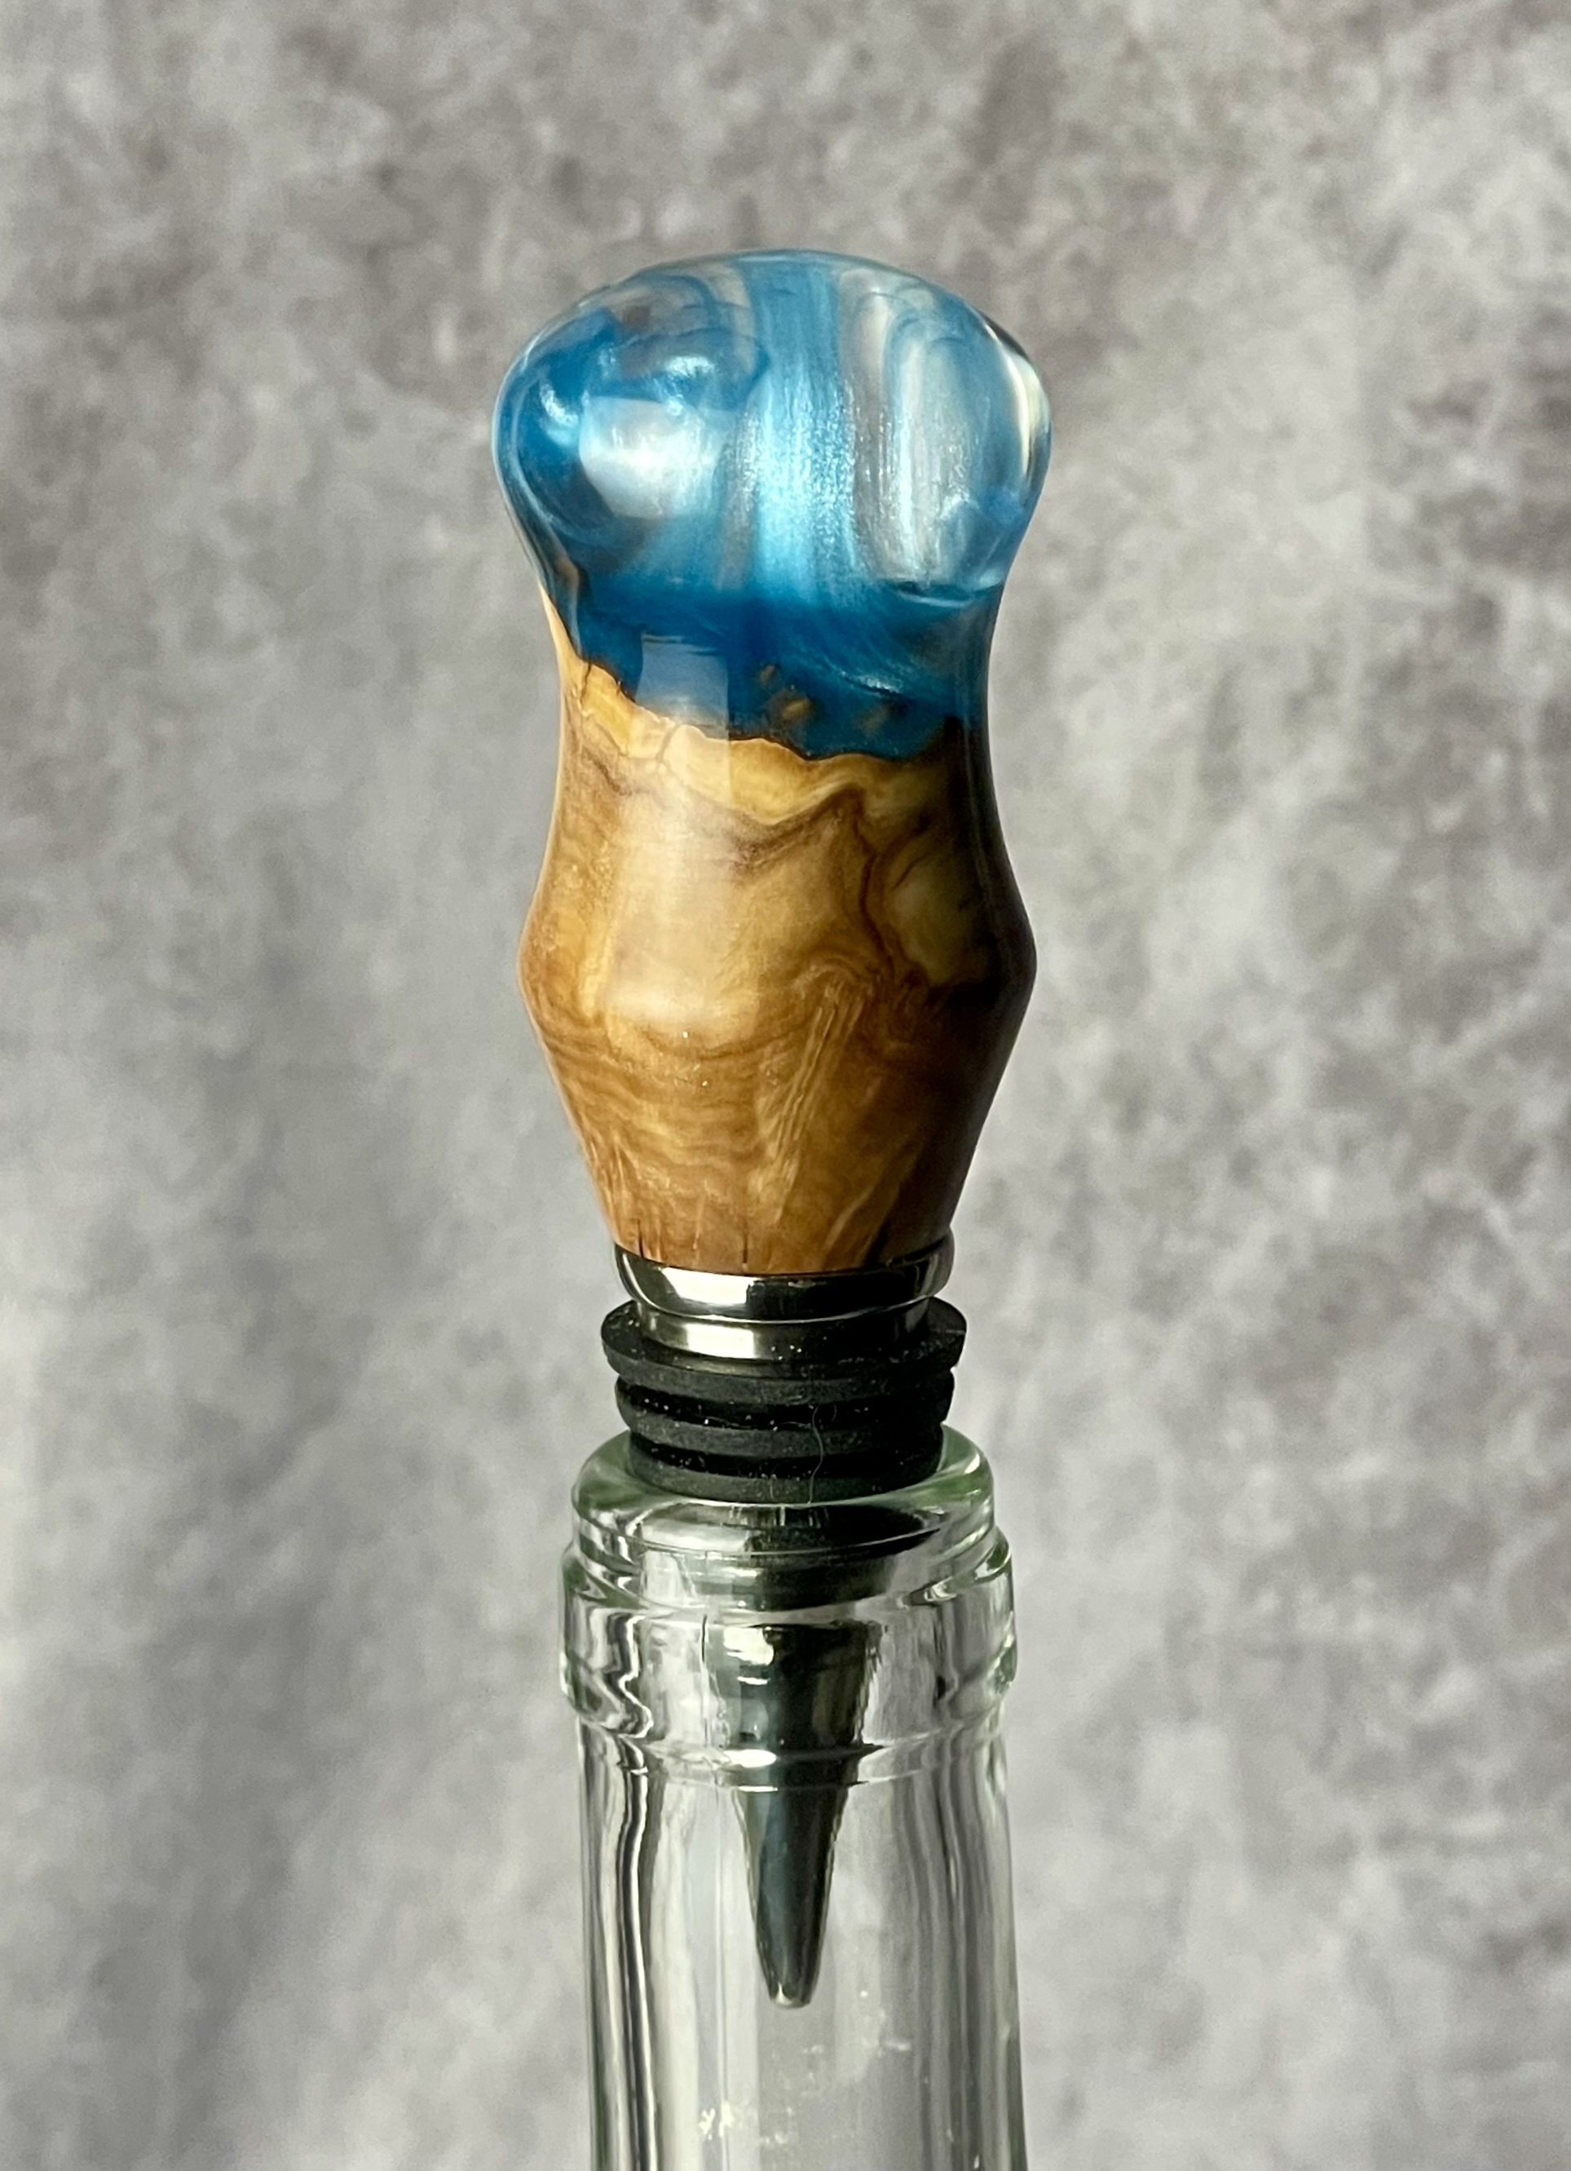
Bottle Stopper Process (A)
Cut wood 1.5” square on band saw
Drill on drill press and tap
Turn on stopper mandrel to fit pvc
Make blank (hot glue wood down, not CA)
Mount in jaws, flatten concave, drill and tap
Mount on Mandrel, Turn and finish
Notes:
Square wood
Round wood
Blank

Slide 16
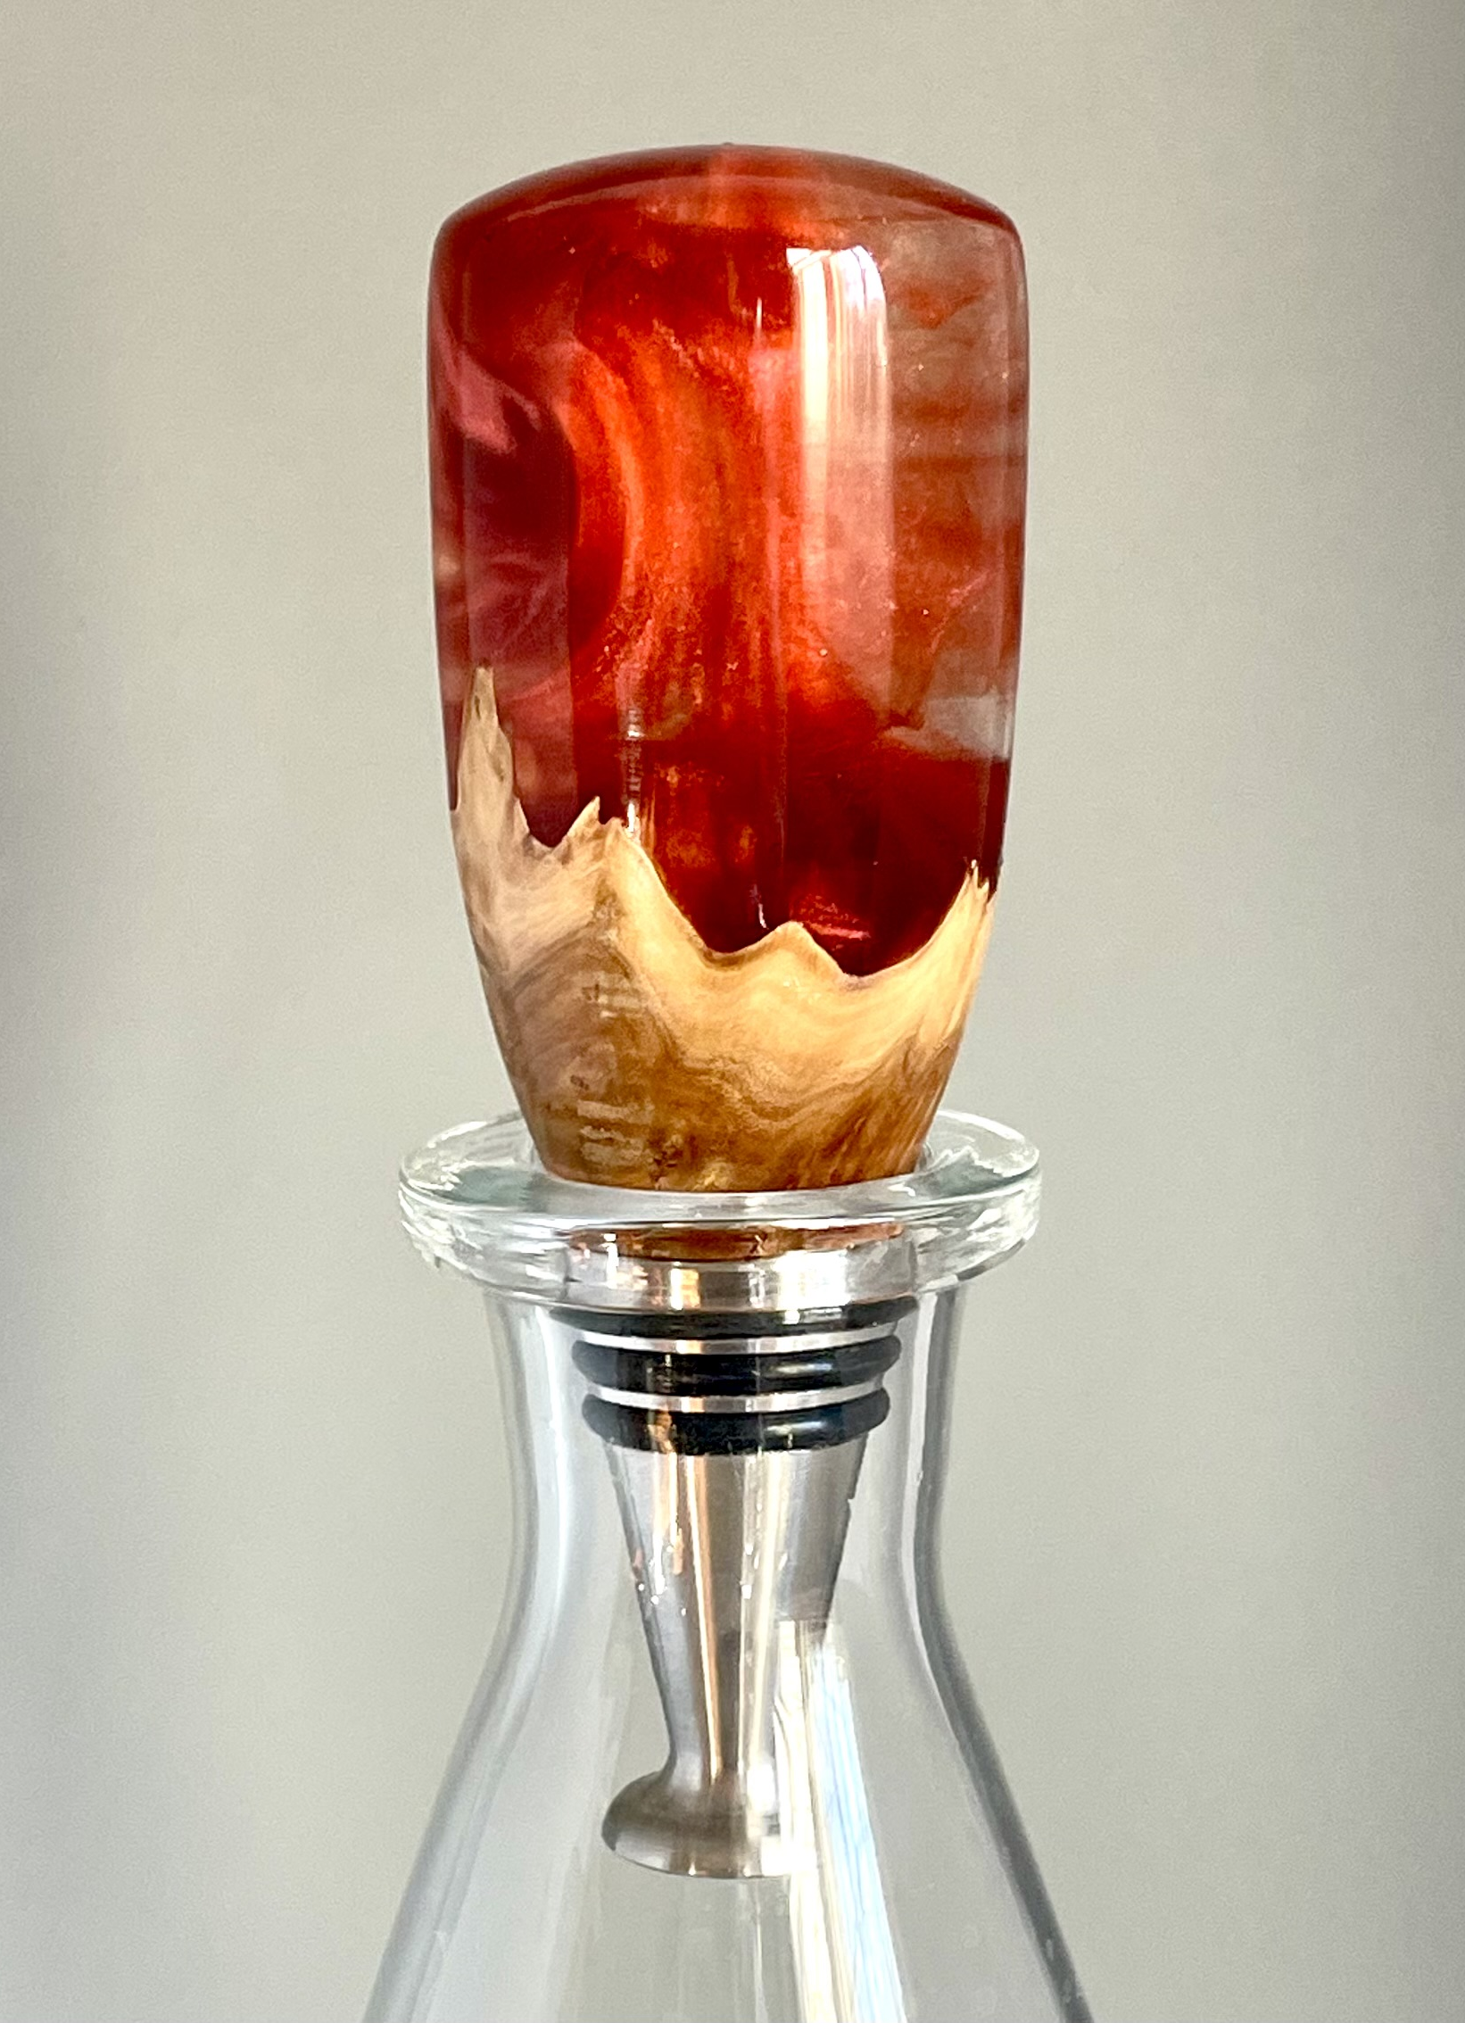
Bottle Stopper Process (B)
Cut wood 1.5” square on band saw
Firmly hold in mold (Glue, rubberband)
Pour resin and put in pressure pot
Mount in jaws, flatten concave, drill and tap
Mount on Mandrel, Turn and finish
Notes:
Square wood
Round wood
Blank

Slide 17
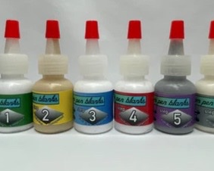
finishes
Sandpaper (starting at 320 grit - 800)
CA glue (not Parfix)
Ack’s Sanding Paste and Brad’s Sanding Paste or Yorkshire Grits
Magic Juice (Viva Towels) or sanding pads
Notes:
Magic
Acks
Brad’s
Ca glue
Blue or Viva towels

Slide 18
